Slide 1
Putting the “Tele” into “Telebiometrics”
John Larmouth
ASN.1 Rapporteur (SG 17 Q.12)
j.larmouth@btinternet.com
Radioactivity safety and security workshop

Slide 2
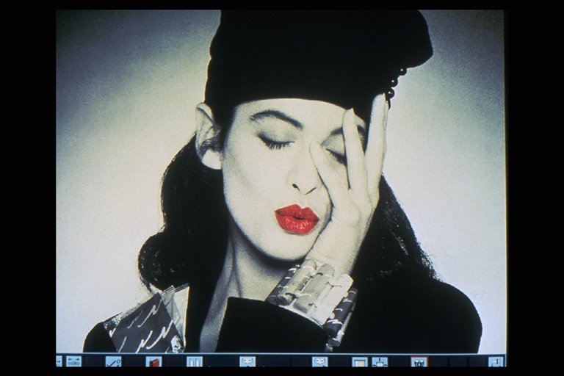
Please don’t go to sleep
This is a little boring history! (Part 1)
In the beginning there was biometrics
With safety and security concerns
And SI Units and all that
Then there was begat the Telebiomteric Multi-Modal Model (X.1081) featuring Leonardo da Vinci’s “The Perfect Man”

Slide 3
Please don’t go to sleep
This is a little boring history! (Part 2)
Then ASN.1 (ITU-T) OIDs came in
Providing OIDs for messages in the Telebiometric Multi-modal Model
And providing OIDs for all the Quantities and Units that might be needed in messages
Then serious attempts in ITU-T (SG 17 Q.9) were made to add ASN.1 specifications for messages for telehealth (putting the “tele” into “biometrics”)

Slide 4
Please don’t go to sleep
This is a little boring history! (Part 3)
And so we get to where we are today:
  Serious efforts led by ITU-T SG 17 Q.9 to standardize telecommunications protocols related to telemedicine and e-health.
  Concern by SG 17 (the lead ITU-T Study Group on security) that necessary security features are included in such protocols.
  This summit/workshop to coordinate and progress this area, particularly related to nuclear-medicine teleconsultation

Slide 5
Critical actors (1)
ISO/IEC JTC 1 SC 37
Pure biometrics standardization (no “tele”)
Biometrics started over a hundred years ago with literally measuring the relative sizes of arms and legs
SC 37 is mainly concerned with formats to support biometric identification
Finger-print, iris, face, vein, DNA, signature etc

Slide 6
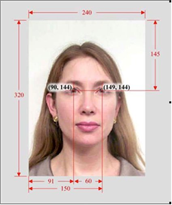
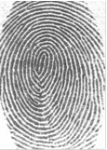
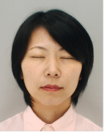
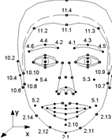
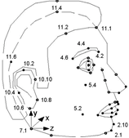
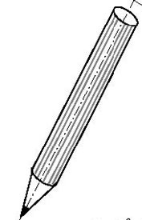
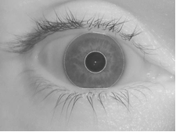
Illustrations

Slide 7
But this moves us on to our first cartoon
Artist Oli Morning
The first very light-hearted illustration of safety and security issues in biometrics
I hope none of you had this problem going through airport immigration this week!
But the text on the notice board is accurate, for those of you that can read it!
The cartoon quotes 80000-14, but this is twin text with X.1081 “A framework for the specification of security and safety aspects of biometrics”

Slide 8
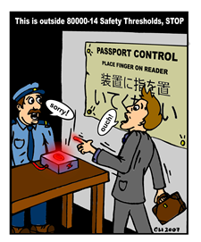
Illustrating X.1081!

Slide 9
An interesting aside
SG 17 is the lead Study Group on security
But when we talk about security and safety, the two words are often translated into the same word in French
X.1081 gives a clear definition of the two words to clarify their meaning

Slide 10
Critical actors (2)
ISO/IEC JTC 1/SC 37 – No “tele” except joint work with SG 17 on the Biometric Interworking Protocol (BIP) – X.1083
IEC TC 25 and ISO TC 12 – work jointly on the 80000 series, producing either IEC or ISO Standards (mainly to support SI Units)
Parts of 80000 produce twin text with the X.1000 series in ITU-T, but with the “tele” element added by SG 17 Q.9

Slide 11
HL 7 International
It would be wrong not to mention HL7 (formally International HL7 Inc); the HL7 stands for Health Level 7 (meaning level 7 – application layer of OSI)
They play no part in Q.9 work, but have an immense tree of over 40,000 ASN.1 Object Identifiers for formats and other things in the tele-health area.
See the HL7 root – 2.16.840.1.113883 – and
http://www.oid-info.com/get/1.3.6.1.6.3.13

Slide 12
A brief introduction to X.1081
Concerned with a multi-modal model of the interactions between the human body and its environment
What does the human body detect? What can be detected about it?
Video in/out, audio in/out, tango in/out, chemo in/out, radio in/out (the subject of this workshop), calor in/out

Slide 13
The X.1081 icon
Based on the Leonardo portrayal of “The perfect man”
The idea is of a one metre sphere around the perfect (naked) man and the interactions that occur across that sphere
Leonardo’s drawing was on the frontispiece of the early drafts of X.1081, but later moved to the body, and later interesting features were air-brushed out for publication (some have cried “Vandalism”!)

Slide 14
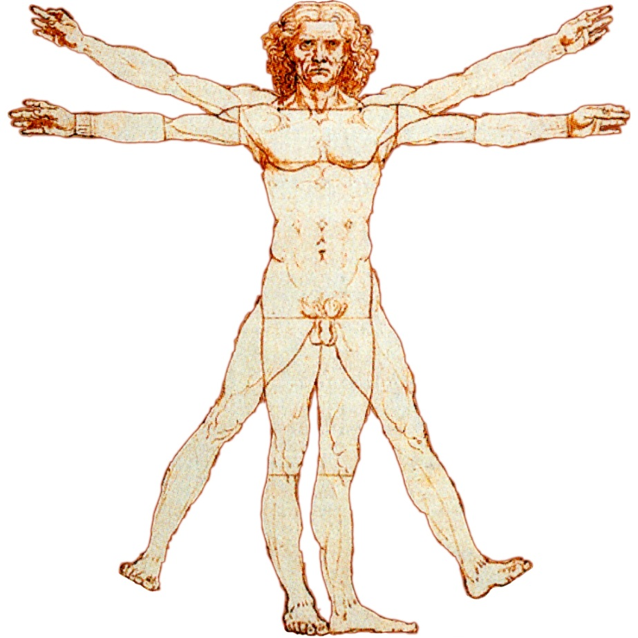
The two drawings
The Da Vinci drawing
The X.1081 published version

Slide 15
The Perfect Woman
Today we have to be careful about sex equality
So Q.9 has developed an equivalent drawing of “The Perfect Woman”
But I cannot show that in mixed company!

Slide 16
Whither telehealth standardisation? (1)
Overlapping terms (e-health, e-medicine, tele-medicine, etc.)
Nuclear (and Tsunami) is related to the ASN.1-based Common Alerting Protocol (see also WMO/TD No. 1556, Registering WMO alerting identifiers)
But many other types of alert and accidents need to be supported by telemedicine work, not just nuclear or Tsunamis

Slide 17
Whither telehealth standardisation? (2)
Providing telemedicine support to paramedics going to an old peoples home, or car accident
Persuading equipment manufacturers to adopt standardized protocols and models (most of which do not exist yet) for telemedicine to enable competition in its provision
Provide a robust security, safety and legal standardization framework to enable deployment in practice

Slide 18
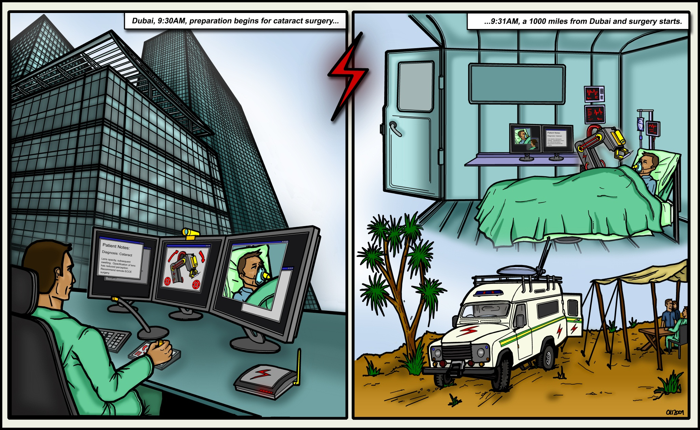
Time to finish – another Oli cartoon (1)

Slide 19
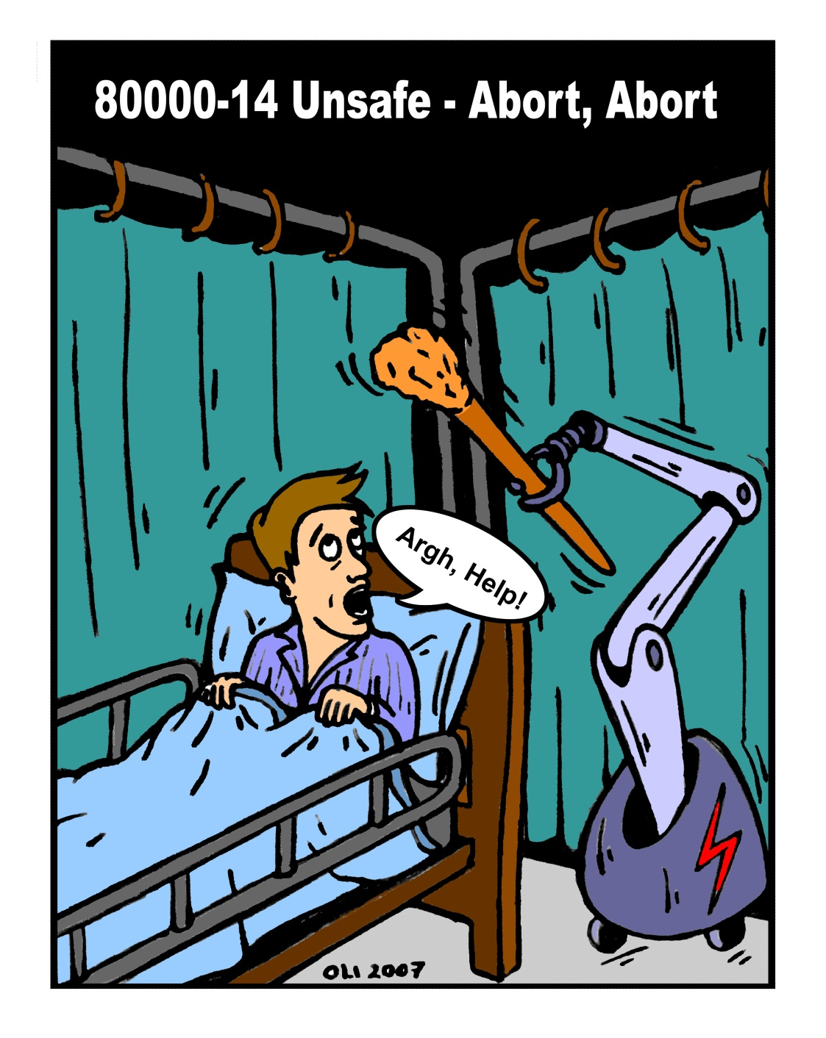
Time to finish – another Oli cartoon (2)
It went wrong!
Bye all, I will let you get down to the serious business of the workshop!

