Slide 1
My Vision and
Bridging the Standardization Gap (BSG)
New Program
Seizo Onoe
Director of Telecommunication Standardization Bureau (TSB)
23 January 2024

Slide 2
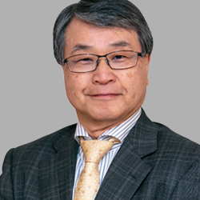
My Vision
Outreach worldwide
“Standards and technologies are meaningful only after people could use them. Enabling people around the world to benefit from technology – that’s what we do.”

Slide 3
Value of standardization
Standardization becomes truly valuable and meaningful only when the standards are widely spread.
Wide Adoption
Universal Affordable services
Market
Growth
Healthy
Competition
Standardization
Cost/Price
Reduction

Slide 4
But How?
But How?
Strengthening Cooperation
Industry Engagement
Bridging the Standardization Gap
By strengthening cooperation between multiple standardization bodies.
To respond to rapid technological advancements and the expanding landscape of technical fields, we are now in an era where organizations with diverse roles and expertise to collaborate, rather than doing everything in a single organization.
Through industry engagement and the implementation of standards by industry.
The industry play a role in implementing the standards and contributing to technology diffusion.
The industry engagement drives the development of implementable standards and their adoption in practice.
ITU-T Bridging the Standardization Gap (BSG) as essential tool for the dissemination of standards.
Bringing the benefits of technology to the world by strengthening standard-making capabilities and assisting the application of standards in developing countries.
Collaboration leveraging each other's strengths is crucial. ITU's greatest advantage lies in its global reach.

Slide 5
But How?
But How?
Strengthening Cooperation
Industry Engagement
Bridging the Standardization Gap
By strengthening cooperation between multiple standardization bodies.
To respond to rapid technological advancements and the expanding landscape of technical fields, we are now in an era where organizations with diverse roles and expertise to collaborate, rather than doing everything in a single organization.
Through industry engagement and the implementation of standards by industry.
The industry play a role in implementing the standards and contributing to technology diffusion.
The industry engagement drives the development of implementable standards and their adoption in practice.
ITU-T Bridging the Standardization Gap (BSG) as essential tool for the dissemination of standards.
Bringing the benefits of technology to the world by strengthening standard-making capabilities and assisting the application of standards in developing countries.

Slide 6
Value of standardization
Industry engagement is crucial for implementing the standards.
Wide Adoption
Universal Affordable services
Market
Growth
Healthy
Competition
Standardization
Cost/Price
Reduction

Slide 7
But How?
But How?
Strengthening Cooperation
Industry Engagement
Bridging the Standardization Gap
By strengthening cooperation between multiple standardization bodies.
To respond to rapid technological advancements and the expanding landscape of technical fields, we are now in an era where organizations with diverse roles and expertise to collaborate, rather than doing everything in a single organization.
Through industry engagement and the implementation of standards by industry.
The industry play a role in implementing the standards and contributing to technology diffusion.
The industry engagement drives the development of implementable standards and their adoption in practice.
ITU-T Bridging the Standardization Gap (BSG) as essential tool for the dissemination of standards.
Bringing the benefits of technology to the world by strengthening standard-making capabilities and assisting the application of standards in developing countries.

Slide 8
What lies at the foundation
What lies at the foundation
Open and Inclusive
Efficient, Effective and Transparent
Promoting diversity by encouraging multi-stakeholder participation in standardization processes.
Diverse members need to be involved, including developed/developing countries, regions, gender, large/small enterprises, etc.
Implementing effective organizational management through efficient resource allocation in a transparent manner.
Improve organizational performance, including setting priorities, reducing waste and improving processes.

Slide 9
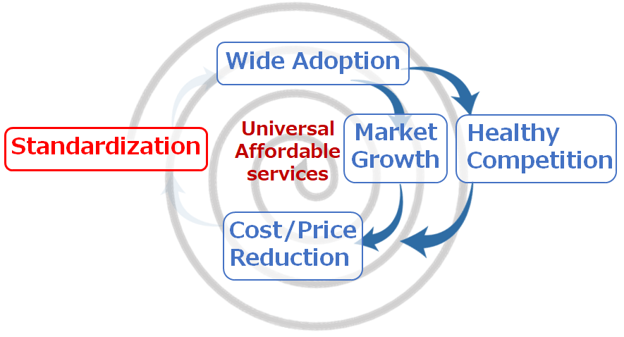
To achieve universal meaningful connectivity and sustainable digital transformation through standardization.
My vision and goals as TSB Director
Standardization becomes truly valuable and meaningful only when the standards are widely spread.
Outreach Worldwide
Strengthening Cooperation
Industry Engagement
Bridging
the Standardization Gap
Open and Inclusive
Efficient, Effective and Transparent

Slide 10
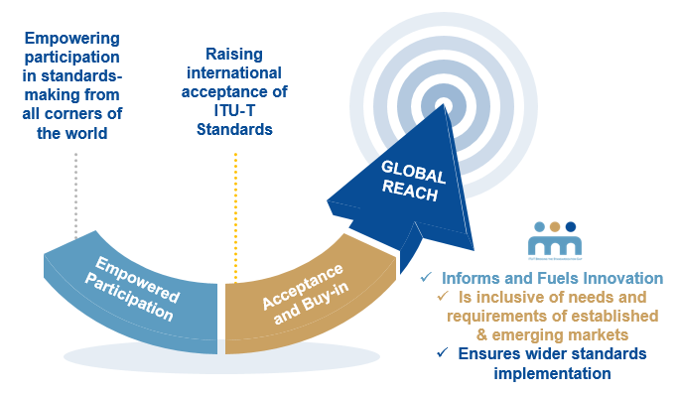
Outreach Worldwide
It’s crucial to disseminate standards to every corner globally.
New BSG Program
NEW
Thematic initiatives in implementation of standards (DFS, U4SSC, CDCP, MLS etc.)
Tools, Data Analytics & Survey/Quiz
Strategic Events, Resource Mobilization & Outreaching
Empowering
effective engagement in development
of ITU-T standards
through enhanced
capacity building
Enhancing
adoption & implementation
of ITU-T standards
NEW
NEW
Updated BSG trainings
Fellowship & Language/Interpretation
Cooperation & Partnership
Funding support
Bridging the Standardization Gap
for meaningful connectivity & sustainable development
through ITU-T standards

Slide 11
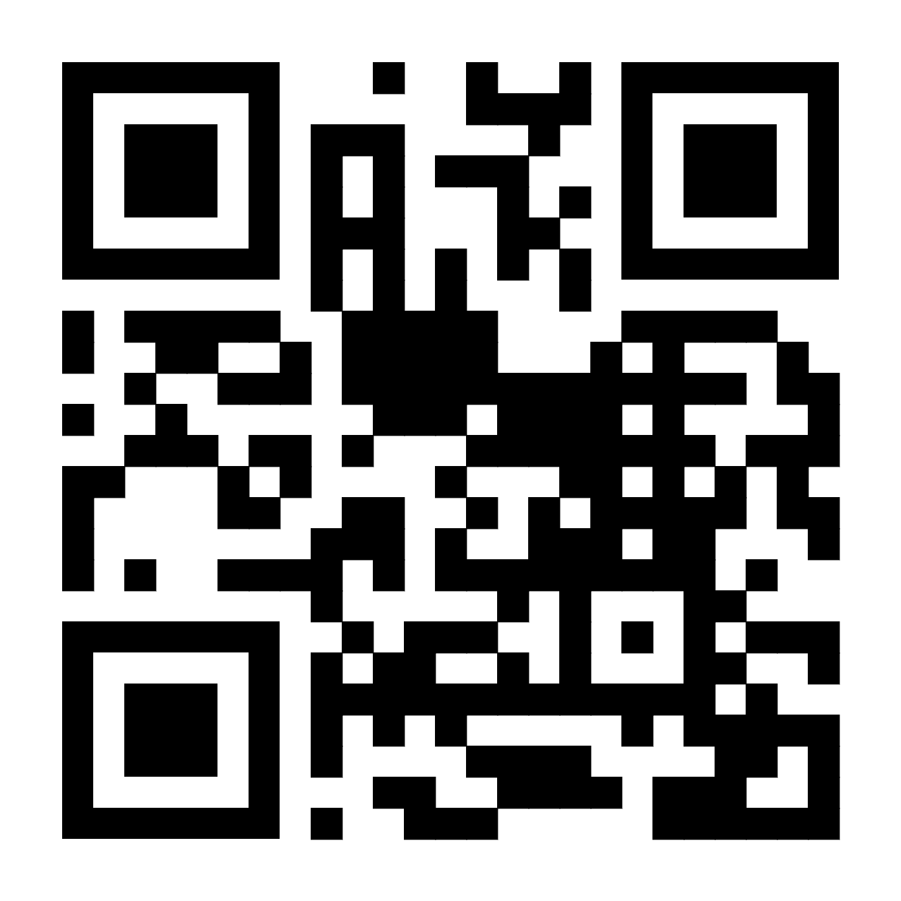
Launch
new BSG website!
Thank you!
https://www.itu.int/bsg/

