Slide 1
Setting the standard
WTSA-20 updates of the regional preparations
Interregional Meeting for Preparation of WTSA-20
18 September 2020
Virtual Meeting, 1230 – 1500 CEST

Slide 2
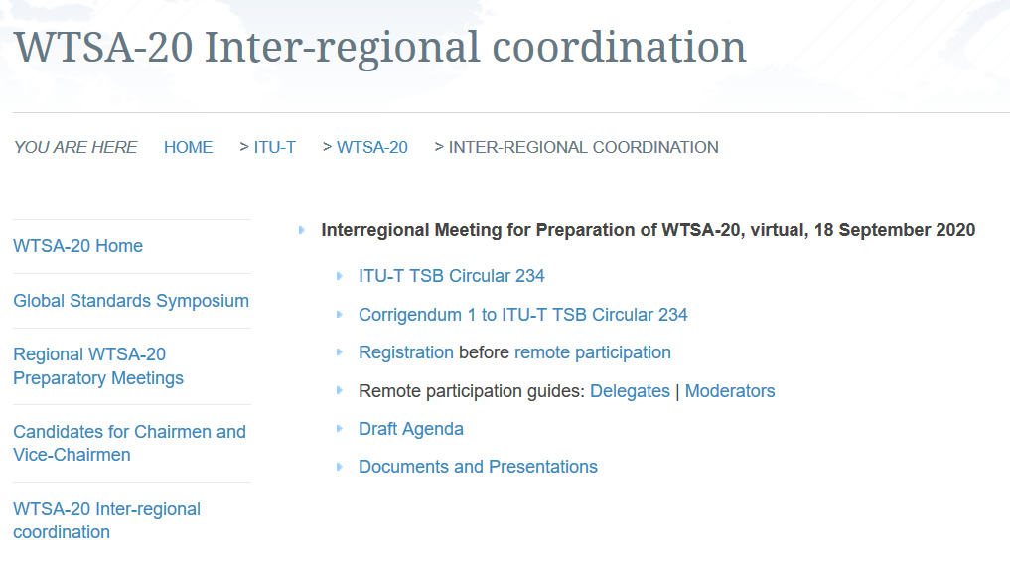
A new dedicated webpage to facilitate dialogue

Slide 3
A dedicated webpage for a quick overview of all meetings in each of the Regions

Slide 4
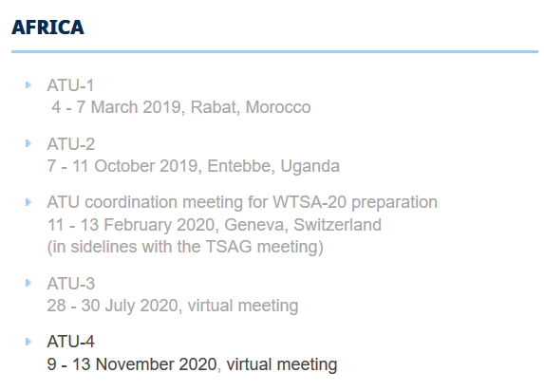
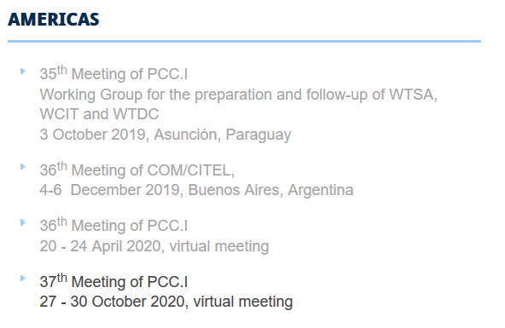
WTSA-20 – Status of the work in the Regions 1/3

Slide 5
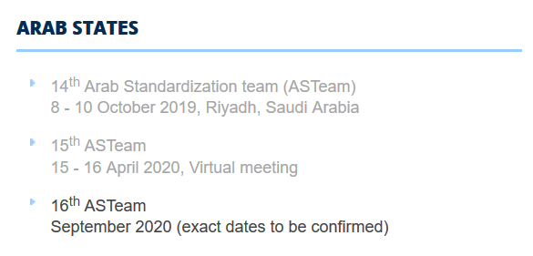
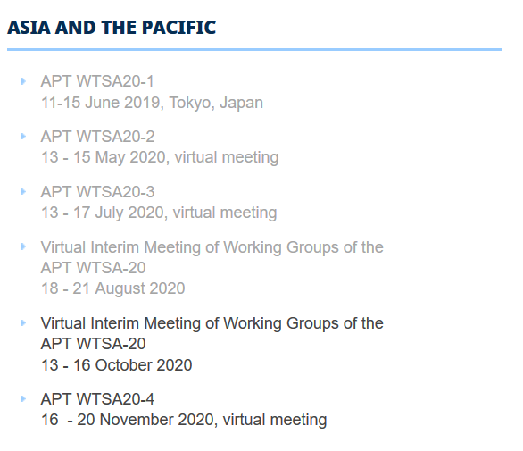
WTSA-20 – Status of the work in the Regions 2/3

Slide 6
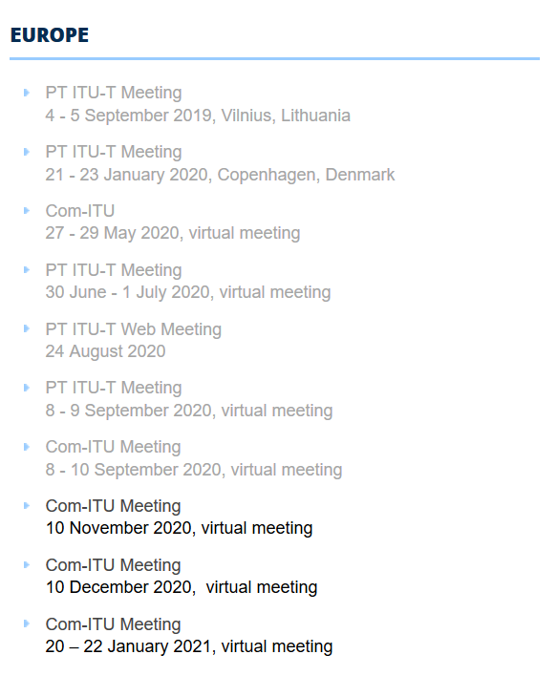
WTSA-20 – Status of the work in the Regions

Slide 7
Kindly Notify TSB for any updates you may have for your next meetings. Thank you

Slide 8
Setting the standard
Thank you for your attention
Questions?

