Slide 1


ITU-T
STUDY GROUP 17
Security
Heung Youl YOUM
Chairman, SG17
Summary of Results
Study Period 2017-2020

Slide 2
Contents
1
2
3
4
Study Group 17 Security
Future perspective
of SG17
Conclusions
Acknowledgements
Additional Slides
  Terms of reference
  Management team
  Structure
  Other groups (JCAs and Regional Groups)
  Highlights of achievements / Projects
  Highlights of WP1, WP2, WP3, WP4, Q1/17
  Statistics
  Workshops (with SG17 leadership / participation)
2

Slide 3
Study Group 17- Security
Building confidence and security in the use of ICTs
  Cybersecurity
  Identity management
  Quantum Key Distribution
  Countering spam
  Information Security Management
  Fintech security
  Cloud computing
  security
  Telebiometrics
  Application security
  PKI, PMI, Directory
IoT security
  Big Data analytics security
  Languages
  (ASN.1, SDL, MSC, TTCN-3 …)
  ITS security
  DLT security
  SDN/NFV security
  Incubation
  (emerging technologies)
  Smart-grid security
  Mobile (5G) security
in Q4/17 from CG activity on XSS
  Security is Absolutely First Everywhere (SAFE)
3

Slide 4
Future Perspective of SG17

Slide 5





Visions for security and data protection (I)
  Security of and for telecommunications and ICT
  Global Security Experts
  Addressing existing and emerging threats
  Centre of security excellence
  Strengthening the security framework and cybersecurity
  Building confidence and security in use of ICTs
  Managing new emerging threats in telecommunication and ICTs infrastructure
  New security risk assessment-based approaches and measures
  Addressing PII protection and technical and operational aspects of data protection
5

Slide 6


Vision for security and data protection(II)
  Key Recommendations for security/PII/data protection
  Attractiveness of participation
  Separation of security responsibilities within ITU-T
SG17
  Trust for realizing highly connected Information Society
SG13
  Collaboration within ITU-T
SG20
SC6
  Collaboration with outside SDOs
SC27
TC307
FIDO
OASIS
6

Slide 7
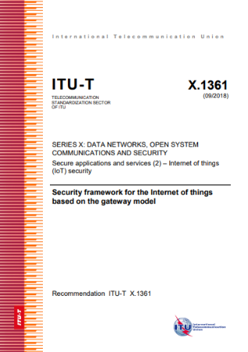

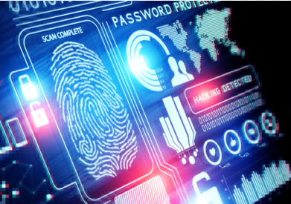
Key objectives and outcomes
SG17
  SG17 as centre of security competence
  Cybersecurity and key security techniques
  Producing high quality implementable ITU-T Recs
  Adoption of security by design approaches
  Incubation mechanisms for emerging technologies
  Efficient SG17 structure
7

Slide 8
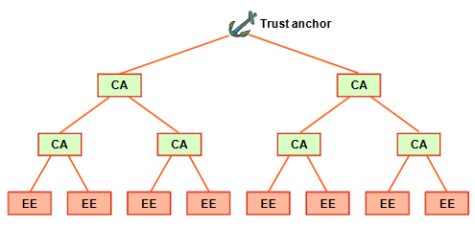
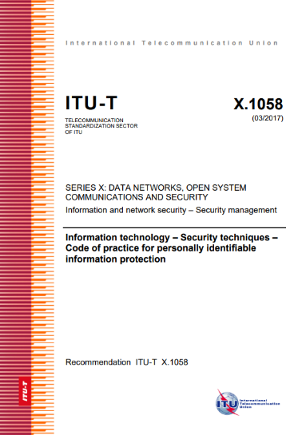





Major topics to address existing and new threats
  Key security techniques
SG17
  Public key infrastructure
  Quantum key distribution
  Distributed Identity (DiD)
  AI/ML security
  Protection of Personally Identifiable Information (PII)
  DLT security
  Internet of things
  Operational and technical aspects for data protection
  Security for 5G/6G
  Fintech and OTT security
8

Slide 9
Proposed Questions
  SG17 proposed 12 Questions for the next study period (2021-2024).
  11 Restructured (of 14 existing) Questions
  1 new Question, Emerging technologies security
12 Questions
Security standardization strategy and coordination | Cloud computing and Big data infrastructure security
Security architecture and network security | Identity management and telebiometrics architecture and mechanisms
Telecommunication information security management and security services | Generic technologies to support secure applications
Cybersecurity and countering spam | Intelligent transport system security
Security for telecommunication services and Internet of Things | Distributed Ledger Technology (DLT) security
Secure application services | Security for/by emerging technologies including quantum-based security
Incubation
9

Slide 10


LSG – JCAs – Projects
  SG17 should be the lead study group responsible for:
Languages
and
description
techniques
JCA-IdM and JCA-COP
as well as ASN.1 & OID Projects
need to continue given their
important contributions.
10

Slide 11

  Increased Participation
  with maximum 262 participants
  SG17 achieved significantly build-up of participation and energy in:
  Identity Management
  Cybersecurity
  SG17 has successfully evolved to:
  Cloud Computing Security
  Emerging issues, such as Quantum based security and OTT security
  DLT Security
  SG17 has built strong relations with other key bodies working on security and conducted numerous collaborative efforts
  address new security challenges
  with security experts in core Questions.
  SG17 has promoted and disseminated ITU-T security work
11

Slide 12
Acknowledgements
Great thanks are due to the many people who have contributed to the enormous success of SG17 during this study period:
Delegates with their many contributions
Editors in drafting texts for Recommendations
Rapporteurs in leading work efforts
Liaison officers in coordinating efforts with other bodies
Project leaders and JCA leaders
Management team including Working Party chairmen
TSB support – Counsellors, Assistants and other staff
Best wishes to all for the next study period.

Slide 13
Additional Slides
NOTE: The statistics in these additional slides represents the status as of 3 September 2020. They will be updated after Jan 2021 SG17 Special e-plenary..

Slide 14
Supplemental Slides
Terms of reference
Management team
Structure
Other groups (JCAs and Regional Groups)
Highlights of achievements / Projects
Highlights of WP1, WP2, WP3, WP4/17 and Q1/17
Statistics
Workshops (with SG17 leadership / participation).

Slide 15
Terms of Reference
Original: ITU-T Study Group 17 is responsible for building confidence and security in the use of information and communication technologies (ICT). This includes studies relating to cybersecurity, security management, countering spam and identity management. It also includes security architecture and framework, protection of personally identifiable information, and security of applications and services for the Internet of things (IoT), smart grid, smartphone, software-defined networking (SDN), Internet protocol television (IPTV), web services, social network, cloud computing, big data analytics, mobile financial system and telebiometrics.
Study Group 17 is also responsible for the application of open system communications, including directory and object identifiers, and for technical languages, the method for their usage and other issues related to the software aspects of telecommunication systems and test specification languages in support of conformance testing to improve the quality of Recommendations.
Added: Intelligent Transport System security, Security aspects of DLT, Quantum based communications, and AI/ML.

Slide 16
Management Team (I)
Chairman | YOUM Heung Youl | Korea (Republic of)
Vice-Chairmen | DOLMATOV Vasiliy | Russian Federation
 | ISHAG Muataz Elsadig EVREN Gökhan | Sudan Turkey
 | GONZALES Juan* (FUREY Inette) LATROUS Wala Turki | USA Tunisia
 | LIN Zhaoji | China (P.R.)
 | MOLINARI Lia* (MIGUAL Hugo Darío) | Argentina
 | MIYAKE Yutaka | Japan
 | MBATHAS Eric Anicet* (KETTIN ZANGA Patrick-Kennedy) | Central Africa
 | * Replaced the previous vice-chairman in () from that member state appointed by WTSA16 during this study period.

Slide 17
Management Team (II)
WP Chairmen |  | WP vice-chairmen
WP 1/17 | MIYAKE Yutaka (Japan) | DOLMATOV Vasiliy (Russian Federation), EVREN Gökhan (Turkey)
WP 2/17 | NAKAO Koji (Japan) | GONZALEZ Juan (USA), FUREY Inette* (USA)
WP 3/17 | TADDEI Arnaud (Broadcom) | BAI Xiaoyuan (China), LIN Zhaoji* (China)
WP 4/17 | NAH Jae Hoon (Korea, Republic of) LIN Zhaoji (China), LI Kepeng* (Alibaba)
 |  | * Replaced by the new leader during this study period.
TSB | YANG Xiaoya | Counsellor
 | BILANI Joumana | Administrative assistant

Slide 18
Study Group Structure
WP 1/17, Telecommunication/ICT Security
Security architectures/frameworks, Telecommunications information security management, Security aspects of telecommunication services, networks and Internet of Things, Security aspects for Intelligent Transport System.
WP 2/17, Cyberspace security
Cybersecurity, Countering spam, Security aspects for Distributed Ledger Technologies.
WP 3/17, Application security
Secure application services, Cloud computing security, Formal languages for telecommunication software and testing.
WP 4/17, Identity management and authentication
Telebiometrics, identity management and architectures, Generic technologies to support secure applications.
Q1/17, Telecommunication/ICT security coordination

Slide 19
SG 17-related other groups (I)
JCA-IdM (Identity Management)
  Co-Chairmen: Mr BARBIR Abbie, Aetna,
  Mr TAKECHI Hiroshi, NEC
  Mr PARK Keundug, Korea (Republic of)
  Represented: SGs 2, 3, 5, 9, 12, 13, 15, 16, 17, Decentralized Identify Foundation, FIDO Alliance, ISO/IEC JTC 1/SC 27/WG 5, ISO TC 307, Kantara Initiative, Mobile Driving License, NH-ISAC Identity working group, OASIS, OpenIdD Foundation, Soverin Foundation, SSI Open Standards and UPU,…
  4 meetings
JCA-COP (Child Online Protection)
  Established April 2012

Slide 20
SG 17-related other groups (III)
SG17 Regional Group for Africa.
  Created April 2015 in last study period
  Held 1 meeting this study period
SG17 Regional Group for Arab.
  Created March 2017
  Held 3 meetings this study period

Slide 21
Highlights of achievements (I)
SG17 successfully transitioned into a core competency center on security attracting 130/181/262 (Min/Average/Max) participants.
SG17 examined 941 Contributions and 3,405 TDs.
64 new Recommendations, 38 revised Recommendations, 4 amended Recommendations, 7 new Supplements, 18 Technical Corrigenda, and 7 Technical Reports were approved under AAP, TAP or agreement.
4 Recommendations under TAP and 32 AAP consent
140 new work items established.
3 Lead Study Group responsibilities
2 JCAs and 2 Projects
Increased collaboration with SDOs (e.g., joint texts).

Slide 22
Highlights of achievements (II)
Lead study group for Security
  Close coordination and collaboration with other SGs and SDOs on security and PII protection; particular focus has been placed upon partnerships and avoiding potential conflicts in the work.
  Joint work with several SCs in ISO/IEC JTC 1.
  Produced 7th edition of the “Security Manual” that promotes ITU-T’s security work.
  Produced 2nd edition of the Technical Report on successful use of security standards
  Security Standards Roadmap and Security Compendium kept up-to-date.

Slide 23
Highlights of achievements (III)
Lead study group for Security
  Security collaboration arrangements between SG17 and SG13 on cloud computing security and Quantum key distribution, and between SG17 and SG20 on IoT security.
  Nine workshops held on security.
  Maintained an on-line listing of SG17 relationships with TCs of ISO and IEC and SCs of ISO/IEC JTC 1 (identifies nature of relation of joint work, common/twin text, cooperation mode, etc)
  (In response to WTSA-16 Resolution 7).

Slide 24
Highlights of achievements (IV)
Lead study group for Identity Management
  Continued collaboration with OASIS and FIDO on IdM.
  Continuation of Joint Coordination Activity on Identity Management (JCA-IdM).
Lead study group for Languages and Description Techniques
  Collaboration with ETSI MTS on TTCN-3.
  Collaboration with JTC 1/SC 6 on ASN.1, OIDs and registration.
  Collaboration with SDL Forum Society on SDL.

Slide 25
Telecommunication/ICT Security
(WP 1/17) Highlights
Security architecture and framework
  Network security architecture, SDN/NFV security, …
  6 new Recs, 1 new Supplement.
Telecommunications information security management
  ISM framework, risk/asset/incident management, PII code of practice, …
  3 new Recommendations, 1 revised Rec, 2 new Supplement, 1 Corrigendum.
Security aspects of telecommunication services, networks and Internet of Things
  IoT security, SDN security, smart-grid security, 5G security, IPTV security, …
  12 new Recs; 1 Amendment; 1 Corrigendum; 1 new Supplements
Security aspects for Intelligent Transport System
  ITS security
  3 new Recs;

Slide 26
Cyberspace security
(WP 2/17) Highlights (II)
Cybersecurity
  In support of WTSA-12 Resolution 50.
  Cybersecurity information exchange framework.
  7 new Recs, 1 revised Recs, 2 new Amendment, 4 new Technical Report.
Countering spam by technical means
  In support WTSA-12 Resolution 52
  Countering spam in voice spam, mobile messaging spam, …
  2 new Recs, 2 new Supplements
Security aspects for Distributed Ledger Technologies
  3 new Recs,

Slide 27
Application security
(WP 3/17) Highlights
Secure applications services
  Application security, Fintech security…
  7 new Recs
Cloud computing and Big data infrastructure security
  Cloud computing security framework, software as a service security, CaaS/IaaS/NaaS security, Big Data as a Service, …
  6 new Recs.
Formal languages for telecommunication software and testing
  SDL-2010, UML, MSC, URN, Testing and Test Control Notation (TTCN-3), …
  44 revised Recs; 2 implementation guides.

Slide 28
Identity management and authentication
(WP 4/17) Highlights
Telebiometrics
  Telebiometrics, e-Health & telemedicines security protocols
  3 new Recs, q revised Recs, a Corrigendum.
Identity management architecture and mechanisms
  entity authentication assurance, FIDO authentications, …
  5 new Recs, 1 Supplements.
Generic technologies to support secure applications
  X.500-series on Directory including X.509 on PKI, Abstract Syntax Notation One (ASN.1), Object Identifiers (OIDs) and associated registration authorities, certified e-mail.
  ASN.1 and OID project (see separate slide)
  5 new Recs, 20 revised Recs, 14 technical corrigenda to ASN.1; 1 TR; 1 Supplement

Slide 29
Telecommunication/ICT security coordination (Q1/17)
(Major focus is on coordination and outreach)
  Management support
Security coordination
  Within SG17, with ITU-T SGs, with ITU-D and externally.
  Kept TSAG informed on security efforts.
  Made presentations to workshops/seminars.
  Maintained reference information on the LSG on security webpage.
Compendium of Security Recommendations
  Includes catalogs of approved security-related Recommendations and security definitions extracted from approved Recommendations.
Security Standards Roadmap
  Includes searchable database of approved ICT security standards from ITU-T and others (e.g., ATIS, ENISA, ETSI, IEEE, ISO/IEC JTC 1, IETF, OASIS, 3GPP, 3GPP2).
Security manual
  7th edition produced.
Successful Use of Security Standards
  2nd edition produced on how approved security-related ITU-T Recommendations can be successfully deployed

Slide 30
ASN.1 and OID Projects
The SG17 ASN.1 project & the OID project continue to assist:
  Existing users of ASN.1 and object identifiers (OID), within and outside of ITU‑T (e.g., ITU‑T SG 16, ISO/IEC JTC 1/SC 27, ISO TC 215, 3GPP, etc.).
  Countries (e.g., Algeria, Andorra, Argentina, Bolivia, Bosnia and Herzegovina, Brazil, Honduras, Lithuania, Malaysia, Mongolia, Nicaragua, Oman, Philippines, Rwanda, and Sri Lank), and in particular developing countries, in setting a national registration authority for OIDs.
These projects provided speakers and tutorial material and coordinates the provision of tool support to users and the contents of related websites.
In cooperation with the TSB, a database is being maintained that contains a machine-processable copy of the current version of all ASN.1 modules that are included in ITU‑T Recommendations. Contains modules from over 200 ITU-T Recommendations. Database: http://www.itu.int/ITU-T/asn1/database
The International OID tree has more than 1,521,745 registrations as of 15 July 2020. OID Repository: http://www.oid-info.com.

Slide 31
Statistics (I)
60 Rapporteur group meetings held
(stand-alone, e-meetings, or collaborative with ISO/IEC JTC 1/SC 6, 27)
941 contributions received
(excluding Rapporteur meetings)
8 SG17 meetings and 2 special e-plenary meetings held
8 WP 1, 2, 3, 4/17 meetings held in conjunction with SG17 meetings
Min/Average/Max SG participants: 130/181/262.

Slide 32
Statistics (II)
102 New/Revised Recommendations approved.
12 Questions assigned by WTSA-16.
2 Questions generated during study period.
140 new work items
3,405 TDs
12 Questions proposed for next period.
9 Workshop held on security of emerging technologies
Maintained an on-line listing of SG17 relationships

Slide 33
Workshops (I)
SG17 organized seven ITU workshops:
Fintech Security
Geneva, Switzerland, 26 August 2019.
Quantum Information Technology (QIT) for Networks
Shanghai, China, 5-7 June 2019
Artificial Intelligence/Machine Learning and Security
Geneva, Switzerland, 21 Jan 2019.
Advanced Cybersecurity Attacks and Ransomware
Geneva, Switzerland, 28 August 2018.
5G Security
Geneva, Switzerland, 19 March 2018.
Security Aspects of Intelligent Transport System
Geneva, Switzerland, 28 August 2017.
Security Aspects of Blockchain
Geneva, Switzerland, 21 March 2017

Slide 34
Workshops (II)
SG17 organized two mini workshops:
Cybersecurity Challenges in Automated Driving
Geneva, 26 August 2019, 14:30-17:30.
Secure Quantum Communications
Geneva, 24 January 2019, 14:30-17:30.

