Slide 1


ITU-T
STUDY GROUP 16
Multimedia
Noah Luo
Chairman
ITU-T SG16
Highlights and future directions

Slide 2





ITU-T SG16
Multimedia
Multimedia
systems and
services
Advanced
multimedia
communication
Media
Coding
Legacy
systems
Speech-to-speech translation, Visual surveillance, DLT,
AI
  IPTV,
  Digital Signage, Intelligent
  Transportation Systems,
  E‒health, Accessibility, Digital Culture
  Videoconferencing, Media gateways, Network signal processing, Echo cancellation, Noise reduction, Voiceband data (modems, fax, text telephony)
  Audio, video
  and
  data compression
Notes:
Conferencing systems
Telepresence, media gateways, videoconferencing
Advanced multimedia communication
Multimedia systems and services
IPTV, Digital Signage, Intelligent Transportation Systems, E‒health, Accessibility (IoT moved to in SG20 in Oct. 2015)
Media Coding
Audio and video coding
TDM legacy and transition to IP systems
Network signal processing, echo cancellation, noise reduction, voiceband data (modems, fax, text telephony)

Slide 3
Results
6
3
92
STUDY GROUP MEETINGS
WORKING PARTY MEETING
RAPPORTEUR
GROUP
(E-)
MEETINGS
Significant collaborative
work with:
Questions:
11
16
14
ISO/IEC
IEEE
WTSA-16
WTSA-16
Notes:
6 SG, 1 WP meetings; 11 IPTV-GSI events; 84 Rapporteur group (e-)meetings
Significant collaborative work (ISO/IEC, IEEE, …)
Questions: 18 (WTSA-12) → 16 → 11 (WTSA-16)

Slide 4
Results
Work items under study
Texts approved
Notes:
Some results at the end of the study period.

Slide 5
Collaboration
Internal
External
Regional
SDOs
ISO
SG20
(Accessibility,
IoT)
SG9
(IPTV,
CDN)
JCT1
SG16
SG17 (ICT Security)
UNECE
SG11
(C&I)
IEEE
WHO
SG12
(QoS/QoE)
CONTINUA
(PCHA)

Slide 6
Trend
Increase in digital services and video-centric services
Maturity in
classical
areas
Notes:
Maturity in classical areas
audio compression, videoconferencing, media gateway, legacy TDM systems and their interfacing with IP networks
Increase in e-services and video-centric services

Slide 7
Digital services and
video-centric services
Media compression
E-health,
Digital culture,
DLT, ITS,
Future multimedia mechanisms
VR, immersive systems and artificial Intelligence
Accessibility
Human dimension in communications
Systems:
IPTV, Cable, Broadcasting
Streaming, interactivity, immersive

Slide 8








E-services
Combined use of ICTs for service delivery:
Distribution and delivery of e-services:
Healthcare
The building blocks and delivery platforms
developed by SG16 are used to enable
applications in specific areas
Education
Commerce
Entertainment
Example: Smart cities and communities by SG20
Culture
Transportation
Notes:
Combined use of ICTs for service delivery in a specific industry area, such as healthcare, education, administration, commerce, transportation, entertainment, etc.
Distribution and delivery of e-services: channel agnostic
E.g. Internet, cable networks, NGN, GSTN, IMT-2020, future networks, and wireless networks
The building blocks and delivery platforms developed by SG16 are used to enable application in specific areas
E.g. smart cities applications of e-services by SG20

Slide 9
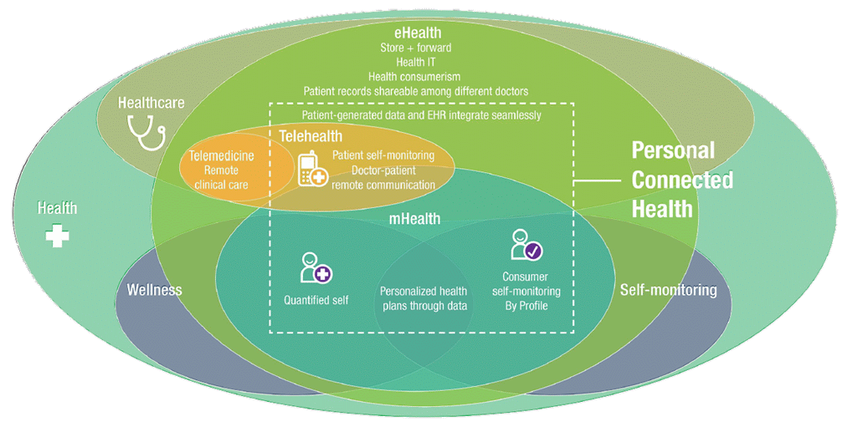
E-health
Notes:
Addressed a specific area: personal connected health – partnership with Continua (PCHA); much more to do!
Mobile health, format for data exchange and interoperability
ITU-T H.810-H.850 suite with the Continua Design Guidelines and associated conformance testing specifications (45 Recommendations)

Slide 10
Video content – a strategic area
Opportunities for revenue generation
80%
Video compression: new H.266 approved
70%
Higher demand more efficient compression
mechanisms
New IP-based digital TV systems
of Internet Traffic
was video in 2015
Forecast
for 2020
Notes:
Important opportunities for revenue generation
Content generation and content delivery
QoE / QoE monitoring: constant challenge
Video compression: new challenges → JVET
Higher demand means that more efficient compression mechanisms remains relevant
Higher resolution for larger screens (4K, 8K)
Good quality with higher compression for smaller screens
Source for video traffic statistics: CISCO VNI Complete Forecast Highlights
https://www.cisco.com/c/dam/m/en_us/solutions/service-provider/vni-forecast-highlights/pdf/Global_2020_Forecast_Highlights.pdf

Slide 11





Use of digital video
Consumer electronic
video equipment
Digital TV broadcast & cable;
Digital TV sets
Internet video
Over-the-top
IPTV
Digital Signage
Artificial Intelligence
Over-the-top (OTT) applications
Mobile:
4G / 5G
Notes:
Consumer electronic video cameras
Moving JPEG; MPEG1-Video; H.262
H.264
Digital TV broadcast & cable; digital TV sets
SD: H.262 or H.264 / HD: H.264 / UHD: H.265?
Internet video – over-the-top
YouTube, Apple: convergence around H.264
Skype (v7: H.264)
IPTV; Digital Signage; Over-the-Top (OTT) applications
Mobile: 3G / 4G / 5G

Slide 12





Future areas for video
Besides going after the "best and newest" video codec… it matters what you do with video
Future IP-based broadcasting
Accessibility
Delivery of high volume
of video content
Artificial Intelligence
Notes:
Besides going after the "best and newest" video codec…
it matters what you do with video
Protocols and systems supporting delivery of high volume of video content
Real-time streaming remains a challenge
Higher compression with high quality and lower delay
Highly interactive systems require tactile Internet
Virtual reality and immersive environments (ILE)
Future IP-based broadcasting
E.g. ATSC 3.0 PHY, approved 2016-03
Adding Artificial Intelligence to video: face / object / action recognition, and acting on it
Accessibility: still many open technical and economic issues

Slide 13

Digital services
Video
SG16
SG16 "Multimedia" continued
to be very productive
during the study period
Growth of video consumption
drives newer codecs,
systems and applications
Work growth in digital services
and video-centric services
and components
Notes:
SG16 "Multimedia" continued to be very productive during the study period
Work growth in e-services and video-centric services and components
Video will be key to ITU-T's future success
Expected increase in standardization in these areas
Growth of video consumption drives newer codecs, systems and applications
especially delivery over IP and the Internet

Slide 14


