Slide 1
ITU-T STUDY GROUP 11
Signalling requirements, protocols, test specifications and combating counterfeit products
Andrey KUCHERYAVY (Russian Federation)
Chairman, SG11
www.itu.int/itu-t/go/tsg11
tsbsg11@itu.int

Slide 2
SG11 in a nutshell
Title: Signalling requirements, protocols, test specifications and combating counterfeit products
SG11 is home to SS7 and holds expertise in:
Signalling architectures, requirement and protocols for legacy and future networks
Conformance & Interoperability
Combating counterfeiting and stolen ICT devices
Test methodologies and specifications
Benchmark testing
Our Mission
To develop protocols and test specifications to achieve consistent end-to-end interoperability of systems and networks

Slide 3
STRATEGIC GOALS AND ACTION PLAN OF SG11, STUDY PERIOD (2017-2020)
Signalling requirements for existing and emerging technologies/services (Tactile Internet (TI), Augmented Reality (AR) and Flying Ad Hoc Networks)
SS7 security (e.g. new authorizations procedures are needed, SS7 firewall/router, etc.) Note: see the summary of the ITU Workshop “SS7 Security”
5G/IMT-2020 control plane and signaling requirements for 5G’s services
Interconnection of 4G (VoLTE/ViLTE) and 5G/IMT-2020 networks
Implementation of C&I Programme
Testing specifications for all types of technologies, networks and services, including testing of Internet technologies/services/apps (e.g. IoT, Tactile Internet, Augmented Reality, Flying Ad Hoc Networks, robotics network etc.)
Recognition procedure of testing laboratories and joint ITU/IEC certification schemes (through ITU-T CASC)
Combating counterfeit and mobile devices theft
Source: presentation of SG11 Chairman, SG11-TD56/GEN. SG11 Action plan (SG11-TD173/GEN)

Slide 4
SG11 in numbers
Study Period
Notes:
During the just concluded Study Period (2013-2016), SG11 has doubled its numbers as compared to the previous Study Period (2008-2012).
Total Publications (Recs., Supplements, Technical Reports and Guidelines) 109 (earlier 71)
Total new Recommendations 88 (earlier 47)
Average number of participants to SG meetings 106 (earlier 56)
Total number of Contributions submitted 503 (earlier 304)
Total number of TDs (without considering revisions) developed 503 (earlier 304)

Slide 5
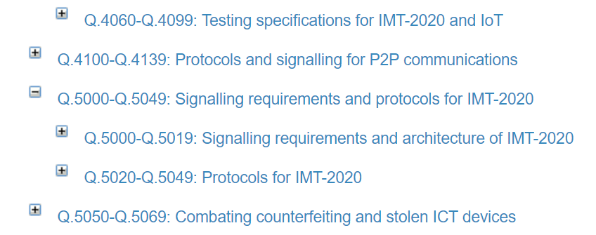
New sub-categories of Q.series, Study Period (2017-2020)

Slide 6
SG11 RELATED WORKSHOPS, STUDY PERIOD (2017-2020)
Workshop - Brainstorming session on SS7​ vulnerabilities​ (Geneva, 22 October 2019)
Third ITU-T Study Group 11 Regional Workshop for Africa on “Counterfeit ICT Devices, Conformance and Interoperability Testing Challenges in Africa”​ Tunis, Tunisia, 30 September 2019​​
ITU Workshop on Benchmarking of emerging technologies and applications. Internet related performance measurements​ Geneva, 11 March 2019
ITU Regional Workshop on Deployment of VoLTE/ViLTE networks based on IMS: from Standardization to Implementation Samarkand, Republic of Uzbekistan​, 2-3 October 2018
ITU Workshop on Global approaches on combating counterfeiting and stolen ICT devices​​ Geneva, Switzerland, 23 July 2018
ITU Regional Forum on “Internet of Things, Telecommunication Networks and Big Data as basic infrastructure for Digital Economy” Saint Petersburg, Russia, 4-6 June 2018
Second ITU-T Study Group 11 Regional Workshop for Africa on “Counterfeit ICT Devices, Conformance and Interoperability Testing Challenges in Africa” Tunis, Tunisia, 23 April 2018
Workshop on "Control plane of IMT-2020 and emerging networks. Current issues and the way forward" Geneva, Switzerland,15 November 2017
ITU Regional Workshop for CIS on "Internet of Things (IoT) and future networks" St Petersburg, Russia, 19-20 June 2017
Counterfeit ICT Devices, Conformance and Interoperability Testing Challenges in Africa​​​ Cairo, Egypt, 5 April 2017

Slide 7
SG11 REGIONAL GROUPS MEETINGS, STUDY PERIOD (2017-2020)
ITU-T SG11 Regional Group for Africa (SG11RG-AFR)
06 April 2017, Cairo (Egypt)
23-25 April 2018, Tunisia (Tunis)
30 September – 02 October 2019, Tunisia (Tunis)
ITU-T SG11 Regional Group for Eastern Europe, Central Asia and Transcaucasia (SG11RG-EECAT)
22 June 2017, St.Petersburg (Russia)
05-06 June 2018, St.Petersburg (Russia)
21-22 May 2019, St.Petersburg (Russia)

Slide 8
Achievements

Slide 9
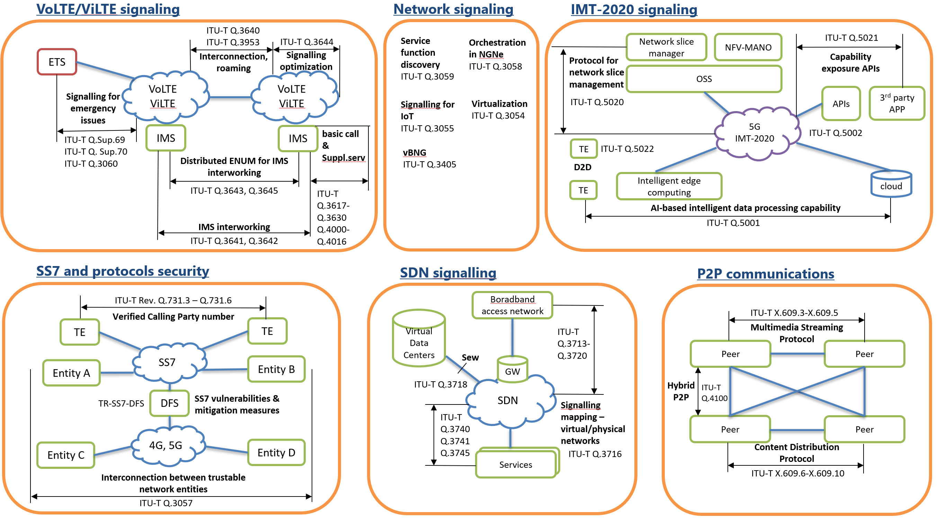
Signalling architectures, requirement and protocols for legacy and future networks

Slide 10
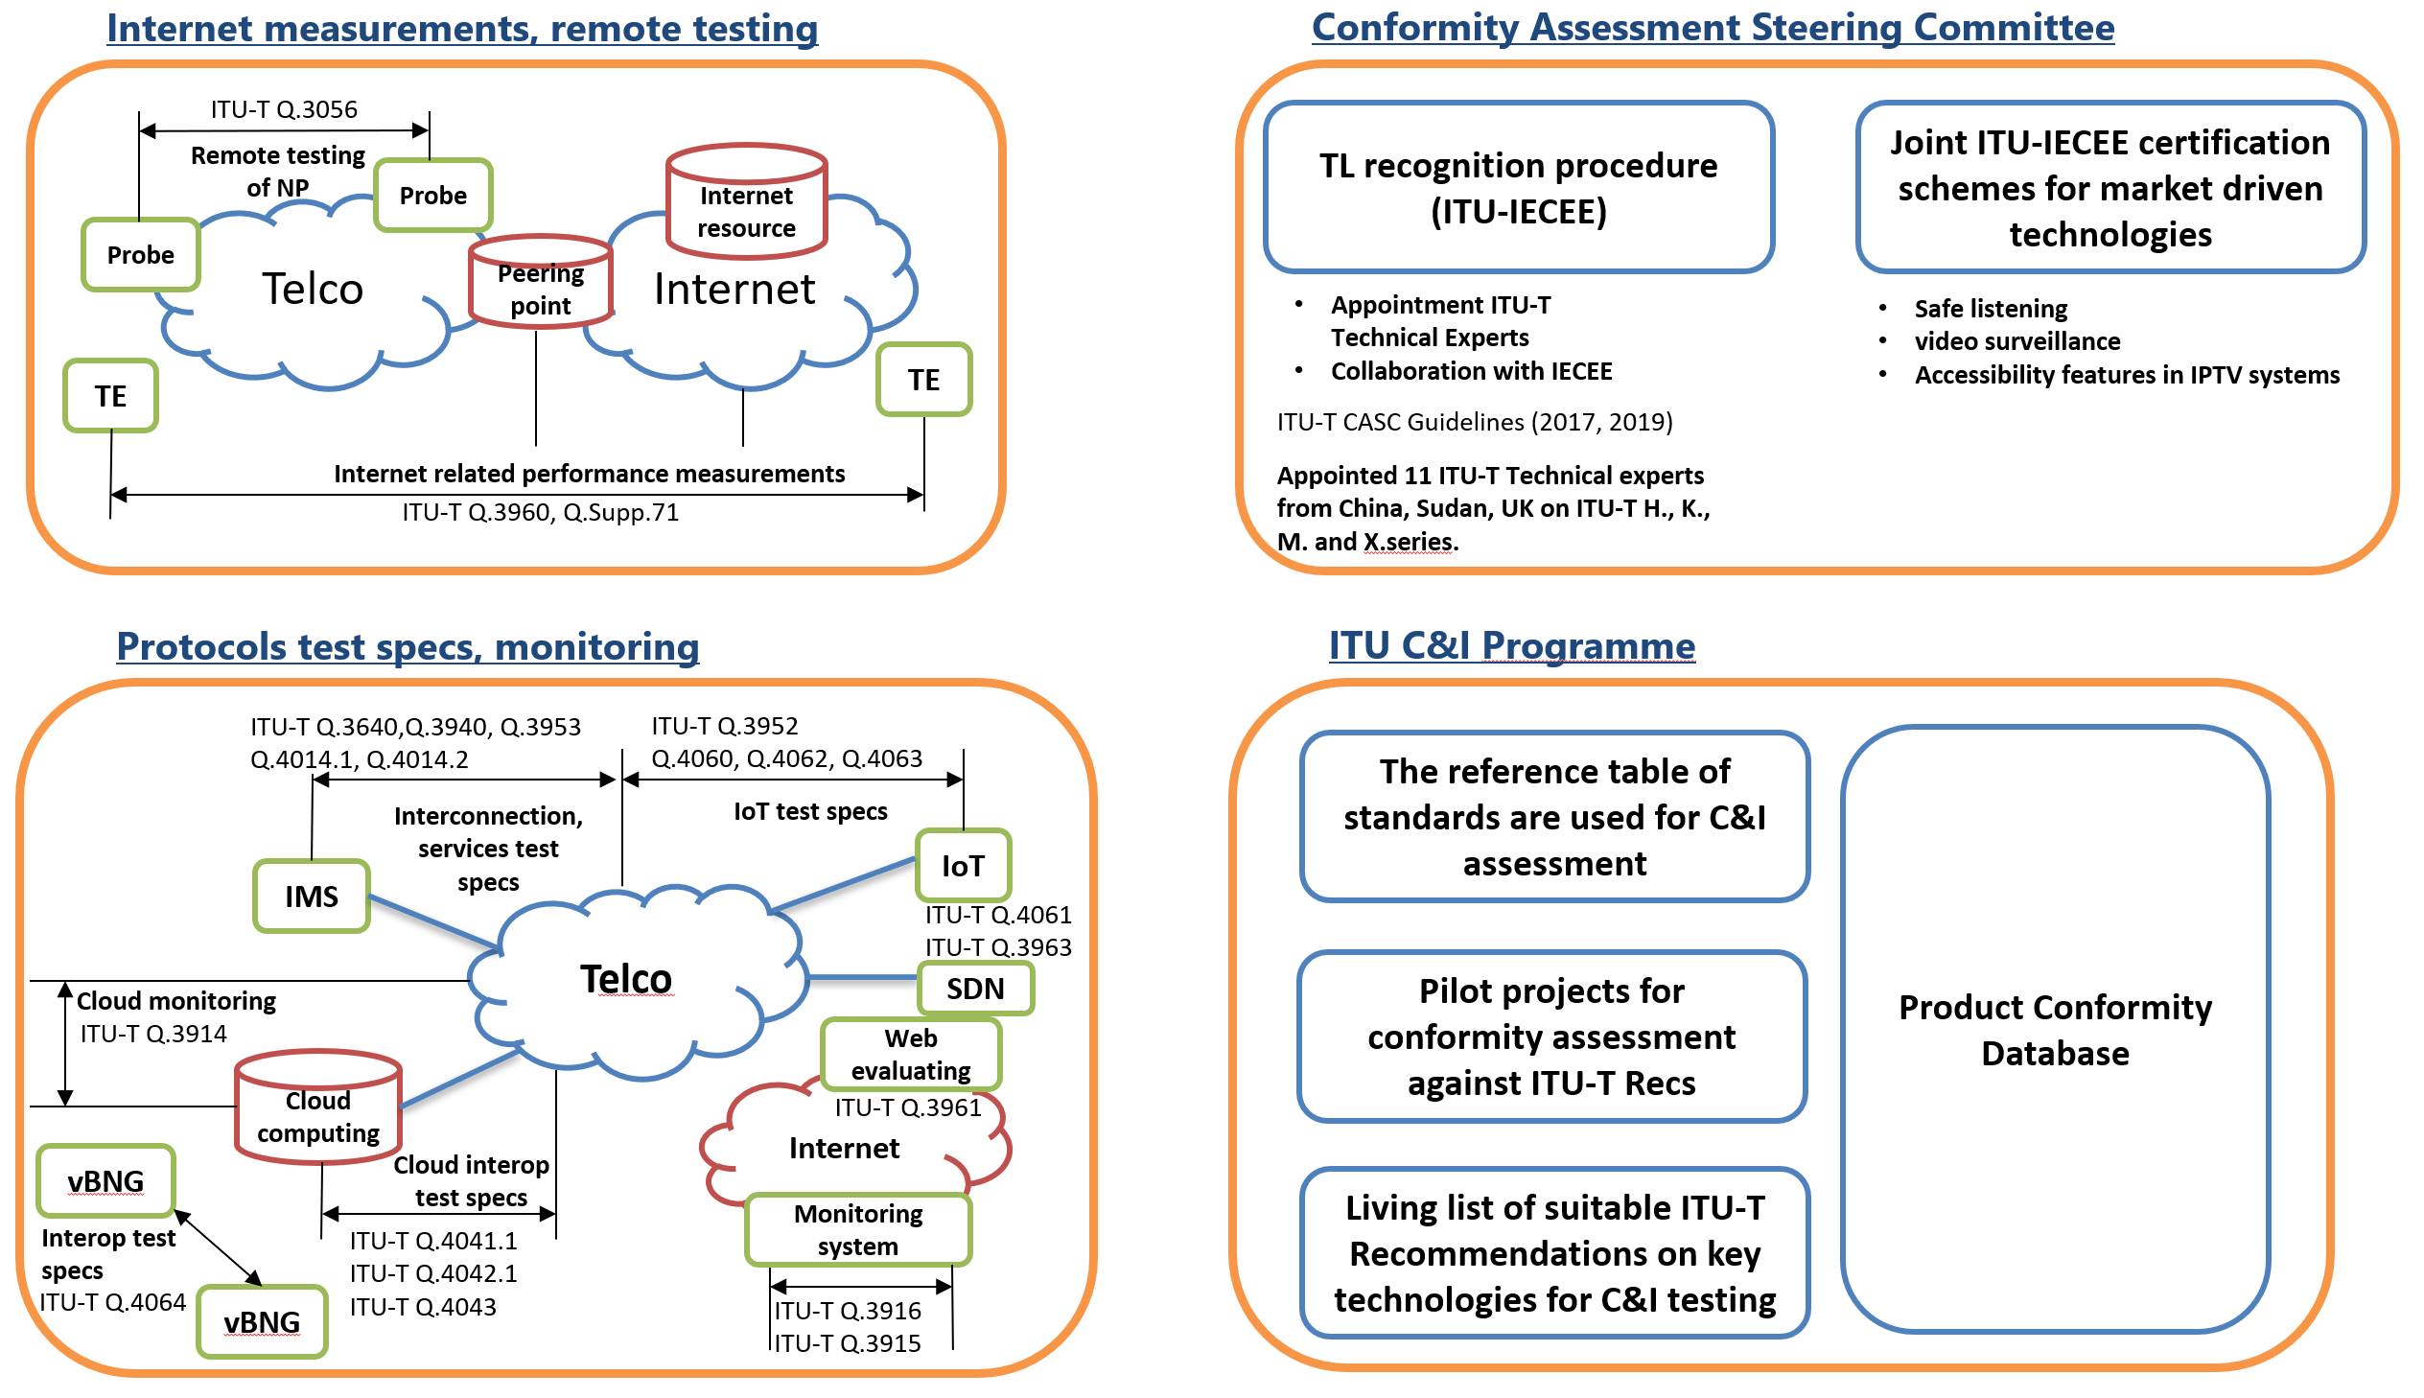
Conformance & Interoperability testing

Slide 11
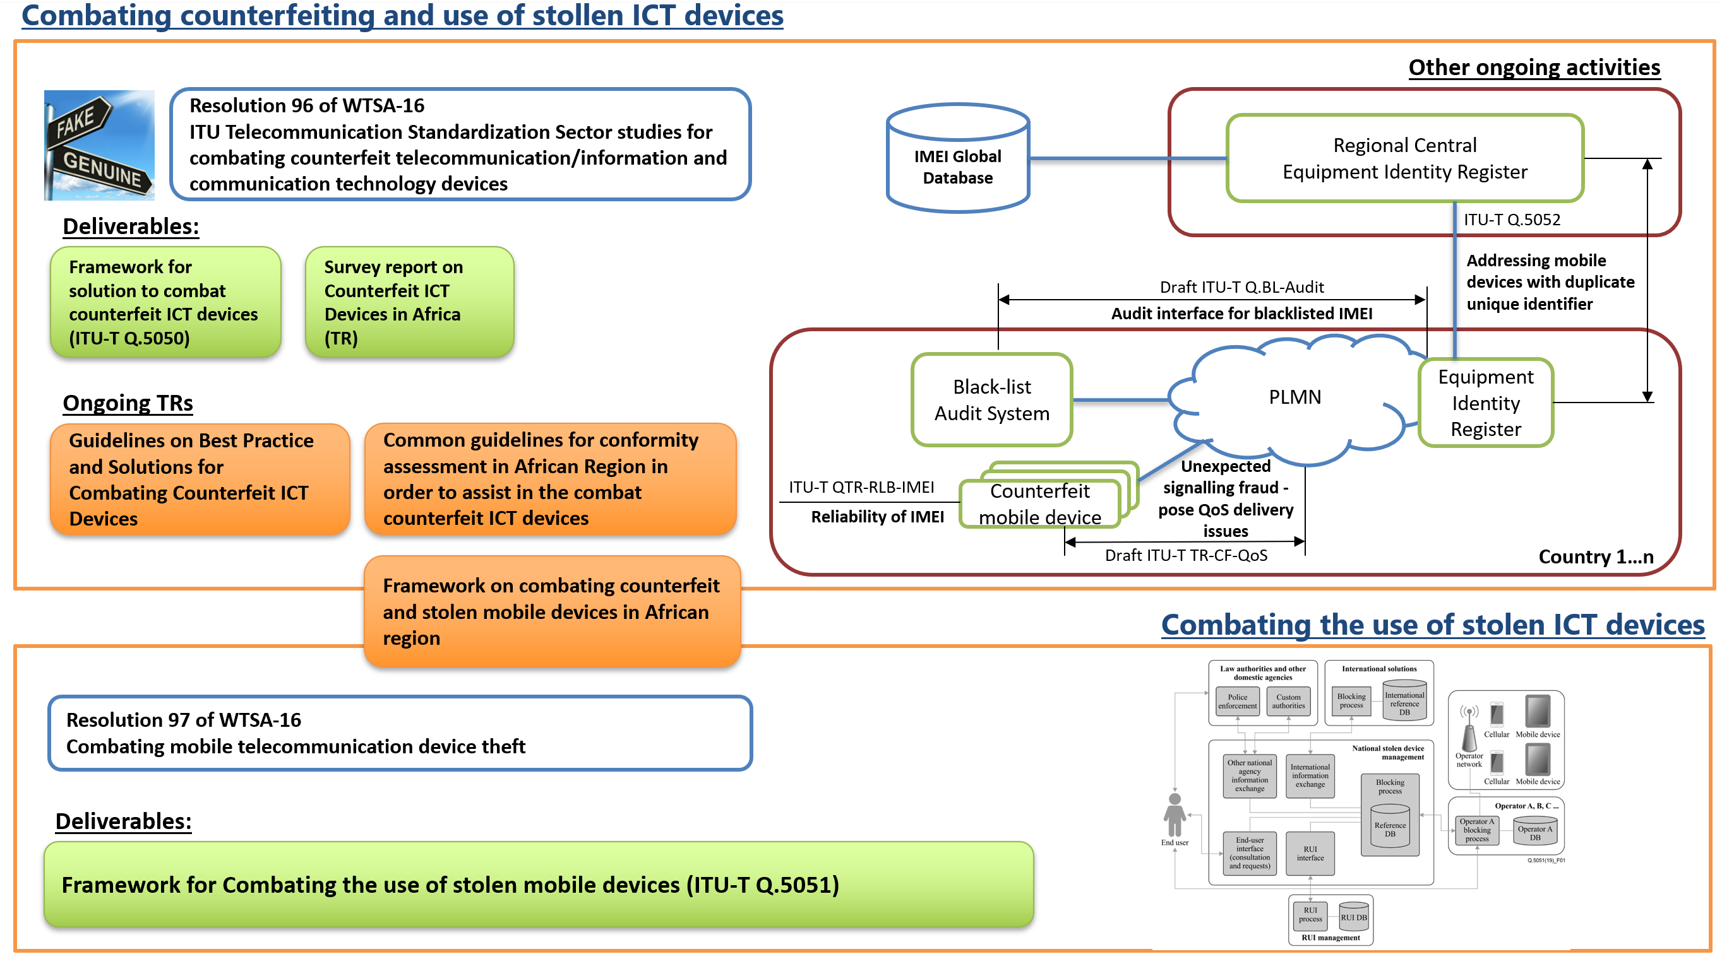
Combating counterfeiting and the use of stolen ICT devices

Slide 13
Future Developments
SG11 aims to:
Lead on developing protocols for all types of networks, including IMT-2020 and beyond
Enhance security of network protocols for ICT communications including those to be used in DFS
Develop signalling and test specifications for networks interconnection
Combat counterfeit and stolen telecommunication/ICT devices and counterfeit or tampered telecommunication/ICT software
Implement C&I programme and develop test specifications
Establish ITU TL recognition procedure and certifications schemes

Slide 14
SG11 contacts
www.itu.int/itu-t/go/tsg11
tsbsg11@itu.int

