Slide 1


SEPTEMBER 2020
Environment,
climate change
and circular economy

Slide 2

SEPTEMBER 2020
ITU-T Study Group 5
Main Statistics and outcomes:
  More than 120 experts participate actively in the work and attend each meeting (including the active participation of Academia members and SMEs)
From 2017-2020:
    Developed 67 Recommendations
    Revised 27 existing Recommendation
    Developed 16 Supplements
    Developed 9 other informative texts
    Over 25 events organized related to EMF, climate change, environment and circular economy
Lead Study Group 5 Roles:
  electromagnetic compatibility, lightning protection and electromagnetic effects
  ICTs related to the environment, climate change, energy efficiency and clean energy
  circular economy, including e‑waste
Notes:
As part of ITU’s Standardization Sector, Study Group 5 is responsible for studying ICT environmental aspects of electromagnetic phenomena and climate change.
Study Group 5 will also study issues related to resistibility, human exposure to electromagnetic fields, circular economy, energy efficiency and climate change adaptation and mitigation.
It is responsible for studies relating to:
protection of telecommunication networks and equipment from interference and lightning;
electromagnetic compatibility (EMC), particle radiation effects, and assessment of human exposure to electromagnetic fields (EMF) produced by ICT installations and devices, including cellular phones and base stations;
the existing copper network outside plant and related indoor installations;
achieving energy efficiency and sustainable clean energy in ICTs;
methodologies for assessing the environmental impact of ICT, publishing guidelines for using ICTs in an eco-friendly way, dealing with e‑waste issues (also including the environmental impact of counterfeit devices), enhancing rare-metal recycling and energy efficiency of ICT, including infrastructures.
Study Group 5 is responsible for studies on how to use ICTs to help countries and the ICT sector to adapt to the effects of environmental challenges, including climate change, in line with the Sustainable Development Goals (SDGs).
Study Group 5 also identifies the needs for more consistent and standardized eco-friendly practices for the ICT sector (e.g. labelling, procurement practices, standardized power supplies/connectors, eco-rating schemes).
All this is reflected in the study group’s many Recommendations and Supplements.

Slide 3

SEPTEMBER 2020
ITU-T Study Group 5
Issues addressed include:
Q1/5 Protection of ICT infrastructure from electromagnetic surges
Q2/5 Equipment resistibility and protective components
Q3/5 Human exposure to electromagnetic fields (EMFs) from ICTs
Q4/5 EMC issues arising in the telecommunication environment
Q5/5 Security and reliability of ICT systems from EM and particle radiations
Q6/5 Achieving energy efficiency and smart energy
Q7/5 Circular economy including e-waste
Q8/5 Guides and terminology on environment and climate change
Q9/5 Climate change and assessment of ICT in the framework of the SDGs
Notes:
These are the issues that ITU-T SG5 is working on to address by providing a platform to share views, developing a series of deliverables for the questions listed, and showcasing initiatives, projects, and standards activities.

Slide 4


SEPTEMBER 2020
ITU-T SG5: Regional Groups
Regional groups |  | Meetings
SG5RG-ARB | ITU-T SG5 Regional Group for the Arab Region | 2
SG5RG-LATAM | ITU-T SG5 Regional Group for Latin America | 2
SG5RG-AFR | ITU-T SG5 Regional Group for Africa | 2
SG5RG-AP | ITU-T SG5 Regional Group for Asia and the Pacific | 1
Notes:
ITU-T Study Group 5 carries out a series of activities within its regional groups.
In total, each regional group has held a number of meetings, as seen in the table.

Slide 5
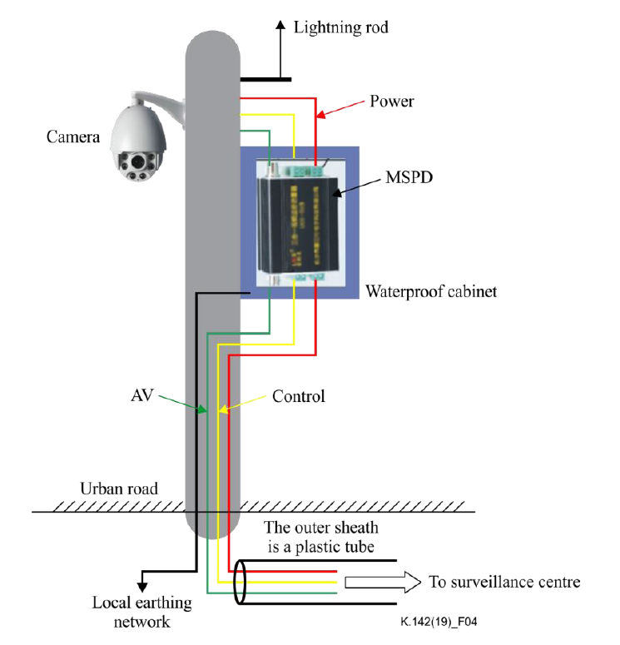
SEPTEMBER 2020
ITU-T SG5: Resistibility, EMC, and Lightning protection
Main protection scheme applied to a video surveillance system
Recommendation ITU-T K.146: Management of interferences on telecommunication transmissions on copper other than speech
Recommendation ITU-T K.142: Lightning protection and earthing of video surveillance system
Recommendation ITU-T K.140: Surge protective component application guide – Fuses
Recommendation ITU-T K.144: Surge protective component application guide - Self-restoring thermally activated overcurrent protectors
Recommendation ITU-T K.133: Electromagnetic (EM) environment of body worn equipment in the 2.4 GHz and 13.56MHz industrial, scientific and medical band
Recommendation ITU-T K.136: Electromagnetic Compatibility requirements for radio telecommunication equipment
Recommendation ITU-T K.138: Quality estimation methods and application guidelines for mitigation measures based on particle radiation tests
Recommendation ITU-T K.139: Reliability requirements for telecommunication systems
affected by particle radiation
Notes:
Next, we explore the breadth of Study Group 5’s activities via the latest standards and guidelines that it has been working on.
The electromagnetic environment is of vital focus in the study group’s work, and so management of EM interference is considered paramount during telecommunication transmissions, along with the EM environment for various context, like protection provided by body worn equipment and EMC of radio telecommunication equipment.
Reducing the risk of damage to ICT equipment due to lightning strikes and surges is another priority, with guidance provided on fuse solutions and fusible component types, the electrical stress levels pre- and post-operation, and various circuits. Attention is paid to self-restoring thermally activated overcurrent protectors as a solution. These OCPs automatically reset when the electrical event causing the overcurrent stops, without the need for manual intervention.
Lastly, the focus on reliability covers reliability requirements and their three types:
alert function reliability,
service reliability, and
maintenance reliability.
These latter Recommendations also include guidance on estimation methods based on the results of irradiation testing that considers the severity of the effect caused by soft errors. Additional mitigation measures are discussed for when they may be needed.

Slide 6
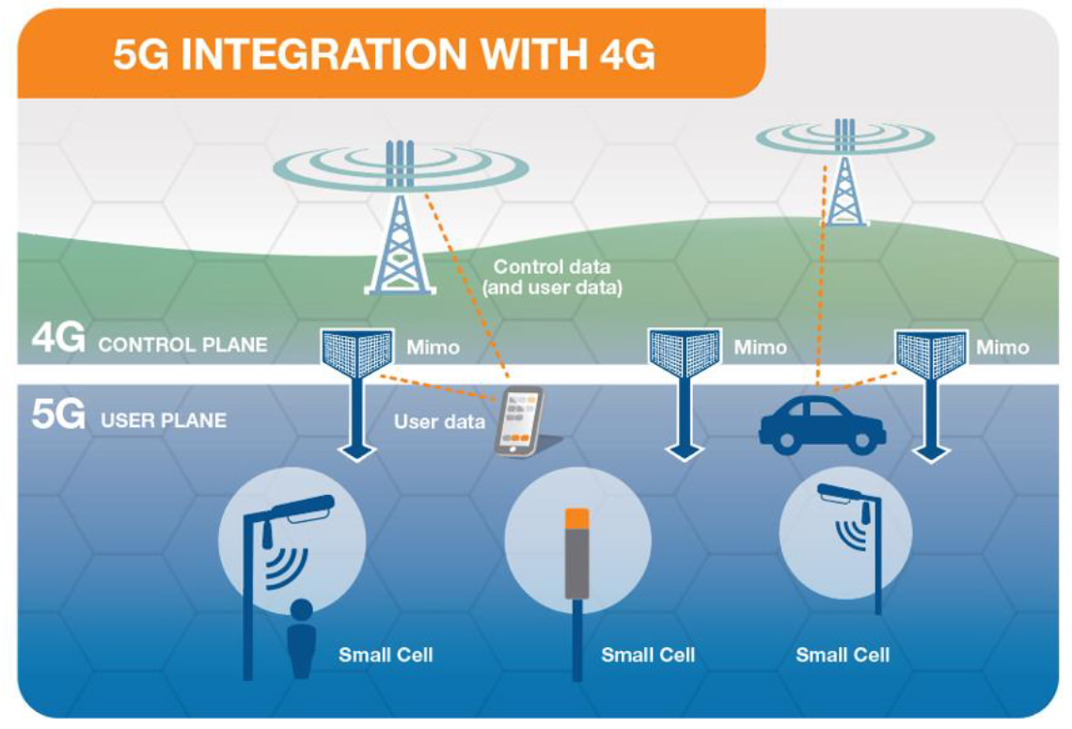
SEPTEMBER 2020
ITU-T SG5: Human exposure to Electromagnetic fields
Recommendation ITU-T K.121: Guidance on the Environmental Management for Compliance with Radio Frequency EMF Limits for Radiocommunication Base Stations
Recommendation ITU-T K.122: Exposure levels in the close proximity of the radiocommunication antennas
Recommendation ITU-T K.145: Assessment and management of compliance with RF EMF exposure limits for workers at radiocommunication sites and facilities
ITU-T K.Suppl.14: The impact of RF-EMF exposure limits stricter than the ICNIRP or IEEE guidelines on 4G and 5G mobile network deployment
ITU-T K.Suppl.16: Electromagnetic field compliance
assessments for 5G wireless networks
Notes:
Electromagnetic fields (EMFs) are invisible areas of energy, often referred to as radiation, that are associated with the use of electrical power and various forms of natural and man-made lighting.
Now, in the age of cellular telephones, wireless routers, and the Internet of things, all of which use EMF, concerns persist about possible connections between EMF and adverse health effects. These exposures are actively being studied by SG5, which works on presenting practical ways to reduce exposures.
This includes giving guidance on how to manage the compliance with radio frequency-EMF limits in areas near to radiocommunication installations and how to establish processes for responding to public concern about exposure. To this end, also included is information on transmitting antennas, the electric field strength levels that can be expected in close proximity, and general safety guidance for telecommunication RF workers.
Some of the challenges faced by countries, regions and cities that are about to deploy 4G or 5G infrastructures are highlighted, along with compliance assessment considerations.

Slide 7

SEPTEMBER 2020
ITU-T SG5: Energy efficiency, Smart Energy and Sustainable Buildings
Recommendations ITU-T L.1220, ITU-T L.1221, and ITU-T L.1222: Innovative Energy storage technology for stationary use:
  Part 1: Overview of energy storage
  Part 2: Battery
  Part 3: Supercapacitor technology
Recommendation ITU-T L.1303: Functional requirements and framework of green data centre energy-saving management system
Recommendation ITU-T L.1305: Data centre infrastructure management system based on big data and artificial intelligence technology
Recommendations ITU-T L.1380, ITU-T L.1381, and ITU-T L.1382: Smart Energy Solutions for:
  Telecom sites
  Data Centre
  Telecommunication rooms
Recommendation ITU-T L.1370: Sustainable & intelligent building services
Recommendation ITU-T L.1371: A methodology for assessing and
scoring the sustainability performance of office buildings
Notes:
While cities are engines of economic growth, they’re also engines of environmental impact. Cities generate around 80 percent of global economic output and 70 percent of energy-related greenhouse gas emissions. And by 2030, cities will become even larger to account for 66 percent of the world’s population, up from 54 percent today.
Buildings, in particular, account for more than one-third of all final energy consumption and half of global electricity use. They’re responsible for approximately one-third of global carbon dioxide emissions.
While rapid urban development demands new infrastructure, there is a cost-effective solution for reducing buildings’ environmental impacts – energy efficiency.
To promote energy efficiency, SG5 has introduced an open series of documents for different families of technologies (e.g., battery systems, super-capacitor systems) that will be enriched progressively as new technologies emerge that may significantly impact the field of energy storage. The study group has also explored various types of energy such as photovoltaic energy, wind energy, fuel cells and the grid, as part of smart energy solutions and control for telecom sites, data centres (including the infrastructure management [DCIM] system) and telecommunication rooms.
Lastly, the concept of sustainable intelligent buildings is explored (with additional emphasis on assessing and scoring the sustainability performance of office buildings), due to its close relation to efficiency and environmentally-aware practices. The concept is therefore the key enabler of the sustainability of the building itself, and of the city as a whole.

Slide 8

SEPTEMBER 2020
ITU-T SG5: E-waste and Circular Economy
Recommendation ITU-T L.1020: Circular Economy: Guide for Operators and Suppliers on approaches to migrate towards circular ICT goods and networks
Recommendation ITU-T L.1021: Extended producer responsibility - Guidelines for sustainable e-waste management
Recommendation ITU-T L.1022: Circular Economy: Definitions and concepts for material efficiency for Information and Communication Technology
Recommendation ITU-T L.1023: Assessment method for circular scoring
Recommendation ITU-T L.1032: Guidelines and certification schemes for e-waste recyclers
Notes:
Implementing the circular economy in cities can bring tremendous economic, social, and environmental benefits. The implementation of a circular economy vision could foster the emergence of thriving cities in which economic productivity increases through reduced congestion, eliminated waste, and reduced costs. E-waste is of particular concern at the moment due to its rapid accumulation; therefore, it is imperative that circular concepts (such as extended producer responsibility for electronic goods) be put to use without delay.
To encourage the adoption of circular and responsible practices, SG5 suggests approaches of circular economy for ICT goods and networks, with a view to improving circularity in the entire supply chain. Emphasis has been placed on the informal sector that is involved in waste electrical and electronic equipment collection and dismantling, and on mitigation through guidelines and certification schemes for e-waste recyclers.

Slide 9
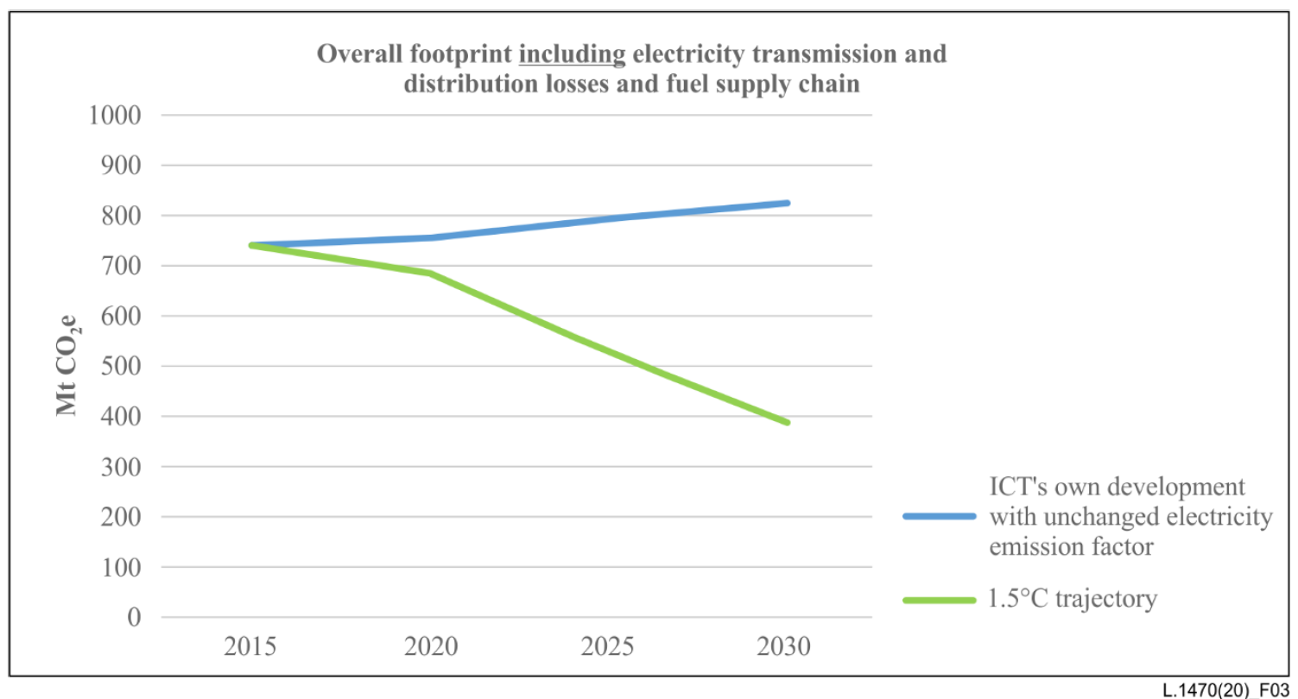
SEPTEMBER 2020
ITU-T SG5: Climate Actions
ICT sector trajectory including electricity grid losses and supply chain
Recommendation ITU-T L.1450: Methodologies for the assessment of the environmental impact of the information and communication technology sector
Recommendation ITU-T L.1451: Methodology for assessing the aggregated positive sector-level impacts of ICT in other sectors
Recommendation ITU-T L.1470: GHG emissions trajectories for the ICT sector compatible with the UNFCCC Paris Agreement
ITU-T L.Suppl.37 to ITU-T L.1470: Guidance to operators of mobile networks, fixed networks and data-centres on setting 1.5°C aligned targets compliant with Recommendation ITU-T L.1470
Notes:
Without a standard methodology evaluating the positive impacts of ICT, the role of ICTs in the fight against global warming will be only partially perceived. It is important, therefore, to have a methodology for calculating the ICT sector footprint with respect to life cycle greenhouse gas emissions;
as well as a methodology for defining GHG emissions budget for the ICT sector (considering a 2 degree C or lower trajectory). The sectoral view in this context had been particularly underrepresented until SG5’s work on the Recommendations you see here.
The trajectories, the long-term ambition for 2050, and the 2015 baseline prescribed by SG5 are all important to support the 1.5 degree C objective described by the IPCC in its Special report: Global warming of 1.5 degree C, and in support of the Science-based Targets (SBT) initiative.

Slide 10
SEPTEMBER 2020
ITU-T SG5: Setting the environmental requirements for 5G
Taking into consideration the development of 5G systems, ITU-T SG5 is developing a series of technical reports and international standards that study the following environmental aspects of 5G:
Energy feeding and efficiency:
  Recommendation ITU-T L.1210: "Sustainable power-feeding solutions for 5G networks"​​
  Recommendation ITU-T L.1220: "Innovative energy storage technology for stationary use - Part 1: Overview of energy storage"
  Recommendation ITU-T L.1221: "Innovative energy storage technology for stationary use - Part 2: Battery"
  Recommendation ITU-T L.1222: "Innovative energy storage technology for stationary use - Part 3: Supercapacitor technology"
  Recommendation ITU-T L.1380: “Smart energy solution for telecom sites"
  Recommendation ITU-T L.1381: “Smart energy solution for data centres"
  Recommendation ITU-T L.1382: “Smart energy solution for telecommunication rooms"​
  ITU-T L.Suppl.36 to ITU-T L.1310: "Study on methods and metrics to evaluate energy efficiency for future 5G syste​ms"
Resistibility​:
  ITU-T K.Suppl.8: "Resistibility analysis of 5G systems"
Electromagnetic compatibility (EMC):
  ITU-T K.Suppl.10: "Analysis of electromagnetic compatibility aspects and definition of requirements for 5G systems“
Electromagnetic f​ields (EMF)​:
  ITU-T K.Suppl.1: "Guide on electromagnetic fields and health"​​​​
  ​​ITU-T K.Suppl.4: "Electromagnetic field considerations SSCs"
  ITU-T K.Suppl.9: "5G technology and human exposure to RF EMF"
  ITU-T K.Suppl.14: "The impact of RF-EMF exposure limits stricter than the ICNIRP or IEEE guidelines on 4G and 5G mobile network deployment"
  ITU-T K.Suppl.16: "Electromagnetic field compliance assessments for 5G wireless networks "
Notes:
ITU-T standards ensure safety, quality, reliability of products and services, as well as their interoperability.
In the 5G world, standards play a key role in the development of equipment and consumer devices. They help ensure the interoperability of equipment and to allow for innovation and for competitive markets.
To this end, ITU-T SG5 is working on standards for every aspect of 5G development.

Slide 11
SEPTEMBER 2020
Advancing climate response and enhancing environmental protection further…
Question number | Question title
A/5 | Electrical protection, reliability, safety and security of ICT systems
B/5 | Protecting equipment and devices against lightning and other electrical events
C/5 | Human exposure to electromagnetic fields (EMFs) due to digital technologies
D/5 | Electromagnetic compatibility (EMC) aspects in ICT environment
E/5 | Environmental efficiency of digital technologies
F/5 | Climate change mitigation and smart energy solutions
G/5 | E-waste, circular economy and sustainable supply chain management
H/5 | Adaptation to climate change trough sustainable and resilient digital technologies
I/5 | Climate change and assessment of digital technologies in the framework of the Sustainable Development Goals (SDGs) and the Paris Agreement
J/5 | Building circular and sustainable cities and communities
K/5 | Guides and terminology on environment
Notes:
This slide shows the future focus of Study Group 5, after the current study period.

Slide 12

SEPTEMBER 2020
Connect 2030: An agenda to connect all to a better world
Target 3.2: By 2023, increase the global e-waste recycling rate to 30%
Target 3.3: By 2023, raise the percentage of countries with an e-waste legislation to 50%
Target 3.4: By 2023, net telecommunication/ICT-enabled greenhouse gas abatement should have increased by 30% compared to the 2015 baseline
ITU-T Study Group 5 is contributing to the accomplishment of the Connect 2030 with Standards such as:
Recommendation ITU-T L.1031 which helps countries to reduce e-waste by 50%. This Recommendation provides a guidance on developing an e-waste inventory, approaches to design e-waste prevention and reduction programmes.
Recommendation ITU-T L.1460 provides guidance on how to decrease the GHG emissions generated by the telecommunication/ICT sector.
Notes:
The 'Connect 2030 Agenda for Global Telecommunication/ICT Development' focuses on how technological advances will contribute to accelerate the achievement of the United Nations Sustainable Development Goals (SDGs) by 2030.
At the same time, 'Connect 2030' supports ITU's role in facilitating progress towards the implementation of the World Summit on the Information Society (WSIS) Action Lines.
The Connect 2030 Agenda is linked to the Strategic Plan of the Union for the period 2020-2023, ensuring that technology serves humanity and the planet.
The Agenda aims to achieve five bold goals as seen on the slide.

Slide 13

SEPTEMBER 2020
FG-AI4EE: Environmental efficiency for AI and other emerging technologies
This FG-AI4EE identifies the standardization needs to develop a sustainable approach to AI and other emerging technologies.
The FG-AI4EE is working on the Requirements, Assessment and Measurement &Implementation of AI and Emerging Technologies for environmental efficiency.
Notes:
ITU-T Focus Group on "Environmental Efficiency for Artificial Intelligence and other Emerging Technologies“ identifies the standardization needs to develop a sustainable approach to AI and other emerging technologies. These include automation, augmented reality, virtual reality, extended reality, smart manufacturing, industry 5.0, cloud/edge computing, nanotechnology, 5G, among others.
The focus group develops technical reports and technical specifications to address the environmental efficiency, as well as water and energy consumption of emerging technologies, and provide guidance to stakeholders on how to operate these technologies in a more environmentally efficient manner to meet the 2030 Agenda for Sustainable Development and its 17 Sustainable Development Goals.

Slide 14
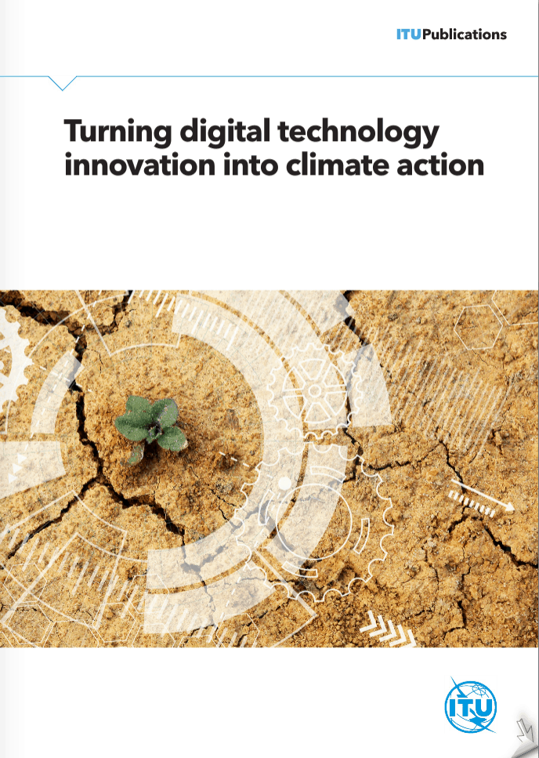

SEPTEMBER 2020
Digital technologies to help the environment and curb climate change
Notes:
ITU’s report on “Turning Digital Technology Innovation Into Climate Action” was launched at the United Nations Secretary-General’s September 2019 Climate Action Summit in New York.
It takes a comprehensive approach to highlight the urgency and severity of climate change, along with the role that ICTs play in both addressing and contributing to the crisis.
ICTs are discussed in relation to issues such as greenhouse gas emissions, the growing carbon footprint, e-waste and the other social and societal impacts of climate change.
The evidence and case studies presented cover measures being deployed to better understand the Earth’s system, reduce greenhouse gas emissions and build climate resilience.
“Frontier technologies to protect the environment and tackle climate change” is a recent report developed by ITU together with several UN bodies.
It explores what is changing on our planet, why these changes are taking place, and who is most at risk as a result. It shows that catastrophic global climate change is already underway, and that urgent action is needed to help monitor, mitigate and adapt to its effects.
The report spotlights eight key emerging technologies, each with the potential to be instrumental in tackling climate change: artificial intelligence (AI), Internet of Things (IoT), 5G, clean energy technology, digital twin, robotics, Space 2.0 technologies, as well as digitalization and Big Data. ​
In helping to tackle climate change, frontier technologies also offer tremendous potential for meeting the United Nations sustainable development goal (SDG) 13 on Climate Action.
Frontier technologies can be key enablers of smartness, sustainability and environmental resilience – offering important opportunities to help assess, mitigate and adapt to climate change.

Slide 15
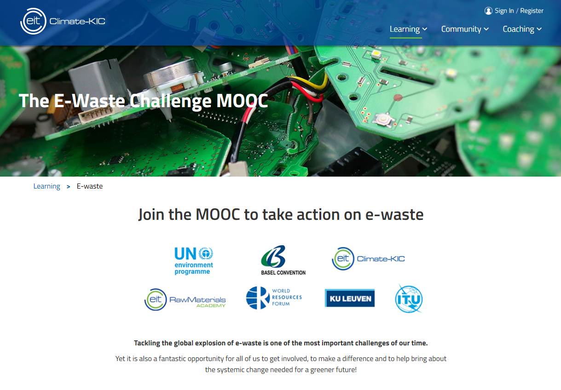
SEPTEMBER 2020
The E-waste Challenge MOOC
The Massive Open Online Course (MOOC) on e-waste has been developed to encourage:
Environmentally sound management of hazardous chemicals and wastes.
Cleaner production processes to minimize use/emissions of hazardous waste.
Protection of human health, communities and the environment from the impact of hazardous waste and climate change.
Design, circular economy, mitigation and adaptation activities to lower the impact on climate change and natural resources.
Notes:
EIT Climate-KIC is Europe’s largest public-private innovation partnership, working together to address the challenge of climate change.
Working with UNEP through the Basel, Rotterdam and Stockholm Convention Secretariat (BRS) and the university partner KU Leuven , EIT Climate-KIC has designed a course that focuses on important shared priorities by promoting the environmentally sound management of e-waste recycling around the world .
The International Telecommunication Union (ITU), World Health Organization, the World Resources Forum and EIT RawMaterials have given their expertise to develop and endorse the materials ensuring they meet the needs of both practitioners and post-graduate students.
The MOOC is designed to be accessible to all but also to provide enough depth and further resources for anyone who wishes to dig deeper into the topics covered.
Entrepreneurs, university students, policy makers, health care providers, business managers and e-waste operators in both developed and developing countries.
Course 4 – Reducing e-waste by design, standards, business and policy, in particular, features insights into the International Telecommunication Union’s standards relating to e-waste, climate change and circular economy.

Slide 16


SEPTEMBER 2020
Thank you!
Questions? Interested in learning more?
Let us know!
Email
Website
tsbsg5@itu.int
www.itu.int/en/ITU-T/studygroups/2017-2020/05/Pages/default.aspx

Slide 17

SEPTEMBER 2020
SEPTEMBER 2020
List of Approved Recommendations (2017-2020)
Work item | Subject / Title
K.20 (rev) | Resistibility of telecommunication equipment installed in a telecommunication centre to overvoltages and overcurrents
K.21 (rev) | Resistibility of telecommunication equipment installed in customer premises to overvoltages and overcurrents
K.35 | Bonding configurations and earthing at remote electronic sites
K.39 | Risk assessment of damages to telecommunication sites due to lightning discharges
K.40 (rev) | Protection against lightning electromagnetic pulses in telecommunication centres
K.44 (rev) | Resistibility tests for telecommunication equipment exposed to overvoltages and overcurrents - Basic Recommendation
K.45 (rev) | Resistibility of telecommunication equipment installed in the access and trunk networks to overvoltages and overcurrents
K.50 (rev) | Safe limits for operating voltages and currents in telecommunication systems powered over the network
K.52 (rev) | Guidance on complying with limits for human exposure to electromagnetic fields
K.61 | Guidance on measurement and numerical prediction of electromagnetic fields for compliance with human exposure limits for telecommunication installations
K.64 | Safe working practices for outside equipment installed in particular environments
K.66 | Protection of customer premises from overvoltages
K.70 | Mitigation techniques to limit human exposure to EMFs in the vicinity of radiocommunication stations
Notes:
This is a complete list of approved Recommendations for the current Study Period. It can be found on the ITU-T SG5 webpages.

Slide 18
SEPTEMBER 2020
SEPTEMBER 2020
List of Approved Recommendations (2017-2020)
Work item | Subject / Title
K.73 | Shielding and bonding for cables between buildings
K.77 | Characteristics of metal oxide varistors for the protection of telecommunication installations
K.83 | Monitoring of electromagnetic field levels
K.90 | Evaluation techniques and working procedures for compliance with exposure limits of network operator personnel to power-frequency electromagnetic fields
K.91 (rev) | Guidance for assessment, evaluation and monitoring of human exposure to radio frequency electromagnetic fields
K.93 | Immunity of home network devices to electromagnetic disturbance
K.99 | Surge protective component application guide - Gas discharge tubes
K.100 (rev) | Measurement of radio frequency electromagnetic fields to determine compliance with human exposure limits when a base station is put into service
K.112 | Lightning protection, earthing and bonding: Practical procedures for radio base stations
K.116 | Electromagnetic compatibility requirements and test methods for radio telecommunication terminal equipment
K.117 | Primary protector parameters for the surge protection of equipment Ethernet ports
K.118 | Requirements for Lightning Protection of Fibre To The distribution point (FTTdp) Equipment
K.119 | Conformance Assessment of Radio Base Stations Regarding Lightning Protection and Earthing
Work item | Subject / Title
K.120 | Lightning Protection and Earthing of Miniature Base Station
K.121 | Guidance on the Environmental Management for Compliance with Radio Frequency EMF Limits for Radiocommunication Base Stations
K.122 | Exposure levels in the close proximity of the radiocommunication antennas
K.123 | Electromagnetic compatibility requirements for electrical equipment in telecommunication facilities
K.124 | Overview of particle radiation effects on telecommunications systems
K.125 | Dangerous effects and protective measures against electromagnetic disturbances when internet data centre is co-sited with high-voltage substation
K.126 | Surge protective component application guide - High frequency signal isolation transformers
K.127 | Immunity requirements for telecommunication equipment in close proximity use of wireless devices
K.128 | Surge protective component application guide - metal oxide varistor (MOV) components
K.129 | Characteristics and ratings of silicon PN junction voltage clamping components used for the protection of telecommunications installations
K.130 | Neutron irradiation test methods for telecommunications equipment
K.131 | Design methodologies for telecommunication systems applying soft error measures
K.132 | EMC requirements of electromagnetic disturbances from lighting equipment located in telecommunication facilities
Notes:
This is a complete list of approved Recommendations for the current Study Period. It can be found on the ITU-T SG5 webpages.

Slide 19
SEPTEMBER 2020
SEPTEMBER 2020
List of Approved Recommendations (2017-2020)
Work item | Subject / Title
K.133 | Electromagnetic (EM) environment of body worn equipment in the 2.4 GHz and 13.56MHz industrial, scientific and medical band
K.134 | Protection of small-size telecommunication installations with poor earthing conditions
K.135 | Technical parameters for residual current operated protective devices with automatic reclosing feature for telecom applications
K.136 | Electromagnetic Compatibility requirements for radio telecommunication equipment
K.137 | Electromagnetic compatibility requirements and measurement methods for wire-line telecommunication network equipment
K.138 | Quality estimation methods and application guidelines for mitigation measures based on particle radiation tests
K.139 | Reliability requirements for telecommunication systems affected by particle radiation
K.140 | Surge protective component application guide - Fuses
K.141 | Electromagnetic compatibility requirements for Information Perception Equipment
K.142 | Lightning protection and earthing of video surveillance system
K.143 | Guidance on safety relating to the use of surge protective devices and surge protective components in telecommunication terminal equipment
K.144 | Surge protective component application guide - Self-restoring thermally activated overcurrent protectors
K.145 | Assessment and management of compliance with RF EMF exposure limits for workers at radiocommunication sites and facilities
Work item | Subject / Title
K.146 | Management of interferences on telecommunication transmissions on copper other than speech
K.147 | Ethernet port resistibility testing for overvoltages and overcurrents
L.1000 | Universal power adapter and charger solution for mobile terminals and other hand-held ICT devices
L.1006 | Test suites for assessment of the External universal power adapter solutions for stationary information and communication technology devices
L.1007 | Test suites for assessment of the External universal power adapter solutions for portable information and communication technology devices
L.1015 | Criteria for evaluation of the environmental impact of mobile phones
L.1020 | Circular Economy: Guide for Operators and Suppliers on approaches to migrate towards circular ICT goods and networks
L.1021 | Extended producer responsibility - Guidelines for sustainable e-waste management
L.1022 | Circular Economy: Definitions and concepts for material efficiency for Information and Communication Technology
L.1030 | E-waste management framework for countries
L.1031 | Guideline on Implementing the E-waste Reduction Target of the Connect2020 Agenda
L.1032 | Guidelines and certification schemes for e-waste recyclers
L.1205 | Interfacing of renewable energy or distributed power sources to up to 400 VDC power feeding systems
Notes:
This is a complete list of approved Recommendations for the current Study Period. It can be found on the ITU-T SG5 webpages.

Slide 20
SEPTEMBER 2020
SEPTEMBER 2020
List of Approved Recommendations (2017-2020)
Work item | Subject / Title
L.1206 | Impact on information and communication technology equipment architecture of multiple AC, -48 VDC or up to 400 VDC power inputs
L.1207 | Progressive migration of a telecommunication/information and communication technology site to 400 VDC sources and distribution
L.1210 | Sustainable power-feeding solutions for 5G networks
L.1220 | Innovative energy storage technology for stationary use - Part 1: Overview of energy storage
L.1221 | Innovative energy storage technology for stationary use - Part 2: Battery
L.1222 | Innovative energy storage technology for stationary use - Part 3: Supercapacitor technology
L.1303 | Functional requirements and framework of green data centre energy-saving management system
L.1305 | Data centre infrastructure management system based on big data and artificial intelligence technology
L.1310 | Energy efficiency metrics and measurement methods for telecommunication equipment
L.1315 | Standardization terms and trends in energy efficiency
L.1316 | Energy efficiency framework
L.1325 | Green ICT solutions for telecom network facilities
L.1331 | Assessment of mobile network energy efficiency
L.1332 | Total network infrastructure energy efficiency metrics
L.1351 | Base station site energy parameter measurement methodology
L.1360 | Energy control of SDN architecture
L.1361 | Measurement method for energy efficiency of Network Function Virtualization
L.1362 | Interface for power management in network function virtualization environments – Green abstraction layer version 2
Work item | Subject / Title
L.1370 | Sustainable and intelligent building services
L.1371 | A methodology for assessing and scoring the sustainability performance of office buildings
L.1380 | Smart energy solution for telecom sites
L.1381 | Smart energy solution for data centre
L.1382 | Smart energy solution for telecommunication rooms
L.1450 | Methodologies for the assessment of the environmental impact of the information and communication technology sector
L.1451 | Methodology for assessing the aggregated positive sector-level impacts of ICT in other sectors
L.1460 | Connect 2020 greenhouse gases emissions – Guidelines
L.1470 | GHG emissions trajectories for the ICT sector compatible with the UNFCCC Paris Agreement
L.1504 | ICT and adaptation of agriculture to the effects of climate change
L.1505 | Information and communication technology and adaptation of the fisheries sector to the effects of climate change
L.1506 | Framework of climate change risk assessment for telecommunication and electrical facilities
L.1507 | Use of ICT sites to support environmental sensing
Notes:
This is a complete list of approved Recommendations for the current Study Period. It can be found on the ITU-T SG5 webpages.

Slide 21
SEPTEMBER 2020
SEPTEMBER 2020
List of Agreed Supplements and other informative texts (2017-2020)
Work item | Subject / Title
K.Suppl.1 | Guide on electromagnetic fields and health
K.Suppl.8 | Resistibility analysis of 5G systems
K.Suppl.9 | 5G technology and human exposure to RF EMF
K.Suppl.10 | Analysis of EMC aspects and definition of requirements for 5G mobile systems
K.Suppl.13 | Radiofrequency electromagnetic field (RF-EMF) exposure levels from mobile and portable devices during different conditions of use
K.Suppl.14 | The impact of RF-EMF exposure limits stricter than the ICNIRP or IEEE guidelines on 4G and 5G mobile network deployment
K.Supp.16 to ITU-T K.series | Electromagnetic field compliance assessments for 5G wireless networks
K.Supp.16 to ITU-T K.series | Electromagnetic field (EMF) compliance assessments for 5G wireless networks
K.Sup.19 to ITU-T K-series Recommendations | EMF strength inside subway train
Work item | Subject / Title
K.Suppl.20 | RF Exposure evaluation around base station installed underground
K.Suppl.7 to ITU-T K.44 | AC supply configurations
K.Sup.17 to ITU-T K.44 | Test conditions and methods information
K.Sup.18 to ITU-T K.44 | Causes of telecommunication system overvoltage and overcurrent conditions and their expected levels
K.Suppl.12 to ITU-T K.51 | Narrow pin spacing in connectors potential hazards
K.Suppl.1 to ITU-T K.91 | ITU-T K.91 - Guide on electromagnetic fields and health
K.Suppl.4 to ITU-T K.91 | Electromagnetic field considerations in smart sustainable cities
K.Suppl.15 to ITU-T K.20, K.21, K.44 | Internal DC powering interface surge testing factors
K.Suppl.11 to ITU-T K.131 | Soft error measures for FPGA
K.Suppl.11 to ITU-T K.131 | Soft error measures for field programmable gate arrays
L.Suppl.36 to ITU-T L.1310 | Study on methods and metrics to evaluate energy efficiency for future 5G systems
L.Suppl.37 to ITU-T L.1470 | Guidance to operators of mobile networks, fixed networks and data-centres on setting 1.5°C aligned targets compliant with Recommendation ITU-T L.1470
LSTR.5GEE | Study on methods and metrics to evaluate energy efficiency for future 5G systems

Slide 22

SEPTEMBER 2020
SEPTEMBER 2020
Global portal on Environment and Smart Sustainable Cities
Highlights the latest external resources related to:
Smart sustainable cities
Frontier technologies
Climate Actions
Energy efficient ICTs
E-waste management and circular economy
EMC & EMF security and safety

