Slide 1

Council Working Group on child online protection Twenty-third meeting – 16 September 2025
Document CWG-COP-23/INF/5
4 Septembrer2025
English only
Report by Roblox
Safety 2025
Purpose
Overview of Roblox safety updates
Action required
This report is transmitted to the Council Working Group on child online protection for information.

Slide 2

What is Roblox?

Slide 3
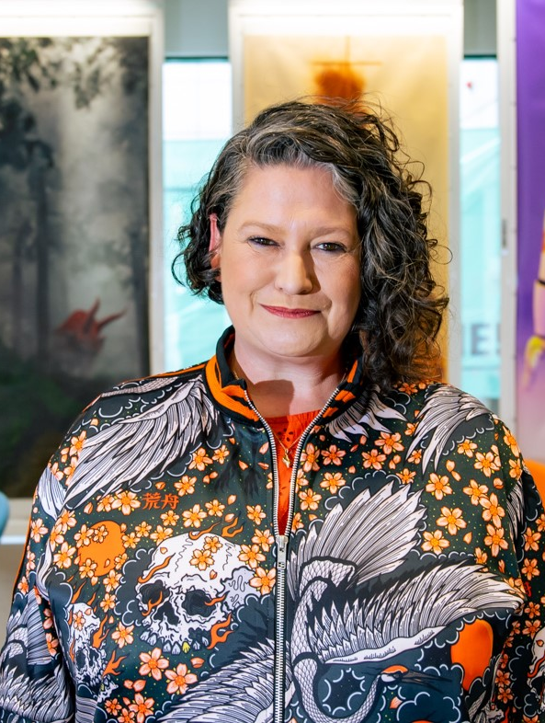
Civility @ Roblox
Who am I?
Our mission
Our team
Our work
Laura Higgins, Snr Director of Community Safety & Civility

Slide 4

Safety at Roblox
Our approach to Safety
100+ updates since 2024
New Parental Controls/ IARC Ratings
Teen Wellbeing Controls
Trusted Connections + FAE

Slide 5
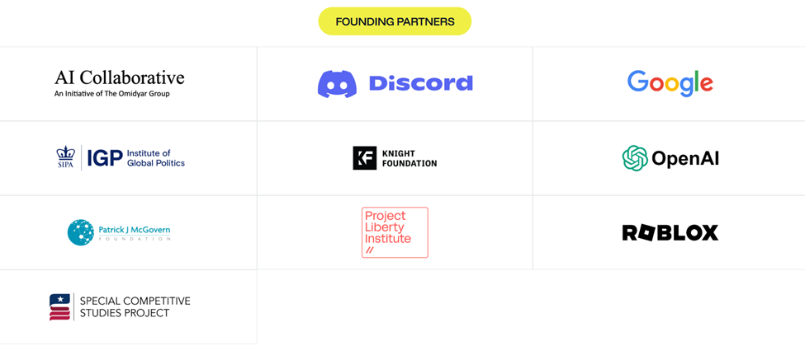
ROOST (Robust Open Online Safety Tools)
Collaboration for Good
Roblox Sentinel
3D Foundational Model (Roblox Cube)
Voice Safety Classifier

Slide 6
Visit corp.roblox.com for more information
Thank you!

