Slide 1
Council Working Group on child online protection Twenty-second meeting – From 12 (p.m.) to 13 February 2025
Document CWG-COP-22/INF/21
31 January 2025
English only
Contribution from UNICEF
UNICEF strategic actions to protect children from violence, and exploitation in relation to the digital environment
Action required
This report is transmitted to the Council Working Group on child online protection for information.

Slide 2
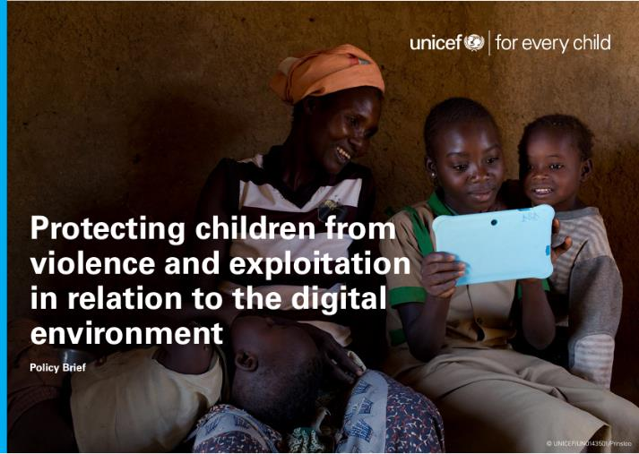

Slide 4
2025 highlights
CHILD RIGHTS & BUSINESS
Child rights impact assessment in relation to the digital environment (toolkit)
Corporate reporting on child rights impacts in relation to the digital environment (research and model disclosures)
Child rights and responsible digital marketing (research and second edition toolkit)
POLICIES & PROGRAMMING
Ongoing comparative analysis of models for industry regulation on child rights and online harms
Neurotechnology and children (recommendations report)
Best interests of the child in the digital environment (consultations and report)
Updating UNICEF AI for Children guidance
National programmes to update/ improve laws, policies, education and service delivery
RESEARCH
‘Disrupting Harm’
Multisectoral models of service delivery for the digital age

Slide 5
Thank you.

