Slide 1
Council Working Group on child online protection Twenty-second meeting – From 12 (p.m.) to 13 February 2025
Document CWG-COP-22/INF/18
31 January 2025
English Only
Contribution by the Council of Europe
CHILDREN’S RIGHTS DIVISION: UPDATES ON RECENT ACTIVITIES
Action required
This report is transmitted to the Council Working Group on Child Online Protection for information.

Slide 2
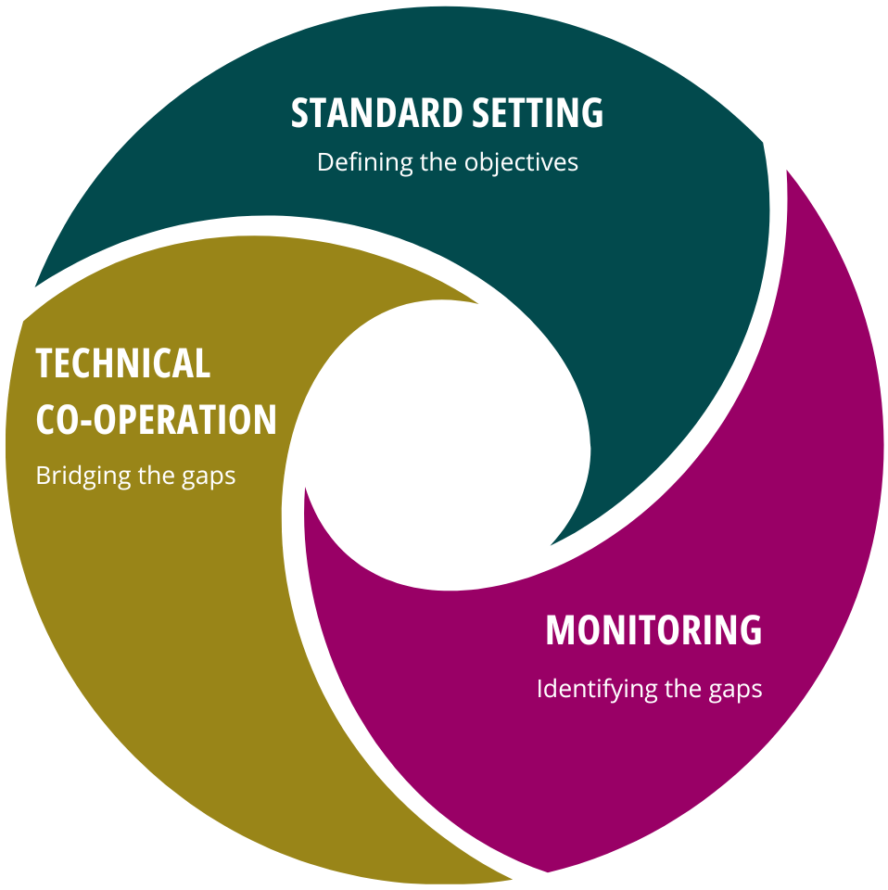
Children’s rights at the Council of Europe
Steering Committee for the Rights of the Child (CDENF) – Standard-setting
Committee of parties to Convention on the Protection of Children against Sexual Exploitation and Sexual Abuse (Lanzarote Committee) – Monitoring
Co-operation projects – Technical co-operation
Notes:
Work on children’s rights in the Council of Europe is led by the Children’s Rights Division, under the Programme launched in 2006 “Building a Europe for and with children”.
And how exactly are actions developed? The Children’s Rights Division works following the dynamic of the Council of Europe strategic triangle, which includes:
Setting standards, legally and non-legally binding, shaping states policies and legislation;
Monitoring the implementation of Conventions and the non-binding standards; and
Co-operation activities
Explain the strategic triangle

Slide 3
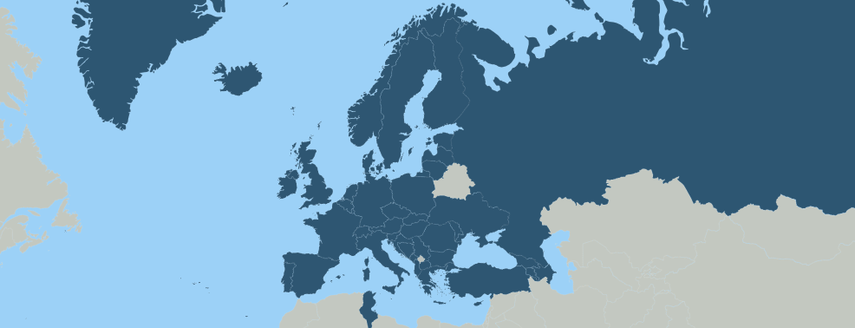
Convention on the Protection of Children against Sexual Exploitation and Sexual Abuse (Lanzarote Convention)
2007
opened for signature
2010
entry into force
2025
currently 48 State parties
The most holistic international treaty for the protection of children against sexual exploitation and sexual abuse
Simultaneous monitoring of the implementation of the Convention in all State parties in thematic monitoring rounds by the Committee of the Parties (Lanzarote Committee)
Link to the Convention on the Protection of Children against Sexual Exploitation and Sexual Abuse

Slide 4
Update on recent activities
Threats and opportunities of emerging technologies (Lanzarote Committee):
Capacity-building event on emerging technologies, Vienna, 5 November 2024
Background paper by Victoria Baines
Declaration on protecting children against sexual exploitation and sexual abuse facilitated by emerging technologies
INHOPE Global CSAM Legislative Overview
Children’s rights and artificial intelligence (Steering Committee for the Rights of the Child):
Mapping study on the rights of the child and artificial intelligence
Development of child rights impact assessment tool on AI, complementing Council of Europe HUDEIRA guidance for Parties of the Framework Convention on AI
www.coe.int/children
children@coe.int

