Slide 1
Council Working Group on child online protection Twenty-second meeting – From 12 (p.m.) to 13 February 2025
Document CWG-COP-20/INF/4
31 January 2025
English only
Report by Eng. Hoda Dahroug
Ministry of Communication and Information Technology (MCIT) Egypt
Digital Citizenship Initiative: A model of best practices for child online protection efforts in Egypt

Slide 2
"Digital Citizenship Initiative: A model of best practices for child online protection efforts in Egypt"
A case study of national efforts of MCIT for enhancing E-safety for children online
30 December 2024
Notes:
Ladies and gentlemen,
Good morning, good afternoon, and good evening…
I am deeply honored to participate in the Group work for Child Online Protection, a promising platform that drives innovation, while ensuring “Online Safety” for all, including our kids, the potential drivers of sustainability.
While the digital age brings us incredible opportunities, it poses risks, particularly when it comes to protecting our children.
As an ICT sector, we are entrusted with the responsibility of fostering e-citizenship while addressing its challenges head-on.
Before we delve into the details of our initiative on Childe Online Protection and Digital Citizenship, let us, first, take a moment to briefly review Egypt's ICT strategy.

Slide 3
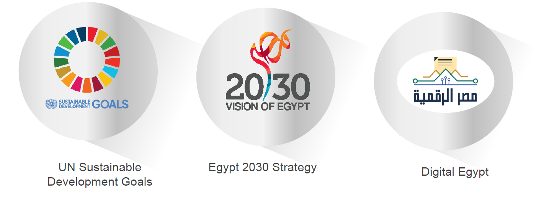
Egypt ICT Strategy
Notes:
With unwavering determination, Egypt has been fully embracing the United Nations' Sustainable Development Goals (SDGs).
Such commitment was reflected in its “2030 Vision” – a visionary blueprint that transcends dreams and transforms them into concrete actions. This comprehensive strategy is not limited to just political and economic dimensions; it delves into the very fabric of Egyptian society, ensuring progress and inclusivity for all.
At the very core of this transformative journey lies the Digital Egypt initiative, a powerful force propelling the nation towards unparalleled innovation. Leading this charge to the future is the Ministry of Communications and Information Technology, with its 3 cross-cutting goals.
On an economic front, the ministry’s goal is not confined to boosting the ICT’s contribution to the GDP, but also attract an influx of hard currencies.
Yet, the ministry's vision goes beyond mere economic gains. It seeks to swiftly introduce and integrate cutting-edge technologies across diverse sectors, ranging from digitizing governmental services to empowering and uplifting the most vulnerable strata of society.
Strategically, the ministry aspires to solidify Egypt's position on the global stage of interconnectivity in an ever-evolving landscape of AI and digital transformation.
But before we delve into the details of our initiatives related to child online protection, let’s take a quick moment to highlight the main pillars and enablers of the MCIT strategy.

Slide 4
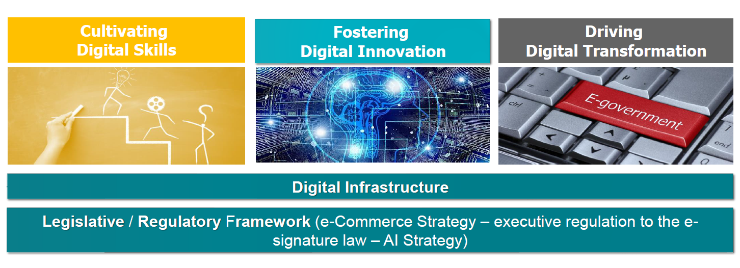
Egypt ICT Strategy
Notes:
At the heart of such strategy, lies three main pillars:
-First.. Digital Transformation.. by digitizing the governmental operations, … all
of them, … to better serve our citizens
-Second ..Capacity Building of all society segments.. from women and Persons
with Disabilities.. to those living in underserved communities…
-The third and most important… is Digital Innovation.. MCIT seeks to build and
foster an ecosystem that encourages entrepreneurship and spurs creativity..
These three pillars are based on two enablers.. first and foremost is our increasing
investment in the ICT infrastructure… second is our efforts to ensure that Egyptian
legislation are conductive to digitization and innovation.

Slide 5
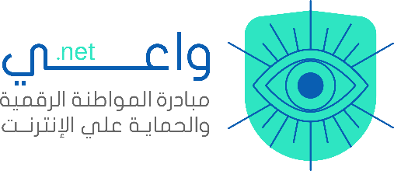
Digital citizenship initiative strategic goals
Raise
Access
Raising community awareness across all groups about electronic risks, support mechanisms, protection methods, and how to access them
Providing specialized knowledge on digital citizenship, electronic risks, and the culture of safe usage
Citizen
Aware
Develop
Build
Developing local and international partnerships to exchange and adopt successful experiences and expertise
Building capacities in using digital citizenship skills, understanding digital risks, and protection mechanisms
Digital
Secure

Slide 6
Goals & objectives
Increase
Build
Enhance
Strengthen
Access to specialized knowledge and valid content on digital citizenship concepts, skills and successful models.
capacity of Egyptian citizens to use digital citizenship skills through specialized training and online counseling support services.
awareness of local communities with digital hazards and increase citizen knowledge with cyber security techniques, and available channels of protection and support.
local and international partnerships to exchange experiences and build successful experiences
Notes:
The initiative tackles its mission head-on, with a set of four mighty goals that will shape the future of digital citizenship.
First, it seeks to increase access to specialized information in the realm of e-citizenship, as well as the best practices of our neighboring countries, all in Arabic.
But knowledge without the right tools is not enough. Hence, the second goal of the initiative takes center stage, focusing on building the capacities of tutors and trainers. To ensure that such knowledge is transferred to future generations, the initiative employs its networking prowess, collaborating with local organizations and youth centers. Together, they form an unstoppable force, paving the way for long-term success.
Of course, embracing the digital realm comes with its set of challenges. This is where the third goal stands. It is determined to keep everyone safe online, ensuring a secure digital future.
But achieving these goals require more partnerships. It recognizes the power of partnerships. From teaming up with UNICEF to develop a curriculum on online safety for children, to cooperating with the ministries of social solidarity, education, and youth and sports – the initiative knows that true success lies in collaboration.

Slide 7
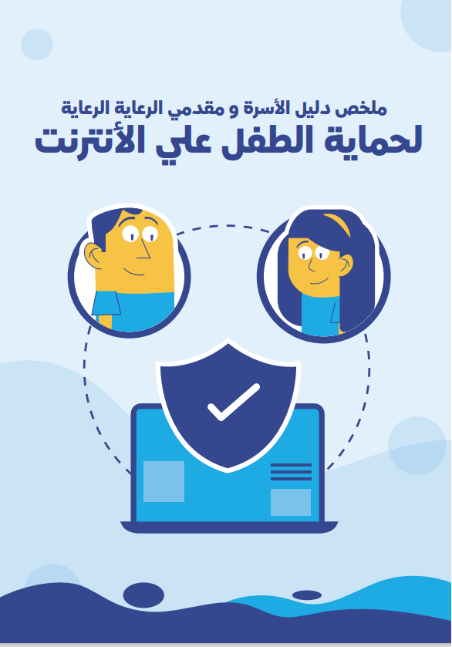
Specialized content on digital citizenship skills
Wa3i.net is a community knowledge platform that provides specialized content and knowledge in Arabic (articles, comics, videos, interactive games)
It contains five sections for target groups (children, adolescents, teachers, women, and parents)
It includes 25 short articles, 4 guidebooks, and 3 interactive activity packages on internet safety and protection skills.
It offers remote training services or webinars, as well as the option to attend in-person training sessions
The children's section offers interactive content such as activities, games, as well as drawings and emojis.
The guidelines were developed in collaboration with UNICEF and the National Council for Childhood and Motherhood.

Slide 8
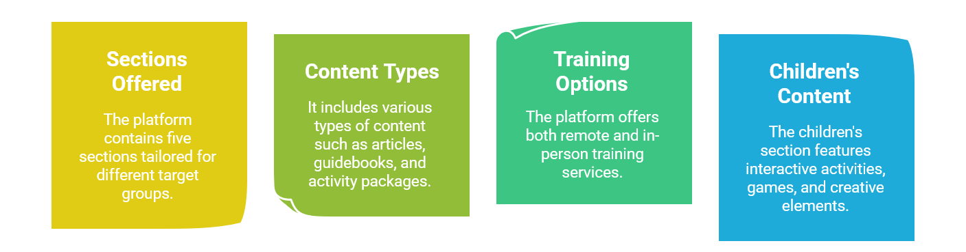
Wa3i.net Content and Services

Slide 9
Different interventions for digital citizenship initiative
Total number of beneficiaries: 3 000
Geographical coverage: 7 governorates

Slide 10
Specialized building capacities programs digital citizenship skills
TOT on digital citizenship skills
12 TOT rounds with a total of 528 trainer
TOT on internet safety and digital threats
8 TOT rounds with a total of 200 trainer and teacher
Interactive training through workshops
14 workshops with a total of 573 children and adolescents

Slide 11
Raising community awareness of digital citizenship culture
Awareness sessions based on Community needs
9 Awareness sessions with a total of 663 of youths, parents and teachers
Safer Internet Day Celebrations/events
3 events with a total of 400 youths
Awareness through webinars and social media
5 online awareness campaigns targeted a total of 500 beneficiary

Slide 12
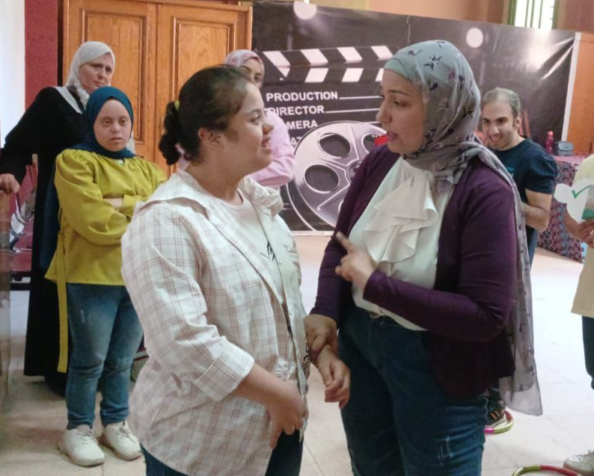
Success stories
1- Qalyubia
Mona Abu Taleb: Trainer at Egypt Public Library in Banha, completed the Training of Trainers (ToT) program under the Digital Citizenship Initiative.
Skills acquired: Developed expertise in identifying online threats and implementing digital safety measures.
Training impact: Led a summer digital safety initiative with nine workshops, two ToT sessions, and two awareness sessions, benefiting 430 participants.
Maximized knowledge impact: Engaged actively with local communities to ensure effective knowledge transfer to children, teenagers, and educators across Qalyubia Governorate.

Slide 13
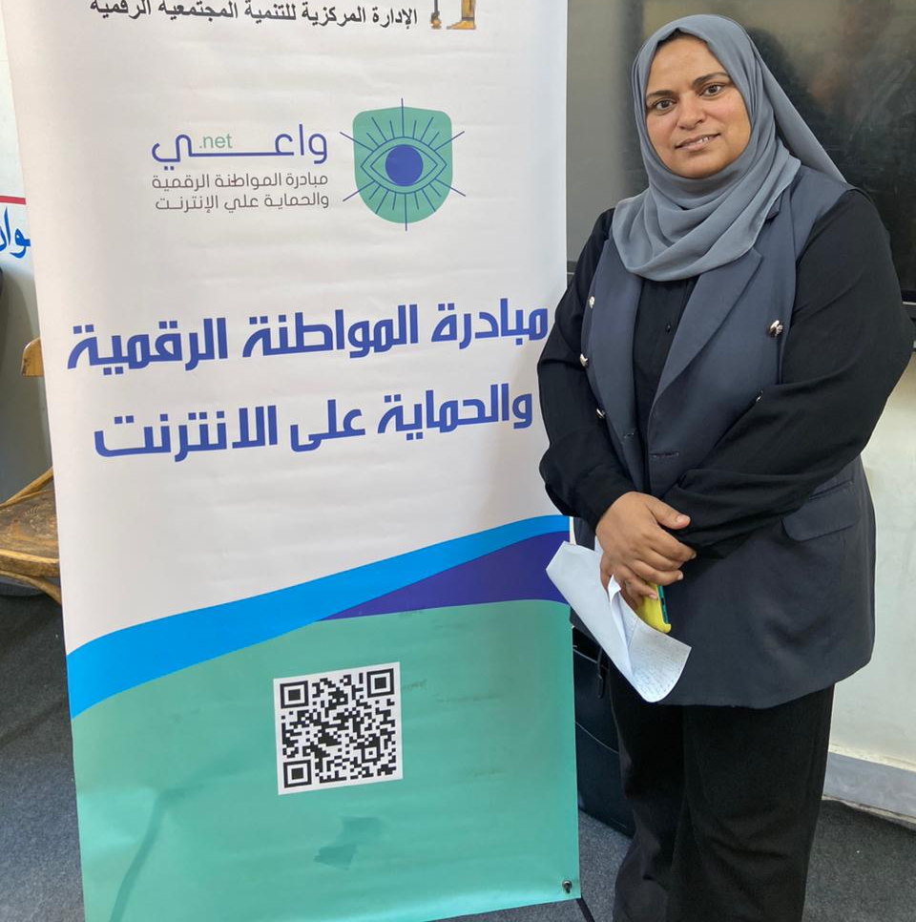
Success stories
2- Aswan
Asmaa: Dedicated teacher from Aswan who completed the Training of Trainers (ToT) program under the Digital Citizenship Initiative.
Skills developed: Learned to recognize online risks and apply digital safety strategies.
Training impact: Successfully trained 60 computer teachers in Aswan, enhancing their skills in promoting digital safety.
Maximized knowledge impact: Implemented ongoing support and follow-up sessions for trained teachers to ensure sustained application of digital safety practices in their classrooms.

Slide 14
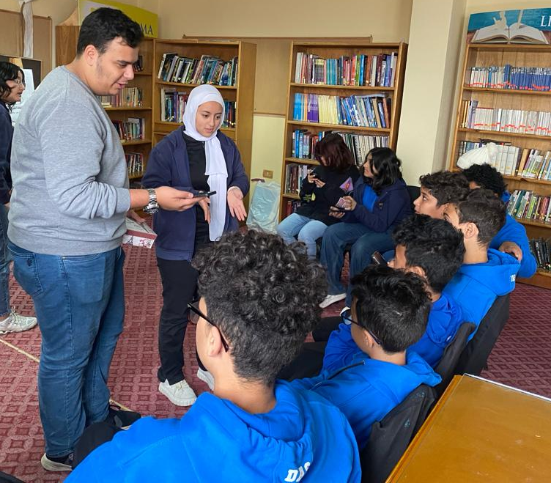
Success Stories
3- Daqahliyah
Initiative: A group of senior students in Mansoura promoted digital citizenship and online safety through a peer-to-peer training program.
Training Accomplished: After specialized training, they learned about digital threats, safe internet practices, and developed presentation and soft skills.
Training Impact: 25 senior students educated 38 younger peers, fostering a culture of responsible internet use and digital awareness.
Maximized knowledge Impact: The senior students employed engaging teaching methods and relatable examples to ensure their peers understood and embraced digital safety principles in everyday online interactions.

Slide 15
Summer training program for children and adolescents Egypt Public Library in Banha
Library trainers received TOT and interactive training and were able to execute a summer training program which included 4 training rounds for youth centers trainers, 11 interactive workshops for kids and adolescents and an awareness session for parents with a total of 300 beneficiaries

Slide 16
Teachers – In Aswan
Computer teachers in Aswan Governorate received ToT on digital citizenship skills and online protection. Teacher Asma Hilal, in collaboration with the Directorate of Education, conducted training for 100 teachers from the activities and computer teachers in Aswan Governorate.

Slide 17
ToT for teachers and trainers
Listing 03
Green marketing is a practice whereby companies seek go
Green marketing is a practice whereby companies seek go

Slide 18
Thank you
Eng. Hoda Dahroug
Advisor to the CIT Minister for Digital Community Development
Regional Manager of the Digital Transformation for Sustainable Development in Egypt project (UNDP-MCIT)
hdahroug@mcit.gov.eg
Notes:
Ladies and gentlemen,
As I bring this lengthy, yet hopefully useful presentation to a close, it is important to highlight that our children hold the key to unlocking promising future.
It is our shared responsibility to nurture their growth and protect them from an increasingly dangerous digital world.
Today, we have witnessed Egypt's unwavering dedication in creating a secure and empowering digital environment for our young ones. However, we should not stop there, we have a long journey ahead! let us march forward with a shared vision, ensuring that every child can develop and flourish in the digital landscape that lies ahead.
Thank you for listening!

