Slide 1

Council Working Group
on Child Online Protection
Twentieth meeting - From 22 to 23 January 2024
Document CWG-COP-20/INF/24
19 January 2024
English Only
Contribution from euCONSENT
MAKING THE INTERNET AGE-AWARE
Purpose
To summarise the latest legislation requiring online age assurance, international standards, methods and the interoperability being deployed by euCONSENT in partnership with the UN Safe Online initiative.
Action required
This report is transmitted to the Council Working Group on Child Online Protection for information.
References
ISO 27566; IEEE P2090; IEEE P2089.1

Slide 2

Making the Internet age-aware:
What we’ll cover
What is age assurance?
Legislative drivers
How does it work?
Methods, accuracy and the state of the art
International standards, measurement, audit and certification
Reusability and Interoperability – euCONSENT / AgeAware.net
Discussion: Should New Zealand makes its Internet age-aware?

Slide 3




What is Age Assurance?
Age Assurance is the ability to prove your age or age-range online without disclosing your full identity
It includes both Age Estimation and Age Verification
These are defined in ISO 27566 (working draft 2.0) as:
Photo by scion_cho on Foter

Slide 4
There are a wide range of legislative drivers for age assurance
Sale of age-restricted goods and services | Vaping, alcohol
Processing children’s data | GDPR Social media laws in US states
Advertising age-restricted products | Digital Services Act profiling of children ban High-Fat, Salt and Sugar; Gambling
Wider harms protection | Content (Adult) Contact (talking with strangers) Conduct (Bullying, Harassment) Contract (Lootboxes, Skins)

Slide 5

Global Regulations Are tightening
Canada
Bill S-210 to restrict young persons' online access to sexually explicit material
UK
Audio-Visual Media Services Directive
GDPR
Online Safety Act
China
Tencent apply age / ID checks
Ireland
Fundamentals for Child Oriented Approach to Data Processing
USA
COPPA 2.0
Kids Online Safety Act
EU
Audio-Visual Media Services Directive
GDPR
Digital Services Act
Code of Practice on Age=-Appropriate Design
Singapore
Online Safety Act
California
Age Appropriate Design Bill
Germany – KJM
France – Arcom
Italy – Bill
Poland - Bill
Cyprus – CRTA
Spain - AEPD
India
Digital Personal Data Protection Act, 2023
Philippines
Senate Bill 2009
Indonesia
Electronic Information & Transactions Law 2023
Australia
eSafety AV Roadmap
Class 2 Codes of Conduct
South Africa
Film & Publication Act
New Zealand
Content Regulation Review

Slide 6

Tipping point…
We have reached the tipping point where the majority of information society services are required to ask users to provide an indication of their age before being able to give them access to their content in a compliant manner.

Slide 7

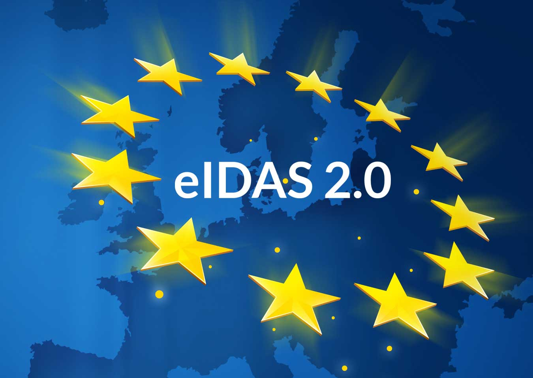


The options
Each site conducts its own age assurance
  The new cookie pop-up (but on steroids)
Government digital ID e.g. EU Digital Identity Wallet
  Surveillance concerns
  Negative impact on user experience of current and planned digital ID wallets
Major global platforms
  Competition concerns
  Marking their own homework
  Liability issues
A competitive interoperable network of third-party age assurance providers - euCONSENT

Slide 8
How does age assurance work
To protect identity, the independent age verification providers were created to act as a trusted intermediary:
Data protection laws (e.g. GDPR) or specific legislation (e.g. new US state laws) prevent the retention, re-use or mis-application of personal data obtained for the purpose of age assurance.
Source of age / Id data
AGE ASSURANCE PROVIDER
RELYING PARTY

Slide 9
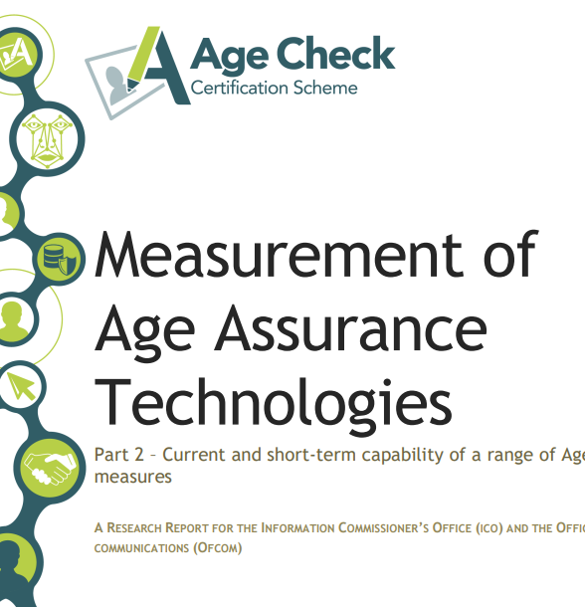
Methods, accuracy and the state of the art
In 2022, the Age Check Certification Scheme was commissioned by UK Information Commissioner’s Office (ICO) to produce a technical study about the measurement of age assurance technologies. (Source)
ICO & Ofcom commissioned ‘Part 2’ – measuring the effectiveness and/or accuracy of age assurance systems across different services in 2023
  Part 2 focused on accuracy and was developed in context of the current ‘state-of-the-art’ of age assurance measures.
Last week the ICO updated its statutory opinion on age assurance.

Slide 10
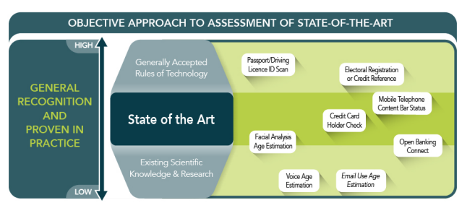
There are a range of methods of age assurance, at different stages of maturity

Slide 11
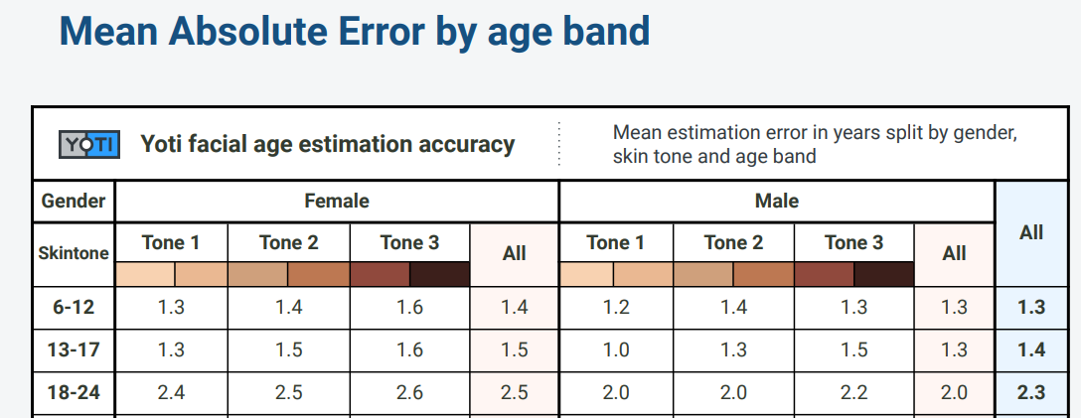
Consumers prefer facial age estimation, which is increasingly accurate and shows minimal bias at key ages
Source: https://www.yoti.com/blog/yoti-age-estimation-white-paper/

Slide 12

International standards facilitate co-regulation through audit and certification
Clarity and consistency from regulators
  144 US state bills requiring age assurance!
Effective procurement or specifications
Measurement of accuracy
Interoperability
Efficiency – lowers cost to digital services and ultimately consumers

Slide 13

International Standards
BSI PAS 1296:2018
  APPROVED AND IN USE
IEEE 2089.1 Best practice process
  OUT FOR BALLOT
ISO 27566
  Framework Working Draft 2.0
  In development
    Part 2 – Measurement
    Part 3 - Interoperability

Slide 14
Indicators of Confidence
BASIC
STANDARD
ENHANCED
STRICT
Multi-Factor Checks or High Accuracy Single Factor
ID Validation
Liveness Detection
Presentation Attack
Simple Age Verification
Online Age Check Systems
Active Age Estimation
ASSERTED
Self Declaration
Passive AI & Contra Indicators
Self Declaration
90%+
99%+
99.9%+
99.99%+
ACCURACY
SECONDARY METRICS
Could include: MAE = Mean Absolute Error; SD = Standard Deviation; FPR = False Positive Rate; FNR = False Negative Rate; PPV = Positive Prediction Value; OEP = Outcome Error Parity; and links to age of interest/buffer age

Slide 15
Age Verification Standards Development Timetable
CD Ballot Comments and Draft International Standard (DIS) Development
October 2024
DIS Translation Period (8 Weeks)
October 2024 – December 2024
DIS Ballot (12 Weeks)
December 2024 – March 2025
DIS Ballot Comments and FDIS Development
(April 2025)
FDIS Ballot (8 Weeks)
April 2025 – May 2025
PUBLICATION MAY 2025

Slide 16

Reusability and Interoperability

Slide 17


Began as a Pilot Project initiated by the European Parliament, then funded by the European Commission from 2021-2022 with just €1.4m
Now being continued with United Nations funding, through the Safe Online initiative hosted by UNICEF.
Designed to create a platform for interoperable (re-usable) online age checks and a mechanism for parental consent
Primarily to address Digital Services Act, GDPR and Audio-Visual Media Services Directive
Delivered by a multinational consortium of AV providers, auditors, eIDAS nodes, and academics
The consortium formed a new non-profit NGO based in Belgium, to which all intellectual property was donated.

Slide 18
The members of the NGO, euCONSENT ASBL were drawn from those originally involved
Academics & Researchers
Abhilash Nair
Exeter University, UK
Professor Sonia Livingstone
London School of Economics, UK
Professor Simone van der Hof
University of Leiden, Netherlands
Audit
Age Check Certification Scheme
Legal
The New Paradigm
Technology
Upcominds, Greece
JusProg, Germany
AgeChecked, UK
Yoti, UK
AGEify, Cyprus
VerifyMyAge
Communications and Engagement
Lisal Experts, Romania
Age Verification Providers Association
Onno Hansen-Staszyński
John Carr OBE

Slide 19
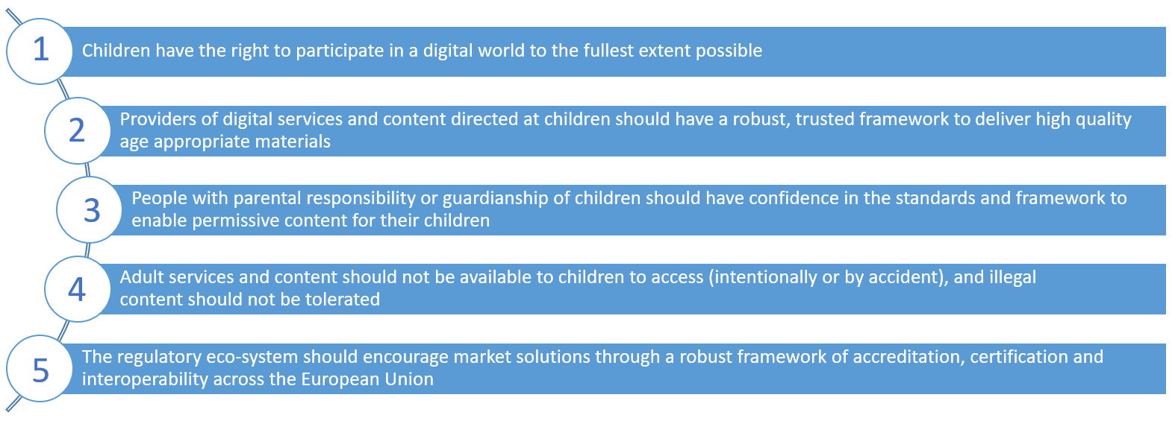
The project began with principles before consulting children and only then designing the technical solution

Slide 20

There is a Project Advisory Board with key stakeholders from civil society, regulators and industry

Slide 21





euCONSENT is not an age assurance provider itself but instead it is a network, mirroring eIDAS, the European digital ID scheme
Website A
AV Provider a
User A
Website B
AV Provider b
User A

Slide 22

euCONSENT is not an age assurance provider itself but instead it is a tokenised network, mirroring European digital ID scheme (eIDAS)
Website A
AV Provider a
User A
Website B
AV Provider b
User A

Slide 23
Phase 1 delivered a successful wide-scale pilot which proved the concept
Five countries: Belgium, Cyprus, Germany, Greece and the UK
1.600 users in total (400 each from Belgium, Germany, UK and Greece/Cyprus)
Three user categories: Adults, children over the digital age of consent, children under the digital age of consent (with their parents)
Three AV providers (AgeChecked, AGEify, Yoti) and two PC providers (JustProg, UpcomPC)
Five dummy websites in four languages
First Pilot - Mission completion rates: 80% two missions – 61% three missions
  Reported user problems were unrelated to the interoperability functionality
    The UX aspect of the solutions needs to be improved
    Some flaws in the design of the missions
    Some minor bugs to the AV/PC nodes, which appeared under specific conditions
Second Pilot - Mission completion rate: 86% two missions
  Less negative feedback on the user experience
  Minor bugs did not recur

Slide 24
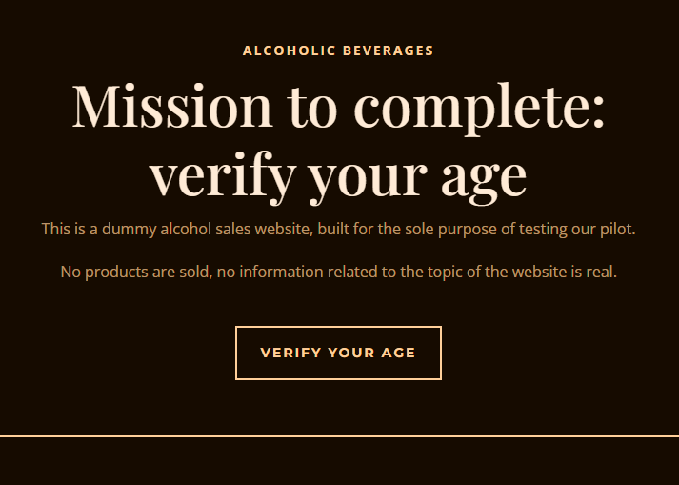

Slide 25
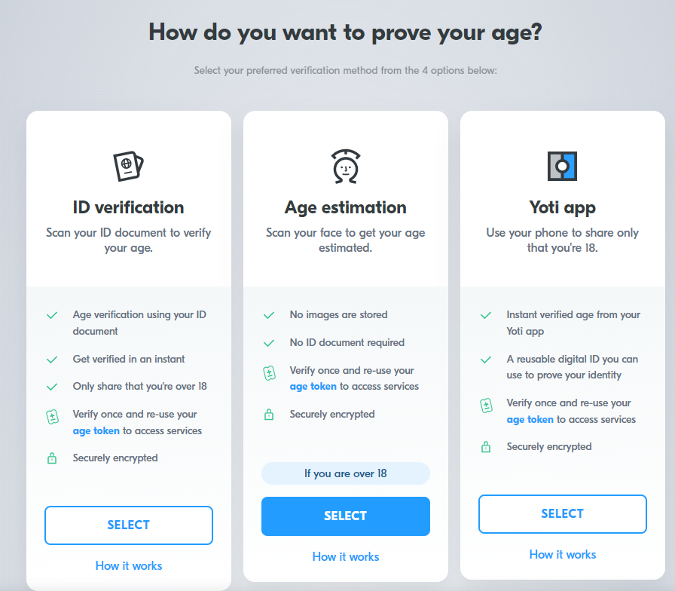
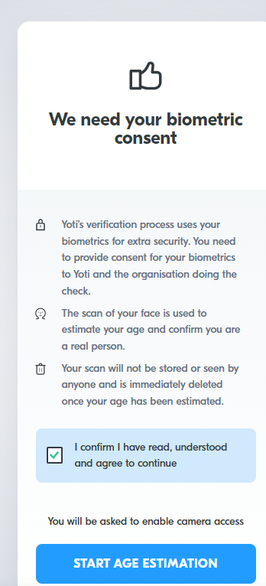

Slide 26
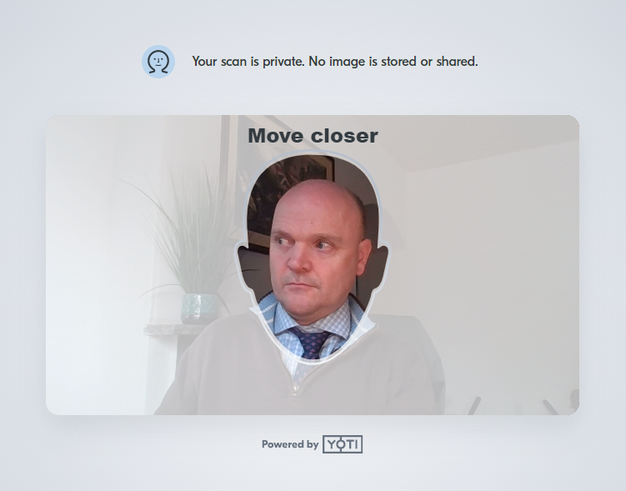
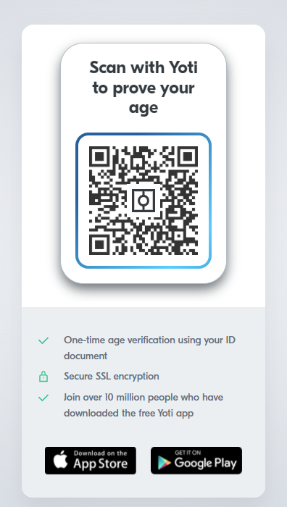
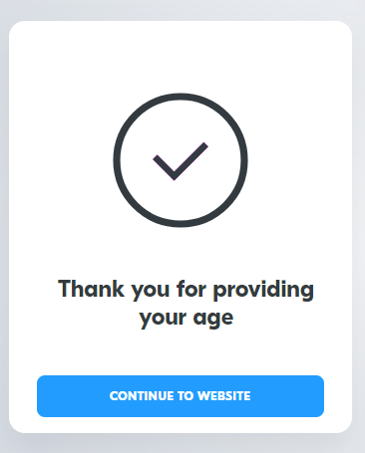

Slide 27
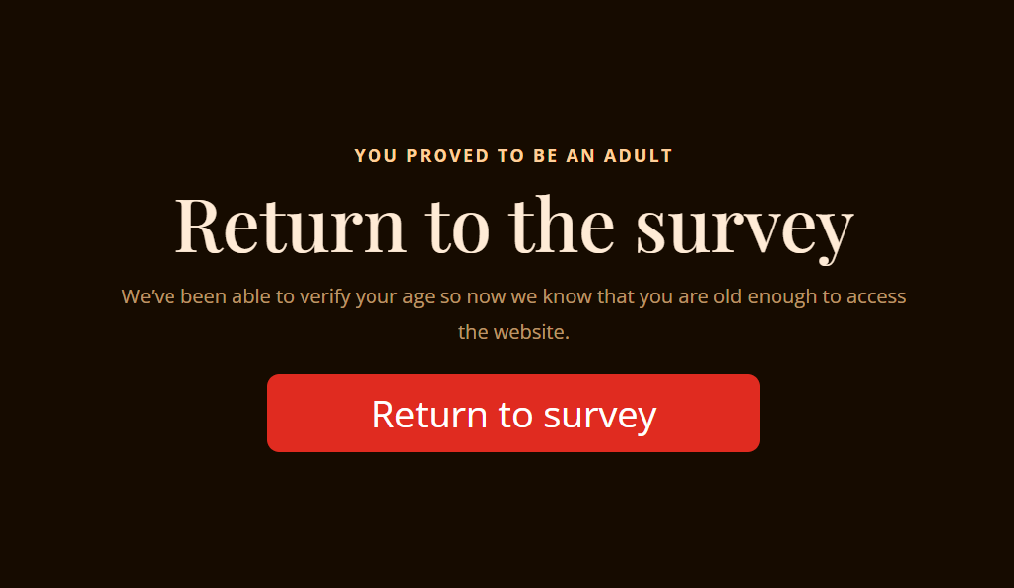

Slide 28
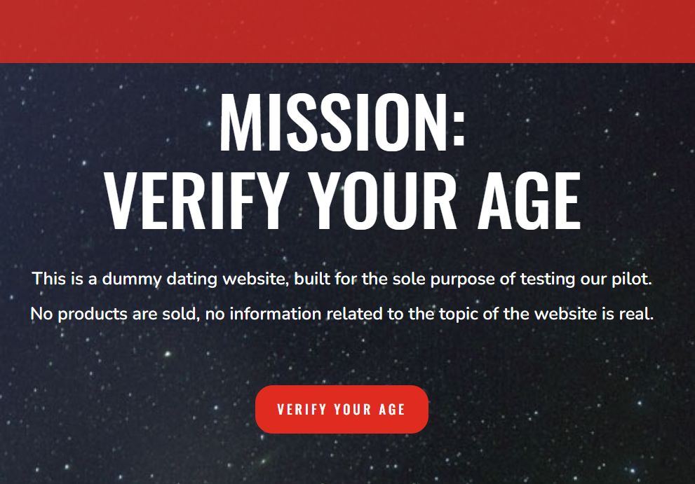


Slide 29
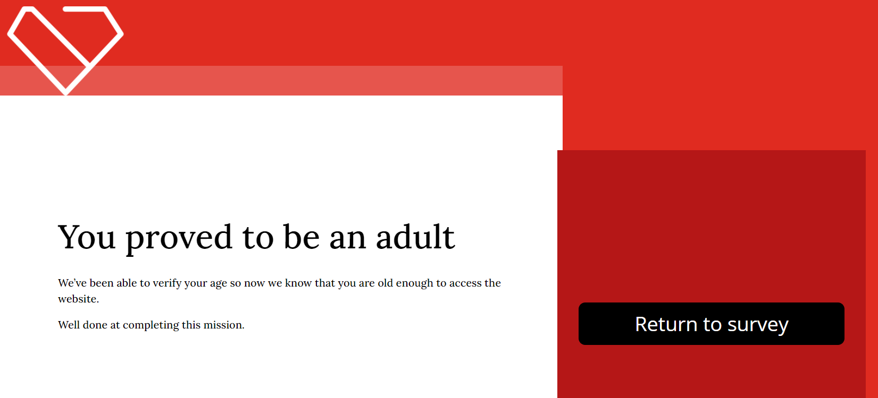

Slide 30

Parental consent
Parental consent is required before younger children may give consent for their personal data to be shared (article 8 GDPR)
The age varies by Member State, from 13 – 16, creating an additional challenge
And each data controller must be given individual consent
Hard to find authoritative registries of parents and guardians
euCONSENT enabled the re-use of these relationships once established
IEEE P2089.2 will develop an international standard for parental consent, focused on:
  Establishing the level of confidence in the relationship between parent/guardian and child
  Standardising the functionality for which parents are asked to give consent

Slide 31
The achievements and characteristics of euCONSENT
Five main achievements from Phase 1
Governance and widespread stakeholder engagement by retaining the Advisory Board
The project’s EU-endorsement, name recognition and first-mover advantage
An agreed mechanism for bringing providers together to solve the problem
A new standard and certification process to create a trust network
The software “docker” that facilitates the mechanism
The key characteristics:
  It’s a network not an age verification provider
  Common levels of assurance
  Audited and certified participants
  Anonymized, tokenized
  Minimum impact on the user experience
  Open and competitive market

Slide 32
The future of euCONSENT and age assurance
Phase 2 of the project will put the pilot into live operation, ideally with several global platforms.
  Develop certification against the new ISO and IEEE Standards
  Refine the underlying ethical principles of euCONSENT against the overall objective of conformity with the UN Rights of the Child.
  Build on the stakeholder engagement of Phase I, including a further conference
  Deepen the involvement of international organisations, national regulators,
  Extend use to apps
  Add a “double-blind” cryptographic solution based on a the French CNIL’s development work.
  Build on the integration with the current eIDAS implementation to prepare for the launch of the European Digital Identity (EUDI) wallet
Making the Internet age-aware

Slide 33


Thank You
John Carr OBE and Iain Corby
SecGen@euconsent.eu

