Slide 1
Council Working Group on Child Online Protection
Twentieth meeting - From 22 to 23 January 2024
Document CWG-COP-20/INF/22
22 January 2024
English Only
Report by Italy
Digital literacy for child protection
Purpose
The purpose of this contribution is to encourage the process of media literacy by promoting intergovernmental projects aimed at strengthening the so-called 'digital citizenship' in order to empower and stimulate young people to become 'active and responsible citizens' capable of protecting themselves from the risks of the digital world.

Slide 2
Council Working Group on Child Online Protection
Twentieth meeting - From 22 to 23 January 2024
Document CWG-COP-20/INF/22
17 January 2024
English Only
Governance of the Digitalization
Cyber Risks
Technical
Legal
Economical

Slide 3
Council Working Group on Child Online Protection
Twentieth meeting - From 22 to 23 January 2024
Document CWG-COP-20/INF/22
17 January 2024
English Only
Consciunsly and Responsibly use of technologies
Institution policies
European Commission
Digital literacy to deal with misinformation and risks

Slide 4
Council Working Group on Child Online Protection
Twentieth meeting - From 22 to 23 January 2024
Document CWG-COP-20/INF/22
17 January 2024
English Only
Minors access to age-inappropriate content
2018
EU Audiovisual Media Services Directive
Transposed in Italy by legislative decree n. 208 of November 8, 2021
Protect minors from dissemination of content that may harm their physical, mental or moral development
2022
EU Digital Service Act
EU Digital Market Act
Regulatory framework to all online digital platforms
Promote an open, safe and fair environment that acts to limit the dissemination of illegal content

Slide 5
Council Working Group on Child Online Protection
Twentieth meeting - From 22 to 23 January 2024
Document CWG-COP-20/INF/22
17 January 2024
English Only
Initiative in Italy 2023
Caivano Decree
Systems for protecting minors from the risks of cyberspace
Internet Access services providers
Parental control system
Filtering of inappropriate content
Blocking contents
establishment of a (three-year) fund for the support and promotion of educational and media and digital literacy projects
Italian Budget Law

Slide 6
Council Working Group on Child Online Protection
Twentieth meeting - From 22 to 23 January 2024
Document CWG-COP-20/INF/22
17 January 2024
English Only
Interlocutions with the gaming world and the video game industry to Encourage students to pursue careers in science, technology, engineering and math
Position paper: Gaming Challenges and Opportunities for the Diffusion of Digital Competencies
Of the Digital Transformation Department within Digital Republic
Empowering young people stimulating them toward a path to become active, responsible citizens capable of protecting themselves from the risks of the digital world

Slide 7
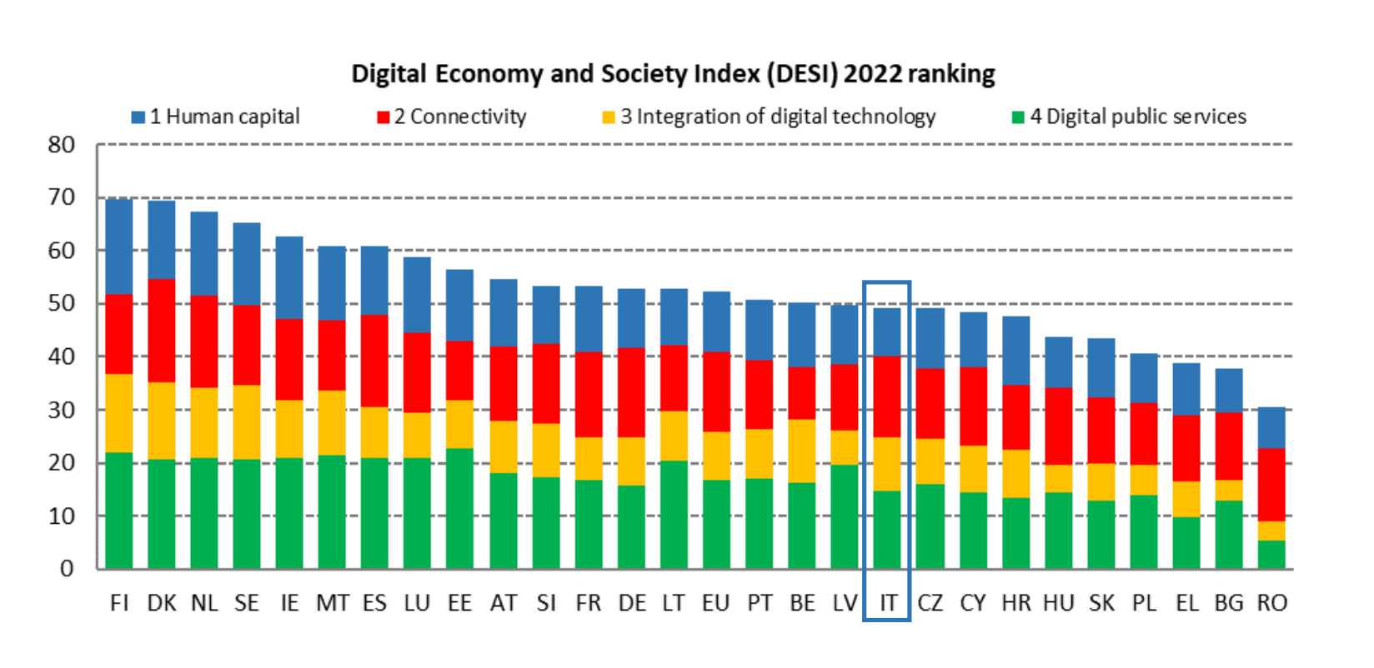
Council Working Group on Child Online Protection
Twentieth meeting - From 22 to 23 January 2024
Document CWG-COP-20/INF/22
17 January 2024
English Only
Constant increase in the last five years of Italian minors who use digital media
Despite the important progress in the Digitalization level, still has several positions to climb in the European rankings on basic digital skills
https://digital-strategy.ec.europa.eu/en/policies/desi

Slide 8
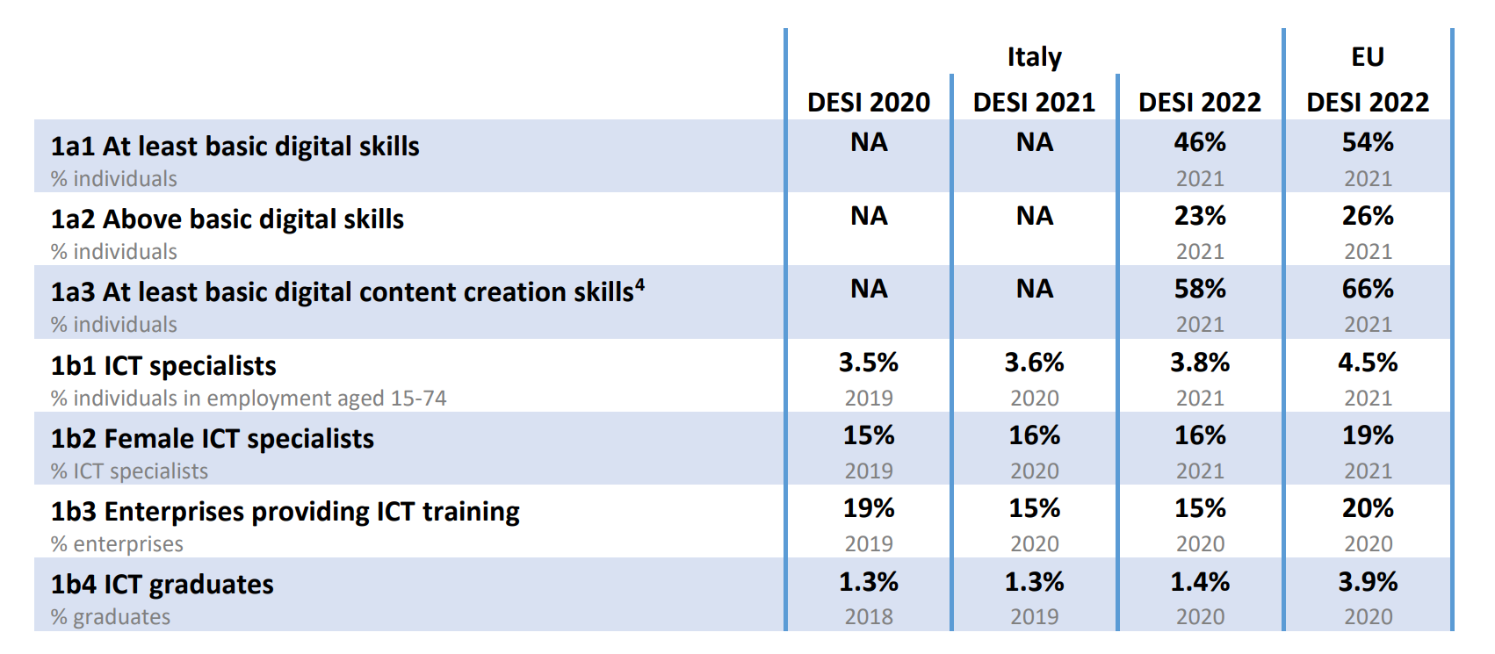
Council Working Group on Child Online Protection
Twentieth meeting - From 22 to 23 January 2024
Document CWG-COP-20/INF/22
17 January 2024
English Only
https://digital-strategy.ec.europa.eu/en/policies/desi

Slide 9
Council Working Group on Child Online Protection
Twentieth meeting - From 22 to 23 January 2024
Document CWG-COP-20/INF/22
17 January 2024
English Only
Italy has a very low percentage of graduates in Information and Communication Technologies
and in the labour market the percentage of ICT specialists is 3.8 percent of total employment
https://digital-strategy.ec.europa.eu/en/policies/desi

Slide 10
Council Working Group on Child Online Protection
Twentieth meeting - From 22 to 23 January 2024
Document CWG-COP-20/INF/22
17 January 2024
English Only
Thank you for your attention!

