Slide 1

Council Working Group
on Child Online Protection
Twentieth meeting - From 22 to 23 January 2024
Document CWG-COP-20/INF/20
16 January 2024
English Only
Contribution from UNICRI
RESPONSIBLE USE OF AI IN ONLINE CHILD ABUSE AND EXPLOITATION INVESTIGATIONS
Action required
This report is transmitted to the Council Working Group on Child Online Protection for information.

Slide 2
Responsible Use of AI in Online Child Abuse and Exploitation Investigations
20th Meeting of ITU Council Working Group on Child Online Protection
January 22-23, 2024
Inês Ferreira, Associate Programme Officer

Slide 3


UNICRI CENTRE FOR AI & ROBOTICS
A specialized UN centre established in 2017 in The Hague, the Netherlands, to advance understanding of the challenges and opportunities of AI from the perspective of justice and crime.
© Funda in Business

Slide 4

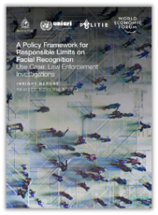

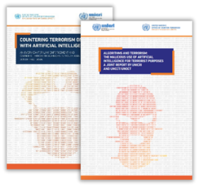

SOME OF OUR WORK
Leveraging AI in combating sexual exploitation and abuse of children
Setting up responsible limits on Facial Recognition Technology
Fostering responsible AI innovation in law enforcement
Establishing citizen trust in the responsible use of AI systems for anonymized crowd monitoring
Building knowledge on counter-terrorism in the age of AI,
Notes:
Initiative launched in 2020 with the UAE. Global Hub was launched in July 2022. Available in all UN languages.

Slide 5

Support global law enforcement in exploring the positive potential of AI tools to combat child sexual exploitation and abuse online
ADVOCACY & NETWORK-BUILDING
Convene events with law enforcement, tech providers and related actors on AI and online child sexual abuse and exploitation.
THE AI FOR SAFER CHILDREN GLOBAL HUB
Develop an online platform, designed to support law enforcement in leveraging AI to combat online child sexual exploitation and abuse.
ETHICAL AND LEGAL PROCESS
Design and implement a strategy to ensure that the initiative is developed in line with all relevant ethical and legal principles and frameworks.

Slide 6
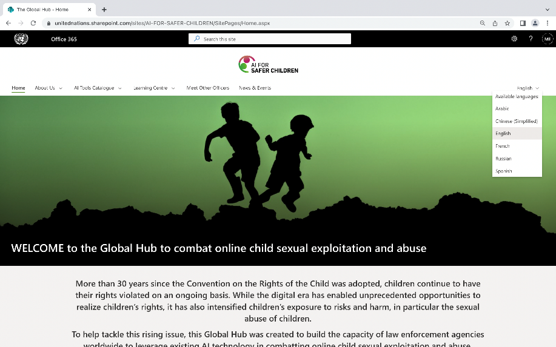
The AI for Safer Children Global Hub
Launched in July 2022, available in the six official UN languages.
Currently, 550+ investigators from 106 countries.
Catalogue with 80 AI tools.
Notes:
Initiative launched in 2020 with the UAE. Global Hub was launched in July 2022. Available in all UN languages.

Slide 7

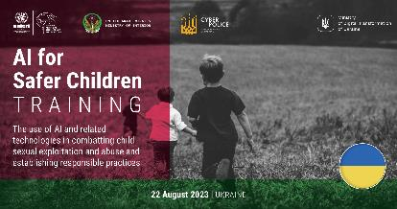





Specialized country and regional trainings
Seven trainings – both regional and specialized – were delivered in 2023
to 415 law enforcement participants from 20 countries
with more trainings coming up in 2024.
Notes:
Initiative launched in 2020 with the UAE. Global Hub was launched in July 2022. Available in all UN languages.

Slide 8





What have we learned?
The AI tools on the catalogue have helped law enforcement investigations
Cut investigation times
“After adopting a tool from the Global Hub’s catalogue, the time we spent on analyzing child abuse images and videos that used to take 1 to 2 weeks we can now do in 1 day.”
Reduce backlogs
“The AI tools I used significantly cut forensic backlogs from over 1.5 years down to 4 to 6 months - time that can make a world of difference for victims.”
Safeguard well-being
“AI tools can take measures such as automatically muting child abuse videos once it categorizes the file as such, which “minimizes the mental impact of the violence in those files.”

Slide 9






But AI systems are not perfect
Their powerful characteristics also create risks
VALUE EMBEDDING
SCALABILITY
INVISIBILITY
AUTONOMY
BLACK BOX

Slide 10

Why is it a problem? Humans are flawed too…
AI systems are often perceived as neutral and project greater authority
The law enforcement context is particularly sensitive.

Slide 11


What is the solution?
RESPONSIBLE AI INNOVATION helps identify, prevent and minimize risks and maximize the benefits of using AI systems.
RISKS
BENEFITS

Slide 12
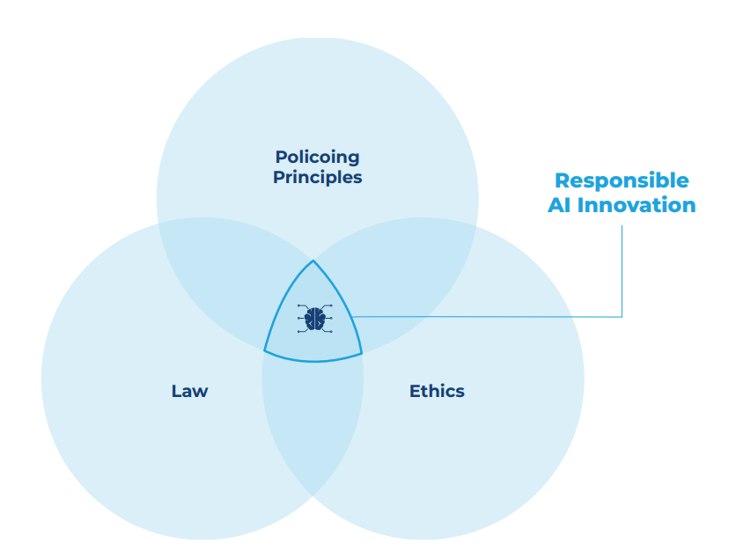

What is responsible AI innovation?
        respects the law & human rights
        minimizes any harm to people
        respects human autonomy
        promotes fairness
        is supported by good governance
SOURCE:

Slide 13
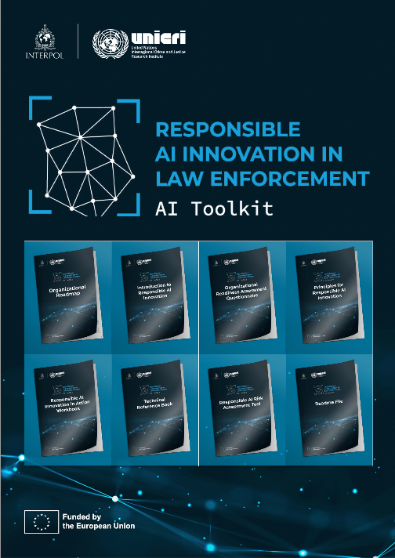
THE AI TOOLKIT
Set of seven resources tailor-made by UNICRI and INTERPOL to support law enforcement agencies to navigate the complex task of institutionalizing responsible AI and integrating AI systems into their work.
Launched by UNICRI and INTERPOL in June 2023, with EU funding. Updated web-version coming up in Feb 2024!
Notes:
Stakeholders need sector specific guidance & training.

Slide 14
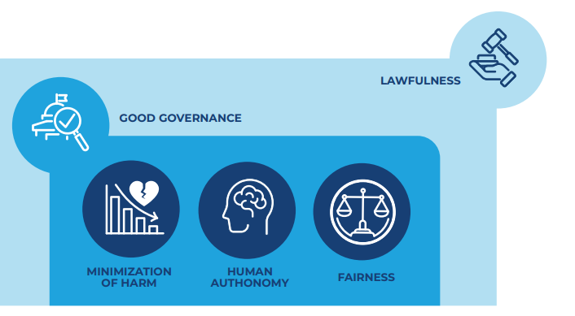
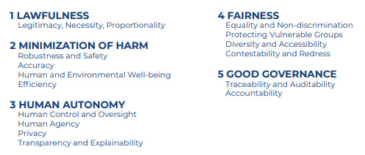
The Principles for Responsible AI Innovation
SOURCE:

Slide 15
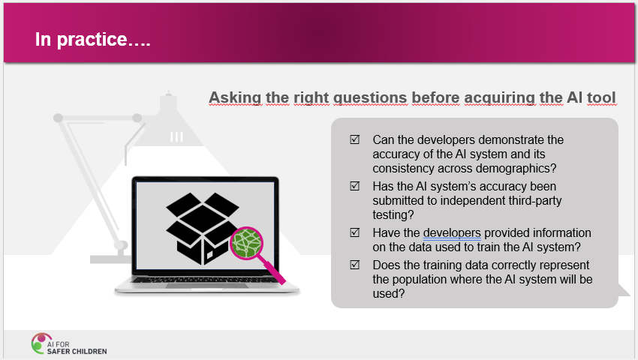
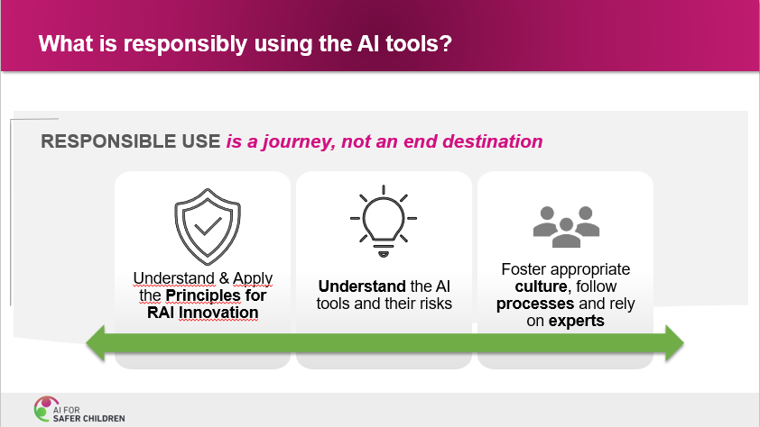
Raising awareness for responsible use in trainings
Why is the responsible use of the AI tools important? AI benefits and risks
What does it mean in practice: responsible use throughout the AI life cycle & necessary organizational components
Main take-aways: asking the right questions when acquiring tools, being thorough when using the AI tools
Notes:
Initiative launched in 2020 with the UAE. Global Hub was launched in July 2022. Available in all UN languages.

Slide 16

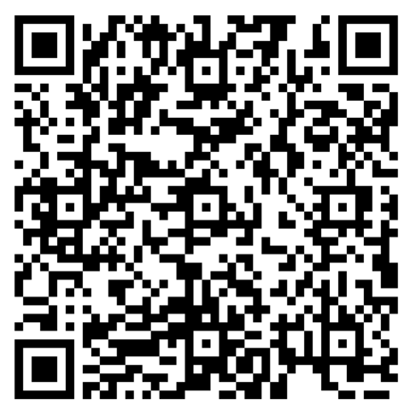


Learn more:
ACCESS THE
AI TOOLKIT
JOIN THE GLOBAL HUB
Notes:
Accuracy of the AI system consistent across demographics? What data was used to train it? Independent third-party testing? Am I confident in the AI tool’s results? Why? Do I understand how it works?

Slide 17
Thank You!
unicri.aicentre@un.org ines.goncalvesferreira@un.org

