Slide 1

Council Working Group
on Child Online Protection
Twentieth meeting - From 22 to 23 January 2024
Document CWG-COP-20/INF/19
16 January 2024
English Only
Contribution from Egypt (Arab Republic of)
ROLE OF THE DIGITAL CITIZENSHIP INITIATIVE IN ENHANCING COMMUNITY AWARENESS WITH EXISTING NATIONAL LEGAL PROTECTION FRAMEWORK FOR PROTECTING CHILDREN ONLINE
Purpose
A case Study of National Efforts of MCIT for enhancing E-safety for children online
Action required
This report is transmitted to the Council Working Group on Child Online Protection for information.

Slide 2
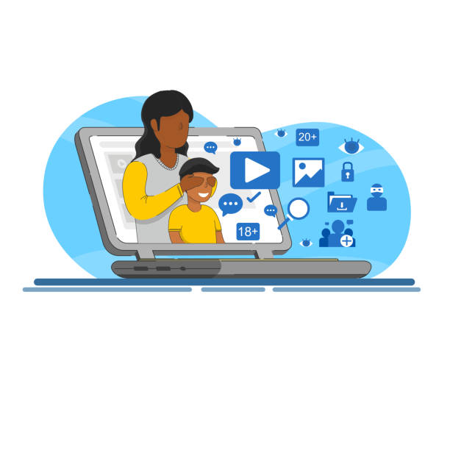
Role of the Digital Citizenship Initiative in Enghancing Community Awareness with Existing National Legal Protection Framwork for Protecting Children Online
A case Study of National Efforts of MCIT for enhancing E-safety for children online
16 Jan 2024
Notes:
Ladies and gentlemen,
Good morning, good afternoon, and good evening…
I am deeply honored to participate in the Group work for Child Online Protection, a promising platform that drives innovation, while ensuring “Online Safety” for all, including our kids, the potential drivers of sustainability.
While the digital age brings us incredible opportunities, it poses risks, particularly when it comes to protecting our children.
As an ICT sector, we are entrusted with the responsibility of fostering e-citizenship while addressing its challenges head-on.
Before we delve into the details of our initiative on Childe Online Protection and Digital Citizenship, let us, first, take a moment to briefly review Egypt's ICT strategy.

Slide 3
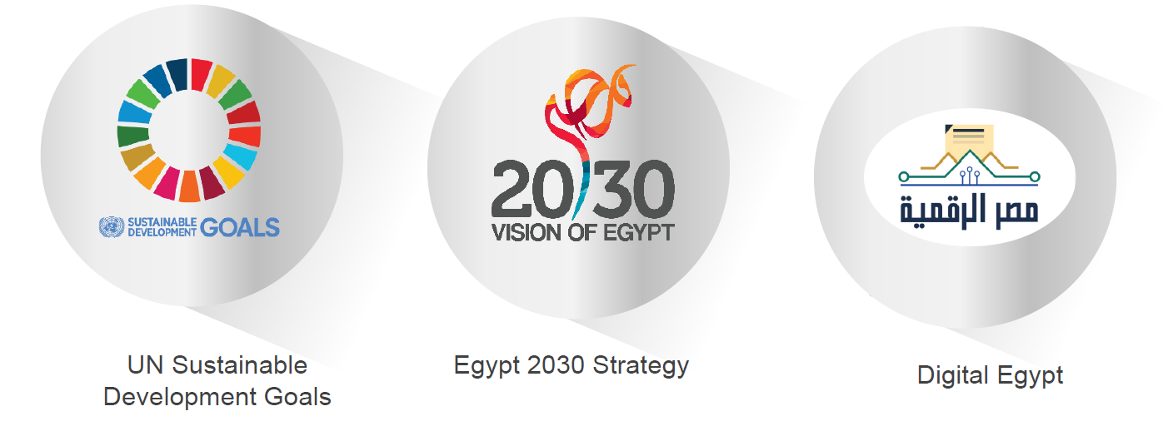
Egypt ICT Strategy
Notes:
With unwavering determination, Egypt has been fully embracing the United Nations' Sustainable Development Goals (SDGs).
Such commitment was reflected in its “2030 Vision” – a visionary blueprint that transcends dreams and transforms them into concrete actions. This comprehensive strategy is not limited to just political and economic dimensions; it delves into the very fabric of Egyptian society, ensuring progress and inclusivity for all.
At the very core of this transformative journey lies the Digital Egypt initiative, a powerful force propelling the nation towards unparalleled innovation. Leading this charge to the future is the Ministry of Communications and Information Technology, with its 3 cross-cutting goals.
On an economic front, the ministry’s goal is not confined to boosting the ICT’s contribution to the GDP, but also attract an influx of hard currencies.
Yet, the ministry's vision goes beyond mere economic gains. It seeks to swiftly introduce and integrate cutting-edge technologies across diverse sectors, ranging from digitizing governmental services to empowering and uplifting the most vulnerable strata of society.
Strategically, the ministry aspires to solidify Egypt's position on the global stage of interconnectivity in an ever-evolving landscape of AI and digital transformation.
But before we delve into the details of our initiatives related to child online protection, let’s take a quick moment to highlight the main pillars and enablers of the MCIT strategy.

Slide 4
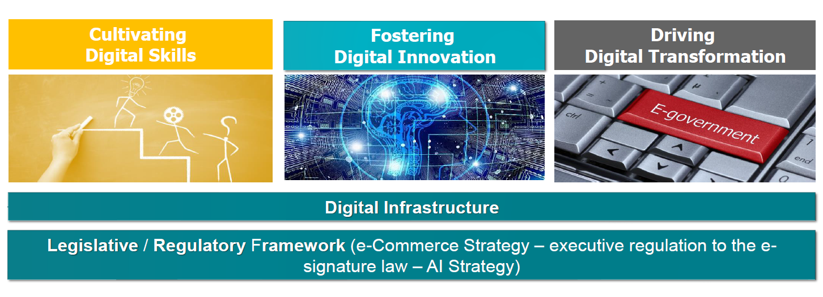
Egypt ICT Strategy
Notes:
At the heart of such strategy, lies three main pillars:
-First.. Digital Transformation.. by digitizing the governmental operations, … all
of them, … to better serve our citizens
-Second ..Capacity Building of all society segments.. from women and Persons
with Disabilities.. to those living in underserved communities…
-The third and most important… is Digital Innovation.. MCIT seeks to build and
foster an ecosystem that encourages entrepreneurship and spurs creativity..
These three pillars are based on two enablers.. first and foremost is our increasing
investment in the ICT infrastructure… second is our efforts to ensure that Egyptian
legislation are conductive to digitization and innovation.

Slide 5
Legal Framework For protecting children online in Egypt
1- Article 116-bis (a)(46) "Shall be imprisoned for a period of not less than two (2) years and a fine of not less than ten thousand (10,000) Egyptian pounds, and not exceeding fifty thousand (50,000) Egyptian pounds any one importing, or exporting, or producing, or preparing, or viewing, or printing, or promoting, or possessing, or broadcasting pornographic material using children, or related to the sexual exploitation of children. Tools and other instrumentalities used to commit these
2- crimes and proceeds derived from such offences shall be seized, and the premises used to commit such offences shall be closed for a period not less than six (6) months.

Slide 6
Legal Framework For protecting children online in Egypt
2- All the above shall be undertaken without violating the rights of those with good intentions, or publish or promote pornographic activities, or induce or exploit children to engage in prostitution or pornographic activities or defame them, or sell them.
b) anyone using a computer or internet Without prejudice to any stronger penalty prescribed in any other law, each of the following shall be subject to the same penalty:
a) anyone using a computer or internet or information networks or cartoons to prepare, or save, or process, or display, or print r information networks or cartoons to induce children to delinquency or use them in committing crimes or engage them in illegitimate activities or immoral acts, even if the crime did not occur
References :The Cabinet THE NATIONAL COUNCIL FOR CHILDHOOD AND MOTHERHOODLAW NO. 12 OF 1996 PROMULGATING THE CHILD LAWAMENDED BYLAW NO. 126 OF 2008
International Centre for Missing & Exploited Children (ICMEC) Education Portal October 2018 - Egypt
Notes:
Reference from: The CabinetTHE NATIONAL COUNCIL FOR CHILDHOOD AND MOTHERHOODLAW NO. 12 OF 1996 PROMULGATING THE CHILD LAWAMENDED BYLAW NO. 126 OF 2008

Slide 7
National Efforts for protecting children online in Egypt
Supporting introducing legislative amendments to laws and regulations related to Child online protection
Mapping existing laws and legislation regarding protection of children online and disseminate it for more community awareness
Networking with protection system representatives for improving supporting channels and reporting mechanisms
Hold multisectoral forum to enhance child protection stakeholder coordination and to engage decision and policy makers in strengthening the capacities of national protection systems and services to all forms of online violence against children.

Slide 8


Digital Citizenship and Internet Safety Initiative
National Case Study
Citizens recognize the rights, responsibilities and opportunities of living, learning, and working in an interconnected digital world, and they Vision act and model in ways that are safe, legal and ethical.
Notes:
The protection of children online is a significant matter in Egypt, addressed through an initiative known as "Nabtet Masr". This innovative project, overseen by the National Council of Childhood and Motherhood, not only encourages us to report and address child abuse through an innovative application, but also demonstrates a firm dedication to safeguarding the well-being of our children.
But the dedication doesn't stop there. The Ministry of Communications and Information Technology (MCIT) understands the immense importance of this cause and has been on a transformative journey to create an environment where our children can thrive and feel secure. Since 2007, MCIT has been at the forefront of implementing impactful programs that address the challenges of the modern era.
This e-Citizenship initiative acts as a guiding light, equipping citizens with the essential skills and tools needed to excel in the rapidly evolving digital age. However, at its core, this initiative places children as a top priority. Through engaging programs and interactive workshops, they are introduced to the limitless potential of technology. They learn to harness it as a catalyst for their personal growth and development, becoming the digital pioneers of the future, all while maintaining ethical and legal practices.

Slide 9

Goals & Objectives
Increase
Build
Enhance
Strengthen
  Access to specialized knowledge and valid content on digital citizenship concepts, skills and successful models.
  capacity of Egyptian citizens to use digital citizenship skills through specialized training and online counseling support services.
  awareness of local communities with digital hazards and increase citizen knowledge with cyber security techniques, and available channels of protection and support.
  local and international partnerships to exchange experiences and build successful experiences
Notes:
The initiative tackles its mission head-on, with a set of four mighty goals that will shape the future of digital citizenship.
First, it seeks to increase access to specialized information in the realm of e-citizenship, as well as the best practices of our neighboring countries, all in Arabic.
But knowledge without the right tools is not enough. Hence, the second goal of the initiative takes center stage, focusing on building the capacities of tutors and trainers. To ensure that such knowledge is transferred to future generations, the initiative employs its networking prowess, collaborating with local organizations and youth centers. Together, they form an unstoppable force, paving the way for long-term success.
Of course, embracing the digital realm comes with its set of challenges. This is where the third goal stands. It is determined to keep everyone safe online, ensuring a secure digital future.
But achieving these goals require more partnerships. It recognizes the power of partnerships. From teaming up with UNICEF to develop a curriculum on online safety for children, to cooperating with the ministries of social solidarity, education, and youth and sports – the initiative knows that true success lies in collaboration.

Slide 10
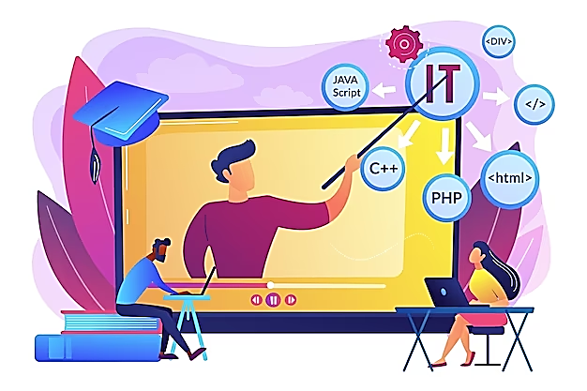
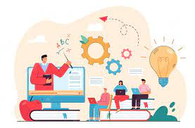
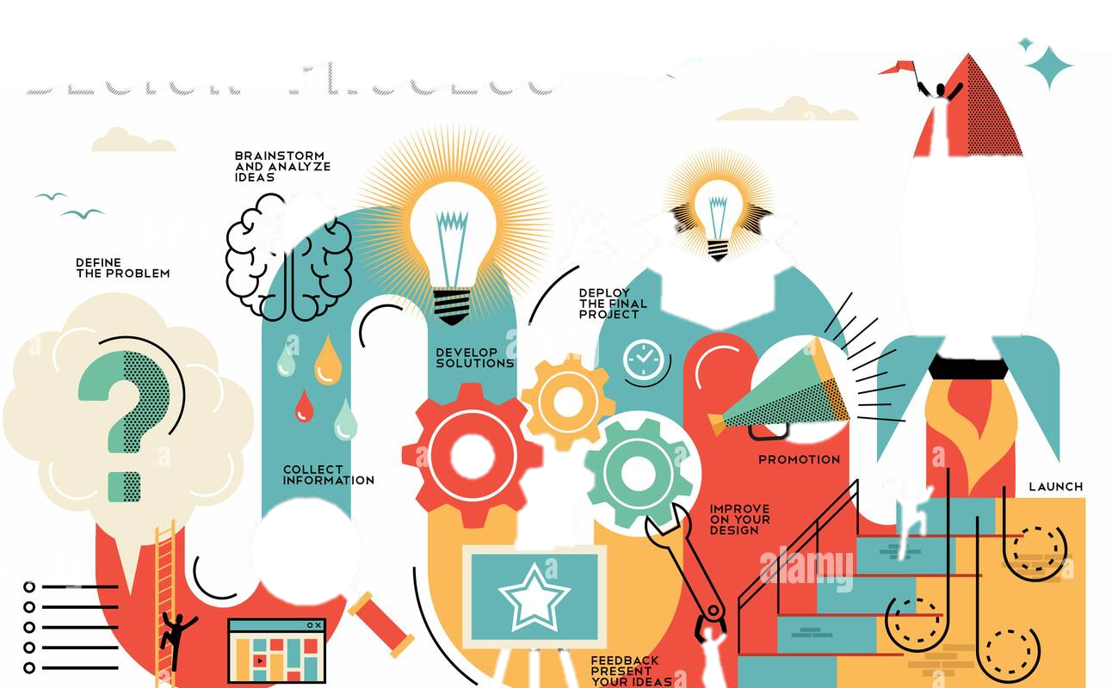
Foundational Enablers
Child – Parent – Tutor Preceptive
Arabic Specialized and Holistic Interventions
Continuous Improvements
Notes:
Realizing the centrality of dialogue in the success of initiatives, we invite children to share their dreams and aspirations, their concerns and uncertainties. We lend our ears to parents, seeking their wisdom and guidance. We collaborate with tutors, drawing upon their expertise to shape educational initiatives that cultivate digital citizenship.
To ensure accessibility, all our interactives are conducted in Arabic. We start with general training to make sure everyone understands the basics and feels like they're part of the group. Then, we go deeper into more specialized content.
Our interactive activities and training sessions are a mix of giving guidance and letting people discover things on their own. We give them the tools they need, share our knowledge, and provide a structure to follow. We empower them to take charge of their learning journey.

Slide 11
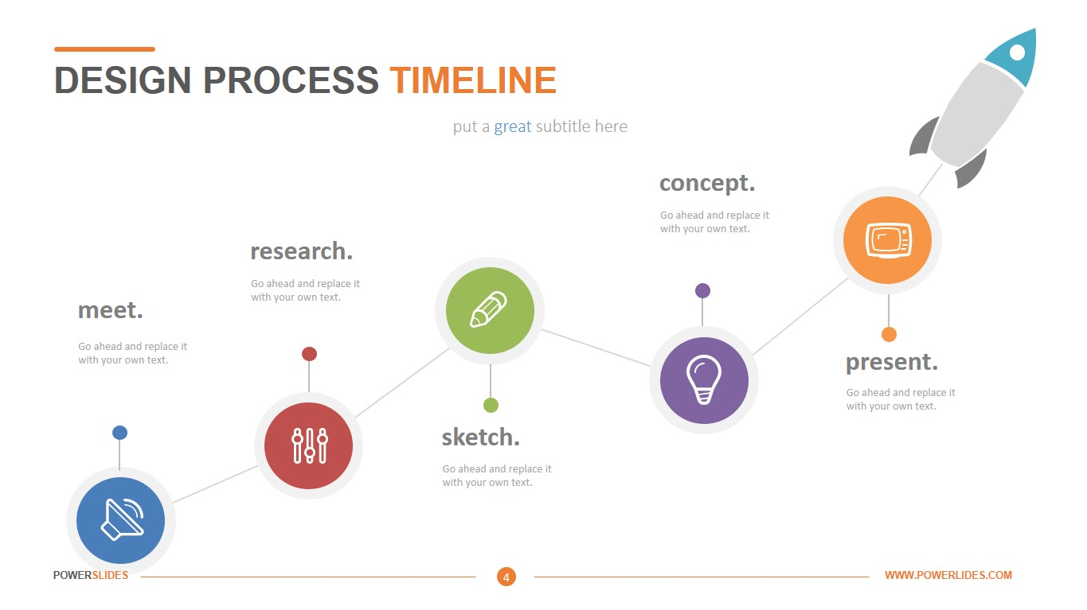



Digital Citizenship Initiative Pillars
Awareness Campaigns and Competitions
Specialized Arabic Content
Single Access Point Portal
Networking & Cooperation
Customized Capacity Trainings
Towards Enabled Digital Citizens
Notes:
The Digital Citizenship Initiative is built upon five fundamental pillars
The first pillar of this transformative vision is the "Wa3i” portal. This portal serves as a gateway for Egyptian citizens to enhance their understanding of the principles of e-citizenship. It provides accessible and comprehensive resources that enable individuals to develop a holistic vision of the skills required to thrive in the digital age.
Through the "Wa3i.net" portal, citizens have access to a wealth of specialized Arabic content, including articles, interactive sessions, and relevant circulars. This ensures that the information shared is tailored to the unique needs and cultural context of the Egyptian population, fostering a sense of inclusivity and relevance.
Recognizing the importance of continuous learning and capacity building, the third pillar of these initiatives focuses on providing regular training sessions. These sessions, conducted every three months, equip individuals with the necessary skills and knowledge to navigate the digital realm safely and responsibly.
The fourth pillar revolves around raising awareness about cyber threats and digital hazards. Through the "Wa3i" website, citizens can access valuable information, register for awareness campaigns, and stay up-to-date with the latest trends and best practices in digital security. By fostering a culture of preparedness, we empower individuals to protect themselves and their communities from the risks that come with our increasingly interconnected world.
Lastly, but certainly not least, the realization of this vision lies on the establishment of both local and international networks. Locally, strategic partnerships have been forged with the National Council for Childhood and Motherhood and the National Council for Women. Internationally, we are member in the Child Protection Committee in the ITU, where we contribute to the global decision-making process.

Slide 12

Digital Citizenship
Portal
Guidelines Customized by subjects & Age group targets pressing issues
Interactive Competitions & challenges at schools
Monthly Awareness Calendar and Webinar for teachers & parents
Best Practices & Statistics
Direct access for available support channels and help lines
Children-friendly and interactive content (videos, infographics, games)
Notes:
Our portal offers rich and culturally relevant content. We scan the best practices locally an internationally, with careful selection to fit our context.
Through our portal, you can explore upcoming awareness sessions and webinar on our monthly calendar.
Besides the support lines and guidance, we organize interactive competitions at schools to further engage our children in our initiatives. These competitions will be regularly published on our website to ensure it reaches everyone.

Slide 13
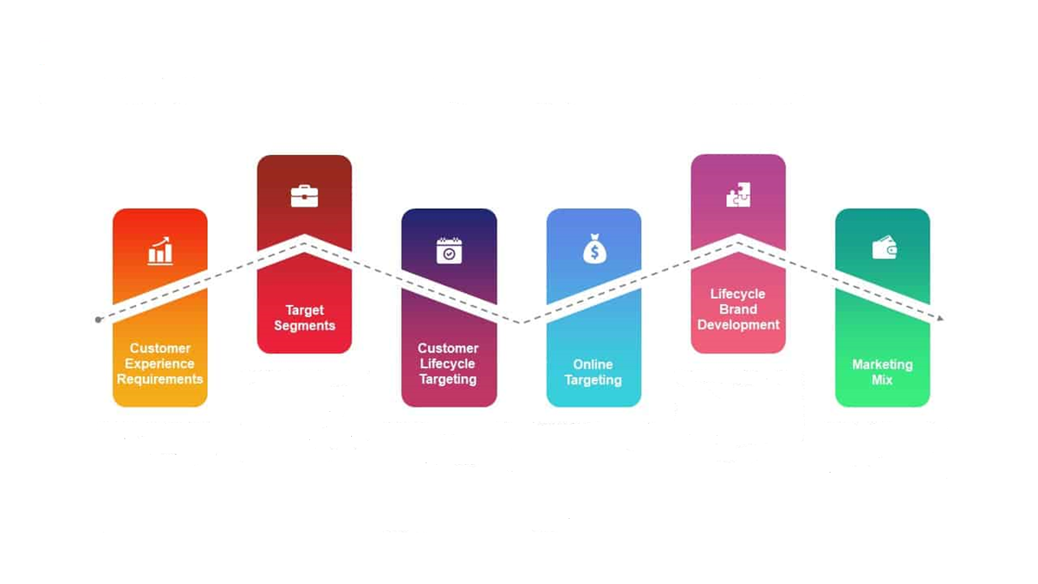




Digital Citizenship Portal
Audience Representation
Youth
Women
Caregivers
Policy Makers
Services Providers
single online portal on through which all available online safety resources and content can be accessed– and updated regularly with emerging trends.
Awareness Calendar
Best Practices
Arabic Content
Helplines & support Resources
Capacity Trainings & Webinar
Statistics & Figures
Teens
Children
Teachers
Senior Citizen

Slide 14
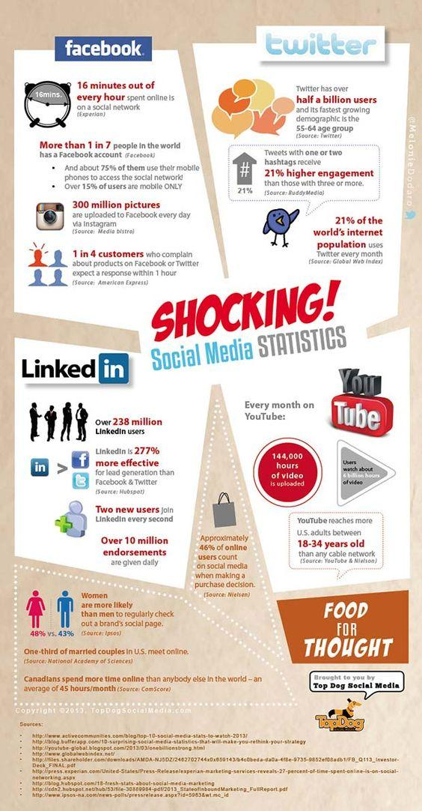
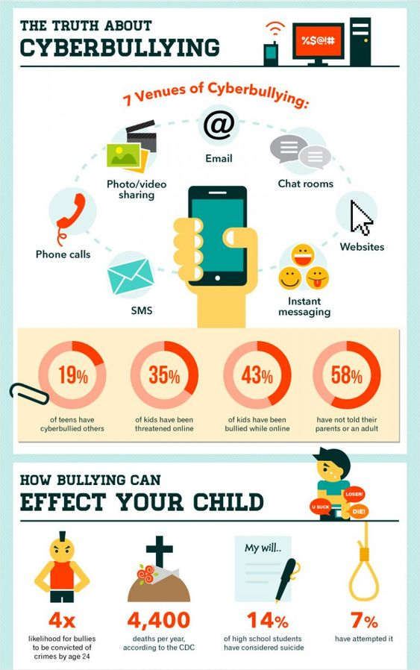

Arabic Content
Interactive short Content, infographic, videos, creative Posters and short movies
Specialized Content, guidelines and training modules.
Case Studies and best Practices
Statistics and research studies
Notes:
The Wa3i portal provides a diverse collection of Arabic content, encompassing various formats such as interactive short content, infographics, videos, creative posters, and short movies.
This content covers essential topics related to Digital Citizenship, while also offering specialized training modules and guidelines.
Furthermore, the platform offers access to valuable resources such as case studies, best practices, statistics, and research studies on the latest updates of Cyber Security.

Slide 15
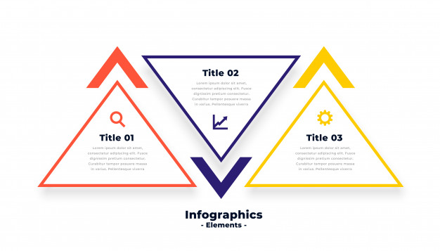


Content Creation Mechanisms
Content Experts
Produce new content & Materials
National & International channels
Stakeholders
Mapping available resources
Promote resources of partners
Integrated Arabic Knowledge Resources on Digital Citizenship and Online Safety
Notes:
On the "Wa3i" platform, content creation follows a two-step process. Initially, we scan content from both international and national channels to gather best practices in Internet Safety. After a thorough filtering process, we generate our own content that combines these best practices with content specifically tailored to the cultural setting of Egypt.
To ensure awareness of internet hazards among children aged 9-15, we establish collaborations with local and international organizations. Through these partnerships, we develop content specifically designed for this age group. Additionally, we work alongside Non-Governmental Organizations and Youth Centers to disseminate the content effectively by reaching targeted points and locations.

Slide 16

Awareness Calendar
Monthly Awareness Sessions and Webinar based on target audience needs.
Awareness main pillars include:
Digital Citizenship Concept and Skills
Online threats and internet safety mechanisms and available support channels
Laws against cybercrimes and legal support procedures
Available protection apps and features “google family control”
Notes:
Tailored to address the unique requirements of the intended audience, the monthly awareness sessions and webinars offer two distinct tracks.
The first track focuses on introducing the fundamental principles and skills associated with Digital Citizenship.
The second track is designed to enhance participants' abilities in dealing with cybercrimes by providing them with essential skills and knowledge regarding relevant legislations and laws.
Additionally, participants are educated on the utilization of protection features such as "Google Family Control," enabling parents to effectively supervise their children's online accounts.

Slide 17

Capacity Building Programs
Specialized Knowledge for Teachers, Parents and educators.
Learning Management System for interactive learning and delivering content in various forms
Accessible and downloadable modules and resources including games, videos, .etc
Self-Learning materials and class room activities
Webinar with experts based on customized needs.
Notes:
Capacity building is a crucial component of the services offered by our portal.
We offer a diverse range of capacity building programs that align with the ongoing digital transformations.
These programs cater to the specific needs of teachers, parents, and educators, providing them with specialized training and knowledge. As we promote e-learning, all modules are conveniently accessible online, facilitating interactive learning and self-paced study.

Slide 18
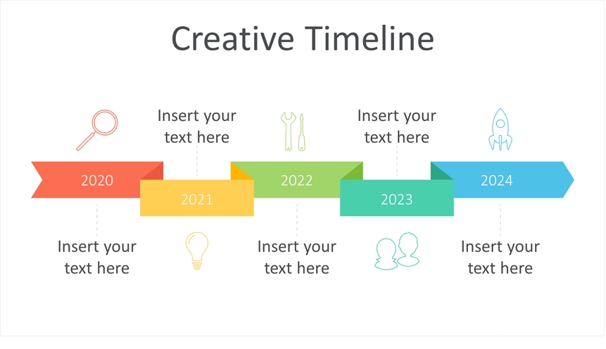
Initiative Stakeholders
ITU, COP,NGOS, Industry and Service Providers
UNICEF
Egypt
Children
Women
Senior Citizen
Youth
Teachers
Ministry
of Youth
&Sports
National Council For Women
Ministry
of
Education
Ministry
of social Solidarity
National Council for Children and Motherhood
Notes:
To ensure inclusivity, we have engaged various stakeholders who represent diverse sectors of society.
In relation to children, we have established partnerships with the National Council for Children and Motherhood.
To cater to the needs of youth, we collaborate with the Ministry of Youth & Supports.
In addressing the concerns of women, we have formed partnerships with the National Council for Women.
Additionally, we work together with the Ministry of Education to support teachers, and with the Ministry of Social Solidarity to serve the public.

Slide 19
Thank You
Eng. Hoda Dahroug
Advisor to the CIT Minister for Digital Community Development
Regional Manager of the Digital Transformation for Sustainable Development in Egypt project (UNDP-MCIT)
hdahroug@mcit.gov.g
Notes:
Ladies and gentlemen,
As I bring this lengthy, yet hopefully useful presentation to a close, it is important to highlight that our children hold the key to unlocking promising future.
It is our shared responsibility to nurture their growth and protect them from an increasingly dangerous digital world.
Today, we have witnessed Egypt's unwavering dedication in creating a secure and empowering digital environment for our young ones. However, we should not stop there, we have a long journey ahead! let us march forward with a shared vision, ensuring that every child can develop and flourish in the digital landscape that lies ahead.
Thank you for listening!

