Slide 1
Council Working Group on Child Online Protection
Twentieth meeting - From 22 to 23 January 2024
Document CWG-COP-20/INF/16
15 January 2024
English Only
Contribution from Malawi
TRAINING OF TRAINERS FOR EDUCATORS
Action required
This report is transmitted to the Council Working Group on Child Online Protection for information.

Slide 2
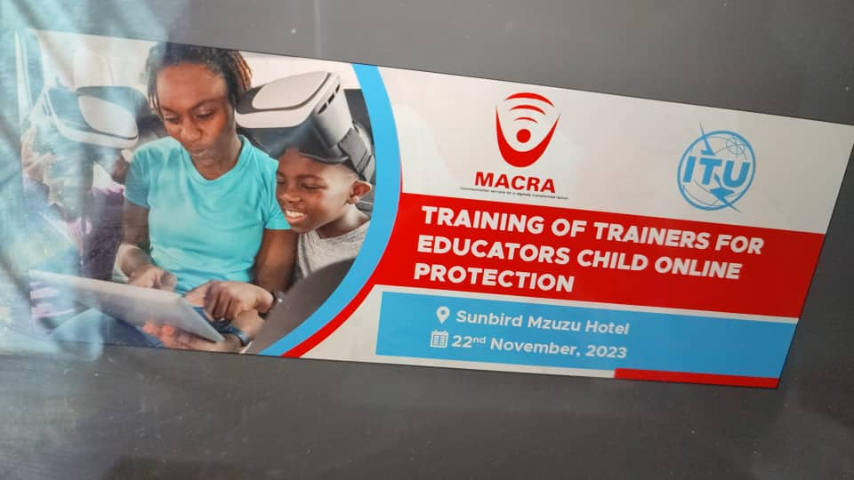
Malawi Report Training Of Trainers For Educators Child Online Protection
By
Christopher Banda
Malawi Communications Regulatory Authority – Malawi CERT
Boniface Mandere
Article iii

Slide 3
Outline of the presentation
Background
Purpose
Participants of the training
Results of the training
Plan of action/ follow up

Slide 4
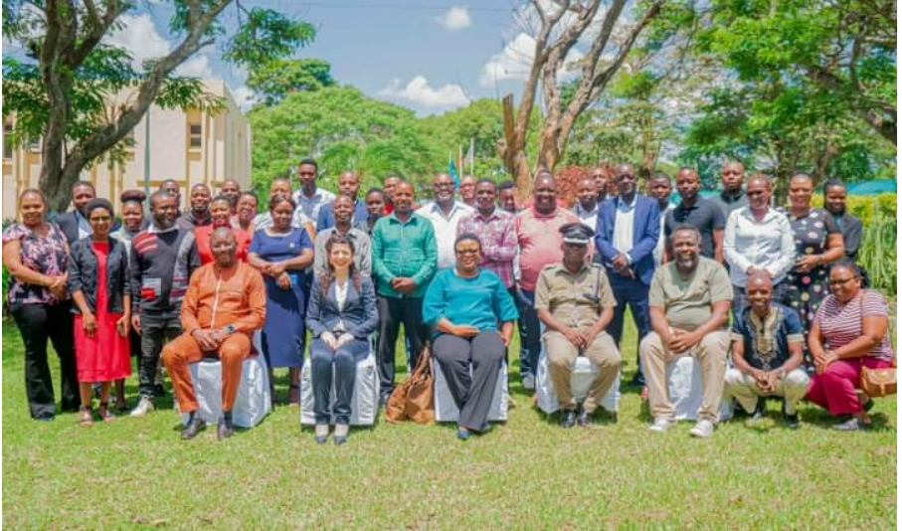
Background
The training of the trainers was organized in partnership between MACRA and ITU
Malawi has finalized the proposes of developing Nation online child protection strategy ( waiting approval)
The training was organized to respond the COP priority area, 4 and 5
The COP has six priority areas, p1, Coordination and International Corporation, p2 legal, policy and regulatory framework, p3 safe online environment, p4 COP education and awareness, p5 capacity building and p6 monitoring and evaluation

Slide 5
Purpose
To sensitize social workers, NGO, government officers on the National child protection programs, National Child Online Protection Strategy
To build the capacity of social workers, NGO and government officer on the understanding of child online protection
To sensitize on the Scope and Kinds of Child Online Protection Challenges​
To trainers them on how to become a trainer - Learning and Teaching Theories
To build the team of people to advocates the campaign of making internet safe for children in Malawi

Slide 6
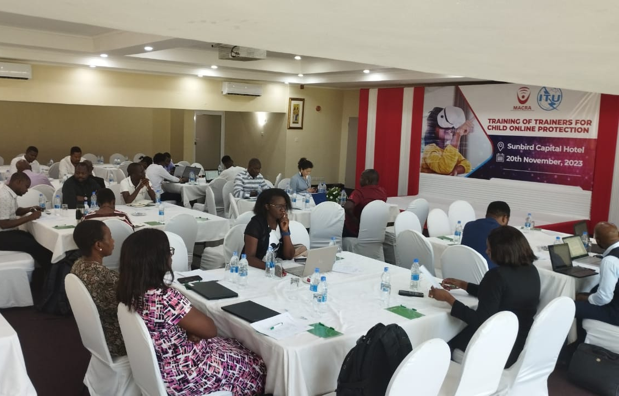
Participants of the training
The trainings was conducted in three regions of Malawi to cover more participants
Central region of Malawi Lilongwe – inviting techinical officers from Government departments, International organization working in area of child protection and the local organization
Northern region of Malawi Mzuzu- inviting local organization, educators and few members of the faith based organization, church and Mosque
Southern region of Malawi inviting participants from local organizations in the field of human rights and children’s rights, government officials from institutional care (homes and center for children in need of care and protection)
All the three centers of training media was invited not only to cover the trainings but also as participants

Slide 7
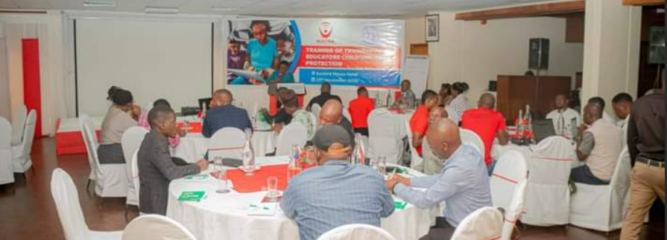
Results of the training
Some of the participants completed the process of certification – to become trainers
High schools attended the training were able to organize in school awareness meeting with teachers and students/ leaners
Media coverage in all printed and electronic platforms raising the online child protection
A team of organization, individuals and government officers to champion the campaign of making internet safe for children were identified and documented
Presentation of online child protection strategy was presented to national technical working group on child protection
Materials to promote safe internet for children were shared with key stakeholders

Slide 8
Action Plan
Commemoration of the safer internet day 8th February 2024
Press briefing and interface with media houses
School outreach activities targeting not less than 30 national and district secondary school and not less than 10 high schools in Malawi during the period of February – April A team
Arraignment of the National child Online Strategy by end of January
Setting the ground for online project of youth network on safe internet (child online protection)

