Slide 1
Council Working Group on Child Online Protection
Twentieth meeting - From 22 to 23 January 2024
Document CWG-COP-20/INF/14
23 January 2024
English Only
Report by International Centre for Missing & Exploited Children (ICMEC)
CHILD SEXUAL ABUSE MATERIAL:
MODEL LEGISLATION & GLOBAL REVIEW
Purpose
Through The Koons Family on International Law & Policy, ICMEC conducts extensive research into laws that exist around the world to better understand how countries deal with CSAM. Since 2006, we have tallied the presence–and absence–of adequate anti-child sexual abuse material law in 196 countries. This presentation highlights the findings of our most recent publication, which is the 10th Edition of this research.
Action required
This report is transmitted to the Council Working Group on Child Online Protection for information.
References
https://www.icmec.org/csam-model-legislation/
https://cdn.icmec.org/wp-content/uploads/2023/10/CSAM-Model-Legislation_10th-Ed-Oct-2023.pdf

Slide 2
CSAM:
Model Legislation & Global Review
ICMEC’s flagship research publication
First published in 2006
Now in the 10th Edition (2023)
https://www.icmec.org/csam-model-legislation/
Notes:
1/3 if all internet users today are children
800 million children around the world are active on social media
ICMEC first released the Child Pornography: Model Legislation & Global Review in 2006. (Research began in 2004 and focused on the 184 INTERPOL member countries.) Beginning with the 6th Edition, we expanded the review to 196 countries (193 UN member countries +3).
The name of the report was changed in the 9th Edition to Child Sexual Abuse Material: Model Legislation & Global Review in order to align the terminology with that which is more accepted by the international child protection community – more aptly describing the true nature and extent of sexually exploitive images of child victims to which children can never consent.
It should be noted that the term “child pornography” is often still utilized in national legislation despite the widespread international consensus that the term should be replaced with “child sexual abuse material (CSAM).” When “child pornography” is used in this report, it is to maintain the integrity of the source document (i.e., international, and regional legal instruments and Embassy responses) and the language used therein.

Slide 3
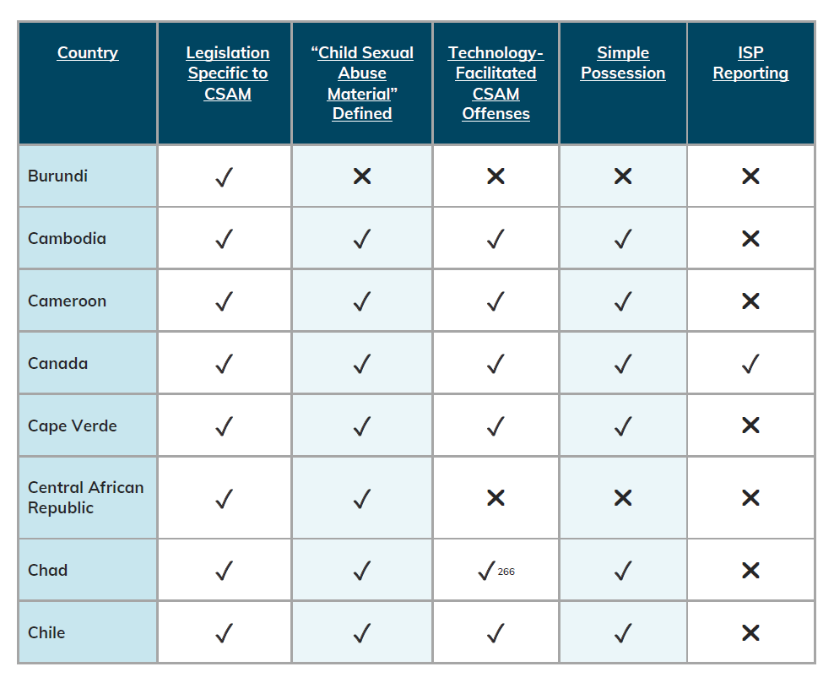
Core Criteria
Does national legislation exist with specific regard to child sexual abuse material (CSAM)?
Is “CSAM” defined?
Are technology-facilitated offenses criminalized?
Is simple possession of CSAM criminalized?
Are ISPs mandated to report suspected CSAM?
Notes:
5 core criteria
Does national legislation exist with specific regard to child sexual abuse material (CSAM)?
Is “CSAM” defined?
Are technology-facilitated offenses criminalized?
Is simple possession of CSAM criminalized?
Are ISPs mandated to report suspected CSAM?
A sample of the results table is provided.

Slide 4
Findings

Slide 5
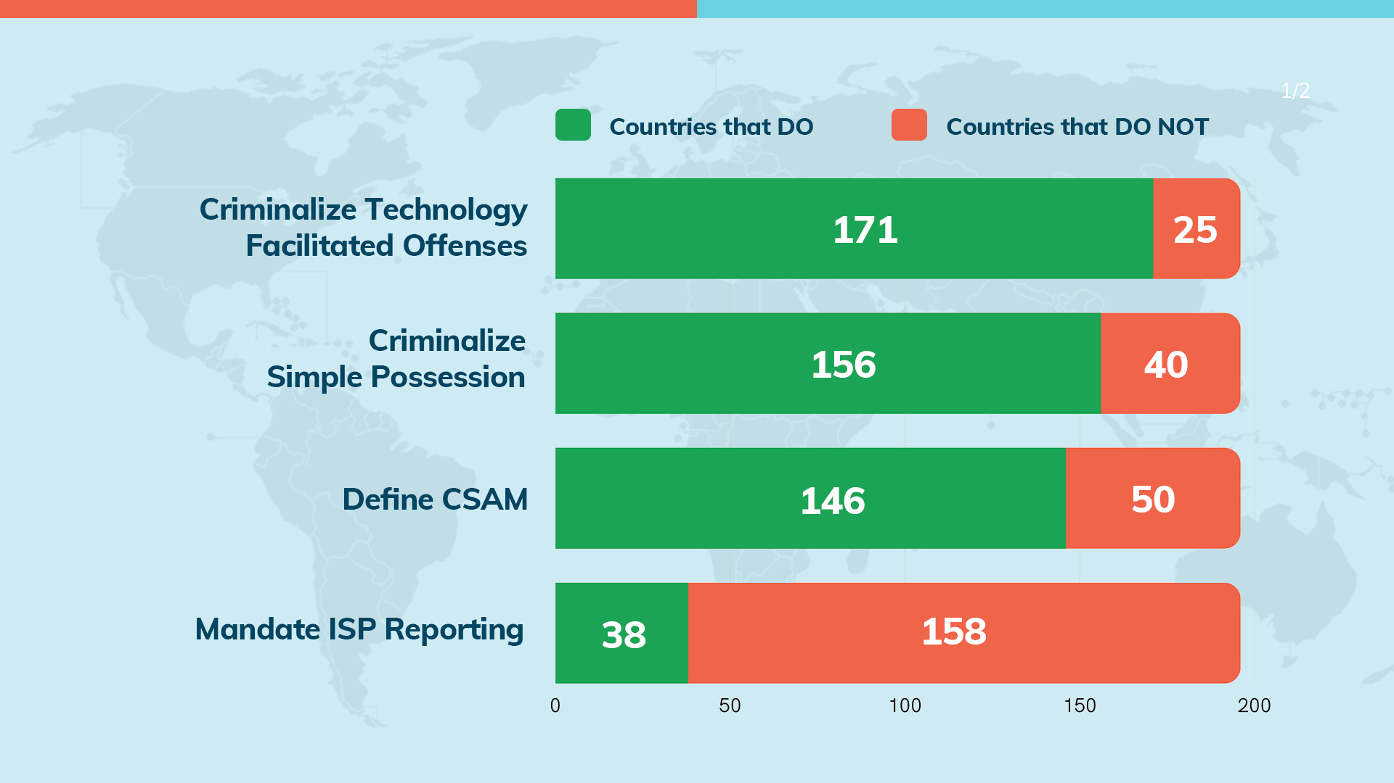
Findings
Notes:
171 countries do criminalize tech-facilitated offenses / 25 countries do not criminalize tech-facilitated offenses
156 countries criminalize simple possession / 40 countries do not criminalize simple possession
146 countries define CSAM / 50 countries do not define CSAM
38 countries do mandate ISP reporting / 158 countries do not mandate ISP reporting

Slide 6
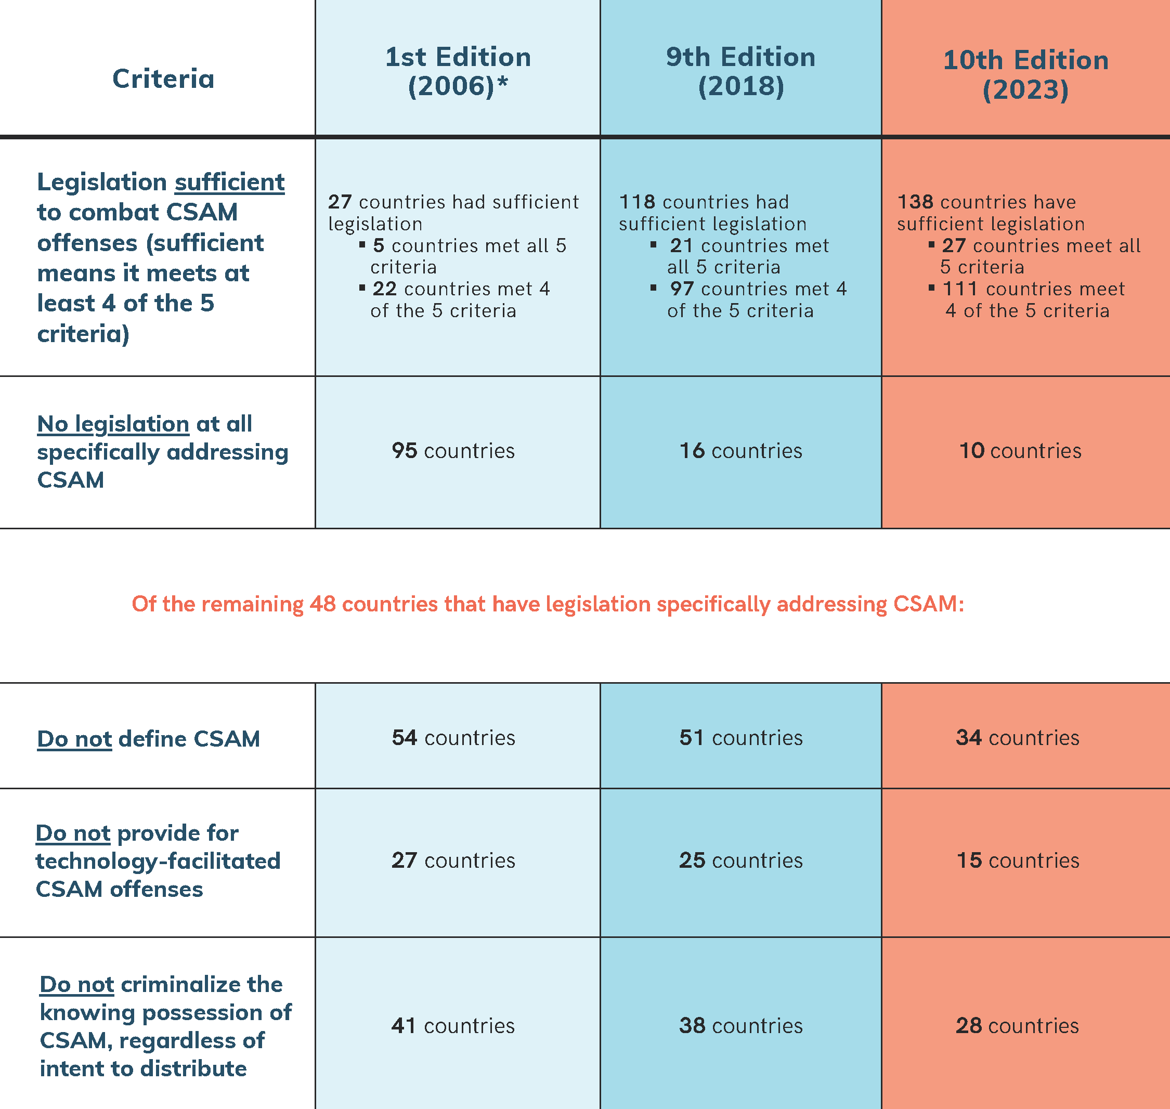
Findings
Notes:
Out of 196 countries – 156 have introduced new legislation or improved existing legislation on CSAM since the 1st edition was published in 2006.
Today 27 countries meet all 5 criteria, 111 countries meet at least 4 of the criteria (considered to be sufficient), and only 10 countries have no legislation in place.
** The 1st Edition of this report looked at the legislation of 184 INTERPOL member countries. With the 6th Edition, the report was expanded to look at the legislation of 196 countries. This difference may reduce the comparative value between the 1st Edition and later editions of the report.

Slide 7
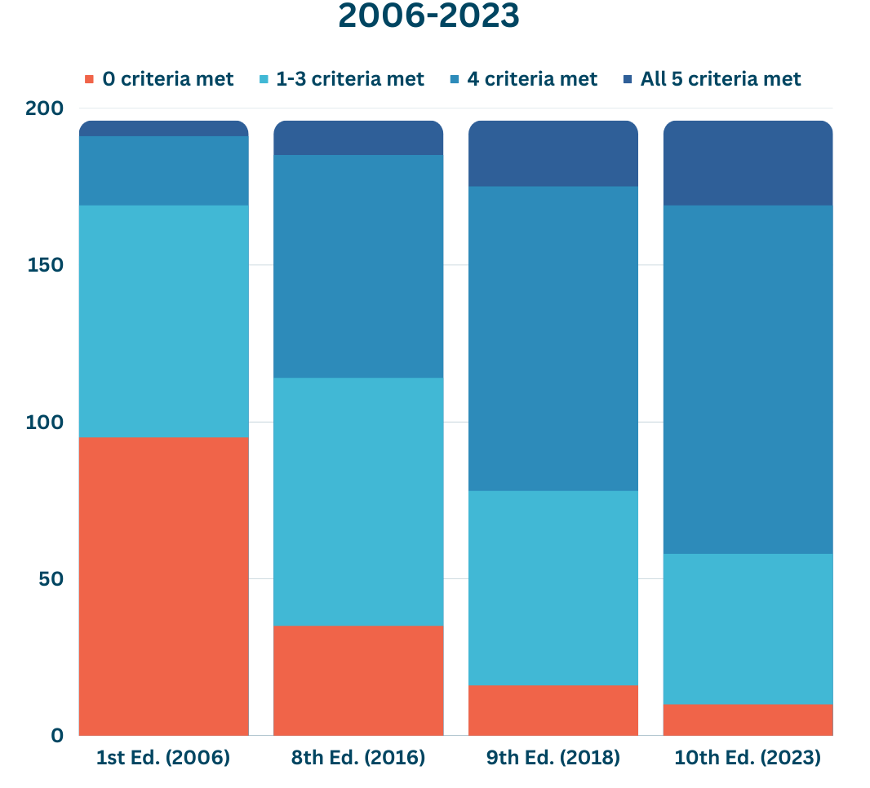
Notes:
Since the 1st Edition, 156 countries have introduced new CSAM legislation or improved their existing legislation.
In the 1st Ed. – 95 countries had no legislation; 22 countries had 4 criteria; 5 countries had all 5
In the 8th Ed. – 35 countries had no legislation; 71 countries had 4 criteria; 11 countries had all 5
In the 9th Ed. – 16 countries had no legislation, 97 countries had 4 criteria; 21 countries met all 5 criteria
In the 10th Ed. – 10 countries have no legislation; 111 countries meet 4 criteria; 27 countries meet all 5

Slide 8
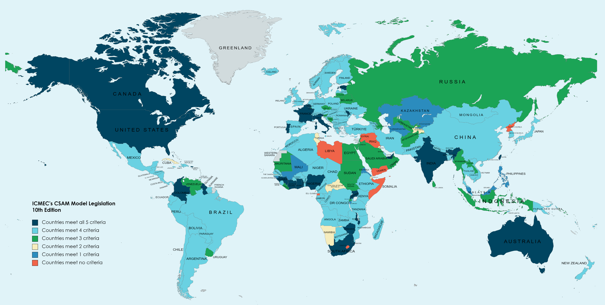
Results Map
Notes:
Countries that meet all 5 criteria = 27
Countries that meet 4 criteria (sufficient) = 111
Countries that meet 3 criteria = 31
Countries that meet 2 criteria = 8
Countries that meet 1 criteria = 9
Countries that do not meet any of the criteria = 10

Slide 9
New Areas of Focus Ongoing Areas of Concern
COVID-19 & its Impact on CSAM
Dark Web
Computer-Generated CSAM, Generative AI, Deepfakes
Data Retention and Law Enforcement Investigations
Livestreamed Child Sexual Abuse
Tech Tools to Curb CSAM / Privacy Debate
Self-Generated Images and Sextortion
Online Grooming
End to End Encryption (E2EE)
Notes:
A few of the content areas (both new and continuing areas of concern) addressed in the report include:
The COVID-19 Pandemic and its Impact on CSAM
Computer-Generated CSAM (Gen AI, Deepfakes)
Livestreamed Child Sexual Abuse
Sextortion and Self-Generated Images
E2EE
Dark Web
Data Retention and LE Investigations
Tech Tools to Curb CSAM/Privacy Debate
Online Grooming

Slide 10
Simone Bevans
Jewel Dela Cruz
Thank You
sbevans@icmec.org
jdelacruz@icmec.org
www.icmec.org
icmec_official

