Slide 1
Council Working Group on Child Online Protection
Twentieth meeting - From 22 to 23 January 2024
Document CWG-COP-20/INF/13
12 January 2024
English Only
Report by UNICEF
Legislating for the digital age
Purpose
To share UNICEF’s global guidance to improve legislative frameworks to protect children from online sexual abuse and exploitation
Action required
This report is transmitted to the Council Working Group on Child Online Protection for information.
References
United Nations Children’s Fund (2022) Legislating for the digital age: Global guide on improving legislative frameworks to protect children from online sexual exploitation and abuse, https://www.unicef.org/reports/legislating-digital-age

Slide 2
A robust legal framework is necessary to respond to all forms of child sexual exploitation and abuse, inclusive of those forms facilitated by information and communication technologies.
UNICEF’s programmatic learning in this field reiterates the importance of ensuring that online sexual abuse and exploitation are not addressed in isolation but rather integrated into broader responses to combat violence against children.
2 | Legislating for the digital age

Slide 3
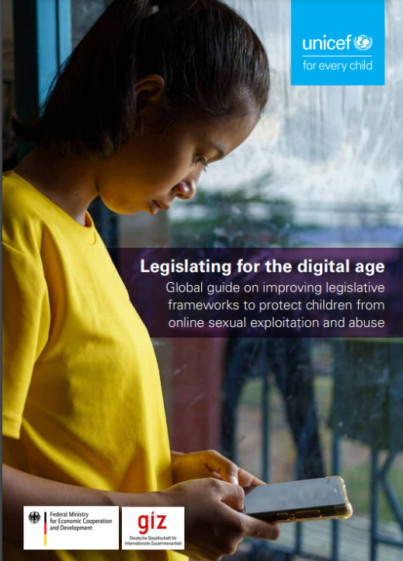
Purpose of the guide
To provide guidance on how to strengthen legislative frameworks to protect children from online sexual exploitation and abuse in line with international and regional standards and good practices.
Available at: https://www.unicef.org/reports/legislating-digital-age (summary and full versions available)
3 | Legislating for the digital age
Notes:
\

Slide 4
© UNICEF/UN0573162
Intended users
Governments
Civil society
Businesses
Country offices of international orgs
© UNICEF/PHOTO CREDIT
4 | Legislating for the digital age

Slide 5
Overview of the guide
1. Introduction | 7. Duties and responsibilities in relation to business
2. Consolidated checklist | 8. Procedures and methods of investigation
3. Evidence-based legislation | 9. Victim support, rehabilitation, reintegration and redress
4. Stakeholder engagement and catalysts for legal reform | 10. Independent monitoring and regulation
5. Methods of legislative reform | 11. Implementation of legislation
6. Criminalization | 12. Glossary
5 | Legislating for the digital age

Slide 6
Legislative drafters need to understand the prevalence, the particular forms it takes within the country, the emerging trends and the legal gaps and barriers to the protection of children
Data sources: administrative data; research which places the experiences of children and young people at its centre
Take into account children’s views – and civil society expertise – in the development of legislation
Multi-sectoral bodies to share information and inform policy development
Monitoring and evaluating legislation – “post-legislative scrutiny”
Evidence-based legislation
See part 3. https://www.unicef.org/reports/legislating-digital-age for a full list and elaboration of minimum and recommended standards for evidence-based legislation
6 | Legislating for the digital age

Slide 7
Part of State party obligations under art. 34 of the Convention on the Rights of the Child and its on the Sale of Children, Child Prostitution and Child Pornography
Offences relating to:
production, offering, distribution, dissemination, importing and exporting of child sexual abuse material, accessing or interacting with child sexual abuse material online
online sexual extortion of a child
online grooming of a child
new or emerging issues such as ‘cyberflashing’ and ‘cyberstalking’
Remove statute of limitations in respect of offences of child sexual exploitation
Minimum penalties/sanctions for adult perpetrators and enhanced penalties/sanctions for aggravating factors e.g. young age of the victim
Criminalization of certain acts and activities
7 | Legislating for the digital age

Slide 8
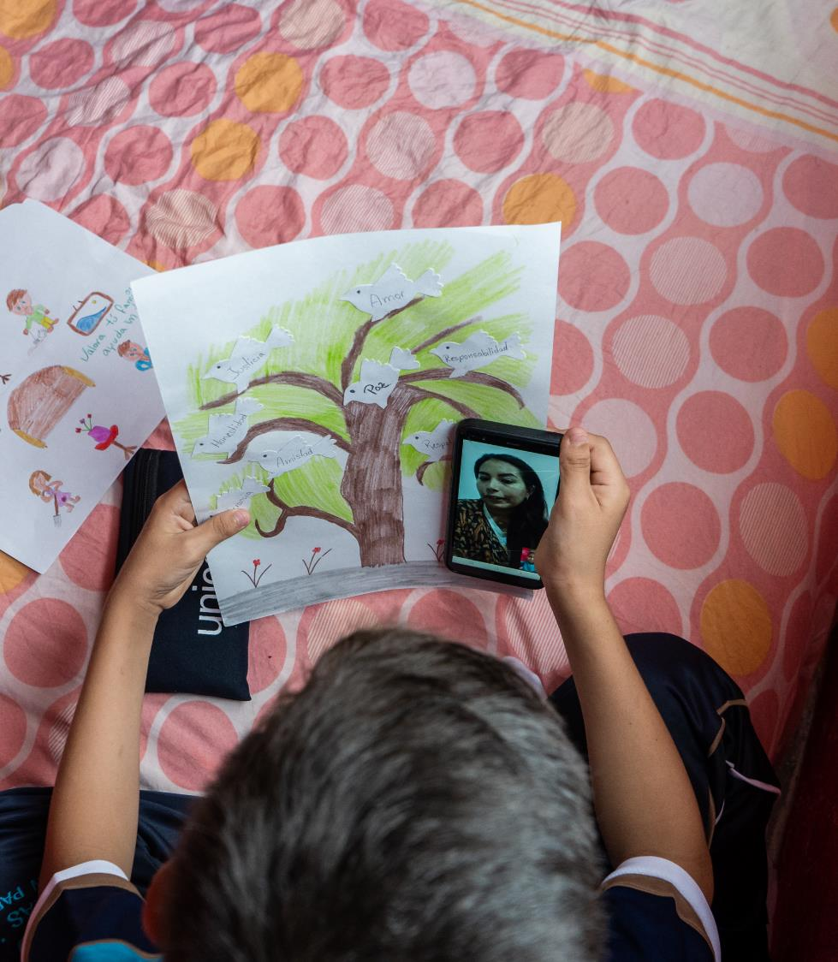
Duties and responsibilities in relation to business
A rights-based approach within the broader framework of the UN Guiding Principles on Business and Human Rights
Place children’s rights at the core of legislation to regulate business conduct, services and design of digital technologies
Criminal, civil and administrative sanctions for legal persons for offences relating to online child sexual exploitation and abuse and violations of obligations to protect children from such harms
© UNICEF/UN0413050

Slide 9
Procedures and methods
Powers and procedures to deal with procedural and evidential issues such as:
Designate a point of contact to receive referrals, leads and tips (e.g. CyberTips)
Establish national specialized unit and specialist investigation units at sub-national level explicitly mandated to investigate online crimes against children
Establish powers and procedures for undertaking criminal investigations of online crimes against children
Chain of custody
Admissibility of digital and forensic evidence
See part 8. https://www.unicef.org/reports/legislating-digital-age for a full list and elaboration of minimum and recommended standards for investigations
9 |

Slide 10
Victim support, rehabilitation, redress
Support for child victims in line with art. 39 of the CRC such as:
Child-friendly practices and support in the justice system
Tailored rehabilitation and reintegration services
Specialist training for the workforce
Mechanisms of collaboration and coordination between stakeholders
Sufficient financial resources for victim support services
Differing forms of and platforms for compensation
See part 9. https://www.unicef.org/reports/legislating-digital-age for a full list and elaboration of minimum and recommended standards for redress
10 | Legislating for the digital age

Slide 11
An independent monitoring mechanism forms part of State party “general measures of implementation” under art. 4 of CRC
Children’s rights in relation to the digital environment should be integrated into the legislative mandate and activities of the National Human Rights Institution (NHRI)
Children’s online protection can also be integrated within the mandate of independent regulatory systems for the digital environment, collaborating closely with other bodies (e.g. NHRI)
Some countries have established an independent regulator for online safety
Independent monitoring
See part 10. https://www.unicef.org/reports/legislating-digital-age for a full list and elaboration of minimum and recommended standards for monitoring
11 | Legislating for the digital age

Slide 12
Implementation
Secondary legislation/ authoritative instruments (e.g. guidelines, policies, standard operating procedures) to give effect to primary legislation
Education for children and support for parents and caregivers
Training for professionals:
to identify children at risk,
to understand support services and reporting mechanisms, and
to understand opportunities/ risks relating to the digital environment
Adequate financial and human resources
See part 11. https://www.unicef.org/reports/legislating-digital-age for a full list and elaboration of minimum and recommended standards for implementation
12 | Legislating for the digital age

Slide 13
Criminalization of online sexual exploitation and abuse and enforcement of those laws
New procedures for investigation, storage and preservation of electronic evidence
Regulation of businesses in the digital environment
Child protection services for victims
Access to redress for victims
Independent monitoring of children’s rights in relation to the digital environment
At a minimum…
13 | Legislating for the digital age

Slide 14
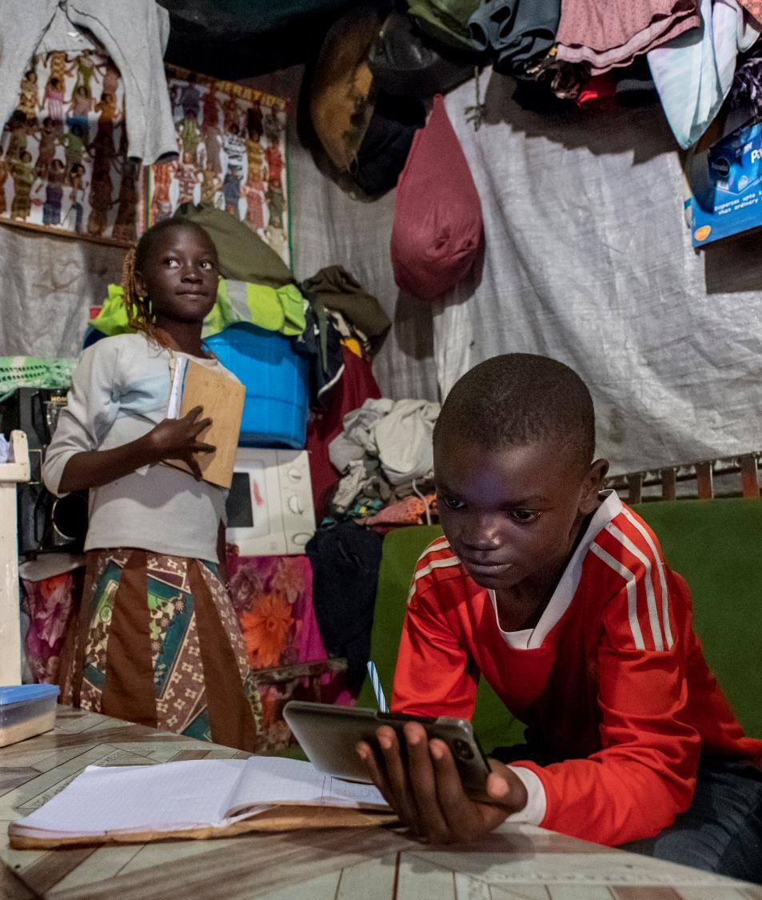
Calls to action
Continuous advancement
Global cooperation
A child-centred approach
© UNICEF/UNI362244
14 | Legislating for the digital age

Slide 15
Thank you.
© UNICEF/UN0216133

