Slide 1

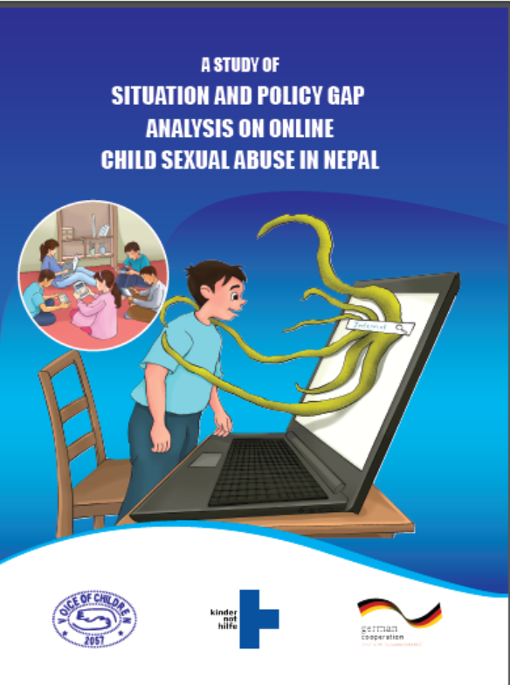
Council Working Group
on Child Online Protection
Twentieth meeting - From 22 to 23 January 2024
Document CWG-COP-20/INF/10
12 January 2024
English Only
Report by Voice of Children, Nepal
A Study of Situation and Policy Gap Analysis on Online Child Sexual Abuse in Nepal
Raju Ghimire
Deputy Director, Voice of Children Nepal
raju@voiceofchildren.org.np

Slide 2
Purpose of the Study
To assess the situation about online child sexual abuse including knowledge, attitude, practice, issues and challenges;
To review and analyse national legal provisions to identify the policy gaps relating to online child sexual abuse;
Key Findings – situation of OCSA in Nepal
Excessive and unlimited access to internet facility of children for various purposes without effective monitoring and supervision initiatives;
Limited understating and knowledge about online sexual child abuse among children, parents and concerned stakeholders;
Insufficient and limited response of legal provisions to online child sexual abuse;
Non-recognition of online child sexual abuse;
Limited accessibility to complaint handling mechanism;

Slide 3
Key Findings – Policy Gap Study
Act Relating to Children, 2018 does not clearly define critical concepts and terminologies like child pornography or child abuse material, corruption of children, grooming and solicitation of children for sexual purposes, sexting, sextortion, online child sex abuse or live streaming, sex tourism, paedophilia and cyberstalking/bullying etc.;
If child sexual abuser is parent either father or mother, or guardian, to respond to such incidents, the existing Act Relating to Children is found silent;
The Act remains silent on making special arrangements to some of the special groups of children for their special protection;
Act does not speak about cross-border issues pertaining to online child sexual abuse;
The Act Relating to Children is silent about corporate responsibility of ISP providers;

Slide 4
Action required and Recommendations
An Act must ensure all relevant issues of OCSA as the umbrella Act on child rights issues and specific Section relating to Online Child Sexual Abuse should be incorporated in the Act
Incorporating the gaps through a consultative process in to the Act Relating to Children 2018 in addressing online child sexual abuse is strongly recommended.
Child psychologist be kept in the hearings process relating to OCSA.
Corruption of children and grooming or solicitation of children for sexual purposes are not even within the sphere of crime under the existing Act.

Slide 5
Action required and Recommendations……
5. If child sexual abuser is parent either father or mother, or guardian, to respond such incident existing Act relating to child is found silent. There is provision of only temporary protection center if victim is rescued.
6. It is recommended that awareness and educational reforms programs are implemented in coordination with different stakeholders including parents, children, Ministry of Education, provincial and local governments.
7. Complain handling mechanism should be placed at least at the district level (registration, investigation and prosecution)
8. Digital forensic lab to support investigation of OCSA case
9. Complain mechanism should be handled under Act Relating to Children 2018

Slide 6
Reference:
A Study of Situation and Policy Gap Analysis on Online Child Sexual Abuse (OCSA) in Nepal
2023, Kathmandu Nepal
https://www.voiceofchildren.org.np/

