Slide 1


Council Working Group
on Child Online Protection
Twentieth meeting - From 22 to 23 January 2024
Document CWG-COP-20/INF/9
22 January 2024
English Only
Report by ECPAT International
THE ROLE OF LEGISLATION IN PROTECTING CHILDREN ONLINE
Purpose
To provide insights, lessons learned, and recommendations into from ongoing civil society advocacy to ensure children’s rights in digital environments.
Action required
This report is transmitted to the Council Working Group on Child Online Protection for information.
References
https://ecpat.org/ecpat-project-beacon/
https://www.end-violence.org/disrupting-harm
https://ecpat.org/resource/voice-research-children-parents-online/
https://www.childsafetyineurope.com/

Slide 2

Largest network of civil society organisations dedicated on ending all forms of sexual exploitation and abuse of children.
124 organisations in 104 countries.
*
About
ECPAT
International
Over 30 years pushing for critical systemic and necessary social changes to end sexual exploitation of children together with all relevant stakeholders
*
Based in Bangkok, the ECPAT Secretariat coordinates research, advocacy and action
*

Slide 3
  Targeted legislative measures for child online protection
Because children have the right to protection online
Because voluntary action and self-regulation have failed on their own to protect children
Because legal clarity drives action, informs minimum standards and harmonizes action

Slide 4
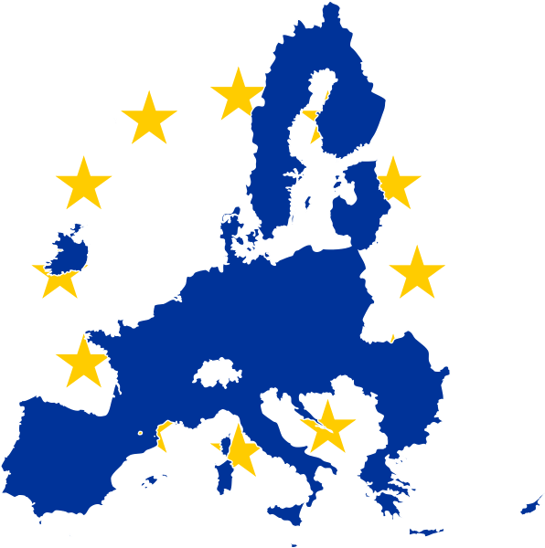

  Placing children’s rights into the heart of the EU’s digital policies

Slide 5
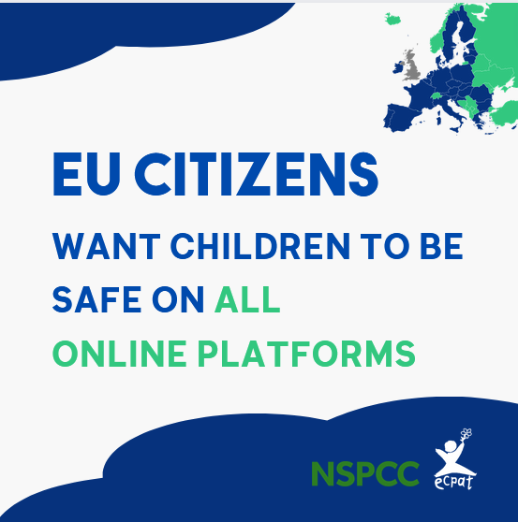

  Project Beacon in the EU
Every child has the right to be safe online.
Advocate for EU robust legal frameworks that ensure child protection in digital spaces
Generate public awareness and pressure in the EU
Coordinate civil society to speak with one voice
Bring public opinion data to the centre of the legal debate

Slide 6


  ECLAG Advocacy Coalition
The ECLAG is a coalition of 65 European and global child rights NGOs working together to end child sexual exploitation and abuse online and offline. The steering group consists of the Brave Movement, ECPAT, Eurochild, Missing Children Europe, IWF, Terre des Hommes and Thorn.
What we do
  Direct Advocacy
  National and EU-wide campaigning -#ChildSafetyON movement
  Education, technical insights and myth-busting

Slide 7


  Evidence-informed policy and legislation
Disrupting Harm in Southeast Asia and Southern & Eastern Africa (Safe Online, Interpol, UNICEF, ECPAT)
  Up to 20% of children surveyed had experienced at least one form of online child sexual abuse or exploitation in the past 12 months
  Impact of research on legislative and policy developments in Kenya, Uganda, Tanzania, Ethiopia, Namibia and South Africa (2023 uptake assessment)
EU Public Opinion Polls
  95% of surveyed EU citizens see importance of laws to regulate online service providers in order to prevent and combat online child sexual abuse and exploitation
VOICE: Values, Opinions and Insights from children (and caregivers) about e-safety (ECPAT, Eurochild, Terre des Hommes Netherlands/Down to Zero Alliance)
  Surveys and focus groups in 15 European, Latin American and Asian countries (Launch April 2024)

Slide 8
  Lessons Learned
The public appreciate the need for balance between privacy and safety in digital law and policy
The public support legislation that protects children in digital environments
Children ask for both privacy and safety, which requires a balance of rights in law
Without legal obligations, child online protection efforts are fragmented, inconsistent and opaque
  Australian Basic Online Safety Expectations – transparency notices
Without legal certainty, many online service providers place compliance over safety
  Interim Derogation to the ePrivacy Directive in the EU + extension in 2024
Robust and comprehensive legislation can bring about crucial changes
  EU Digital Service Act

Slide 9
  Good Practice
Regional Plan of Action for the Protection of Children from All Forms of Online Exploitation and Abuse in ASEAN
eSafety Australia self-assessment toolkits: Incentivising safety by design by supporting risk assessment
Model National Response as guiding framework for national plan of action
UK Age-Appropriate Design Code: Legally binding code of practice for all online services likel to be accessed by children
OECD Transparency Reporting Framework: Consistent reporting means comparable data sets that help us understand responsibility, and the challenge in different contexts
Luxembourg Guidelines: Consistent terminology used globally and across sectors helps ensure comparison and understanding
Lantern: Addressing operational and legal barriers to cross-platform child safety online

Slide 10
  Recommendations
Ensure minimum harmonization of legislation on children’s safety in digital environments
De-mystify the tech and build robust safeguards to drive up trust in digital law and policy
Regulate to ensure consistent transparency reporting standards
Invest in sustainable implementation and enforcement of online safety laws
Encourage use of existing tools, frameworks and knowledge
Continue to centre the perspectives of children in design of legislation and policy
Build sustainable public-private collaboration to ensure child online protection
Incentivise the use of consistent terminology in legislation and policy globally

Slide 11
Amy Crocker, Head of Child Protection and Technology
amyc@ecpat.org

