Slide 1
Council Working Group on Child Online Protection
Twentieth meeting - From 22 to 23 January 2024
Document CWG-COP-20/INF/6
11 January 2024
English Only
Report by Stairway Foundation (Philippines)
COP mainstreaming in the OSAEC and CSAEM Offenders Registry
Purpose
The legislative and policy iniatives of Stairway Foundation in the Philippines in relation to the country elaboration of the OSAEC and CSAEM offenders registry guidelines.
Action required
This report is transmitted to the Council Working Group on Child Online Protection for information.

Slide 2
COP mainstreaming in the OSAEC and CSAEM Offenders Registry

Slide 3
COP mainstreaming in the
OSAEC and CSAEM Offenders Registry
Stairway Foundation
NGO based in the Philippines
Has worked on the issue of child sexual abuse and exploitation since the early 90‘s.
Has worked on the Child Online Protection (COP) since 2006 – an early adopter in the Philippines
Aside from lobbying for policy and legislative changes, Stairway operates the 1st and only child protection focused e-learning platform in the country

Slide 4
COP mainstreaming in the
OSAEC and CSAEM Offenders Registry
The Philippines passed into law Republic Act 11930
or the Anti-Online Sexual Abuse and Exploitation of Children, (OSAEC) and Anti-Child Sexual Abuse Materials (CSAEM) Law on July, 2022. The implementing rules and regulation was later signed on May 18, 2023.

Slide 5
COP mainstreaming in the
OSAEC and CSAEM Offenders Registry
Aside from updating the definitions and terminology for OSAEC and CSAEM, RA11930 included a key provision on establishing an OSAEC and CSAEM offenders registry (sec 37)

Slide 6
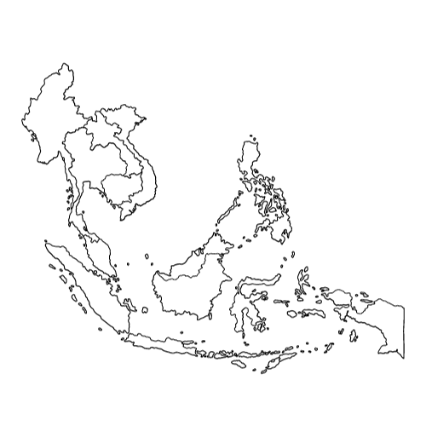
COP mainstreaming in the
OSAEC and CSAEM Offenders Registry
The Philippine OSAEC and CSAEM offenders registry is the first of its kind in South East Asia

Slide 7
COP mainstreaming in the
OSAEC and CSAEM Offenders Registry
The Implementing Rules and Regulation of the law stipulates the elaboration of further guidelines for the OSAEC and CSAEM Offender‘s Registry

Slide 8
COP mainstreaming in the
OSAEC and CSAEM Offenders Registry
In collaboration with the National Coordinating Center against OSAEC and CSAEM (NCC-OSAEC-CSAEM), Stairway Foundation and the NCC shall be organizing a Round Table Discussion this coming February, 2024, on incepting preliminary inputs to the OSAEC and CSAEM offenders registry guidelines

Slide 9
COP mainstreaming in the
OSAEC and CSAEM Offenders Registry
The Round Table Discussion for the guidelines of the OSAEC and CSAEM offenders registry shall focus on the following aspects;
Offender Tiers, Risk Assessment and Registry delisting
Community/Societal/Technological Safeguards
Prevention of Recidivism via Offender Support
Information Sharing Guidelines

Slide 10
COP mainstreaming in the
OSAEC and CSAEM Offenders Registry
One key area of the discussion/guidelines would be on leveraging the registry to create safeguards in the online environment, considering the high social media penetration rate in the Philippines

Slide 11
COP mainstreaming in the
OSAEC and CSAEM Offenders Registry
Learning from the lessons learned on how similar registries are implemented in other territories, and keeping in mind that children are at the center of why we need to elaborate such systems in place

