Slide 1
Council Working Group on Child Online Protection
Twentieth meeting - From 22 to 23 January 2024
Revision 1 to Document CWG-COP-20/INF/3
19 January 2024
English Only
Report by Pusat Kajian Dan Perlidungan Anak (PKPA)
(Center for Child Study and Protection)
BASELINE STUDY REPORT: SITUATIONS OF CYBERSAFETY IN MEDAN AND PALU, INDONESIA
Purpose
To share the results of the baseline study conducted in Medan, and Palu, Indonesia.
To provided insights, and lessons learned to the ongoing advocacy work in Medan, and Palu, Indonesia.
Action required
This report is transmitted to the Council Working Group on Child Online Protection for information.
References
https://bit.ly/PKPA_e-library_baselinestudy

Slide 3
Council Working Group on Child Online Protection
Twentieth meeting - From 22 to 23 January 2024
Purpose of the Study:
The study aimed to understand the current situation of cybersafety in the provinces of Medan and Palu in Indonesia, the study was conducted on August 2022 and the results were shared the national government, particularly the Ministry of Women Empowerment and Child Protection (MoWECP) on February 08, 2023.

Slide 5
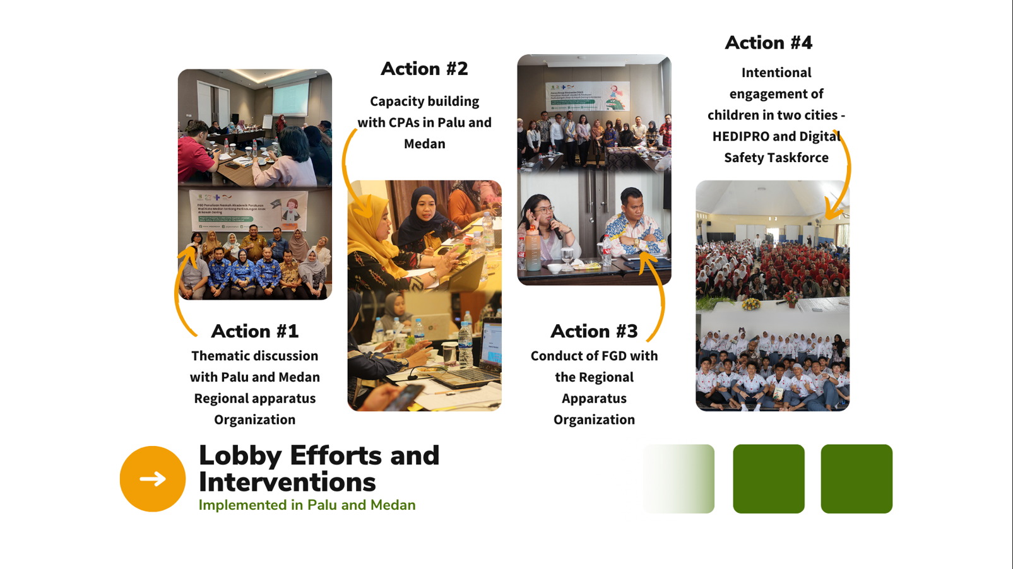

Slide 8
Council Working Group on Child Online Protection
Twentieth meeting - From 22 to 23 January 2024
Action required and Recommendations
Legislation and local regulation must explicitly include online child protection (reporting procedures, management of reports etc)
Need to form unit tasks that have focal point that will handle complaints related to child online protection
Provide tailored-fit training curriculum for child protection actors (law enforcement, social workers) related to handling online violence against children
Engage and build the children’s protective skills.
Expand IEC with creative media to educate the public about a safe and healthy internet
References
https://bit.ly/PKPA_e-library_baselinestudy

