Slide 1
Document CWG-FHR-16/4 11 September 2023
English only
Contribution by the secretariat
PRESENTATION ON RISK MANAGEMENT AND COMPLIANCE ACTIVITIES
Purpose To present an overview of risk management activities at ITU, including the status of the compliance dashboard. Action required The CWG-FHR is invited to note this contribution. __________________ References PP Resolutions 71 (Rev. Bucharest, 2022) and Resolution 217 (Bucharest, 2022); Risk Management Policy – Document C17/74.

Slide 2
Frameworks in place and recent developments
ITU risk management framework 2020
Risk Management Policy & First iteration of Corporate Risk Register
Risk and Internal Control Management
(Parallel)
Working Group on Internal Control 2019
Monitoring of oversight recommendations implementation
Council 2022: ITU Accountability Framework
Three Lines Model and COSO Framework
Council 2023: Strengthening Internal Control
Senior Management-led governance for continual improvement of risk management activities
Recent developments
Senior management & risk escalation: COCO and MCG regular agenda items
Entity-level risks relating to ITU sustainability and attainment of strategic goals, targets and priorities

Slide 3
Status of oversight recommendations

Slide 4
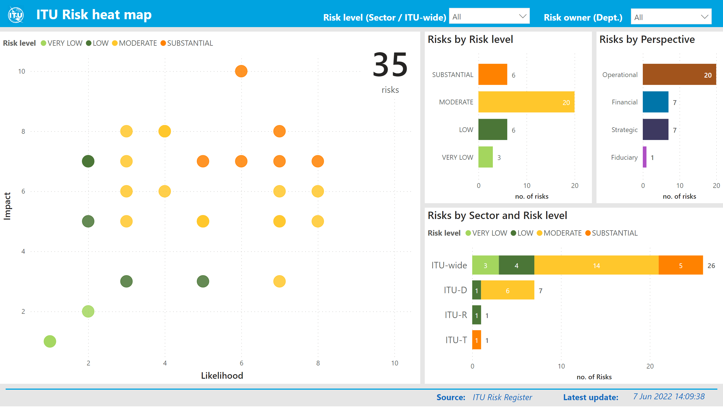
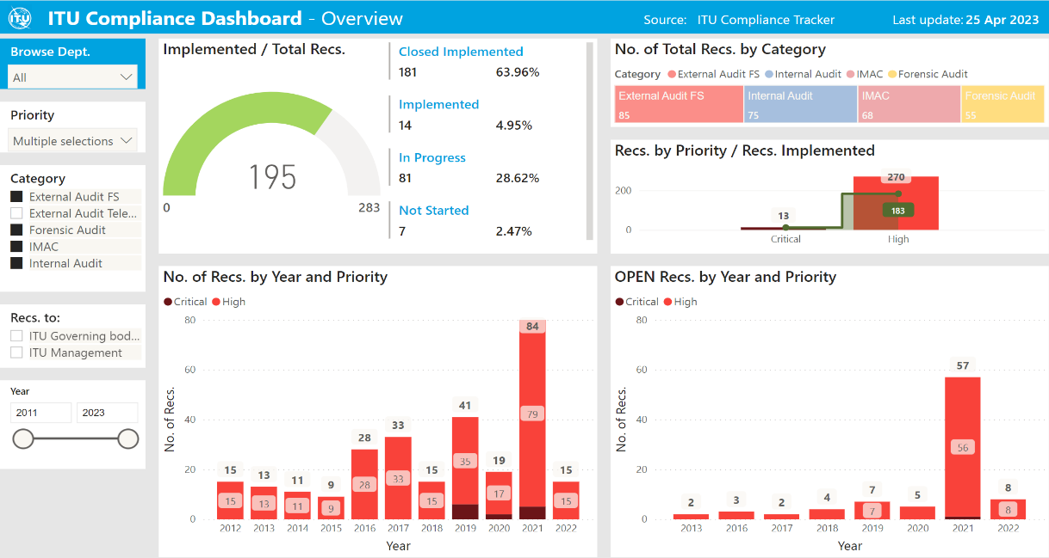
Integration of risk and internal control management activities
Corporate Risk Register
All GS departments, Bureaus
Compliance Tracker
Outstanding oversight recommendations
Best Practice
HLCM Guidelines on Risk Appetites Statements (2019), notably “3.5 Reinforce the link between internal controls and risks”
Risk management integrated approach
Improve engagement by making risk management part of workplans and ongoing control activities
Better integration of risk management with key business processes
Greater assurance of adequate coverage
More aligned with the Accountability Framework reliance on COSO
Risk and Control informed escalation to Senior Management

Slide 5
Integration: First phase completed
Completed analysis of outstanding oversight recommendations to identify related risk categories

Slide 6
Integration: Next phase
Process of updating Risk Register started
Improve risk identification and better coverage
Consider risks related to oversight recommendations to better integrate risk management with key business processes
Improve engagement by making risk management part of ongoing management or work plan activities (less speculative)
Process completed or ongoing with BR, SPM, HRMD, ISD
Best practices
JIU Report on ERM (2020), Benchmark: “6. Established systematic, coherent and dynamic risk management processes” notably “simplifying” the process.
HLCM’s Guidance Notes (2020) – Embedding Risk Management

Slide 7
Continual Improvement
ITU Risk management and the UN Maturity Model

