Slide 1


SAFE ONLINE
Investments to protecting children
and youth from Digital Harm
ITU Council Working Group on Child Online Protection
10 October 2023

Slide 2


Safe Online
Contact Child Sexual Abuse
Grooming/solicitation
Sexual Extortion
Live-streaming of child sexual abuse
Abuse and Harm to Children and Youth
Digital Technologies
Coercing and blackmailing
CSAM production, possession and distribution
Traveling Child Sex Offending
Self-generated Sexual Content

Slide 3

Safe Online

Slide 4

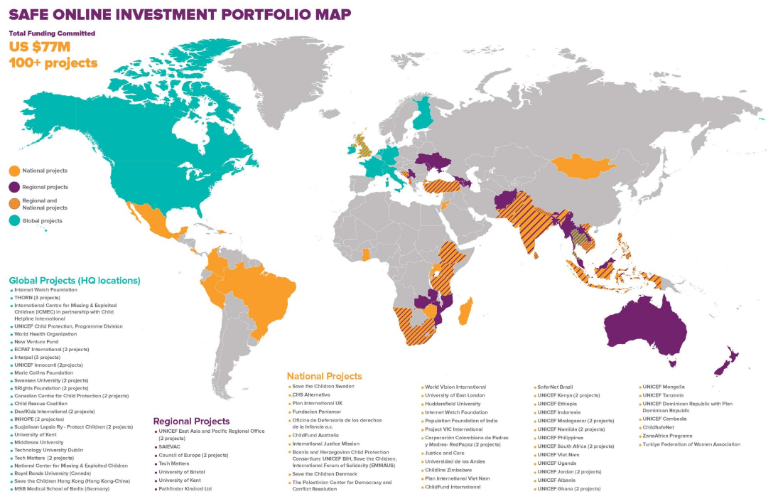




Safe Online Investment Portfolio Map
+100 projects
US$ 77 million investments
+85 countries

Slide 5
Investments Approach
TECHNOLOGY
Invest in improving existing or building new technology
STRENGHTEN SYSTEMS
Build capacities and capabilities of LE to enable use of tools and data
Advocacy to shape
global ecosystem
EVIDENCE & DATA
Collect data & evidence on the context, experiences, and threats and trends

Slide 6
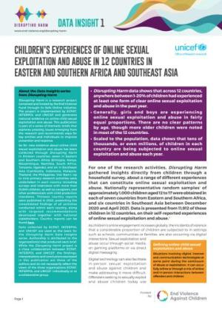

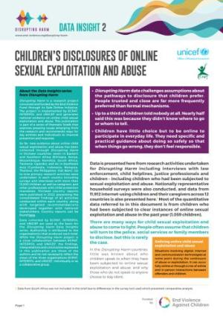
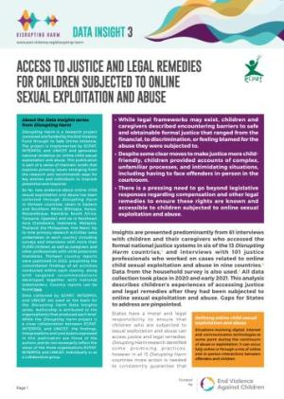


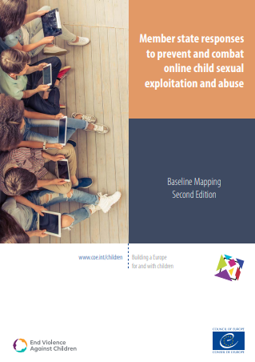
Knowledge & Evidence
Disrupting Harm: $15M to understand online CSEA across 6 regions, 25 countries

Slide 7
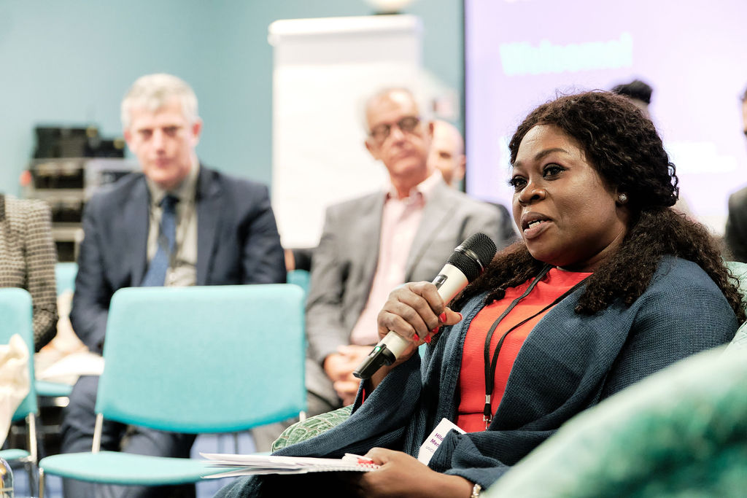
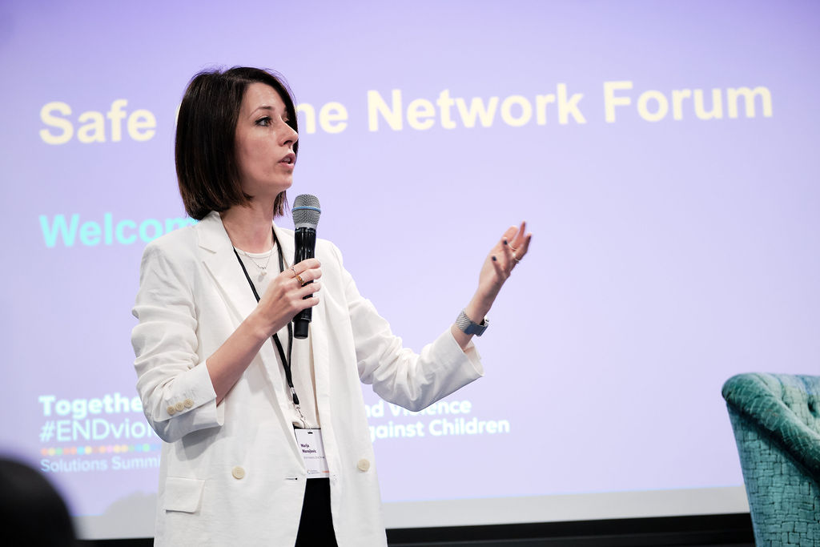

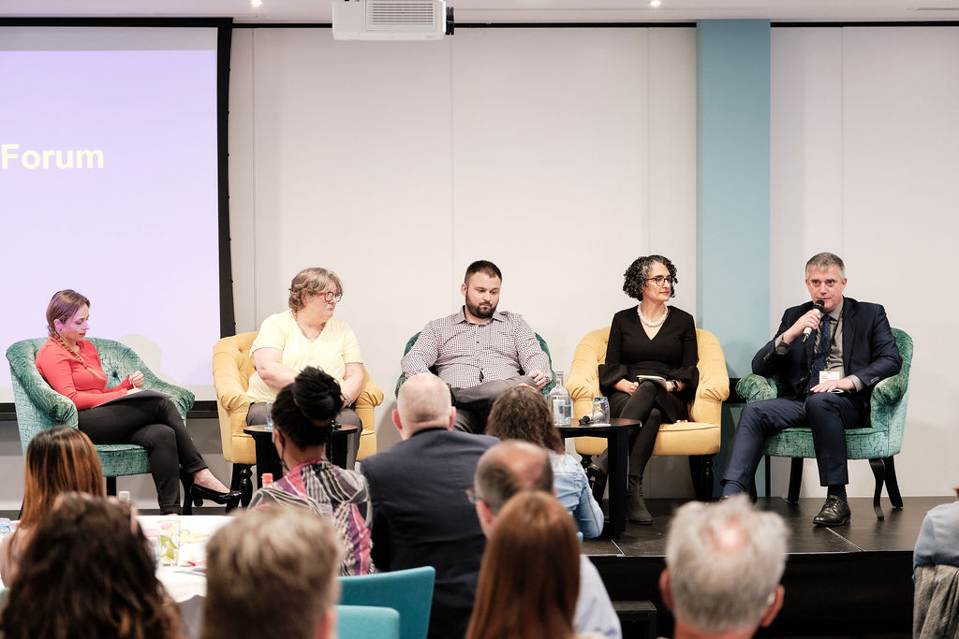
Safe Online Networks
Holistic, cross-sector collaboration
Creativity, learning
and problem solving
Culture that values
improvement, shared lessons
Focus on solutions, capacities,
new trends

Slide 8

Learn, share and networks
Webinars*
Convening*
Portal*
Newsletter
Social media
Technical support, coordination

Slide 9
What we have learned
The whole-system approach is key
Evidence is lacking
Proactive investigative capacity
Technology tools are not enough
LE capacity development is not coherent
International cooperation is critical

Slide 10



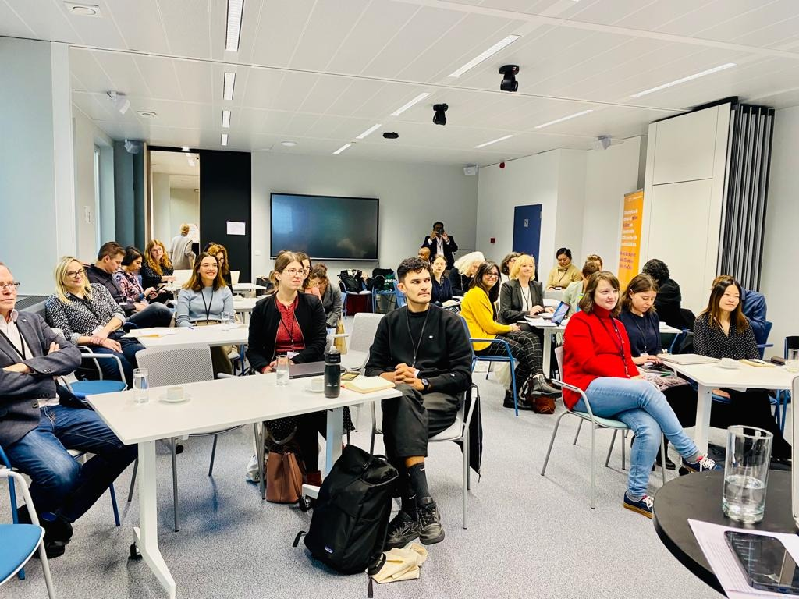
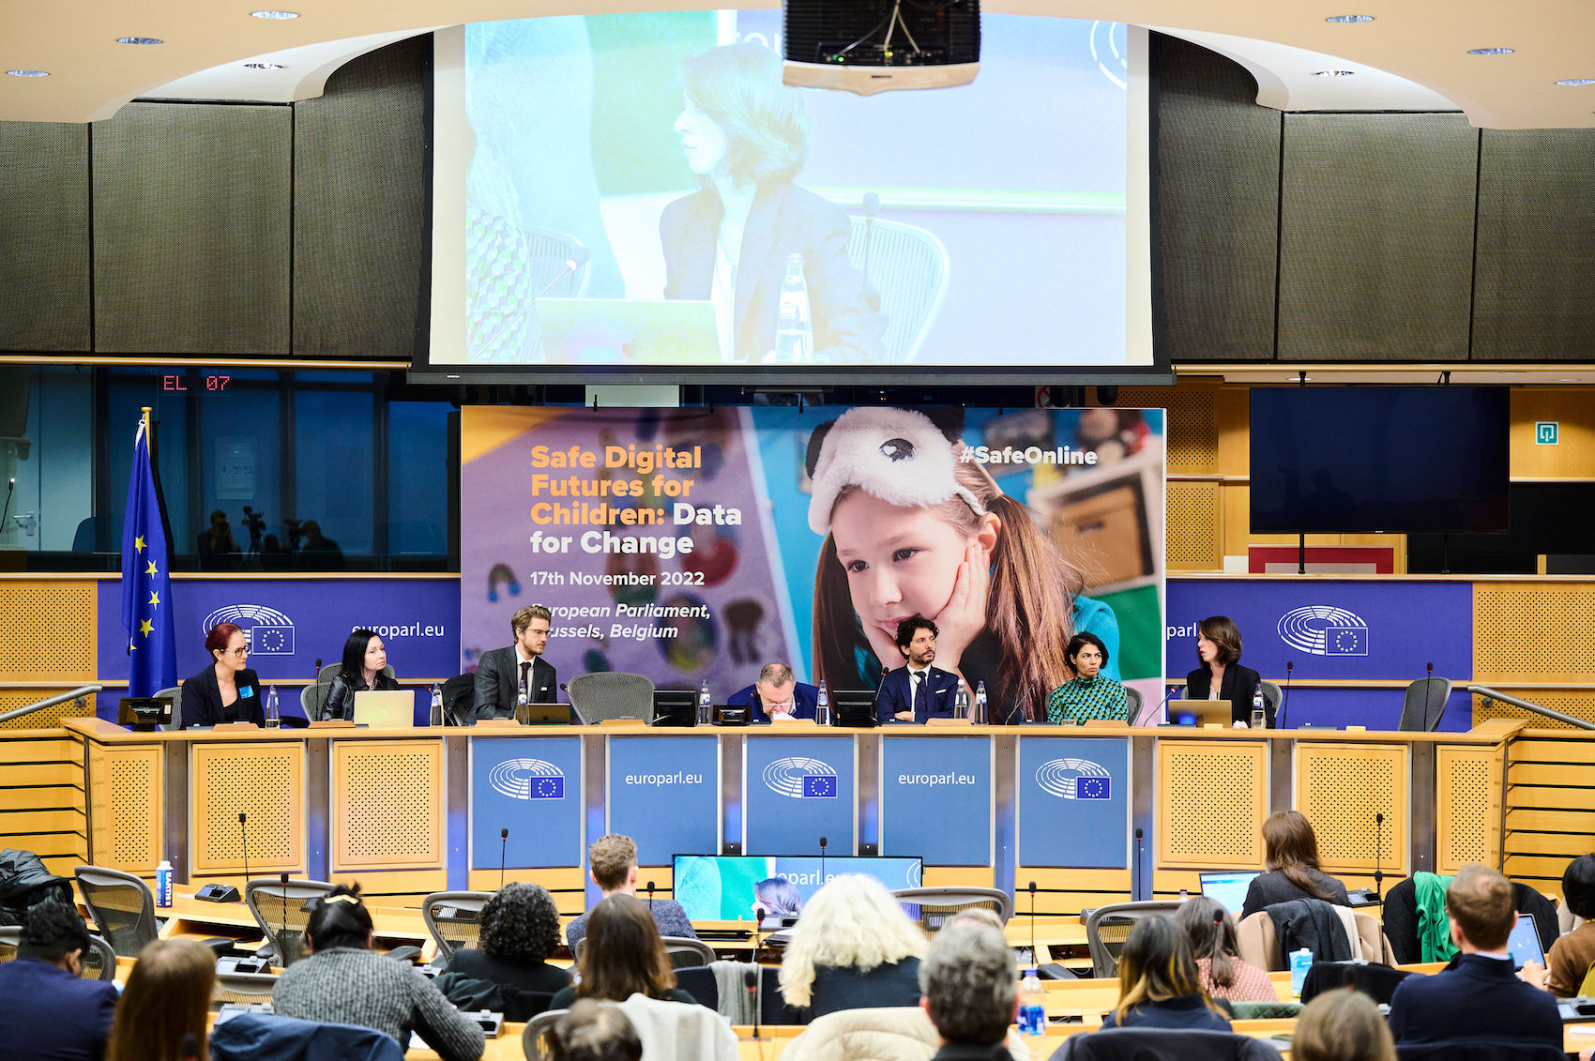
Advocacy

Slide 11
2023 Global Open Call for Proposals
WHO CAN APPLY: Non-profit & for-profit organisations - private companies can only apply for up to USD250k
WHAT ARE WE FUNDING
Networks and Systems (up to USD 750k)
Research and Data (up to 250k)
Technology Tools (up to 300k)
Submissions by 31 October 2023

Slide 12
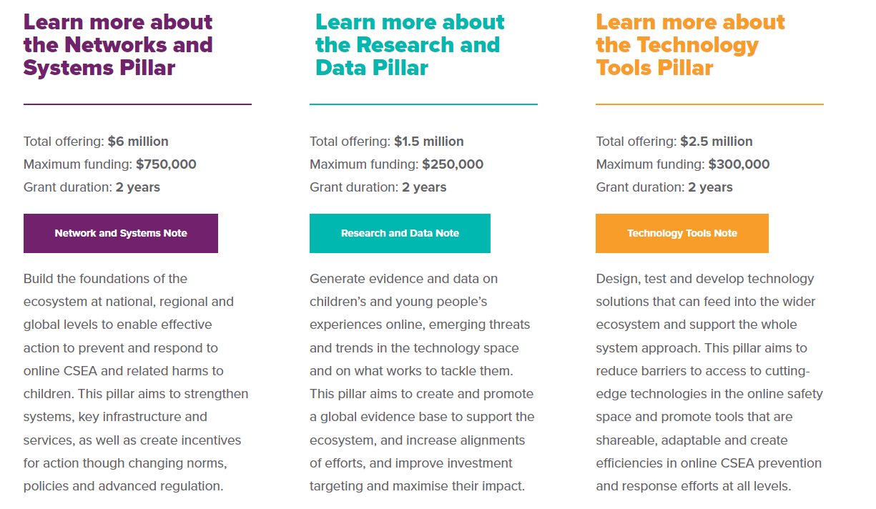

Slide 13
Thank you
Serena Tommasino serena.tommasino@end-violence.org
Website www.end-violence.org
Email secretariat@end-violence
Social Media @GPtoEndViolence
SAFE ONLINE

