Slide 1
The French Data Protection Authority, CNIL
Tuesday 10 October 2023
19th meeting of the ITU Council Working Group on COP
ITU – Child Online Protection
Pascale RAULIN-SERRIER, CNIL
Senior Advisor & Coordinator of the International Digital Education Working Group, GPA

Slide 2
Protecting children in the digital ecosystem: a priority for our data protection authorities
Mandate of European DPAs strengthened by the GDPR
Priority of the Global Privacy Assembly agenda
International cooperation strengthened by the Digital Education Working Group (DEWG)

Slide 3
GDPR, Role of regulators
Art 57(b) “Promote public awareness and understanding of the risks, rules, safeguards and rights in relation to processing. Activities addressed specifically to children shall receive specific attention”

Slide 4
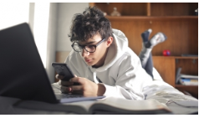
The challenges to digital use, the risks involved
The mass collection of information about their preferences, identity or lifestyle, highly coveted data
Digital should not lock children into a system of predisposition or reinforce inequalities or digital devide
Less aware and more exposed to risks online & inadequately supervised digital practices
Risk of large-scale surveillance of children

Slide 5
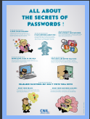
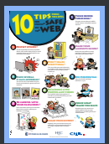
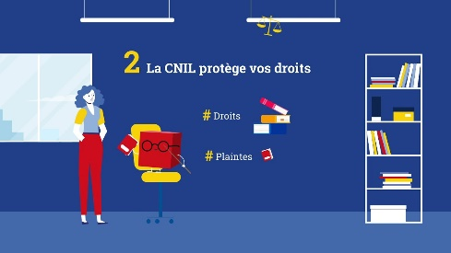
The CNIL, today
An independent government Agency
4 missions
Information and Rights protection
Compliance support and Guidance
Anticipation and Innovation
Investigations and sanctions

Slide 6
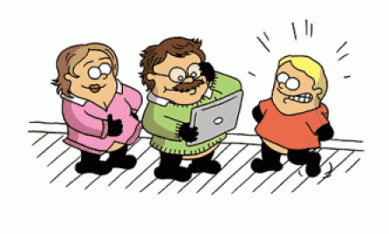
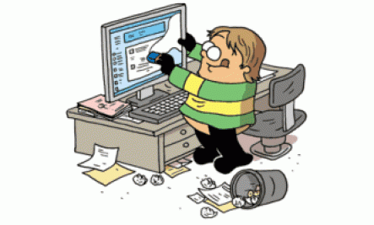
CNIL published 8 recommendations to enhance the protection of children online in 2021
Regulate the capacity of children to act online
Strengthen the information and rights of children by design
Encourage children and youth to exercise their rights
Support for parents in the digital education of their children
Provide specific safeguards to protect the interests of the child
with the aim of providing practical advice and on cnil.fr
appropriate for all audiences (young people, parents,
and professionals)

Slide 7
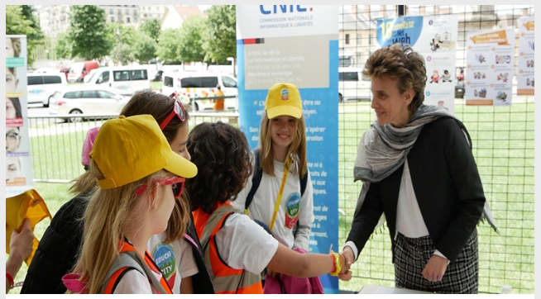
CNIL actions Digital education, a strategic priority
Partnership with the French Ministry of Education
Producing a wide range of resources for young people
Training of trainers in Digital Education
Scaling up to a multi-stakeholder approach

Slide 8
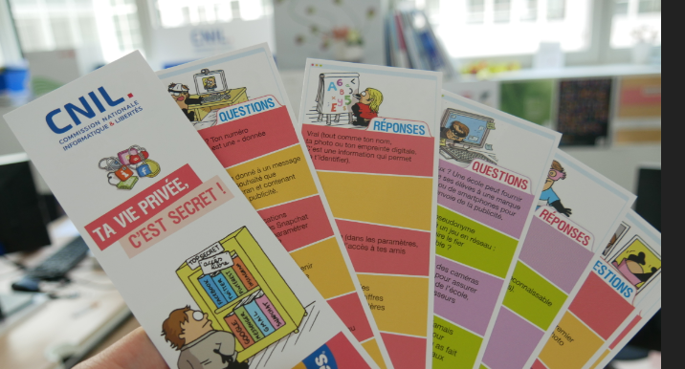
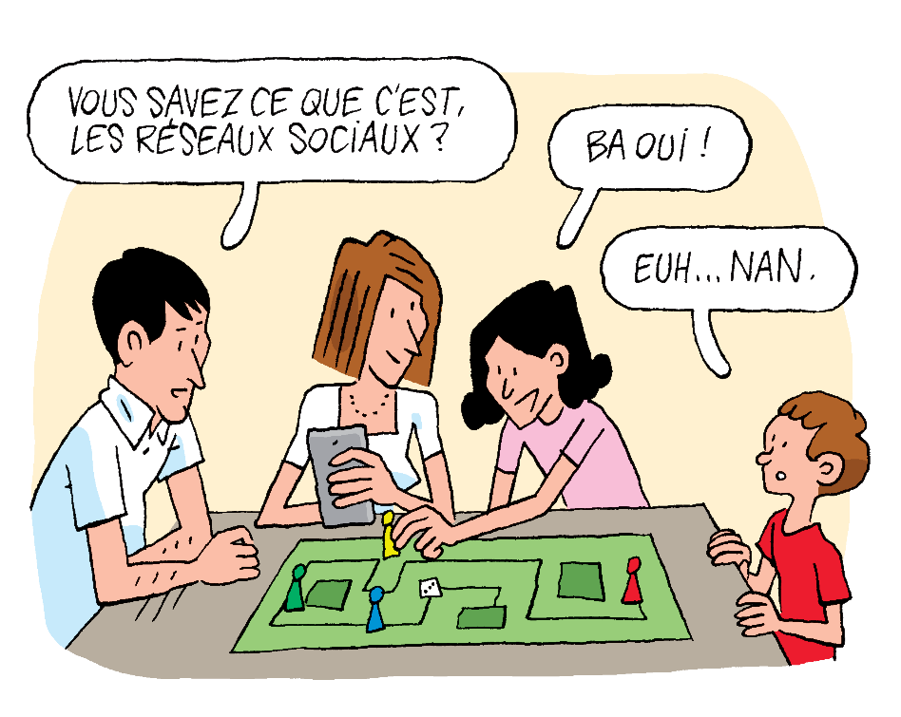
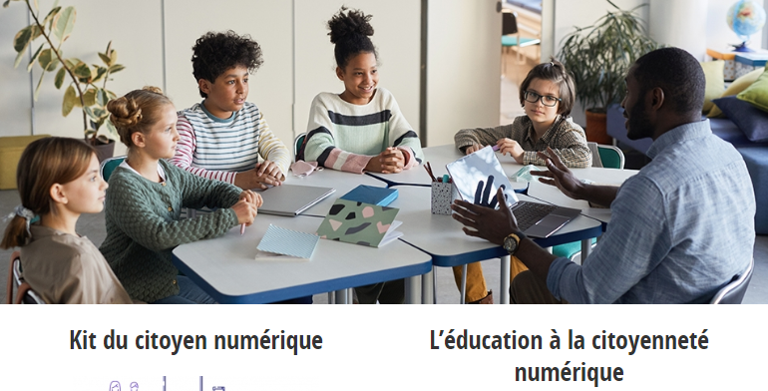
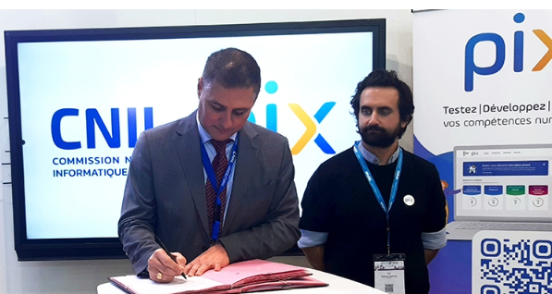
Education and training https://www.cnil.fr/fr/enfants-et-ados
Educate to keep control of data
A strong educational community
requires lifelong training for teachers

Slide 9
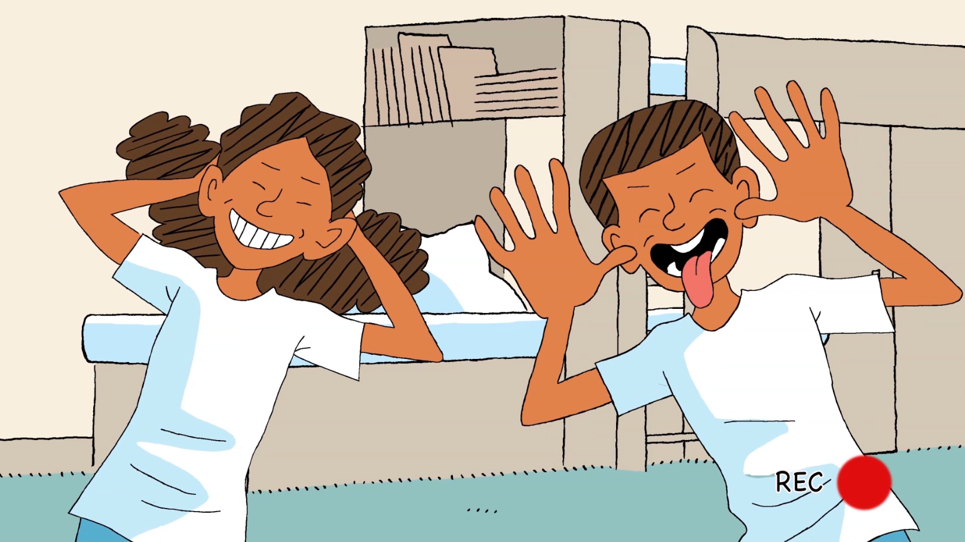
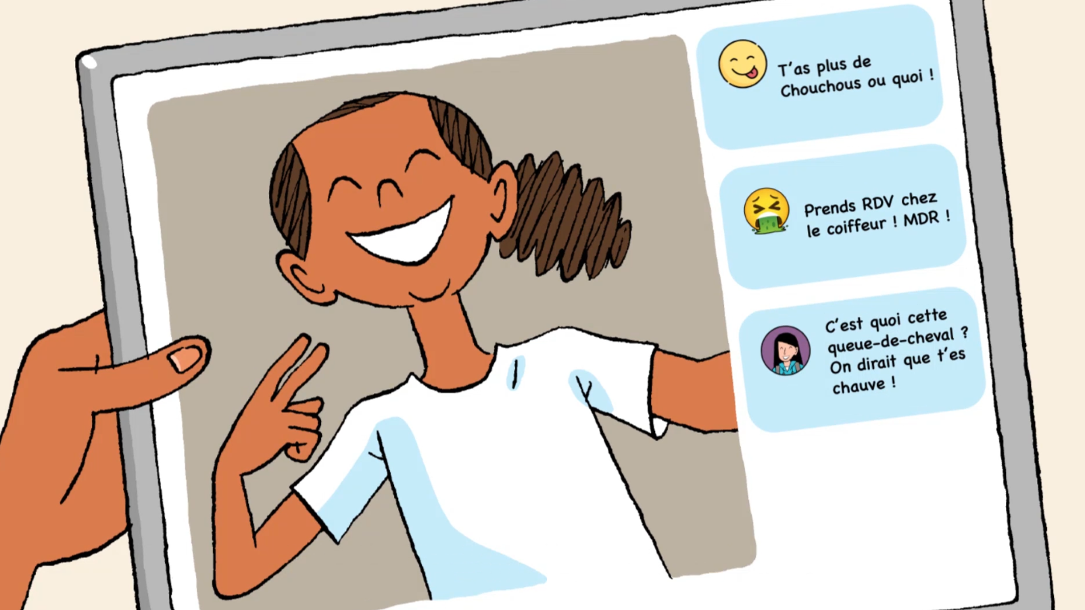
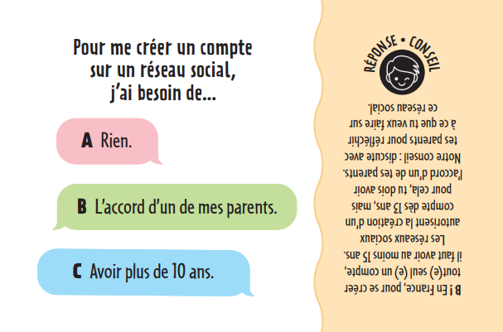
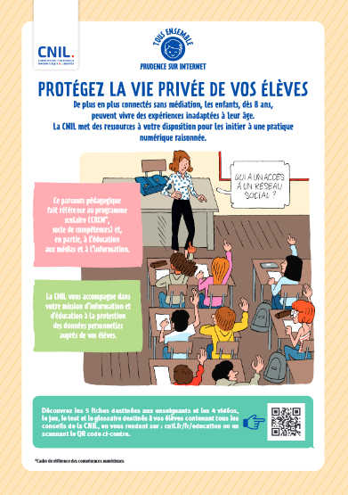
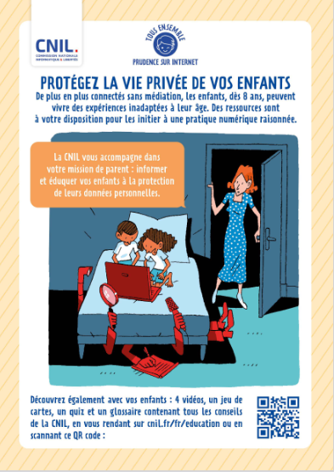
CNIL launched the campaign “All together for a safe internet”
4 video for children from 8-10
A card game
Leaflets for teachers and parents

Slide 10
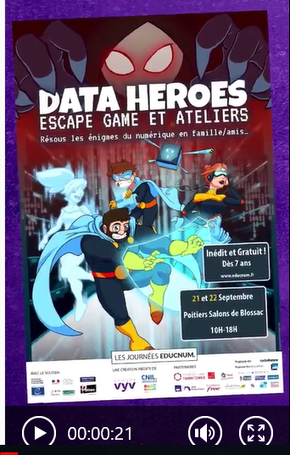
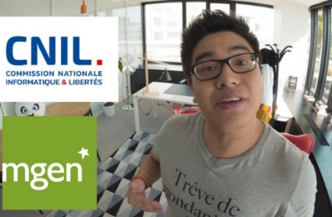
Using means of communication as the Y and Z generations
Escape Game
Video on Cookie
Tips by Kevin, the blogger
www.youtube.com/user/LACNIL OU www.dailymotion.com/cnil

Slide 11
Adoption of an international Resolution on Children’s Digital Rights

Slide 12
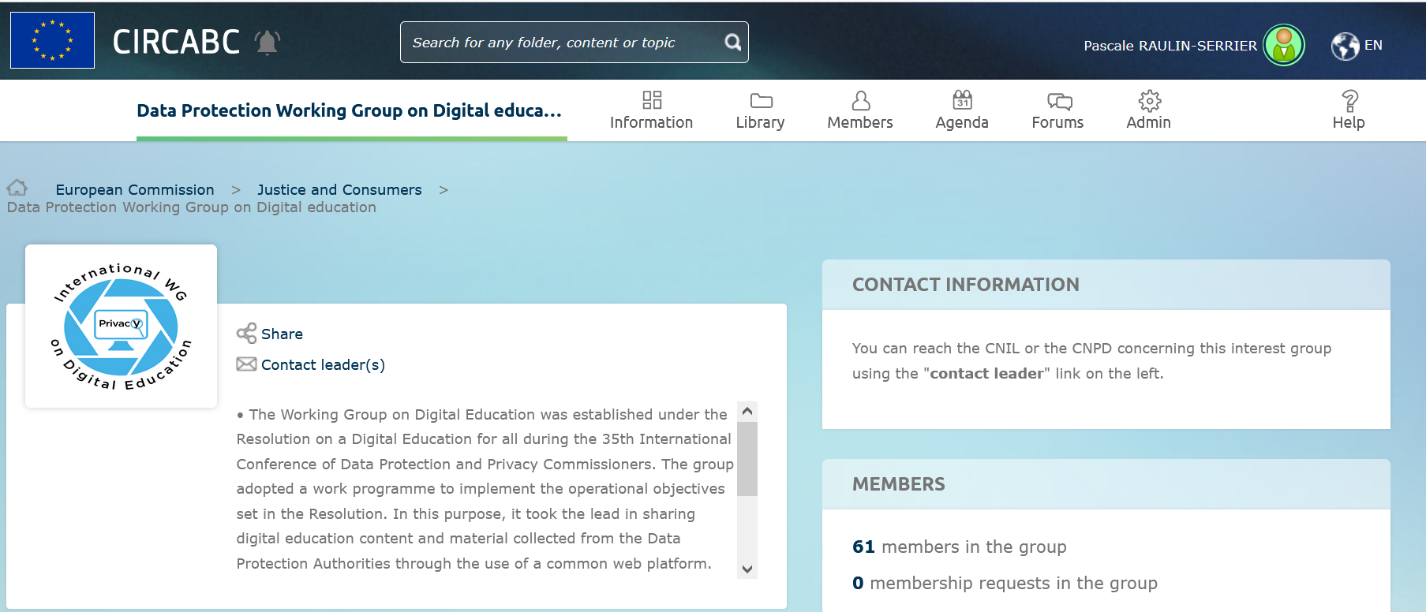
Pooling resources on an online library

Slide 13
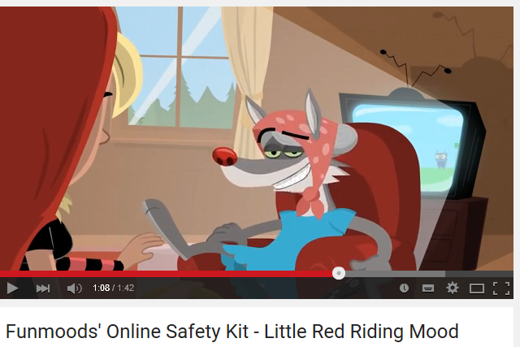
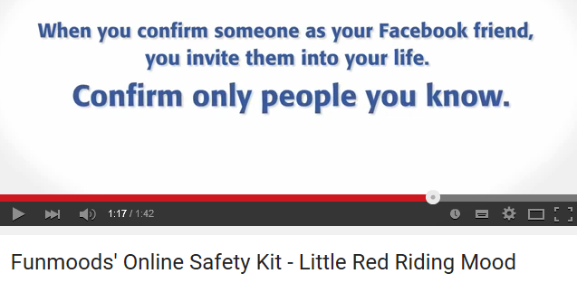
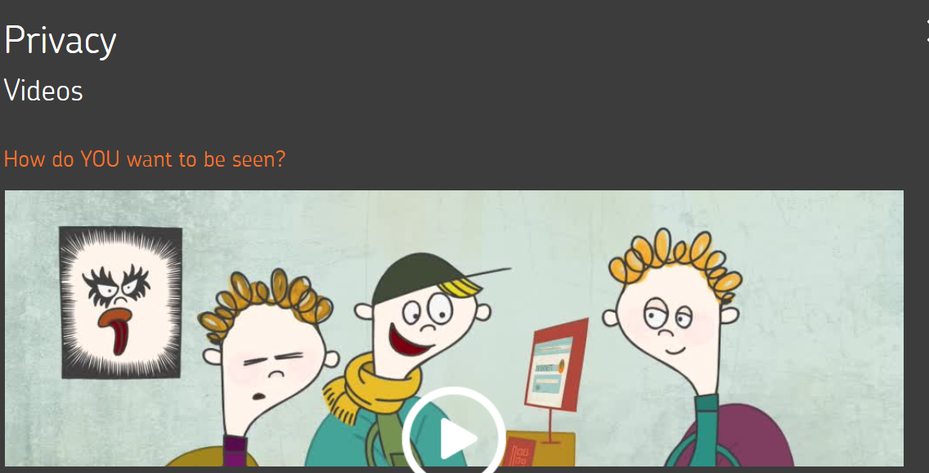
Video used by Gibraltar from
publicly available resources
Video from the CIL Burkina
Video from Norway « how do you want to be seen ? »

Slide 14
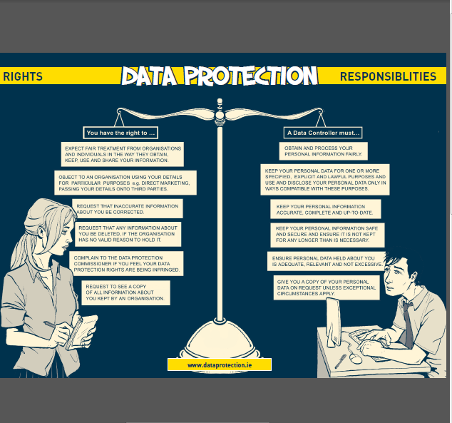
Irish manual « Sign Up, Login Opt Out :
Protecting your Privacy &
Controlling Your Data » Canadian graphic novel

Slide 15
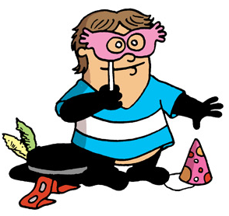
Thank you for your attention any questions?
pserrier@cnil.fr

