Slide 1
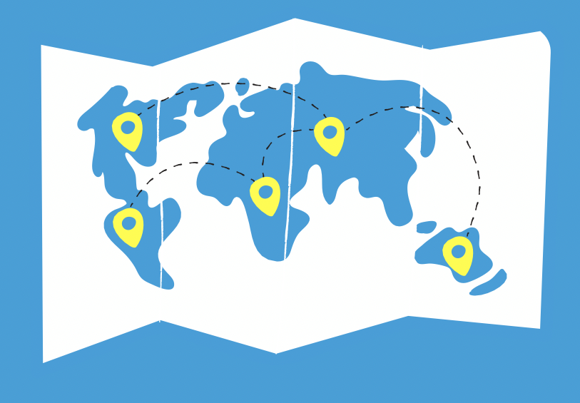
Child Online Protection
POP: Protection
Through Online Participation
What?
Understanding how children use the internet to access protection
Tell the world how children and young people use digital platforms for good
Provide recommendations on how to create, adapt or improve these systems
Why ?
Children look for support online and try to support each other through online means
How?
Multi-sectoral effort to gather evidence on support systems
Making data accessible through a digital map
Publishing recommendations
Helping stakeholders to improve existing systems and implement new ones
By better understanding how these work, as un agencies and protection stakeholders we can make recommendations to the world on how to successfully implement these systems and/or improve them,
And help children live in a world free from violence.
Where does PoP come in?
Different partners come together to gather evidence on:
Online helplines and services,
Child and youth led digital solutions to protection needs,
Learnings from the industry
A.I. Driven systems that address children’s protection
Notes:
WHAT?
Aim to understand how children and young people use the internet to access protection and be safer from violence online or offline
PoP aims to tell the world how children and young people use digital platforms for good.
Pop will provide all relevant groups with recommendations on how to create, adapt or improve these systems
WHY?
- Children are increasingly looking for support online, when at risk of being a victim of violence, online or offline, and we need to support them in their efforts.
HOW?
Multi-sectoral effort to gather evidence on support systems
Mapping different systems and making the data accessible through a digital map
Analyzing the data and publishing recommendations for the countries, organizations, industry and children EVERYWHERE to effectively implement and improve these services.

Slide 2
Child Online Protection
POP: Protection
Through Online Participation
Multistakeholder collaboration
Research: Understand how children use the internet to access protection
Digital Map: Share evidence on how children and young people use digital platforms for good December 2023
Global Summit: Partners meeting in Madrid, Spain (Dates TBC) November 2023
Report: Provide recommendations on how to create, adapt or improve online support systems December 2023
Help children live in a world free from violence through ICTs.

Slide 3
Child Online Protection
POP: Protection
Through Online Participation
Collecting the evidence by disseminating surveys
PoP collects the evidence by disseminating three surveys on the three systems:
Official help services
In-depth interviews with selected child helplines from different regions
Child and youth solutions
In-depth interviews with children and youth leading protection solutions using the internet.
AI drive systems
Learnings on how the platforms are used to access safety.
Lessons learned from the ICT industry are also collected
Different perspectives will be brought together to combine expertise from:
The private sector
UN agencies
Civil society organizations
Child helplines
Academia
Children and young people
Policymakers

Slide 4
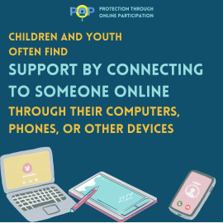
Child Online Protection
POP: Protection
Through Online Participation
Survey : Official help services​
Data collection is based on :
Country-based helplines hotlines functioning through online channels, addressing children’s protection, wellbeing and mental health in an interactive manner between human beings.

Slide 5
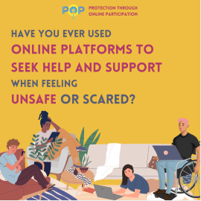
Child Online Protection
POP: Protection
Through Online Participation
Survey - Child and youth-led solutions
Data collection is based on :
How children and young people look for help online when they feel scared or unsafe.
By ‘online’ we mean on the Internet:
Social media
Online games
Chat rooms
Websites
Videos streaming

Slide 6
Child Online Protection
POP: Protection
Through Online Participation
Survey - Child and youth-led solutions
Highlight from online survey:
377 youth and children participated in the online survey
53% child respondents said they sometimes use online platforms to seek help and support when you feel scared, not safe, or uncomfortable; while 34% child respondents said they never use online platform
47% youth respondents said they sometimes use online platforms to seek help and support when you feel scared, not safe, or uncomfortable; while 25% youth respondents said they never use online platform.
Young people answered that they either 1) found these platforms themselves (54%) or 2) learn from their peers (34%)
30% youth noted that they are aware that the platforms are made by people of their age, while for children only 18% answered this.
79% respondents agree that young people and children should be involved in designing the online platforms that youth and children use when feeling unsafe online or in real life.
Next steps: in-person interviews at IGF and and online for participants who have indicated they are interested in engaging (5 youth and children confirmed, 6 pending)

Slide 7
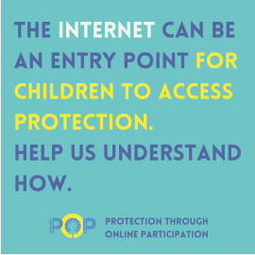
Child Online Protection
POP: Protection
Through Online Participation
Survey – Learning from ICTs industries
Data collection is based on:
Exploring the positive effects of the platforms by documenting their use by children (anyone under the age of 18) and young people (under 24) to access safety and protection when they experience or feel at risk of harm, whether online or offline.
The goal is to collect the views of technology companies and digital platforms being used by children

Slide 8
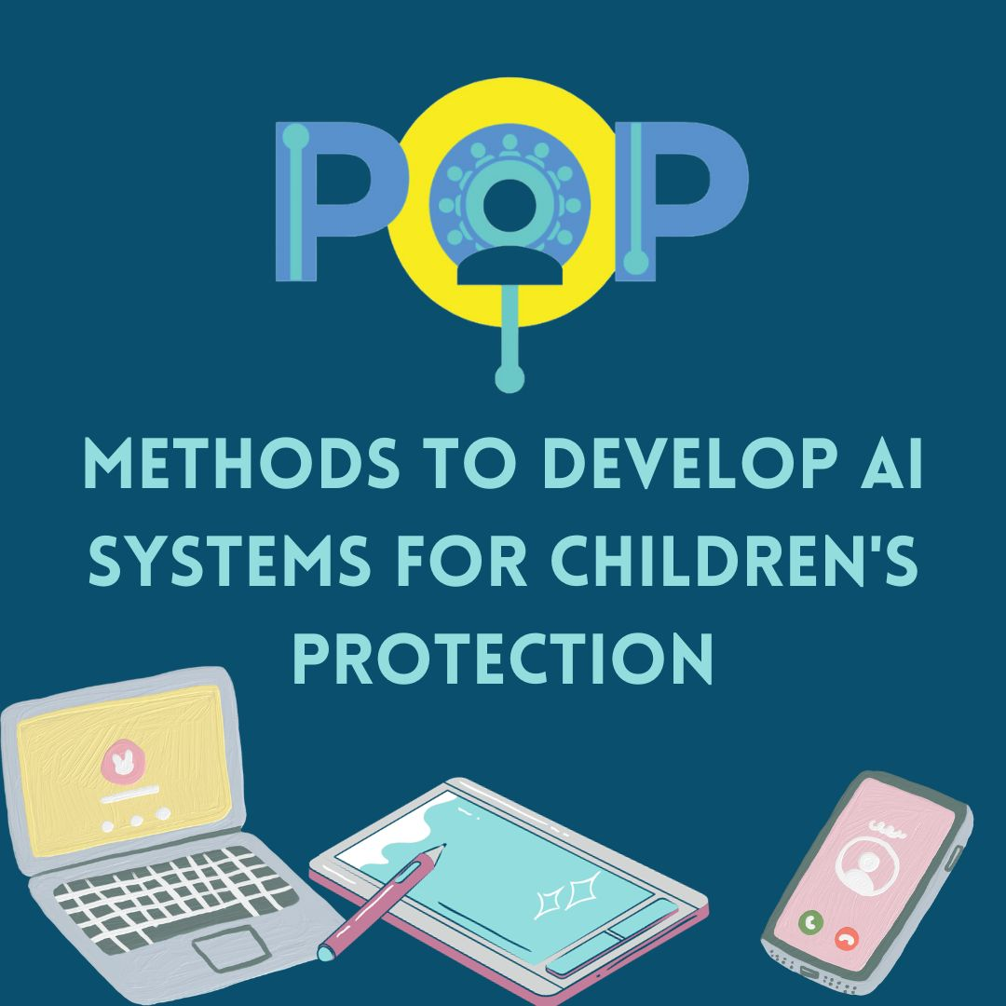
Child Online Protection
POP: Protection
Through Online Participation
Survey – AI driven systems
Data collection is based on :
How children access help via platforms that use artificial intelligence systems
With this survey we aim to get insights on the following:
Aims
To leverage the learnings from the use of AI-based platforms to access security.
To understand how current AI-based platforms are designed to support children's protection
Understand the users
Identify types of protection
Unpack the AI systems
Explore the transparency of the AI systems
Classify the evaluation methods

Slide 9
Child Online Protection
POP: Protection
Through Online Participation
What is the data telling us so far?
Survey results are showing the important role of governments and official services.
Most services use social media channels or digital apps to provide support to children and young people.
Most of the respondents of the survey so far see benefits in communicating through online channels.
They also see challenges in communicating with children through online means. (Poor Internet connection, people not always having access, and online risks).

