Slide 1
Working for a digital world
designed to protect children
from sexual exploitation & abuse
Notes:
Introduce speaker:
Hello, I’m Iain Drennan, Executive Director at WeProtect Global Alliance, and I’m delighted to be able to talk to you all at PIER23 today about how together we can build a digital world designed to protect children from sexual exploitation and abuse.

Slide 2
What the Alliance is doing
Notes:
To make change happen, WeProtect Global Alliance works with all our members to clearly identify and track the problem, agree how to address it and strive towards a vision of a different future.

Slide 3
Our Alliance exists to solve a problem
Notes:
Everything we do comes back to breaking down problems by focusing in on specific themes.
This allows our different members to find help and contribute their know-how in these areas.
As the previous examples showed, action is needed in all these areas simultaneously to make change happen.

Slide 4
We bring experts together
102 Government
92 Civil Society Organisations
66 Companies
9 Intergovernmental Organisations

Slide 5
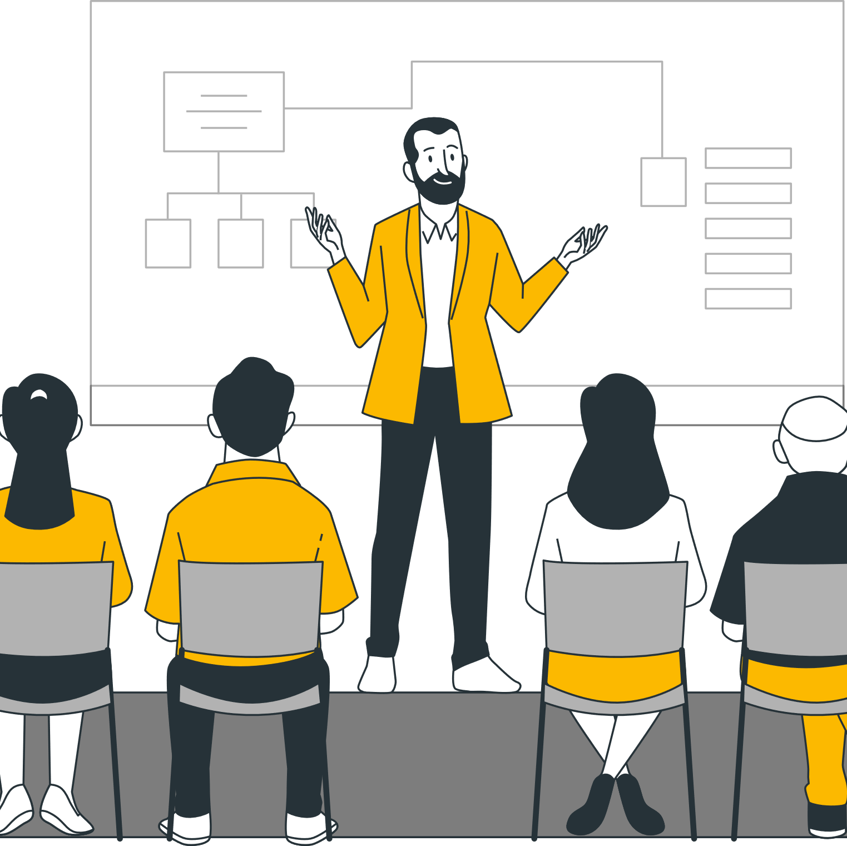
Our Global Summits share approaches
Notes:
The Alliance seeks to align action around the themes through leadership and collaborative activities.
These include our biannual Global Summits where leaders get together to share approaches, discuss challenges and make commitments to do more.
(Here we could embed short edit of the Summit 2022 video...)

Slide 6
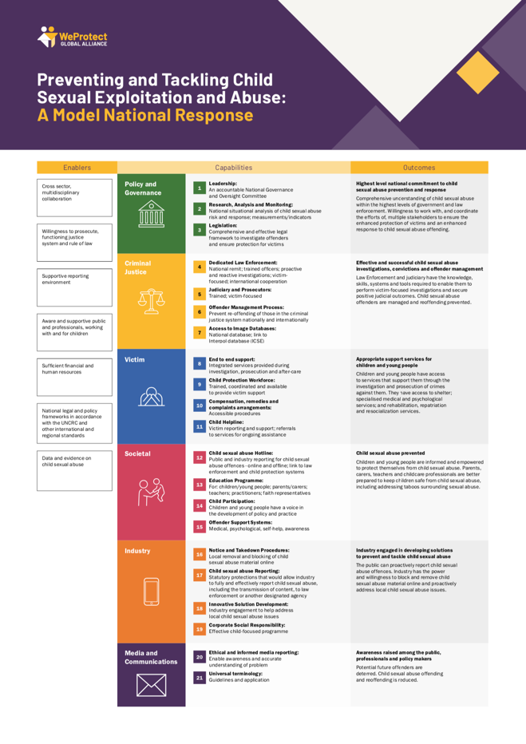
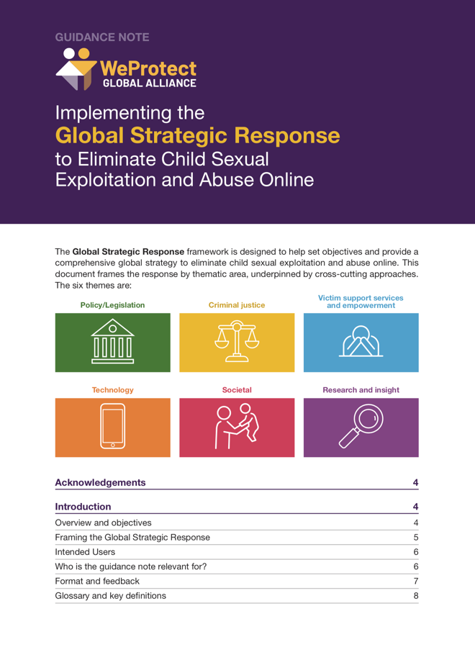
Our frameworks break down the issue
Research & insights
Child & survivor participation
Policy & legislation
Technology industry
Criminal justice
Society & culture
International collaboration
Notes:
We use these themes to outline and demonstrate all the different elements of an effective systems-wide response to child sexual abuse online:
Research & insights: We produce evidence and analysis to define the threat, we promote our members' research and support the open and honest discussion to confront the issue.
Child & survivor participation: To support and protect children, we promote child-centred, multi-sectoral responses. Equally, we recognise that the voices of survivors are key to advocate for system-wide change.
Policy & legislation: We provide a blueprint for laws and national strategies: supporting our government members to share their learning and coordinate their responses.
Technology industry: Supporting our tech members to adhere to a common and transparent approach to reporting abuse and a coordinated response for implementing software solutions.
Criminal justice: We seek consensus amongst our government members on a global approach to targeting offenders and enforcement procedures, as well as common standards for databases and reporting technologies.
Society & culture: Digital culture is about how we interact online. Increased public understanding of how governments and tech companies uphold their duty of care for children online will help accelerate change.
Underpinning this all is international collaboration: As an Alliance, we exist to bring our members together. Our frameworks act as a focus for collaboration by breaking down and addressing the complex problem at national and global levels.

Slide 7
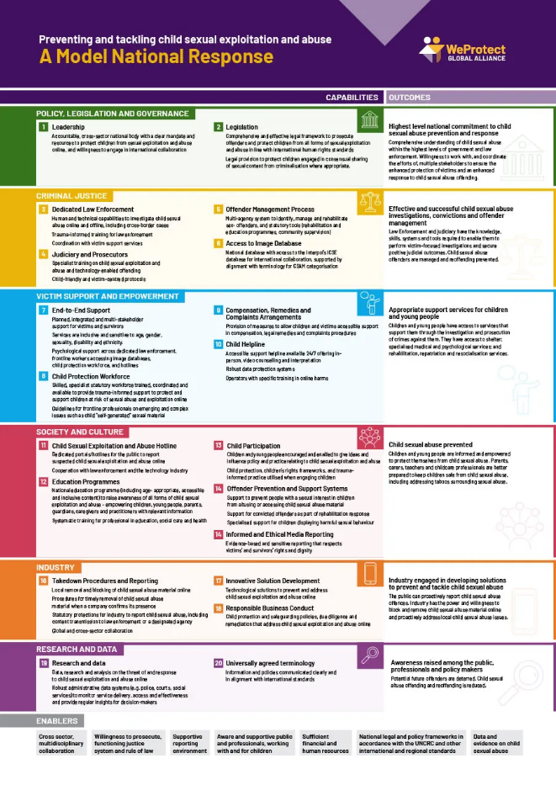
Notes:
To guide the response to child sexual abuse online, we have produced two strategic frameworks that similarly use our thematic approach:
A National Framework – the Model National Response, designed as a blueprint for governments to help guide assessment, priorities and implementation at a national level.
And a Global Framework – the Global Strategic Response, responding to the international nature of the issue and providing strategies for collaboration, coordination and shared learning across our membership.

Slide 8
The Model National Response helps countries protect children online
Policy, Legislation and Governance
Criminal Justice
Victim Support and Empowerment
Society and Culture
Industry
Research and data
Notes:
The Model National Response supports the work we are taking forward with our membership, in particular our government members. It presents a global framework for countries to draw upon to address child abuse and exploitation online, and other forms of violence against children online.
The Model lists the capabilities that a country needs in order to achieve a comprehensive national response, in the context of the need to tackle child abuse and exploitation online, and other forms of violence against children online.
It is our intention that the Model will help a country to:
Evaluate its current response to child sexual exploitation and abuse online and identify gaps
Prioritise national effort on filling gaps
Enhance international cooperation
The capabilities are broken down into six categories, each of which is linked to a set of outcomes that will support a country. Each of the six capabilities in the model sets out a desirable outcome that will have significant child protection benefits.

Slide 9
Framing the Future report
In collaboration with UNICEF, we have conducted a review of the MNR with a focus on national responses in 40+ countries.
The review has:
Mapped evidence of MNR implementation
Identified examples of good practice
Highlighted gaps and challenges
This resulted into the report “Framing the Future” launched at the WeProtect Global Alliance Global Summit on 1-2 June 2022 in Brussels
Notes:
In 2021 , UNICEF and the Alliance conducted a survey in 42 countries to map the evidence of the MNR implementation, identify examples of good practice and highlight challenges and gaps. Itresulted in the publication of a report entitled Framing the Future which we launched during our global summit in June 2022.

Slide 10
Recommendations
Notes:
The framing the future report issued some key recommendations for governments to:
Invest in comprehensive national responses to prevent and respond to online child exploitation and abuse.
Accelerate global collaboration among governments and companies to strengthen prevention and response efforts.
Strengthen the use and collection of data and evidence to enhance effective, sustainable national efforts to protect children.
Share best practices and lessons learned to support national responses to protect children from abuse and exploitation online.
Promote the global implementation of the Model National Response framework, and its continuous refinement based on lessons learned.

Slide 11
Model National Response Maturity Model
In June 2023, in partnership with UNICEF, we have launched a Model National Response Maturity Model – a tool to facilitate tailored national responses and foster a climate of continuous improvement.
The Maturity Model proposes four broad phases for each capability: building, enhancement, integration and maturity.
MNR
Maturity
MNR
Integration
MNR Building
MNR
Enhancement
Notes:
We drew from these review and update processes, to develop a Maturity Model that will facilitate tailored national responses and foster a climate of continuous improvement.
The maturity model has been developed in consultation with UNICEF and other key stakeholders (European Commission, ECPAT International and the governments of our Global Taskforce) and was launched in June 2023 after the piloting phase.
Successful national responses are acquired through a blend of capabilities, continuous refinement and improvement and not by ‘achievement’ of each capability in isolation. As such, there is a need to consider the capabilities of the MNR as interdependent and take a holistic and systems-based approach. Different circumstances can mean that countries do not always move through the phases in a linear or predictable fashion.

Slide 12
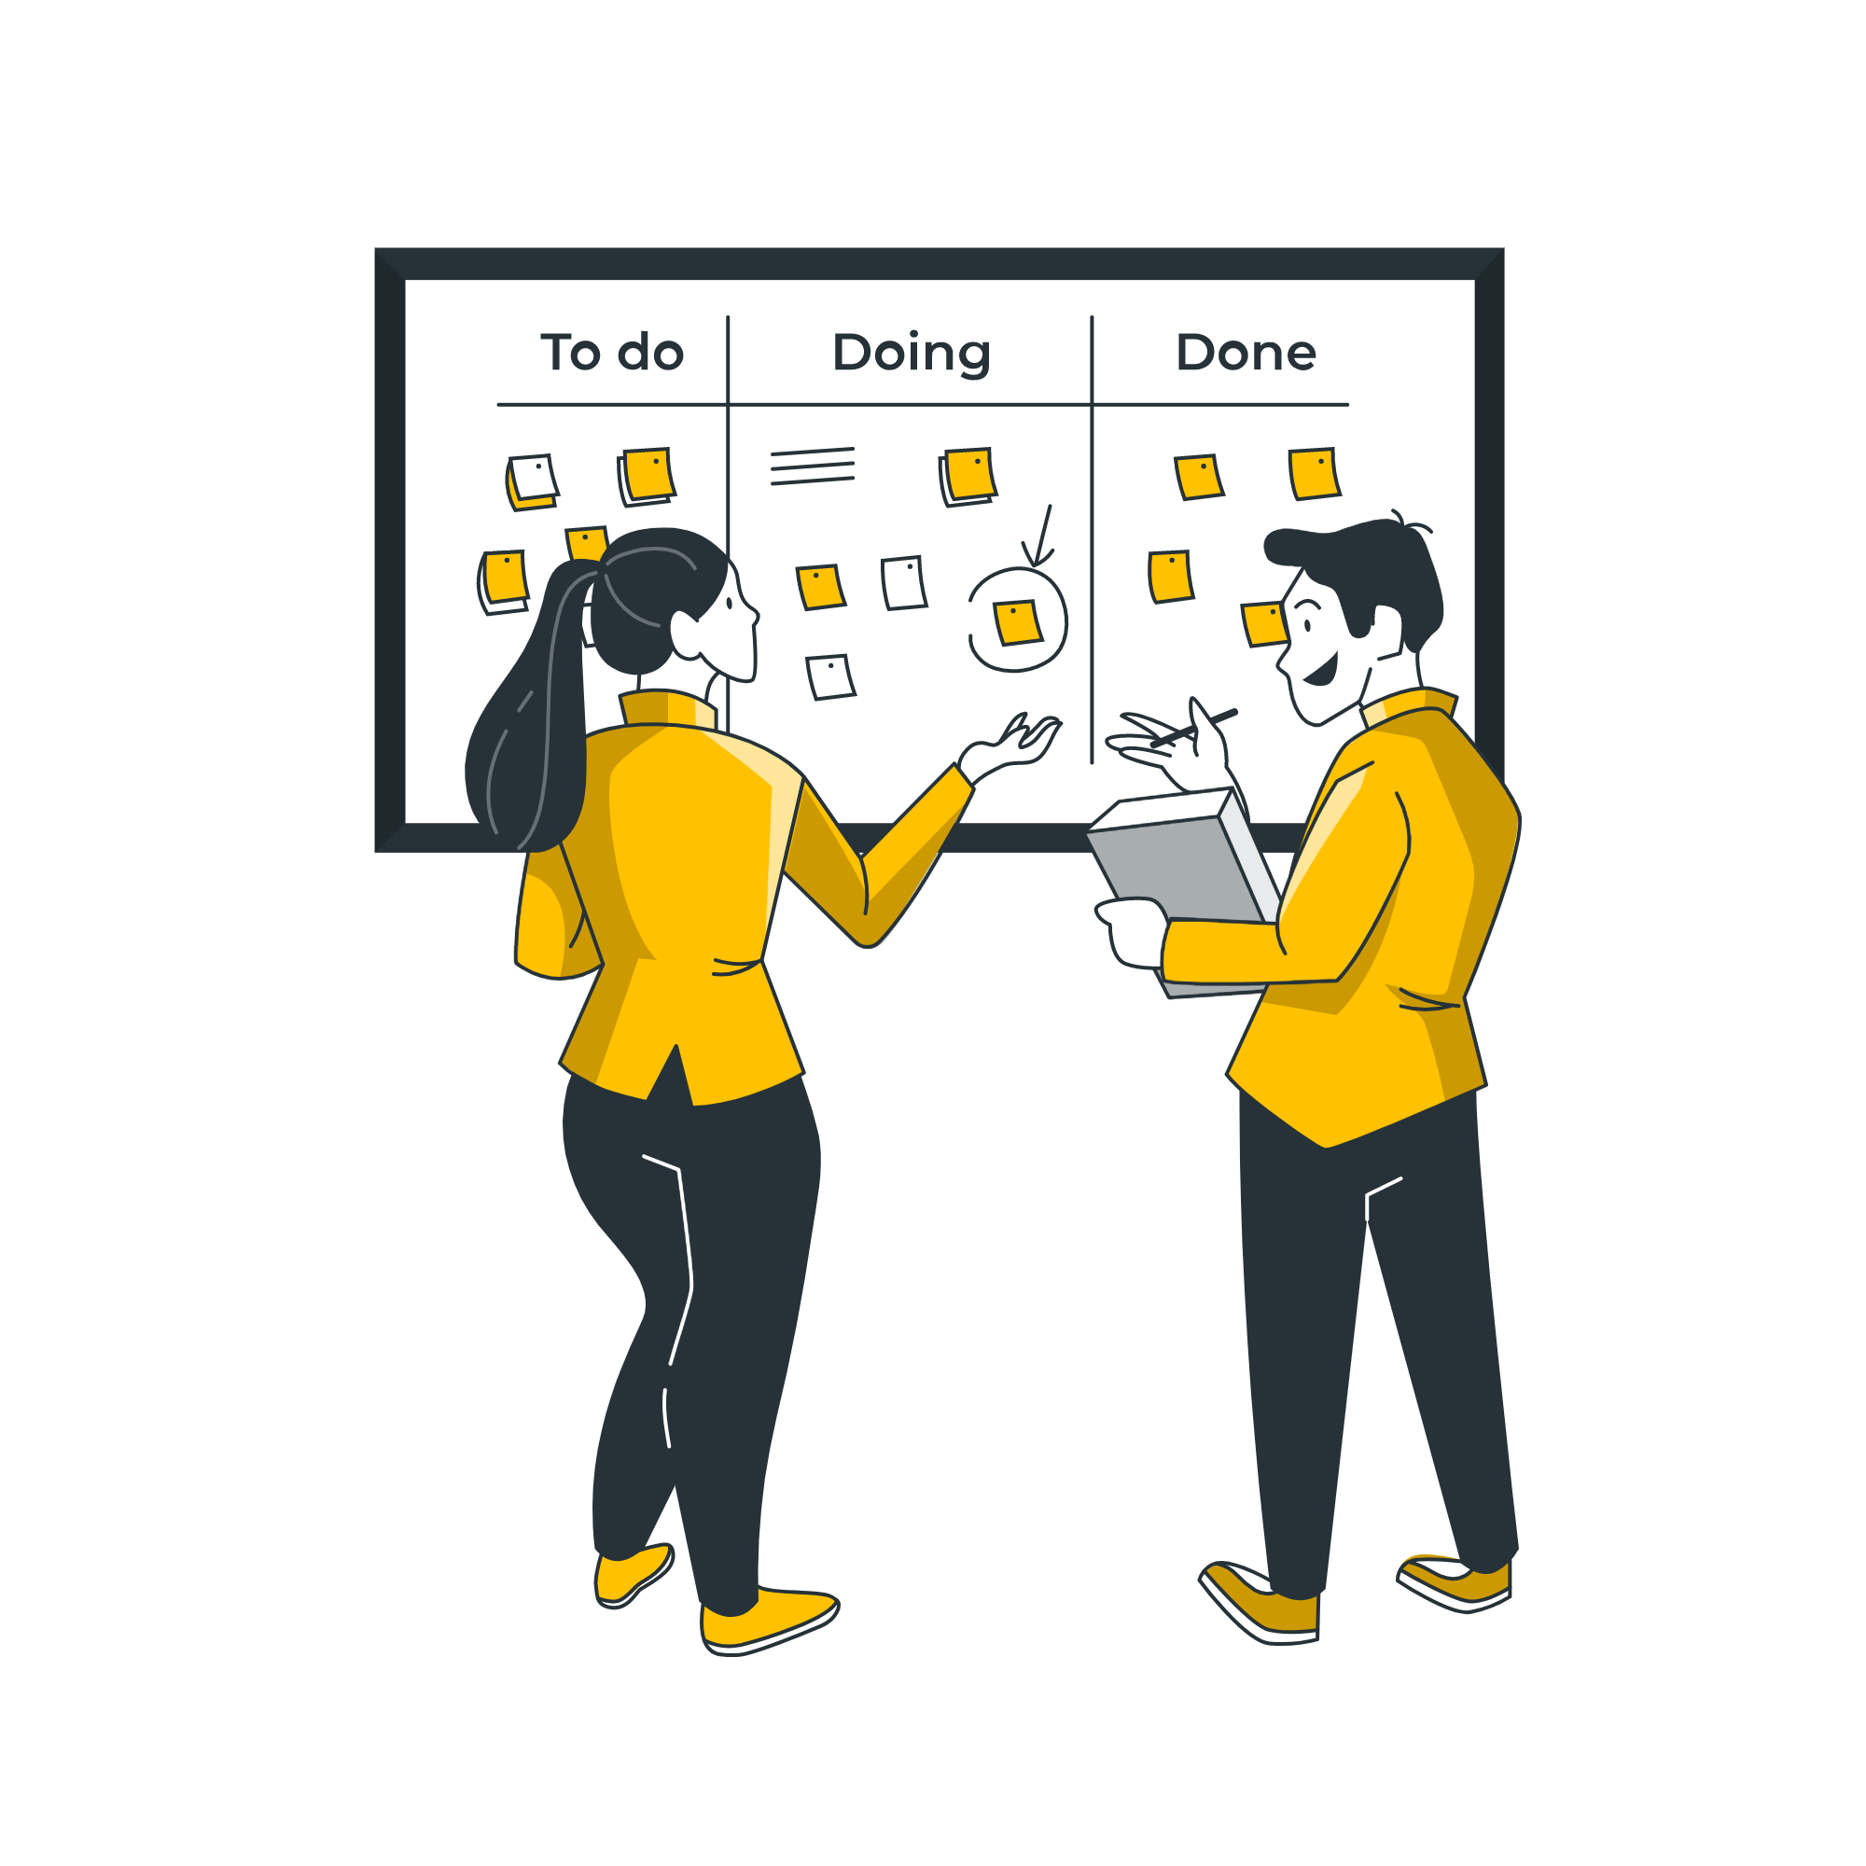
Maturity Model Self-assessment tool
The tool is composed of five tabs :
Introduction
Guidance on how to use the tool
Input – to enable countries to self-assess
Output – to support countries to develop tailored action plans
A radial to visualise their performance in each domain (see next slide)
Notes:
In conjunction, a very practical self-assessment tool has been developed to help government members self-assess their progress against the maturity model and develop tailored strategic action plan.
This self-assessment tool is intended to be used by Alliance government members on an annual basis to support business planning cycles and agreeing future activities to help build maturity against the Model National Response model.
We worked with UNICEF to pilot the Maturity Model and associated self assessment tool in Albania, Ghana and Indonesia to help refine the resource and make it as practical and user friendly as possible.

Slide 13
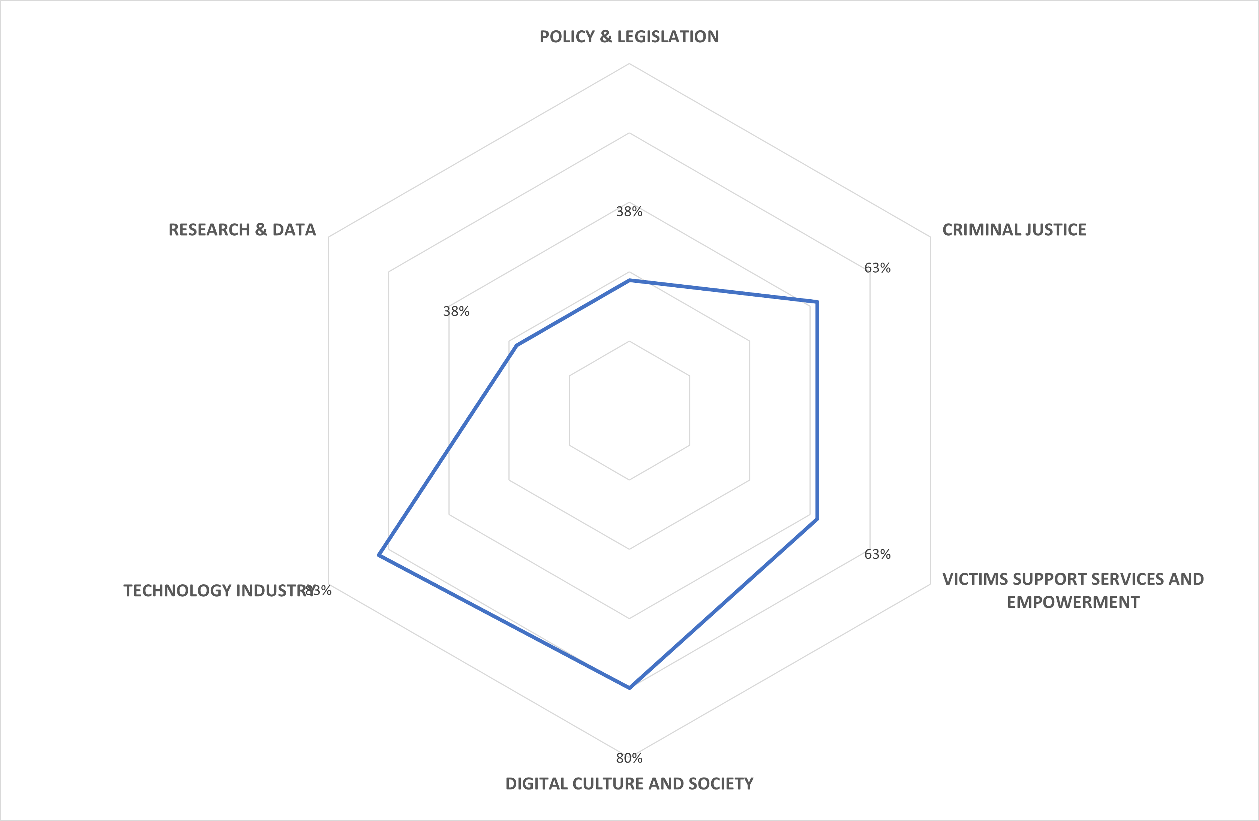

Slide 14
Our 2023 Global Threat Assessment
Publication on 17 October 2023
Conducted in partnership with PA Consulting
Supported by a diverse steering committee representing our wide membership
Meta-analysis using a mixed methods approach
Notes:
We are currently working on the 2023 Global Threat Assessment with PA consulting. We also have the support of a steering committee that is composed of our wide and diverse membership to keep us in check, feedback and challenge us on our interpretation of the data finding and analysis.
We are using a mix methods approach to inform out meta-analysis which includes both quantitative (surveys) and qualitative data ( key informant interview and in-depth literature review). In the next slide we’ll go more in details into the different datasets
We are currently validating our hypothesis with our various stakeholders. In the next few slides, I will give an overview of our preliminary findings.

Slide 15
Key themes
New forms of abuse, like financial sexual extortion and AI-generated imagery
Global alignment of regulatory standards
Public health approaches and prioritising prevention
Need for a more child-centred approach
Notes:
Collaboration between governments, regulators, platforms and the safety tech sector will be critical in years to come, to make sure internet laws sufficiently address risks created by new and emerging technologies
Immersive technologies and generative AI are likely to become increasingly mainstream in the future. They will pose challenges both for the development of safety tech, and future-proofing legislation
Global alignment of regulatory standards will be key to ensuring the effectiveness of new internet laws.
Governments should lead a broader shift towards prevention by investing in public health approaches. Adapted from the field of public health, such approaches involve both the public and private sector investing in interventions that target the whole community, including those at risk of perpetrating child sexual abuse or experiencing it, those who have already been abused, and those who have abused others .
Child-centred approaches are vital as they help ensure interventions and services are responsive to the experiences, rights, and needs of young people

Slide 16
Stay informed, discuss the issue
Behind every image
video
screen there is a real child
www.weprotect.org
info@weprotectga.org
WeProtect
weprotect-global-alliance
Notes:
Thank you very much for your attention,
Stay informed, discuss the issue, and play your part to protect children from sexual exploitation and abuse.

