Slide 1
UNICEF’s Child Online Protection Strategic Framework and Action
12 January 2022
©UNICEF/UN0352056

Slide 2
Our approach
UNICEF takes a comprehensive approach to child protection in the digital environment.
4 priority outcome areas:
Digital technologies are not misused to facilitate sexual exploitation and abuse of children
Children use digital technologies free from bullying and harassment
Children are protected from inappropriate collection and processing of their data
Children are protected from harmful digital marketing practices
©UNICEF/UN017636

Slide 3
Child online protection programming
At national level, UNICEF supports the strengthening of systems to prevent and respond to all forms of violence against children including in the digital environment
In tackling the online dimensions of child sexual abuse, guided by the ‘WeProtect Model National Response’. See recent UNICEF review: https://www.unicef.org/documents/ending-online-child-sexual-exploitation-and-abuse
At global level, we are part of global alliances and set technical guidance to address all forms of violence against children
Pleased to collaborate with ITU at global, regional and national levels

Slide 4
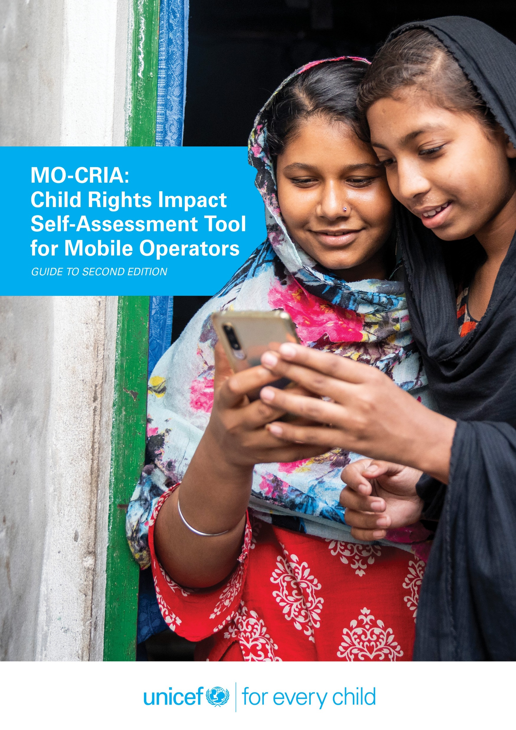
Child rights and business in the digital environment
Built on UN Guiding Principles on Business and Human Rights and the Children's Rights and Business Principles​ with a focus on integrating child rights into human rights due diligence processes.
Industry tools and guidance on child rights e.g.
Child Rights Impact Self-Assessment Tool for Mobile Operators
Recommendations for the Online Gaming Industry on Assessing Impact on Children
Focused on business practice change at scale
Convening and awareness raising

Slide 5
Research, evidence, and policy
Design and support multi-country research on children's use of digital technologies; access, skills, opportunities and risks. Nationally-representative surveys with children in 40+ countries, including more than 50k children.
Disrupting Harm project established to generate high-quality evidence on technology-facilitated sexual exploitation and abuse of children in 13 countries across Eastern and Southern Africa and Southeast Asia.
Policy recommendations in critical areas of relevance to child online protection including:
Artificial Intelligence: https://www.unicef.org/globalinsight/featured-projects/ai-children
Governance of children’s data: https://www.unicef.org/globalinsight/reports/better-governance-childrens-data-manifesto

Slide 6
Thank you

