Slide 1
Global Threat Assessment 2021
Overview
November 2021

Slide 2
Our mission
WeProtect Global Alliance brings together experts from government, the private sector and civil society to protect children from sexual exploitation and abuse online.
Child sexual exploitation and abuse online is partly or entirely facilitated by technology,
i.e. the internet or other wireless communications

Slide 3
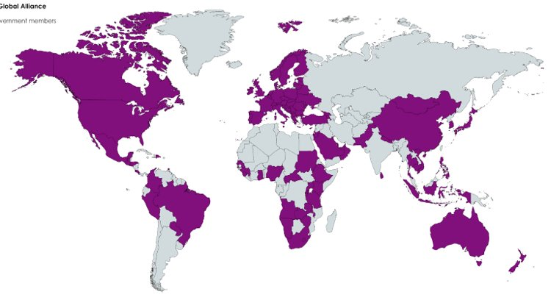
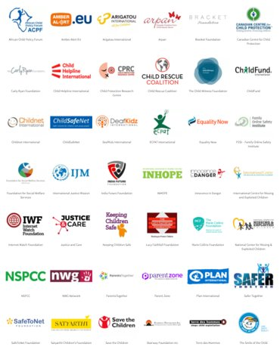
Our members span the globe
98 Governments, 53 companies, 61 civil society organisations and 9 intergovernmental organisations

Slide 4
Developed during unprecedented times, GTA 2021 is our most comprehensive threat assessment yet
Insights from a first-in-kind study into childhood exposure to sexual exploitation and abuse and its risk factors online
Data insights from Crisp, a leading provider of Actor Risk Intelligence
Anonymised survey of 32 global technology companies
More case studies than ever before thanks to a record response from Members from a range of sectors
Tech
Companies
IGOs
NGOs
Law
Enforcement

Slide 5
Our report concludes that children today face a sustained threat of child sexual exploitation and abuse online
Available evidence indicates an increase in:
THE INCIDENCE OF ONLINE GROOMING
97%
increase in ‘online enticement’ (NCMEC)
THE VOLUME OF CHILD SEXUAL ABUSE MATERIAL
63%
increase in reports of child sexual abuse material (NCMEC)
155%
increase in the use of ‘hidden services’ to distribute child sexual abuse material (IWF)
THE SHARING AND DISTRIBUTION
OF CHILD SEXUAL ABUSE MATERIAL
LIVESTREAMING FOR PAYMENT
Increase reported by INTERPOL

Slide 6
The incidence of detected abuse is increasing. Actual levels of abuse are likely to be even higher
COVID IS UNDOUBTEDLY A FACTOR BEHIND THE RECENT REPORTING SPIKE…
BUT AVAILABLE DATA IS NOT GLOBALLY REPRESENTATIVE…
….CHILD SEXUAL EXPLOITATION & ABUSE IS UNDER-REPORTED…
There is relatively less data regarding the scale of the
issue in Global South countries.
of NCMEC’s Cyber Tipline reports come from
children themselves
2%
77%
…AS IS THE INCREASE IN CHILD ‘SELF-GENERATED’ SEXUAL MATERIAL
Increase from 2019-2020 (IWF)
…USE OF DETECTION TOOLS IS NOT WIDESPREAD…
…and IT IS EASY FOR OFFENDERS TO EVADE DETECTION
Of companies that responded to the WeProtect/Tech Coalition survey use tools to detect online grooming.
Offenders with minimal technical ability can evade detection. Those with the knowhow use advanced tech to avoid getting caught.
37%

Slide 7
Various trends have the potential to fuel the sustained growth and complexity in offending
OFFENDERS DIVERSIFYING THEIR PRODUCTION METHODS
THE RISE OF CHILD ‘SELF-GENERATED’ SEXUAL MATERIAL, WHICH IS CREATING COMPLEX CHALLENGES
FOR POLICY-MAKERS
THE REINFORCEMENT OF COMMERCIAL DRIVERS FOR ABUSE
60-70%
New ways of monetising child sexual abuse material, such as affiliate link schemes
Increase in ‘self-generated’ content in exchange for payment
Proportion of referrals to the Victim Identification Unit in the Australian Centre to Counter Child Exploitation that are generated by ‘capping’

Slide 8
Despite the worrying trends, there is HOPE

Slide 9
…Especially in light of developments that have the potential to curb current trends, not least the growth of online safety tech.
ENABLERS FOR AN ENHANCED PREVENTATIVE RESPONSE
Enhancing Online Safety for Children Act (Australia)
EU Digital Services Act (proposal)
UN
General Comment 25
published
Internet Regulation
Online Safety Bill (UK)
Online Safety
Act (Australia)
Interpol Child Abuse Image Database launched
Technology Coalition founded
PhotoDNA developed
Launch of Google Content Safety API image classifier
35% year-on-year growth of Safety Tech industry
Technology
UK Home Office Child Abuse Image Database launched
Project Arachnid launched
Online Safety Tech Industry Association (OSTIA) founded
WePROTECT founded, first WePROTECT international summit
South Asia Initiative to End Violence Against Children (SAIEVAC) Launched
WePROTECT Global Alliance launched as an independent not-for-profit
ICMEC founded
INHOPE founded
Voluntary Cooperation
IWF founded
Europol founded
Global Alliance to end Child Sexual Abuse Online founded
WePROTECT Model National Response published
Voluntary Principles to Counter Online Child Sexual Abuse published
1990
2000
2010
2020

Slide 10
All companies, governments and charities can take action now to improve the response to child sexual abuse online
CROSS-CUTTING: Governments, the private sector, and civil society must commit sufficient funding to tackle the threat.
Policy/legislation | Criminal justice | Victim support services | Technology | Societal | Research and insight
Governments must Criminalise all offences relating to child sexual exploitation and abuse. Invest in strengthening child protection systems. Consider other legislative options (i.e. internet regulation). | Governments must: Invest in deterrence and rehabilitation. Fund specialist police units to cultivate threat expertise. Invest in building international policing capabilities. Governments and police agencies must develop consistent approaches for the investigation of cross-border crimes. | Policymakers must work with industry to set standards to reduce online harm. Governments must invest in victim support services. All stakeholders must safely engage survivors of child sexual abuse to inform the design of effective services, policies and support. | Online service providers must take a ‘Safety by Design’ approach for services aimed at children. Online service providers should publish regular transparency reports. Developers of online safety technologies should continue innovating to enhance the detection of child sexual abuse online. | Governments must incorporate online safety into school curricula. All stakeholders involved in the response must educate communities on the risk and impact of child sexual abuse. | Governments, NGOs and online service providers must invest in research to: Better understand pathways into offending. Better understand the drivers behind child ‘self-generated’ sexual material. Understand risk and protective factors for children. Improve the evidence picture for ‘Global South’ countries.

Slide 11
THANK YOU

