Slide 1
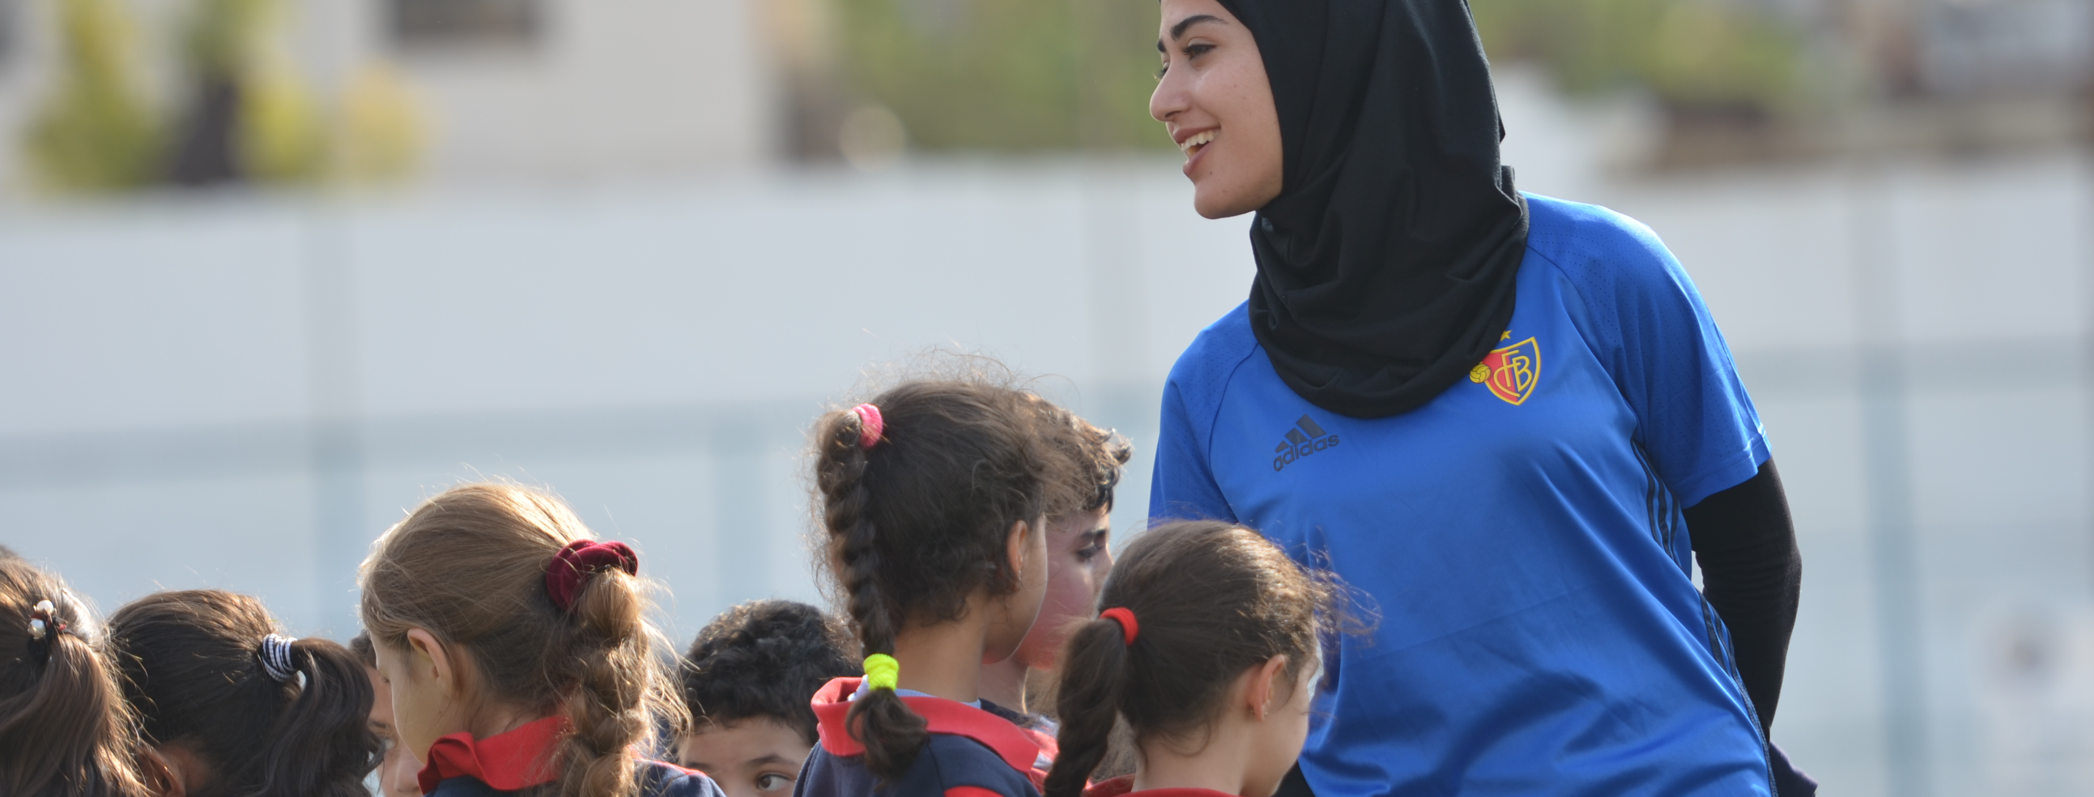
SCORT FOUNDATION
ACTIVITY REPORT

Slide 2
WHO ARE WE?
Scort Foundation - independent, fully funded, and operating foundation.
Aim
Empower leaders working with children and youth, and support them to foster holistic development and peacebuilding initiatives through sport.
Areas of work
Advocacy work, onsite and online educations in Sport for Development
Partners
Broad network
Collaboration with the ITU/Child Online Protection in Sport and with UNHCR and IOC/ORF as co-convener of the “Sport for Refugees Coalition”

Slide 3
COLLABORATION WITH ITU
Main Goal:
Awareness raising about Child Online Protection (COP)
Strengthen capacity within sport-based organisations to promote safe spaces for children
Events :
FCSA Webinar, December 2020: ITU delivered an introductory workshop on COP in football
EFDN conference, April 2021: ITU delivered an introductory session on COP
Laureus USA online workshop, May 2021: ITU delivered online child safety training to sports organisations.
Survey, August 2021: Scort assessed needs and interest to promote COP within EFDN clubs
EFDN virtual round-table, September 2021: ITU and EFDN clubs openly discussed challenges, opportunities and needs to strengthen COP in clubs.

Slide 4
KEY TAKEAWAYS & CHALLENGES
Key Takeaways:
COP viewed as important, interest to take it forward
Variations in how COP is present in sports organisations, from little to extended expertise
Challenges:
Understanding and awareness:
What is COP (terminology)?
How children’s on- and offline worlds are interlinked and why sports organisations should protect both settings?
What can be or is already being done? Who is the focal point for COP within organisations?
Lack of expertise:
Lack of guidance on COP
Lack of practical tools to adapt existing policies

Slide 5
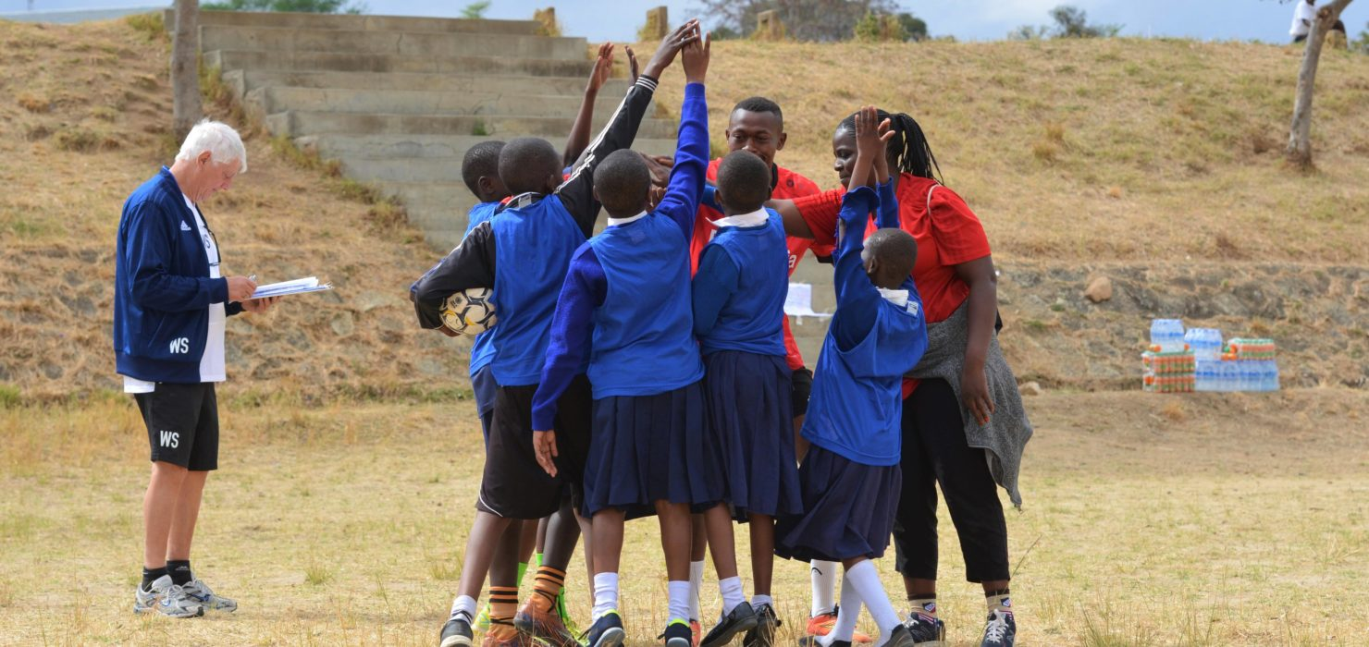
OUR NEXT STEPS
Establish COP in Sports:
Support ITU to develop clear and tangible recommendations through an intersectoral multi-stakeholder working group on how sports organisations can improve their COP policies and practices.

Slide 6
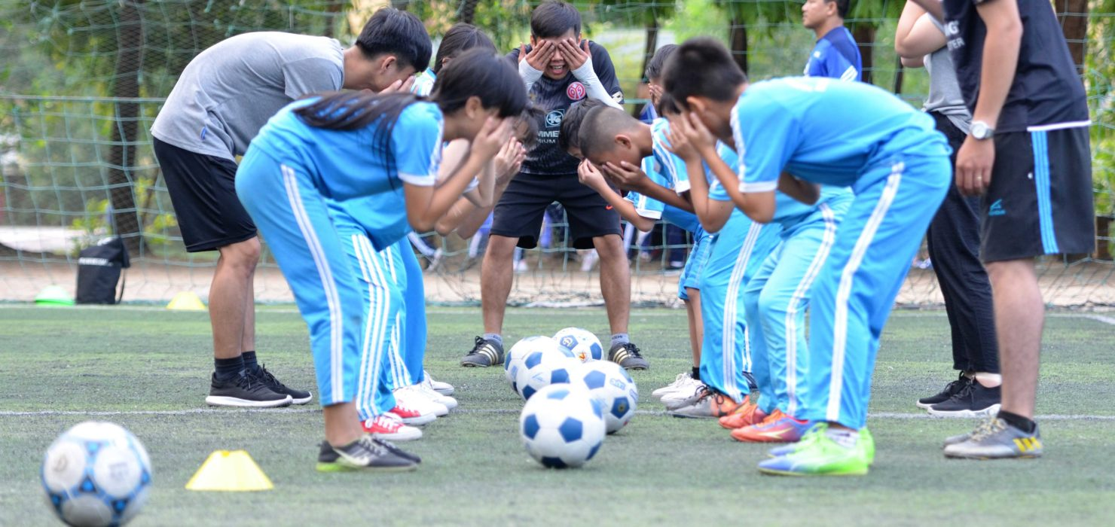
OUR NEXT STEP
THANK YOU !

