Slide 1
Nigeria’s Presentation at the Council Working Group Meeting on Child Online Protection. January 12, 2022
Nigerian Communications Commission

Slide 2
Nigeria’s activities on Child Online Protection

Slide 3
Child Online Protection (COP)
The Internet’s connectivity and online social connections have been increased by social networking sites (e.g. Facebook), micro-blogging (e.g. Twitter), media sharing (e.g. YouTube, Instagram, Flicker, Snap chat), online encyclopedias (e.g. Wikipedia), social voting and online games.
Many children learn and access information through their tech devices without much restrictions on their usage.
While technology can provide many benefits and endless supply of knowledge and information, it may also pose many risks and harm, especially where children are concerned.

Slide 4
The revised ITU 2020 Guidelines on Child Online Protection
Nigeria virtually participated at the official launch of the International Telecommunication Union (ITU) 2020 Guidelines on Child Online Protection (COP), which is a comprehensive set of recommendations for children, parents and educators, industry and policymakers on how to contribute to the development of a safe and empowering online environment for children and young people. June 2020
Nigeria, further participated at the COP virtual training and launch for the African region which was put together to introduce and promote the adoption of the 2020 COP guidelines at national and regional levels.

Slide 5
The revised ITU 2020 Guidelines on Child Online Protection
The meeting also aimed at equipping delegates with adequate information on the revised COP 2020 guideline, create a pool of regional ambassadors, promote the adoption of COP Initiatives and customize to suit different peculiarities in the African continent. October 2020
During the regional launch, it was agreed that countries should have a Mascot that will be appealing to their respective countries and nationalize the Online with ‘SANGO’ to suit their local culture but may replace ‘SANGO’ with ‘Agent COP’

Slide 6
Localization of the revised ITU 2020 Guidelines on Child Online Protection
Based on this, a Virtual Hangout with some children to assess their understanding of online safety, and allow them participate in the review and localization of the ITU 2020 guidelines. The review was done by children within the age bracket of 7-18.
The guidelines reviewed by the children were:
Online with Agent COP
Online with Agent COP – Activity book
Teachers Online Safety - Activity book
The name “SANGO” was changed to “Agent COP” as SANGO translates to “god of thunder and lightning” in Nigeria’s Yoruba language.

Slide 7
Localization of the revised ITU 2020 Guidelines on Child Online Protection

Slide 8
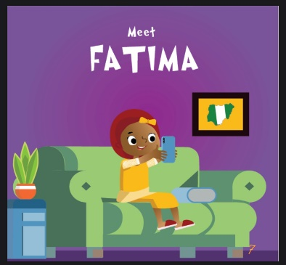
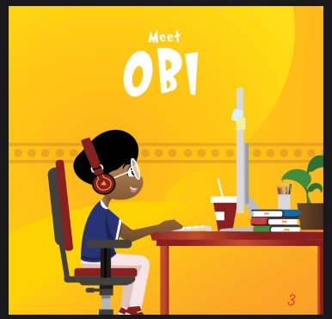
Localization of the revised ITU 2020 Guidelines on Child Online Protection
To further localize the content of the Guidelines to resonate with Nigerian children, the names in the ITU documents were replaced with local names that cut across the tribes in the six geopolitical zones of the country, these are: (Obi, Fatima, Tobi, Doshima, Eniola and Aliyu) and images designed in traditional attires representing the respective zones as shown below:

Slide 9
Localization of the revised ITU 2020 Guidelines on Child Online Protection
The books have been finalized and published on NCC’s website:
https://www.ncc.gov.ng/technical- regulation/internet/publications.
There is a plan to develop an audio version of the localized books, for wider dissemination of the content, particularly to differently abled persons.
Localized books will be shared in schools during sensitization visits.

Slide 10
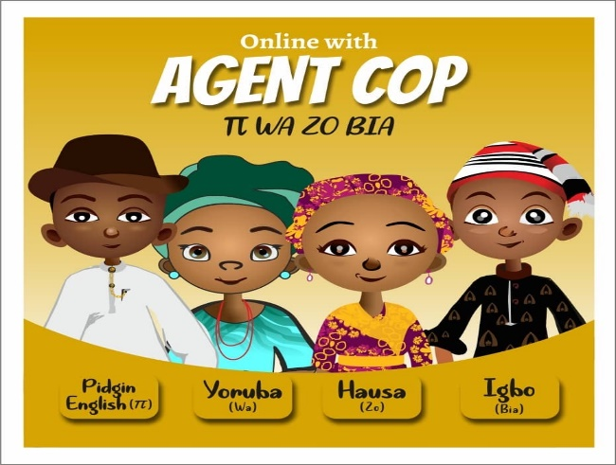
Localization of the revised ITU 2020 Guidelines on Child Online Protection
For ease of acculturation in order to bridge digital literacy gap, the localized COP books were further translated into Pidgin English and 3 major Nigerian languages (Yoruba, Hausa and Igbo – πWaZoBia). Images were developed to suite these languages, to increase acceptability of the Nigerian languages to the general public, and protect confidence of users at all social strata.

Slide 11
Nigeria’s commitment on Cyber Security processes.
The NCC organizes an Annual Conference, which draws participants from the Government and Security Agencies, Telecommunications industry, Academia, Financial Industry, and Civil society. The Conference serves as a medium to discuss regulatory issues, share information such as vulnerabilities and advances made in the industry, best practices, and experiences on how to effectively mitigate against cyber-attacks. Decisions taken at the Conference will be driven and implemented to help curb some of the challenges faced in an ever evolving and ICT dependent world.
The Conference will continue to foster strategic partnership collaboration as well as promote a strengthened cybersecurity environment in this post COVID-19 era.

Slide 12
Nigeria’s commitment on Cyber Security processes.
Development of the National Cyber Security Policy and Strategy (NCSP&S) document February 2021, which signifies the renewal of the President’s commitment to Nigeria’s national security and economic prosperity. The NCP&S encapsulates cyber security issues and Child Online Protection amongst others.
Establishment of a Computer Security Incident Response Team (CSIRT) to mitigate the cyber security issues in collaboration with Office of the National Security Adviser (ONSA).
The National Cybercrime (Prohibition, Prevention, Etc.) Act 2015 is the foremost legal framework on cybersecurity in the country. However, due to the dynamic nature of cybersecurity, there is need to continuously review and update the Cybercrime Act 2015. Accordingly, the Office of the National Security Adviser (ONSA) has started seeking for inputs and reviews to Act from stakeholders.

Slide 13
Review of the draft 2014 Nigerian Child Online Protection Policy (NCOPP) document
The Nigerian Child Online Protection Policy (2014) was reviewed in 2020.
The outcome of the review is that development of the Nigerian Child Online Protection document should comprise a Policy, Implementation Strategy and Action Plan.

Slide 14
Development of Internet Code of Practice (ICOP)
Nigeria launched the Internet Code of Practice (ICOP) on November 26, 2019. The Code examines:
The incorporation of Child Online Protection Policies into Terms and Conditions of Service;
Reporting Mechanisms for and Blocking of Access to, Child Sexual Abuse Content;
Parental Control Measures and Education of Parents, Guardians, and Minors.
The ICOP document is available on the Commissions website: https://www.ncc.gov.ng/accessible/documents/878-internet-code-practice/file

Slide 15
Customization of the document – “Keeping Children Safe Online - Advice for Parents and Caregivers”
Nigeria being a member of the ICANN Governmental Advisory Committee (GAC) adopted and localized the European Union Agency for Law Enforcement Cooperation (EUROPOL) International Edition of the ‘COVID-19 Online Safety Advice for Parents and Carers’ and came up with the localized document ‘Keeping Children Safe Online - Advice for Parents and Caregivers’.

Slide 16
Customization of the document – “Keeping Children Safe Online - Advice for Parents and Caregivers” cont’d...
In developing the localized document:
There were engagements with relevant organizations based on their roles in COP activities such as Cece Yara Foundation, Like a Palm tree foundation – Wise&Harmless, Concerned Parents and Educators. The Cece Yara Foundation helplines were incorporated into the document.
COP issues have also been included in the information being handled by NCC’s toll free line 622.
The document is available on - https://www.ncc.gov.ng/docman-main/internet-governance/885-igov-keeping-children-safe-online-advice-parents/file

Slide 17
Flag off Ceremony on COP sensitization campaign
On February 4th, 2020, Nigeria flagged off a nationwide COP awareness campaign via new and traditional media.
The campaign aimed at enlightening the public, especially children and young adults, on how to stay safe online.
The physical campaign was slowed down by the COVID-19 pandemic, but will resume fully by 2022.
Virtual campaigns are in progress.

Slide 18
Participation at the Africa Safer Internet Day (ASID) 2021
The Africa Safer Internet Day (ASID) is a general discussion by all African ITU Member States to champion the celebration of the Day within the continent. ASID is now celebrated across 170 countries worldwide.
ASID 2021 held on February 9, 2021, under the theme: ‘Positioning and Partnering for Child Online Protection’. This was in collaboration with relevant stakeholders, who took the campaign to schools in Abuja and Lagos, Nigeria.

Slide 19
Africa Safer Internet Day (ASID) – 2021
As part of the ASID - 2021 celebration, a ‘Fireside Chat with Children’ held on February 07, 2021 across the West African region, as a pre event chaired by the regional ITU chairperson. A second Fireside Chat with children held on February 27, 2021 as a post event. This was done in collaboration with Child Online Africa (COA), Ghana.
A book titled ‘What you need to know about Cyberbullying’ was developed in partnership with COA, and shared with participants during the ASID day.
Schools were visited across the six geopolitical zones in the country and there was an interactive session with the children on cyberbullying.
A soft copy of the book is available on NCC’s website: - https://www.ncc.gov.ng/documents/981-what-you-need-to-know-about-cyberbullying/file

Slide 20
Girls in ICT Day 2021
Nigeria participated at the 2021 Girls in ICT day which was celebrated under the theme: “Connected Girls, Creating Brighter Futures” on April 22, 2021.
The event was organized by the Women Entrepreneurs and Executives in Tech Summit (WEETS) and Ministry of Women Affairs in Lagos and Abuja respectively.

Slide 21
Girls in ICT Day 2021
On May 25, 2021, Nigeria leveraged on Moment ‘5’ which is “Online Safety” and celebrated the ITU’s 2021 Girls in ICT Day by visiting 8 schools in different regions of the country (2 each in Abuja, Lagos, Kano, Ibadan and Port Harcourt) to carry out sensitization campaigns on Child Online Protection.

Slide 22
AU Day of the African Child 2021 (DAC)
The African Union Day of the African Child (DAC) is celebrated every year on June 16 and is a time for the world to reflect on the progress made towards children's rights, as well as the barriers they continue to face.
DAC 2021 was celebrated in Nigeria on Saturday, July 03, 2021 in collaboration with Child Online Africa, Ghana by having a virtual Fireside Chat with Children from Nigeria and other African countries. The session was designed to enable children from participating African countries lead conversations on their concerns within the digital space.

Slide 23
Participation at Child Online Protection Related Events
3–7 Feb. 2020
26–30 Oct. 2020
ITU Council Working Group Meetings on Child Online Protection And World Summit on The Information Society which held in Geneva, Switzerland from 3rd – 7th February, 2020
The ITU 2020 Child Online Protection Guidelines Training and Virtual Launch of the Child Online Protection Guidelines for the African Region which held from 26th – 30th October, 2020.
Virtual 2020 International Telecommunication Union (ITU) Child Online Protection (COP) Guidelines and beyond which held on June 24, 2020.
ITU Council Working Group Meetings which held Virtually from 25th – 5th February, 2021
24 June 2020
25–5 Feb. 2021

Slide 24
Participation at Child Online Protection Related Events
Nigeria participates at National, Regional and Global Fora on COP related programs such as NIGF, WAIGF, AfIGF, IGF, Council Working Group Meetings on Child Online Protection, Regional Conferences on COP, and National Programs on Online Safety, etc.
Telecom Consumer Conversations: which is a program organized by the telecom regulatory body and aims at educating parents on how to keep their children safe online.

Slide 25
Sensitization Campaigns
Continuous sensitization campaigns across the nation in year 2021 and beyond;
Establishment of 622 helpline to accommodate child complaints;
Engagement amongst relevant bodies and NGOs on COP activities; using this as a platform to create awareness of COP;
COP awareness campaign during the 2021 National Cyber Security Awareness Month (NCSAM) in October. Week 3 focused on COP activities which are broken down as follows:
Day 1 – Nigerian COP ambassadors were recorded sharing their experiences on COP matters.
Day 2 – publication of submissions made by children across African countries on African Children’s view matters – What is Child Online Safety to you?
Day 3, 4 & 5 – video clips of Senior Government Officials advising on Child Online Safety was published.
All publications are on the NCC’s website and social media handles. https://www.ncc.gov.ng/media-centre/news-headlines?start=25
Plan to organize “Parenting 101” workshop (COP awareness for parents and carers);
Participation at all international COP related activities.

Slide 26
Engagements
Engagement with organizations such as: ITU, ATU, Child Online Africa, Ministry of Women Affairs – Nigeria, Child helpline Nigeria, Public and Private Development Center (PPDC), Cece Yara Foundation etc. and work on collaboration with other relevant stakeholders.
Nigeria is a signatory to the AU charter.

Slide 27
COP complaint handles
Toll free line – 622
Email – cop@ncc.gov.ng
Cece Yara Foundation: 08008008001, 07007007001

Slide 28
Prevailing Challenges
Having a gazetted national policy document in place to guide COP activities in the country.
Ability to work harmoniously with other stakeholders on COP.
The COVID-19 pandemic which ushered in an unprecedented rise in the number of children joining the online world for the first time and leaving young people at risk of accessing inappropriate content or being targeted by cyber criminals.
Inadequate outreach and awareness programs due to the pandemic and security challenges in some part of the country.

Slide 29
Conclusion
Overall, Nigeria continues to strive to improve collaborative efforts with stakeholders within and outside the country, which will ensure a safer Internet for the African child.

Slide 30
Thank you

