Slide 1


ITU
Working Group
on Internal Controls
Follow-up to
CWG-FHR
January 2021

Slide 2
01
Summary & action required
02
Background
03
Group Key update
04
System and measures established
05
System and measures under implementation
ITU
Working Group
on Internal Controls

Slide 3
01
Summary & action required
Working Group
on Internal Controls
Summary A fraud perpetrated by a staff member in an ITU Regional Office was investigated in 2018 by ITU Internal Audit Unit (IAU). On 3 May 2019, the BDT Director set up an internal working group. The rationale for this working group is diverse: the fraud case in a regional office, the follow-up work undertaken by the Internal Audit Unit and the External Auditor, and the inspection work in the Regional/Area Office activities. The internal working group to strengthen internal controls was tasked: Review the weaknesses in the processes exploited during the recent fraud case and the findings of the related Internal Audit and External Audit reports/letters; Review the procedures for managerial oversight in the regional and areas offices, and in particular for programmes and projects; Conduct a thorough risk assessment regarding the possibilities for fraudulent activity in the ITU regional and area offices; Prepare an Action Plan to ensure that any deficiencies and associated risks are mitigated; Accelerate the implementation of all related recommendations of the Internal Audit, External Audit and IMAC; Promote ethical leadership and a ‘zero tolerance for fraud’ approach throughout the ITU HQ and the Regional and Area Offices; Discuss measures to encourage a “speak-up culture”. This document contains an overview of actions undertaken by the working group to date.
Action required
The WG is invited to note this report.
References
C18/22 (Add.1), C18/40, C19/44, C20/63-E
CWG-FHR-11/INF-5

Slide 4
01
Summary & action required
02
Background
03
Group Key update
04
System and measures established
05
System and measures under implementation
ITU
Working Group
on Internal Controls

Slide 5
02
Background
Working Group
on Internal Controls
In May 2018, the IAU investigation team issued a final investigation report to the SG in relation to a fraud case perpetrated in an ITU Regional Office. The IAU report confirmed that an ITU staff member: Participated in fraudulent procurement activities; Failed to disclose his financial or commercial interest in business concerns with which he had occasion to deal in his official capacity; Engaged in outside activities without prior authorization; Failed to disclose conflicts of interest in connection with the recruitment of individuals with whom he had shared business interests or other close relationship; Had improperly sought dependency benefits for his spouse; Exposed ITU to reputational harm and improperly directed resources given in trust to. Based on the investigation and with respect to the financial impact of the misconduct, it was established that transactions processed from 2010 to 2018, and amounting to 4.9 MCHF were compromised. From this figure, the net financial damage to ITU and its donors as determined by the IAU investigation team is estimated to be 1.5 MCHF (almost CHF 540,000, proven and admitted by the staff member and about 1 MCHF as a reasoned computation based on the investigation findings). On 3 May 2019, the BDT Director set up an internal working group. The rationale for this working group is diverse: the fraud case in a regional office, the follow-up work undertaken by the Internal Audit Unit and the External Auditor, and the inspection work in the Regional/Area Office activities. The BDT Director considers it of paramount importance for the ITU, and in particular for the BDT and the Regional/Area Offices, to review the internal control mechanisms as soon as possible.
The internal working group to strengthen internal controls will: Review the weaknesses in the processes exploited during the recent fraud case and the findings of the related Internal Audit and External Audit reports/letters; Review the procedures for managerial oversight in the regional and areas offices, and in particular for programmes and projects; Conduct a thorough risk assessment regarding the possibilities for fraudulent activity in the ITU regional and area offices; Prepare an Action Plan to ensure that any deficiencies and associated risks are mitigated; Accelerate the implementation of all related recommendations of the Internal Audit, External Audit and IMAC; Promote ethical leadership and a ‘zero tolerance for fraud’ approach throughout the ITU HQ and the Regional and Area Offices; Discuss measures to encourage a “speak-up culture”. The group is chaired by the BDT Director and composed further of the (i) Deputy to the Director of the BDT, (ii) Financial controller of the BDT, (iii) Internal Audit Unit, (iv) Procurement Division, (v) Financial Resources Management Department, (vi) Human Resources Management Department, (vii) Legal Affairs Unit, (viii) Ethics Officer and (ix) the Information Services Department. The group aimed to conclude the initial risk assessment and the development of an Action Plan with clear deliverables and timelines, in order to tackle the major deficiencies and lack of internal controls before the 2019 Session of Council. The group may continue its work following any additional findings from the work of the Internal Audit Unit or the External Auditor.

Slide 6
01
Summary & action required
02
Background
03
Group Key update
04
System and measures established
05
System and measures under implementation
ITU
Working Group
on Internal Controls

Slide 7


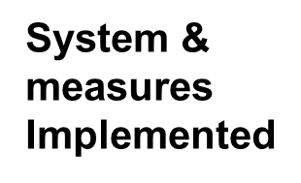








03
Group Key update
Working Group
on Internal Controls
10
23
19
ITU
04
JIU
.
rate
Recommendations
Under
Review

Slide 8
01
Summary & action required
02
Background
03
Group Key update
04
System and measures established
05
System and measures under implementation
ITU
Working Group
on Internal Controls

Slide 9
04
System and measures established as of January 2021
Working Group
on Internal Controls
Policy against fraud, corruption and other proscribed practices
Investigation guidelines
A clause with respect to due process in case of fraud in project agreements
Inspection of Regional Offices’ projects
Strengthen sponsorship policies
Whistleblower Protection SO (SO-2020)
Enhancement of the Financial Disclosure (SO-2020)
Governance, Ethics, Fraud detection
ITU
New procurement procedures for orders < 20’000 CHF
Basic rules for procurement for BDT Projects
Monitoring of cumulative PO amounts per vendor
Reinforcement of petty cash control
Effective management of bank accounts and cash in ITU’s Regional/Area Offices.
Strengthen financial & procurement procedures
Internal working group on strengthening internal controls of BDT
BDT Annual Travel Plan
Control of consultants’ work
Strengthened travel procedures
Strengthen the oversight at the project level – Creation of a BDT Project Board
Asset management for projects
Strengthen BDT internal control procedures

Slide 10

System and measures under implementation (from Sep 2020-to Dec 2020)
Working Group
on Internal Controls
Recommended by :
IMAC
Internal Audit
External Audit
JIU
Working Group
Staff Mobility Policy
ITU
HRMD
Implemented
Unlike field-based organizations such as UNDP and UNICEF, ITU is not big enough to allow for rotation.
20
19
20
20
An ITU Mobility Policy (Service Order 20/14) to allow reassignment of staff, both within HQ and from one duty station to another has been published. The policy will now move into implementation.

Slide 11




04
ITU Compliance Dashboard
Working Group
on Internal Controls
Recommendations
ITU
ITU-wide Compliance Dashboard
Central repository for all recommendations addressed to ITU management by internal and external oversight bodies and track responses.
The tool will be integrated with the ITU Risk Register, in order to enable the assessment of all the risks related to the recommendations still under implementation, and the assessment of the residual risks after their implementation.
Through this secure system, managers can assign staff members responsibility for follow-up, track actions taken and validate when each issue is sufficiently resolved.
External Audit
Internal Audit
IMAC
JIU
Risk Register

Slide 12
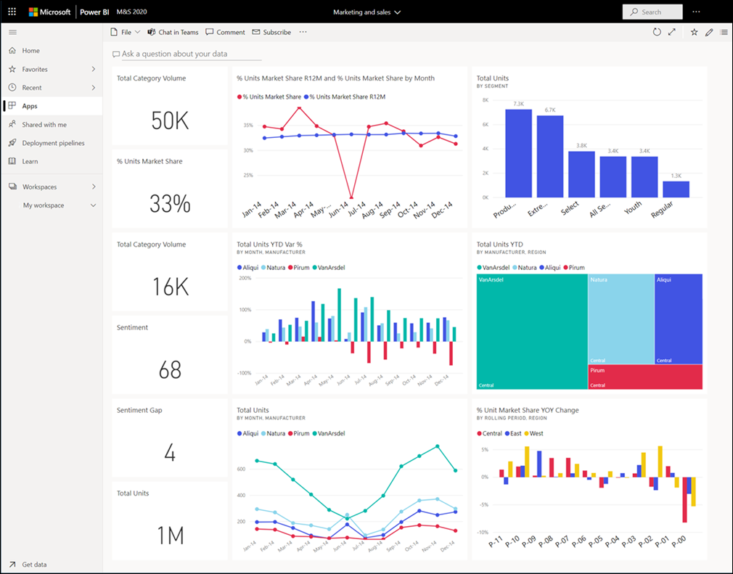
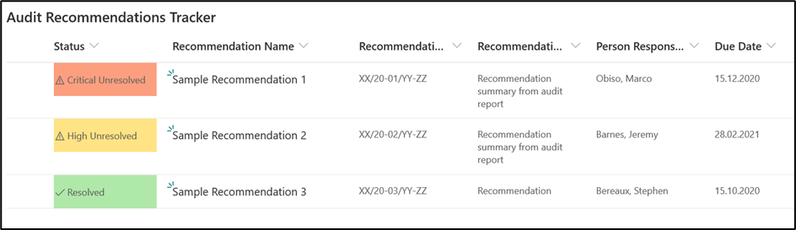
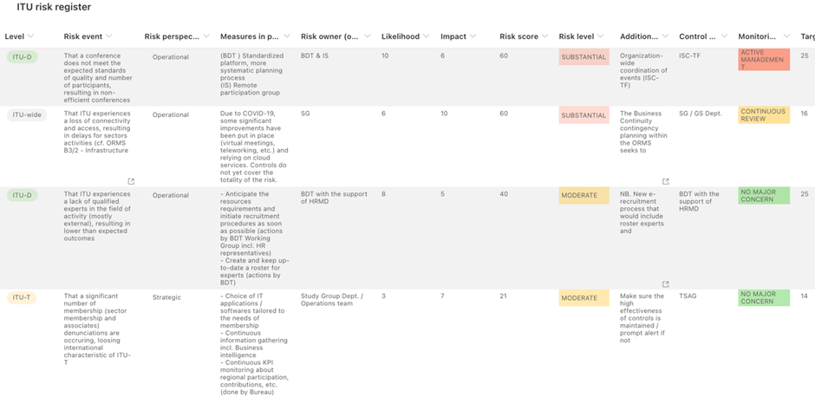
04
ITU Compliance Dashboard
Working Group
on Internal Controls
BDT designed an Audit Recommendations Tracker in June 2020, which was used as a tool to consolidate and follow up on recommendations from various reports. This tool is currently owned by the BDT Deputy Director and used to manage follow-up on recommendations specific to BDT. ITU management is currently in the process of expanding this tool ITU-wide to become an expanded corporate compliance dashboard.
This tool enables ITU management and oversight bodies (internal audit, external audit and IMAC) to have a clear view of the recommendation in progress, the risk related to these recommendations, real time information concerning the progress made to implement the recommendations or to mitigate the residual risk and push out automated email notifications and reminders where necessary.
ITU Compliance Dashboard
ITU
Assess risk and link to ERM
The dashboard provides a colour coding depending on the level of importance and whether or not the issue has been resolved. Access to the information is controlled centrally by ITU management. A screenshot of the interface for this tool is provided in the image below.
Follow-up and updates
Audit Recommendations Centralizing

Slide 13

04
System and measures established
Working Group
on Internal Controls
ITU
Governance, Ethics, Fraud detection
Strengthen financial & procurement procedures
Strengthen BDT internal control procedures
1st Line of Defense
ITU’s 3 lines of Defense
2nd Line of Defense
3rd line of Defense

Slide 14
01
Summary & action required
02
Background
03
Group Key update
04
System and measures established
05
System and measures under implementation
ITU
Working Group
on Internal Controls

Slide 15
05
System and measures under implementation
Working Group
on Internal Controls
Recommended by :
IMAC
Internal Audit
External Audit
JIU
Working Group
New e-recruitment system& Competitive procedures for selection of consultants
ITU
HRMD
In Progress
20
22
JAN
RFP to procure a new e-recruitment system launched
Submission period closed and proposals being evaluated
Pilot test of advertising for consultants conducted for various cases
Pilot introduction of competitive procedures for selection of consultants

Slide 16
05
System and measures under implementation
Working Group
on Internal Controls
Recommended by :
IMAC
Internal Audit
External Audit
JIU
Manage and control the use of consultants
ITU
HRMD
In Progress
20
21
JUN
30
Introduction of procedures to manage and control the use of consultants
Strengthen the monitoring of the quality of work delivered by consultant
Annual limits will be established on how much any one consultant or entity can receive in a fiscal year
Long term improvements will be implemented with introduction of a new Expert Recruitment System under the IT System Project under Slide 17, scheduled for implementation by July 2021, however as interim measures:
  BDT has conducted a comprehensive clean up of its Expert Roster to [100% Complete]:
    Delete any Consultant that BDT has not used in the last 24 months;
    Remove any blacklisted consultants;
    Remove any consultants that did not receive positive evaluations in their last BDT engagement;
    Approximately 340 consultants remain.
  BDT is revising the existing expert recruitment system to [system changes are 80% complete, implementation in Q1 2021]:
    Include delegation of authority for recruitment under CHF15,000 to Regional Directors;
    Include triggers for recruitments exceeding CHF15,000, or more than four engagements in any one year to require Director or Deputy Director Approval;
    Include previous rating/evaluation checks;
  BDT will conduct a process beginning Q1 2021 to invite new experts for inclusion in the roster;
    Revised submission requirements for CVs for new experts;
    Circular Letter and Advertisements to be issued;
    Process will include vetting of experts before inclusion in roster;
    New roster will include blacklisting capability;
    New roster will be periodically reviewed and maintained based on key criteria;

Slide 17
05
System and measures under implementation
Working Group
on Internal Controls
Recommended by :
IMAC
Internal Audit
External Audit
JIU
Working Group
Common IT Systems for
BDT
ITU
BDT
ISD
In Progress
The formal project Process has been launched:
Four key BDT processes and applications (Expense Tracking, Travel Procedures, Operational Planning) have been identified for integration into the ITU’s organizational administrative software applications (SAP);
Recruitment and management of BDT consultants to be integrated in a new software application.
A workplan for migration of all applications and processes has been agreed based on available resources.
20
21
DEC
31
Project Kick-off meeting held on 25 September 2020, with full implementation scheduled December 2021

Slide 18
05
System and measures under implementation
Working Group
on Internal Controls
Recommended by :
IMAC
Internal Audit
External Audit
JIU
Working Group
Accountability Framework
ITU
FRMD
In Progress
20
21
JUN
30
Full review of ITU Accountability Framework.
The review will take into account PWC report on regional presence, external audit report (2019 financial statements)

Slide 19
ITU
Working Group
on Internal Controls
Follow-up
to Council 2020
January 2021

