Slide 1

Children’s Activism and Engagement
In preventing and addressing violence against children
Office of the Special Representative of the Secretary-General on Violence against Children
| 26 Jan 2021

Slide 2
SRSG-VAC Priority Areas
Agenda 2030
  All forms of VAC and its drivers are addressed in SDG implementation
  Child protection and social protection systems are included in national socioeconomic recovery plans and seen as an investment
Cross-cutting areas
  Promote the protection of children online
  Mental health is included in preventing and responding to VAC
  Child safeguarding,
  Gender dimension if VAC
Children as agents of change
  Meaningful participation of children in all matters concerning their protection and well-being
  Children are involved in decision-making process
  The work of the mandate is informed by children

Slide 4

Highlights of from 2020
COVIDUnder19
  Global consultation with 26,000 children 13 – 18 to identify how their rights were affected during the pandemic. Violence online and access were covered.
  U-Report poll with 5,000 children 13-18 focusing on VAC and peer support. Questions addressed experiences regarding violence online
  6 weeks long camp with children, who analyzed the data and built their capacities. Protection and Education were the issues they decided to focus on.

Slide 5
U-Report poll results
4,900 children 13 – 18 years of age.
U-Report asks for age, country, gender.
U-Report Global, U-Report Argentina, U-Report Nigeria, U-Report Kiribati, U-Report Ghana

Slide 6
Peer support
Since coronavirus started, have your friends been able to help you when you’ve needed emotional / personal support?
Yes 62% / No 36%
Have any of your friends reached out to you more for emotional o personal support?
Yes 58% / No 41%

Slide 7
Violence and protection
All children have the right to feel safe and live free from all forms of violence. Since coronavirus started, how safe do you feel?
More than before / 32%
Less than before / 38%
Same as before / 28%
Do you know where to ask for help if needed?
Yes / 49.4%
No / 50.2%

Slide 8
Violence online
43% think children are having more negative experiences online (13% less than before, 8% same as before, 35% don’t know)
Which one has increased the most?
Cyberbullying / 26%
Harrassment / 20%
Unwanted contact / 9.5%
Inappropiate content 23.7%
Hate Speech / 17%

Slide 9
The future
89.9% are worried about the future.
What worries them most?
Not going back to school / 31%
Not being safe / 23%
Not being able to graduate / 20%
Not seeing my friends / 6%
Other 19%

Slide 10
Children being part of the solutions
After this crisis is over, which of the following do you look forward to doing?
Help my family / 46.6%
Help my peers / 8.7%
Get involved with groups / communities / 21.8%
Take civic actions /14.4%
None / 7.9&

Slide 11
Highlights of from 2020
Mapping of children’s engagement
Some findings include:
  Children’s participation in time of COVID:
    Organizations forced to take their offline participation models to online settings
    Where access is available, there are many benefits to children being able to exercise their right to participate online
    Through online channels children help reach other children too, acting as connecting focal points between organizations and children.
    In those countries with high Internet penetration children are using the online at younger ages, and organizations see an increased level of responsibility and empowerment with these children.
  Food for thought: children exercising their activism online
    Digital divide – there are risks pertaining to having access to the internet, while there is a loss of opportunity for not having it.
    Younger children’s right to participate is limited when it comes to participating online because of the minimum age required in many digital social platforms used by children, adolescents and organizations.

Slide 12
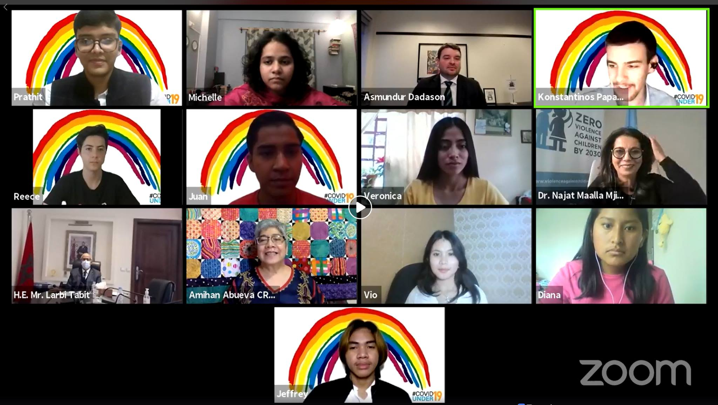
Children as agents of change
“Children are part of the solution, so in everything we do for recovery, we must ensure children are actively involved.”
Najat Maalla M’jid
United Nations SRSG-VAC

