Slide 1
UKCIS Digital Resilience Framework
An introduction / ITU CWG-COP / Jan 2021

Slide 2
Learning how to recognise and manage risk, learn from difficult experiences, recover and stay well, is a vital part of individual development

Slide 3
Parent Zone sits at the heart of modern family life, providing advice knowledge and support to shape the best possible future for children as they embrace the online world.
We bridge the gaps between parents, policy and platforms, providing insights and knowledge in order to shape a better future for all.
We work globally, supporting businesses and governments to deliver digital innovation whilst being responsible, ethical and caring.
www.parentzone.org.uk

Slide 4
The UK Council for Internet Safety (UKCIS) is a collaborative forum through which government, the tech community and the third sector work together to ensure the UK is the safest place in the world to be online.
The Digital Resilience Working Group (DRWG) develops a digital resilience strategy which enables individuals to have the digital skills and emotional understanding to feel empowered to take action when they encounter problems online.
DRWG is chaired by Vicki Shotbolt, CEO of Parent Zone and consultant psychiatrist Dr Richard Graham.

Slide 5
Digital resilience is a dynamic personality asset that grows through engaging with appropriate opportunities and challenges online, rather than through avoidance and safety behaviours. UKCIS Digital Resilience Framework

Slide 6
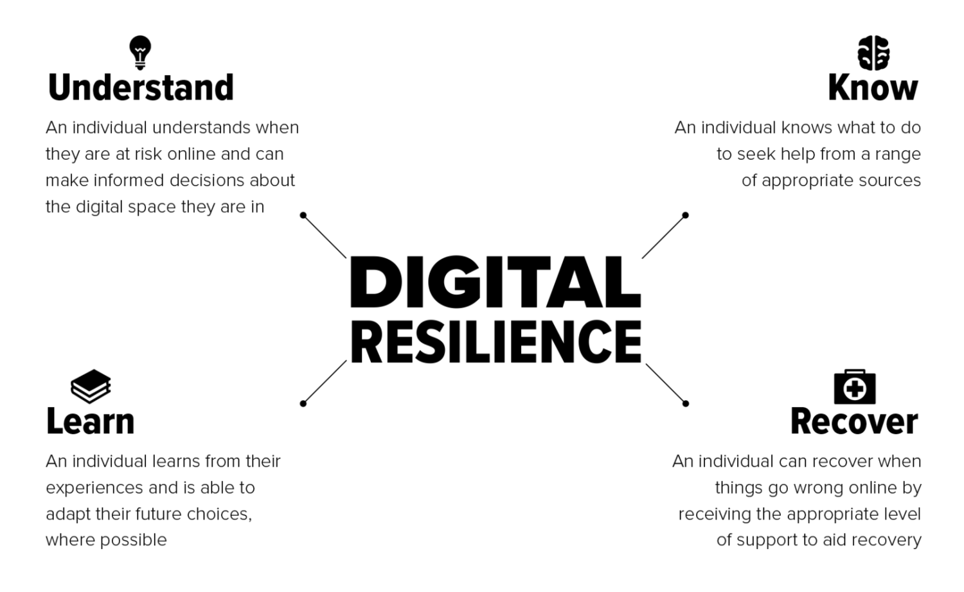

Slide 7
This is not a linear process. All of the elements are equally important and can apply at any time.
Resilience is dynamic. Resilience is shaped by your current situation, previous experience and the context within which you encounter people and content.
A collective responsibility. All of the elements of resilience require individuals to have access to appropriate systems, information and support.

Slide 8
Digital resilience hub
www.drwg.org.uk

Slide 9
Awareness
Increase awareness and understanding of digital resilience and its elements
Knowledge
Add to the knowledge base of digital resilience
Application
Promote initiatives that apply use of the digital resilience framework
www.drwg.org.uk

Slide 10
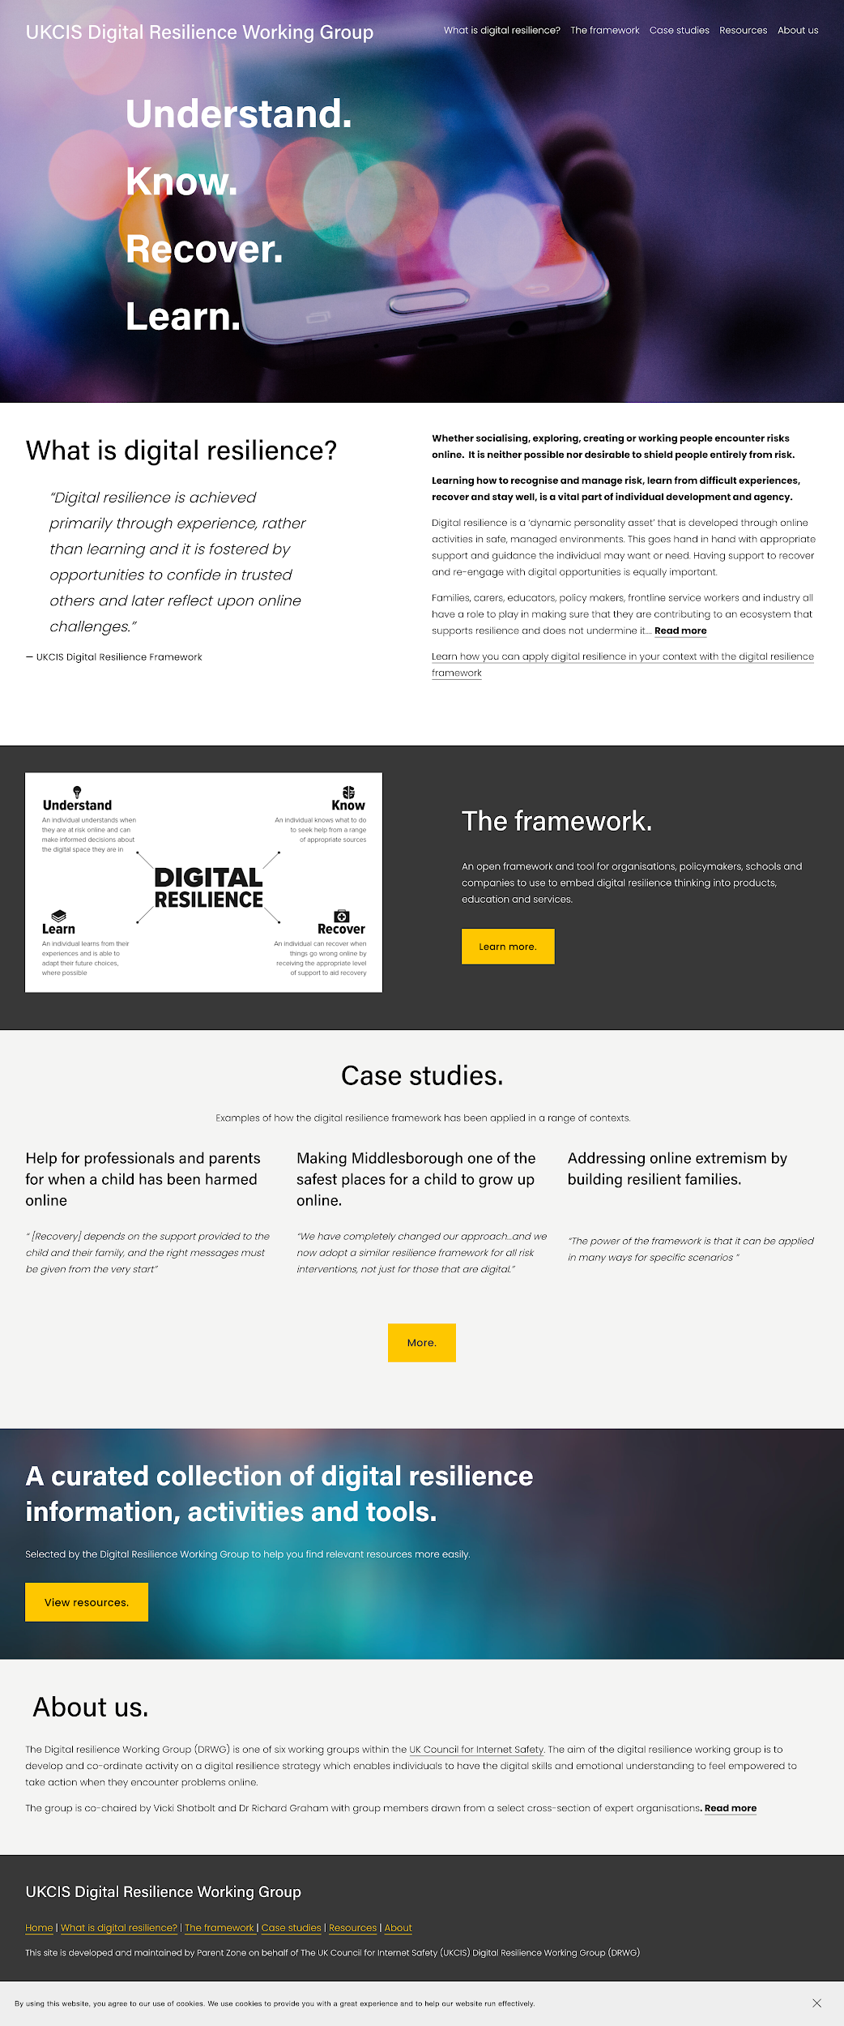
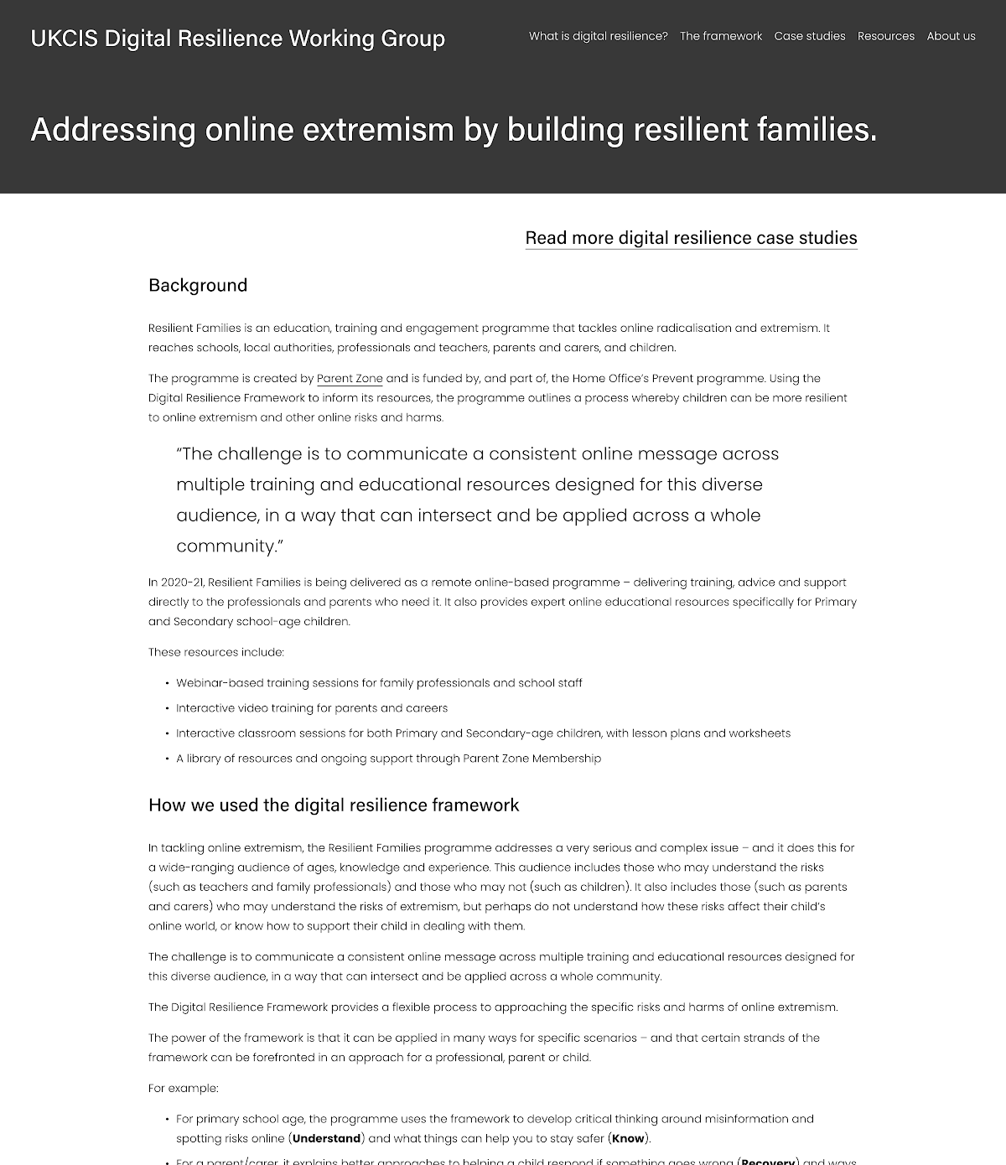
www.drwg.org.uk

Slide 11
Resilience and recovery are not solely the responsibility of an individual, they are the result of collective action.
To enable everyone to be safer online, resilience should define how systems are designed and managed.

Slide 12
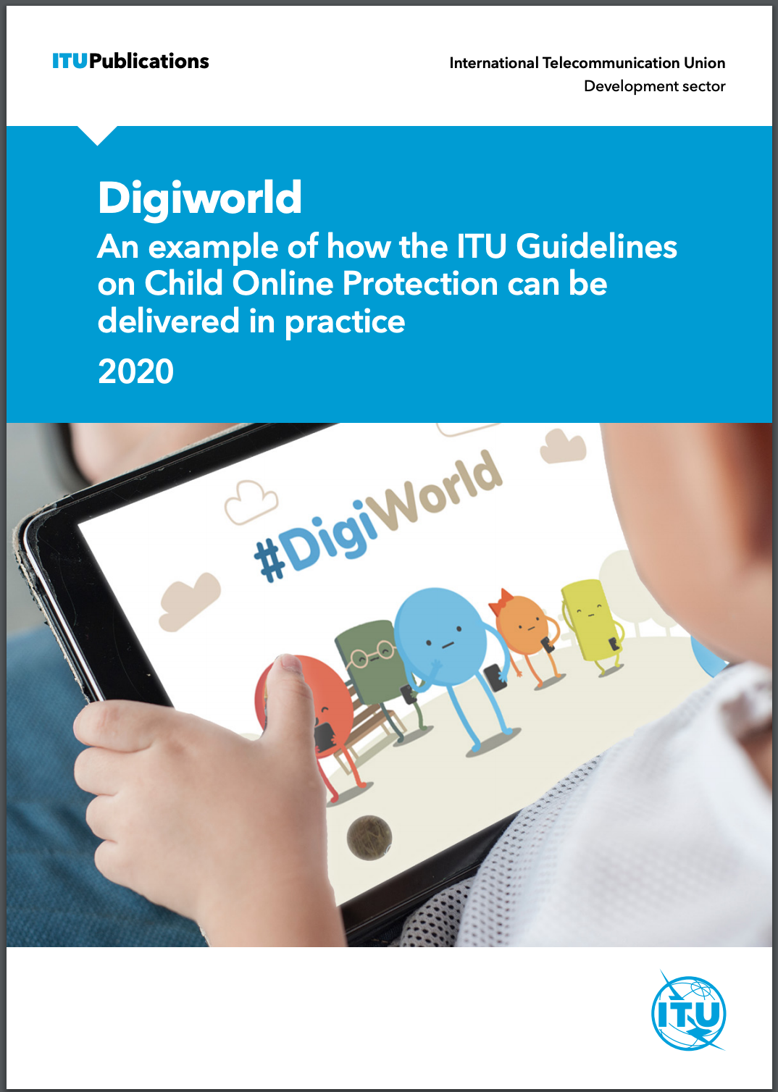
Digiworld
An example on how the ITU COP Guidelines can be delivered in practice – through resilience based interactive resource designed to help children aged between 5 and 16 to develop the knowledge and skills they need to navigate the online world in a safer and more enjoyable way.
www.itu-cop-guidelines.com/casestudies

Slide 13
Call to action
Share www.drwg.org.uk with your network
Highlight other relevant resources and research
Use the framework to review, assess and shape your policy, projects and delivery
Contact us to discuss your ambition and any challenges

Slide 14
email: cliff@parentzone.org.uk twitter: @theparentszone / @cliffmanning
web: www.parentzone.org.uk

