Slide 1
ITU Council Working Group on Child Online Protection, 26 January 2021
Paul Ghent
Chief Operating Officer, WePROTECT Global Alliance
Notes:
Delighted to have the opportunity to speak to you today – many thanks to Fanny and team for the invitation. WePROTECT Global Alliance is deeply grateful for all the impressive work ITU has taken forward to protect children online, most notably through the excellent COP Guidelines.
WePROTECT Global Alliance is a global movement dedicated to putting online-facilitated child sexual abuse and exploitation (online CSAE) on the global agenda and mobilising a worldwide campaign to end it. Government and law enforcement cannot tackle this crime in isolation – it is only through working in partnership with industry and civil society that we can work towards eradicating online CSAE. We bring together the influence, expertise and resources required to transform how online abuse is dealt with worldwide.

Slide 2
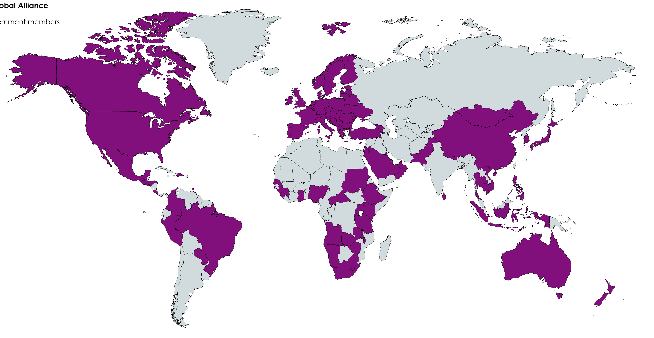
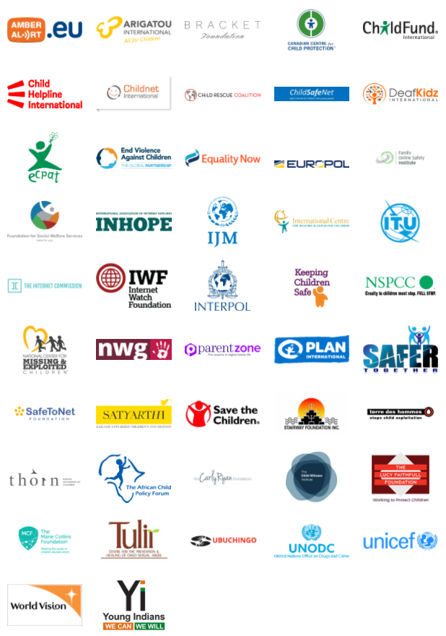
98 governments, 44 private sector companies, 43 civil society organisations and 7 international organisations
Notes:
ITU, as a valued partner and member of WPGA, is at the heart of the fight against child sexual abuse - a fight that requires joint efforts between governments, regional bodies, law enforcement, civil society and industry around the world to ensure children are protected. Our focus is on abuse with an online dimension, whether this is grooming, live streaming or sharing of child sexual abuse material.
Our geographical reach is strong: 98 countries are members along with 44 private sector companies, 43 civil society organisations and 7 international organisations. This diverse membership is key to our ability to deliver real change; a broad coalition of dedicated members is essential to our success.
Membership offers access to an unrivalled global network of expertise and provides an opportunity to showcase national good practice, deepen regional and international collaboration, and exchange ideas and experiences. And since last year, when we became an independent non-profit organisation, we have sought to diversify this network to ensure we have a truly global coalition in place.

Slide 3
Focus since independence
Advocacy – ensuring decision makers act
Knowledge – tools and frameworks
Collaboration – broadening and diversify our membership
Empowerment – amplify the voices of victims and survivors
Notes:
Last year WePROTECT Global Alliance became an independent organisation, having previously sat within the UK Government since its inception. Since then, we have focused on four main strategic objectives:
Advocacy – the recent privacy and safety debate in Europe has highlighted the need for a coordinated approach to ensure the right balance is struck and that the rights of children and victims are protected.
Knowledge – we have been focusing on strengthening our tools and frameworks to provide members with the tools they need to respond
Collaboration – we've strategically grown and diversified our civil society and private sector membership, brining on board more CSOs from the Global South as well as a broader range of private sector companies, including from telecommunications and retail giants such as AT&T and Amazon
Empowerment – we want to amplify the voices of victims and survivors and ensure their feedback is factored into future policy. In partnership with ECPAT International, delivering a research project to put the voices of survivors at the forefront of the response. Focusing on six countries in Latin America and Eastern Europe and will convene a global experts roundtable later this year to consider the findings.

Slide 4
Global Threat Assessment 2021
Objectives:
assess the scale and nature of global online child sexual exploitation and abuse (online CSEA) between 2019-2021, including geographical or technological hotspots;
identify the impact of the global response to the threat;
identify emerging trends and likely developments over the next two years;
set out recommendations to improve the response.
Notes:
Two major projects I wanted to highlight, both of which offer opportunities to get involved and will complement the efforts of ITU on child online protection.
The first is our Global Threat Assessment, which we will deliver later this year.
2018 GTA set out the baseline on the threat of online child sexual abuse
2019 GTA focused on new data from the Global South and expanding on horizon scanning and innovation
2021 will focus on:
desk-based scoping of existing / known data and trends;
development / analysis of primary data, with an emphasis on technology, to fill gaps in existing knowledge;
a focus on prevention and the impact of prevention approaches in this space.

Slide 5
MNR Review
In collaboration with UNICEF, with a focus on 20 countries
Objectives:
Map evidence of MNR implementation
Identify examples of good practice
Highlight gaps and challenges
Report to be launched at the next WPGA Global Summit (date to be confirmed)
Notes:
Our Model National Response – which sets out the capabilities required at a national level to tackle online child sexual abuse – was launched in 2016. We are keen to review its effectiveness and capture the excellent work conducted around the world since its launch.
In collaboration with UNICEF, we are conducting a review that will focusing on 20 countries with three overarching objectives:
1. Map evidence of MNR implementation and review whether the MNR is a useful tool in driving and supporting improvements
2. Identify examples of good practice – with the aim of disseminating to the wider WPGA membership
3. Highlight gaps and challenges – with the aim of highlighting common issues to decision makers and informing future iterations of the MNR and, if applicable, Global Strategic Response
The review will build on two related projects – a UNICEF led desk review of MNR implementation in 24 middle and lower income countries and End Violence's evaluation of grantee projects in lower income countries.
The findings from the review will be synthesised with those from the UNICEF desk review and End Violence grantee evaluation to, for the first time, provide a rich overview of MNR implementation in over 60 countries across the world. And we hope it will a useful practical support the implementation of the COP Guidelines.
The final report will be launched at our next Global Summit, which is scheduled to take place in Brazil either late 2021 or early 2022, COVID permitting. We will keep all WPGA members apprised of developments.

Slide 6
Paul Ghent
Chief Operating Officer
WePROTECT Global Alliance
E: paul@weprotectga.org
@WeProtect WePROTECT Global Alliance www.weprotect.org
Notes:
The MNR Review and Global Threat Assessment are just two tools to assist with the implementation of the COP Guidelines. We look forward to deeper collaboration with ITU and its members over the coming year. As I said at the start, international cooperation is vital to protect our children online, now more so than ever.
Here are my contact details if you have any questions about our work or would like to get involved.

