Slide 1
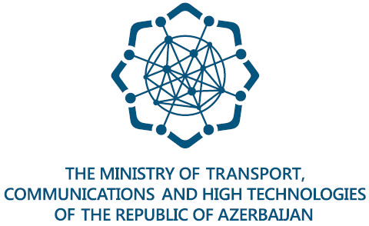
Children Online Protection in the Republic of Azerbaijan
Ministry of Transport, Communications and High Technologies of the Republic of Azerbaijan
Cyber Security Service

Slide 2
Children accessing the Internet in Azerbaijan
There are 2.239.100 children in the age group 0-14 years. (source:the State Statistical Committee)
One of every two teenagers aged 15-18 spends most of their leisure time online.
Over 18% of children between the age groups 0-6 already have their own smartphone or tablet.
67% of children between the age groups 11-14 years have their own gadgets.

Slide 3
Legislative framework
Law on Children’s rights and Family Code of the Republic of Azerbaijan
A person under the age of 18 is legally considered to be a child.
Law on Telecommunication of the Republic of Azerbaijan
Article 33: Duties of operators and providers
Based on subscriber’s request to ensure safe access to the internet resources in order to protect children from harmful information that can threat children’s health and development taking into account the requirements of the Law of the Republic of Azerbaijan "On Protection of Children from harmful information"
Article 34: Rights and duties of subscribers
To take appropriate measures within the use of technical software and equipment in order to protect children from harmful information.

Slide 4
Legislative framework
Law on Protection of Children from Harmful Information regulates issues in the following areas:
Basic principles of protection of children from harmful information
Types of harmful information for children
Classification of information according to the age groups
Requirements for circulation of information products according to the age groups
Expertise of information products

Slide 5
International documents
The Republic of Azerbaijan ratified:
UN Convention on the Rights of Children - 1992
Europe Convention on the Protection of Children from sexual abuse and sexual violence - 2019

Slide 6
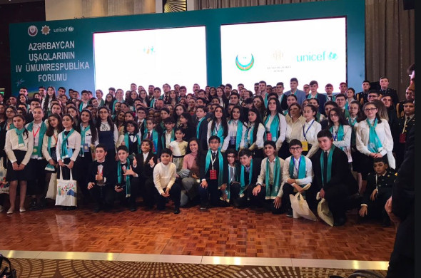
Public awareness
The National Forum of the Azerbaijani children
National Forums of Azerbaijani Children being held every 3 years are the part of the state child policy consistently pursued in the Republic of Azerbaijan.
It is organized by the State Committee for Family, Women and Children Affairs, Heydar Aliyev Foundation and UNICEF Azerbaijan Office. The forum was attended by a total of 380 children from all districts of Azerbaijan.

Slide 7
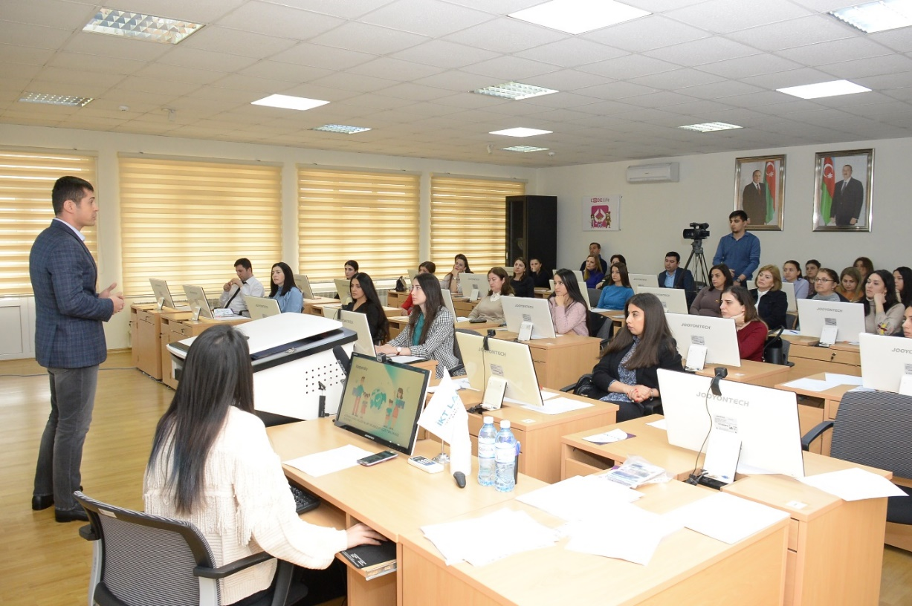
Public awareness
Children Online Safety Seminar
More than 110 teachers from 90 secondary schools from different regions of the country were attended to Children Online Safety Seminar organized by the Ministry of Transport, Communications and High Technologies, Ministry of Education, Kaspersky and Azercell Telecom LLC this year.
This seminar aims to increase awareness of the risks faced when being online and to support capacity building of educators in online safety and to prepare them for Safer Internet Day on February.

Slide 8
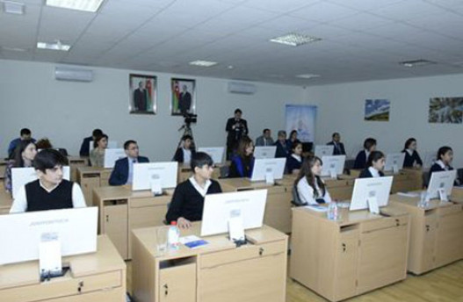
Public awareness
Safer Internet Day
Trainings for schoolchildren are organized dedicated to Safer Internet Day in February.
This training is held in ICT Lab including 19 centers in 17 regions of the country and many students attending this training via teleconference through these centers of ICT Lab.
Ministry of Transport, Communications and High Technologies has joined this initiative of the European Comission since 2010.

Slide 9
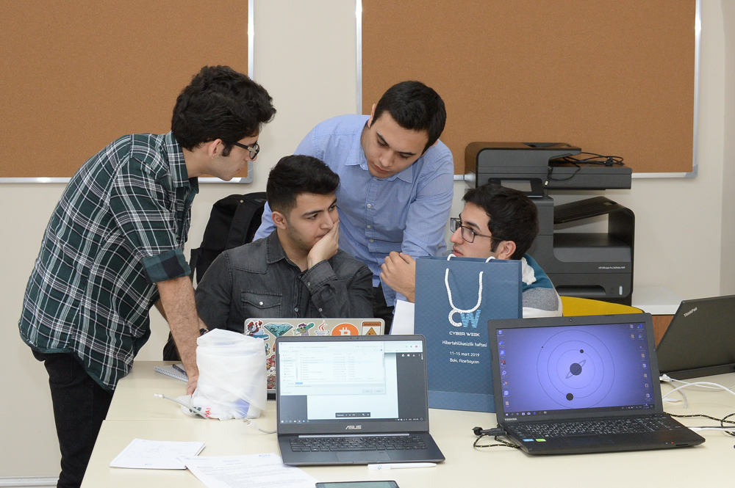
Public awareness
International Cyber Week
The Regional Internet Governance Forum (RIGF), the Hackathon Competition, the Cyber ​​Security Solutions Seminar, as well as training for on safe internet for schoolchildren, parents and children were organized within the framework of the International Cyber Week. (2019)
Children’s Rights Month
It is dedicated the whole month of November to raise awareness of children's rights and making it clear to children and young people in the Republic of Azerbaijan.

Slide 10
Technical measures
Most of the educational institutions including secondary schools all over the country joined Azerbaijan Education Network (AEN) in January-June, 2016 in accordance with the Plan of Action of the “State Education Development Strategy of the Republic of Azerbaijan.
A total of 2351 educational institutions have joined AEN so far to have been provided with high-speed internet
AEN allows to build a more effective teaching process and to promote a successful educational experience despite distance. Teachers and schoolchildren in most remote villages are using electronic resources through AEN.
Websense internet filtering system used at AEN provides a safe internet browsing for schoolchildren as it limits access to websites, which contain information considered to be harmful for children.

Slide 11
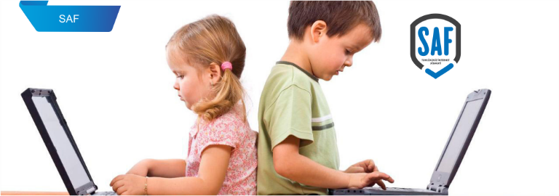
Technical measures
Several internet providers in the Republic of Azerbaijan has launched a SAF service (secure internet service) for the subscribers protect people, particularly children, from the influence of inappropriate sites by limiting their access to web pages containing adult content, as well as content promoting gambling, profanity, crime and violence.
The service is not limited to ensuring the safety of children and the younger generation from the negative impact of the global network, but also provides security against viruses, phishing, and etc.

Slide 12
Technical measures
Public Internet project
Within the framework public Internet project started by the Ministry of Transport, Communications and High Technologies about 20 public parks in the city of Baku has been provided with free internet access.
The main goal of this project is to provide free internet access to the residents and guests. Internet filtering system used at this project provides safe internet browsing to ensure the safety of children and younger generation from negative impact of global network and limits access to the websites, which contain information considered to be harmful for children.
The scope of this project is expanded day by day to provide more locations with internet free access service.

Slide 13
Thanks for your attention

