Slide 1
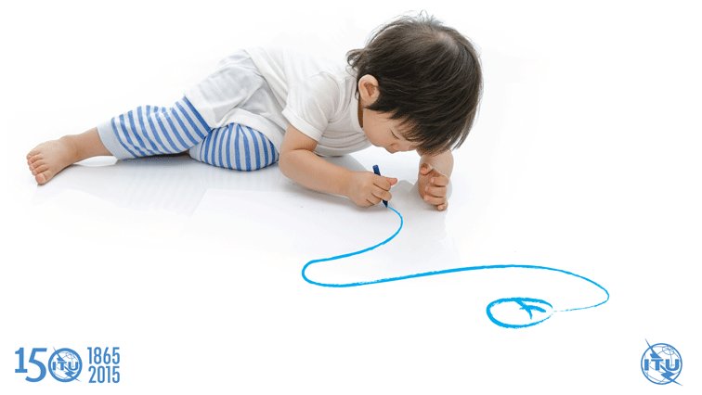
ITU’s Work and Activities in Child Online Protection
CWG COP
16Th Meeting
4 February 2020

Slide 2
Europe Region
16/09/2019 : a half-day workshop on Good Practices in Child Online Protection, Warsaw Poland
17/09/2019 - 18/09/2019: International Conference for Europe: Keeping Children and Young People Safe Online, Warsaw, Poland : co-organised with ITU
In country assistance to Ukraine to develop the National Child Online safety assessment [similar methodology as for Georgia]
Preparation of ToR and expert assignment
Elaboration, administration and analysis of surveys
Expert mission held on 11 November 2019 with national stakeholders workshop, meetings and school visit.
Expert mission held on 19 December 2019 where a one day workshop was held to discuss the draft recommendations of the report
Draft report submitted on 20 December 2019 by experts and under review of Ukraine team after which ITU team will do final review [planned for end January 2020]
Elaboration of a report on Child online Protection ecosystem - the state of play in terms of governance and stakeholder mapping in each of the following western Balkan countries: Albania, Bosnia & Herzegovina, Montenegro, North Macedonia, Serbia as well as Georgia, Moldova, Ukraine
First draft received from expert in December 2019 and reviewed by ITU
Second draft expected by 17 January for ITU review and countries’ review
EUR COP Activities for 2020
Final report for Ukraine handed over by ITU
Western Balkan COP ecosystem report launched at Digital Summit, Tirana, Albania on 2-3 April 2020
Speaker on COP in session at ITU Regional Cybersecurity Forum, Sofia Bulgaria on 27-28 February 2020
ITU expert to speak at International Conference: Keeping Children and Young People Safe Online, Warsaw in September 2020 [no budget for supporting organization]
​ITU Regional Forum for Europe and CIS on Child Online Protection, Odessa Ukraine on 7-8 October 2020

Slide 3
Asia Pacific Region
Presentation on ITU Child Online Guidelines at the ASIA-PACIFIC Telecommunity Symposium on Cybersecurity, 8 October 2019, Kuala Lumpur, Malaysia
Online Presentation on ITU Child Online Protection Initiatives at the UNICEF Workshop in Mongolia Child Online Protection workshop, 22 October 2019
Endorsement of ITU-ASEAN Child Online Protection Framework: Partnering with Industry by ASEAN TELSOM/TELMIN on 24 October 2019
In addition:
ITU is collaborating with UNICEF in organizing :South East Asia Regional Conference on Child Online Protection” 25-27 February 2020, Manila, Philippines
Letters have been written to Philippines, Indonesia, Myanmar , RMI and Afghanistan about collaboration on rolling out of the ITU guidelines related to Child Online Protection funded by DOCA, Australia, Project

Slide 4
Africa Region
Development of COP National strategic framework and identification of two national projects ongoing for Kenya, Malawi, Rwanda and Chad
COP Regional Forum in Ghana 28-30 November 2019
Plans to coordinate the Safer Internet Day 2020 for the Region

Slide 5
Global Level
COP Kids
The COP Kids side event was held on January 9th within the context of the Futurecasters Summit. The event gave younger children the opportunity to meet, debate and negotiate around the topic of Child Online Protection. More than 80 Kids aged 8-13 years old, from different schools in France and Morocco, discussed online safety issues.
During the first part of the day, the groups debated four stories of four potential COP Mascots. The original draft has been developed by the children themselves beforehand at the school level. During the event, the Kids had the possibility to negotiate and vote for one of the Mascots and the corresponding story to become the new incorporation of the COP Initiative.
During the second part of the day, the Kids heard more about the opportunities that the digital world offers, all by learning how to stay safe online. The workshops were organized by three different partners: Action Innocence, ICON and TikTok and focused on different issues, such as data protection, privacy, online bullying, harassment and violent or other harmful content, among others.
Safer Internet Day
The new COP Mascotte will be launched at Safer Internet Day 2020 on 20 February 2020.
Member States and all relevant stakeholders are encouraged to promote and use the Mascotte.
WSIS Forum 2020

Slide 6
Thank You

