Slide 1
The Introduction of Children Online Protection
in China
Presentation
ITU Council Working Group on Child Online Protection

Slide 2
1.China's Internet Achievements
With 25 years of rapid development, China has quickly become an internet giant.
Network infrastructure is continuously upgraded
The Critical Internet resources have seen significant increase in number. By June 2019, there are 396 million people received fiber to the home services, accounting for 91% of the total number of broadband users.
经济全球化
At the same time, China has 50,286 blocks of IPv6, up 14.3% over that at the end of 2018, ranking first in the world.

Slide 3
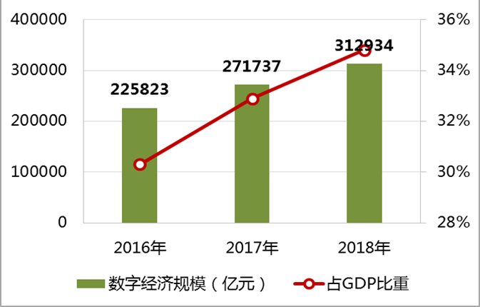
1.China's Internet Achievements
The number of netizens continues to increase
Digital economy is developing rapidly
100 M RMB
Digital economy scale
Percentage of GDP
This year, the number of Chinese netizens has reached 854 million, an increase of 25.08 million from the end of 2018. The Internet penetration rate reached more than 60%.
In 2018, the scale of the digital economy in China reached 31.3 trillion RMB, accounting for 35% of GDP. The digital economy has become a new engine of economic growth.
经济全球化

Slide 4
2.Cyberspace Has Become A New Space For Children Protection
In recent years, with the rapid development of Internet technology and the popularization of smart terminal devices, cyberspace has become an important area for children to study, live and entertainment.
According to the report from China Internet Network Information Center (CNNIC), by the end of 2018, the number of Children netizens in China was 169 million, and the Internet penetration rate of minors has reached 93.7%, which was significantly higher than the Internet penetration rate of the national population during the same period (57.7%).
经济全球化

Slide 5
2.Cyberspace Has Become A New Space For Children Protection
The development of the Internet provides unlimited possibilities for children's growth, but at the same time, children are facing more and more complicated external environments, and it is urgent to strengthen children's online protection.
The choice of Internet devices for Chinese children netizens is more diverse than the overall Internet users.
According to the survey, there are more than 92% children netizens using mobile phones and 48.7% using desktop computers; the number of using TV and tablet to access Internet are (46.7% and 37.4%) both higher than the overall netizens.
经济全球化

Slide 6
3.Measures for Online Protection of Children in China
In the past few years, Chinese government had attached great importance to the online protection of children.
Law on the Protection of Minors
Adopted at the 21st Session of the Standing Committee on September 4, 1991, and latest amended on October 26, 2012.
Article 33
The State adopts measures to prevent minors from internet addiction.
The State encourages research and development of internet products which are conducive to the healthy growth of minors and promotes the use of new technologies for preventing minors from internet addiction.
Article 34
All units and individuals are prohibited from selling, renting, or disseminating by any other means, to minors the books, newspapers, periodicals, audio-visual products, electronic publications and network information of pornography, violence, murder, terrorism, gambling, etc. which are pernicious to minors.
In October 2019, China's top legislature started reviewing a draft revision to the Law on the Protection of Minors, which highlights new stipulations on cyberspace.
The stipulations cover issues such as the management of cyberspace, the protection of personal information and anti-addiction measures in a bid to give well-rounded protection to minors both online and offline.
经济全球化
经济全球化

Slide 7
3.Measures for Online Protection of Children in China
Regulation on the Protection of Children’s Personal Information Online
On August 22,2019, the Cyberspace Administration of China released the Regulation on the Protection of Children’s Personal Information Online, and it went into effect on October 1, 2019.
This is the first legislation in China specifically aimed at children's online protection, and it sets out strict requirements for network operators if they collect, store, use, transfer, or disclose the personal information of minors under 14 years old.
To deal with the new requirements for online protection of minors, China is drafting the “Regulations on the Protection of Minors in Cyberspace” to set out the basic principles for the online protection of minors.
经济全球化

Slide 8
3.Measures for Online Protection of Children in China
Six compliance requirements
Child information protection commissioner
The guardian of the child shall have the "deletion right"
Specialized privacy protocol for child
Children's personal information shall not be disclosed except under special circumstances
Strictly restrict internal access
Safety assessment of children data

Slide 9
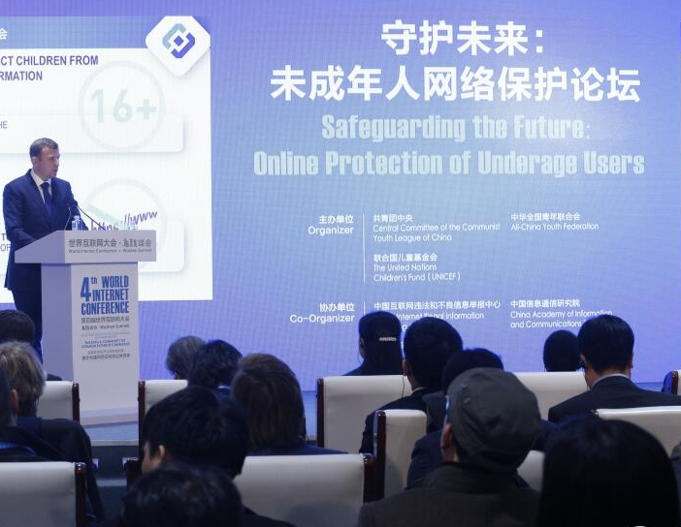
3.Measures for online Protection of Minors in China
International communication and cooperation
Meanwhile, China is highly concerned about international cooperation. China Youth Federation, UNICEF, and CAICT hold a special forum themed "safeguarding the future: online protection of underage users" at the 4th World Internet Conference, more than 100 government officials, scholars, representatives of international organizations and Internet companies from all over the world were invited to share the experience and practice of online protection of children.
经济全球化

Slide 10
4.Global Cooperation to Protect Children in Cyberspace
Internet has no boundaries, online protection of children is a common issue all around the world. Strengthening the protection of children in cyberspace needs jointly efforts from stakeholders of the whole world.
government
society
enterprises
schools
families
Children Protection
Notes:
Here, the government, society, enterprises, schools and families should all take the important responsibilities. Only with the cooperation of all parts can we effectively protect the children well.

Slide 11
Thanks for your attention！

