Slide 1
Briefing on the WTISD 2020 plan CWG-WSIS&SDGs 25 September, 2019
ITUWTISD

Slide 2
WTISD 2020
WTISD aims to help raise awareness of the possibilities that the use of ICTs can bring to societies and economies, as well as ways to bridge the digital divide
WTISD anniversaries in history

Slide 3
WTISD 2020
“Connect 2030: ICTs for the Sustainable Development Goals”
Theme for WTISD 2020 approved by the 2019 Session of Council
In line with Res. 200 (Rev. Dubai, 2018) & Res. 71 (Rev. Dubai, 2018), which define the Connect 2030 Agenda for telecommunications/ICTs

Slide 4
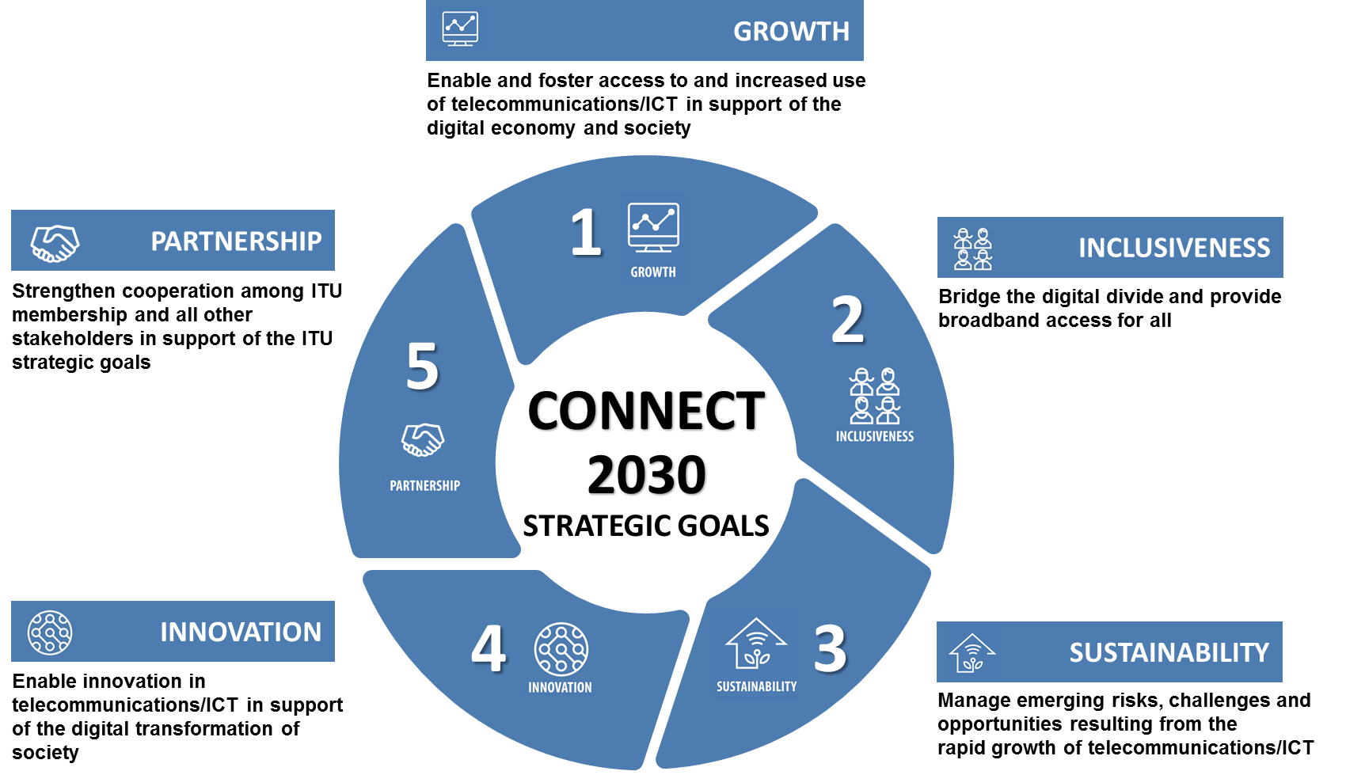
WTISD 2020
Transition to the “Connect 2030” Agenda
Opportunity for all Member States and ITU membership to be engaged in ITU activities
In line with the ITU Strategic Plan 2020-2023
Start the transition from the Connect 2020 to the Connect 2030 Agenda

Slide 5
WTISD 2020
A year-long communications campaign
Invite ITU membership and the public to join
Develop a campaign platform: Measuring “Connect 2020” agenda towards “Connect 2030” agenda
Running a media campaign
WTISD 2020 Laureates
Organize a series of WTISD events -the global WTISD on 17 May& potentially 6 regional events , based on ITU’s guidelines (e.g., WTISD 2020 toolkit)
WTISD 2020 within events: (e.g. WSIS Forum, Council, WTSA, 75th Anniversary of UN, G20, etc.)

Slide 6
WTISD 2020
Sep. 2019
Oct. 2019
Jan. 2020
Mar. 2020
May 2020
Jun. 2020
~ Nov. 2020
Dec. 2020
WTISD 2020 Communications Campaign
Concept Note
“WTISD 2020”
Presented at
CWG on WSIS
Creation of Int.sectoral group on WTISD2020
Kick-off
“WTISD 2020” Year-long Campaign
WTISD 2020 in WSIS Forum
2020
Global Ceremony WTISD 2020
(17 May)
WTISD 2020 in “Council 2020”
GSR2020 (July);
WTSA2020;
WRS2020;
WTIS2020
Closing
WTISD 2020 Year-long Campaign

Slide 7
WTISD 2020
Invitation to Member States
Organize WTISD2020 events
E.g., 1 global WTISD and 6 potentially regional meetings (1 per region)

Slide 8
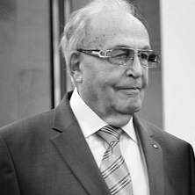
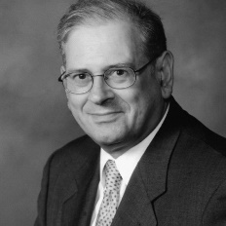
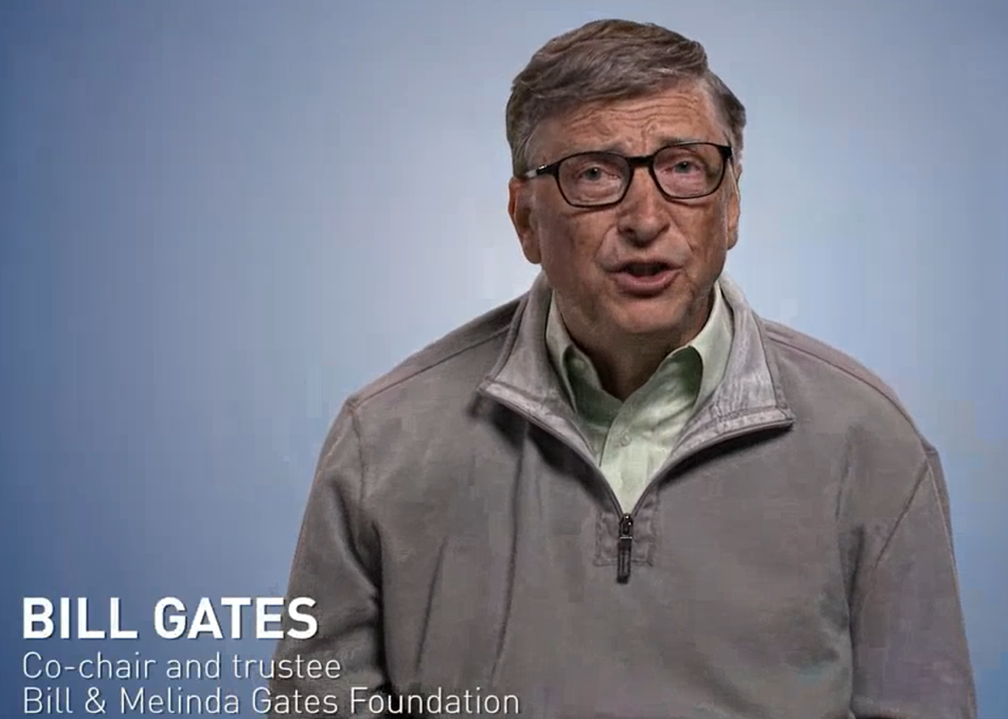
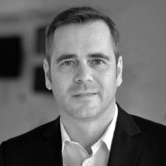
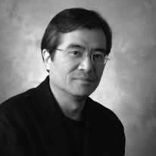
WTISD 2020
Invitation to Member States
2. Share success stories and national strategies towards “Connect 2030”
- Demonstrate progress achieved towards the 2020 goals and set the strategies for “Connect 2030”
Nominate for WTISD 2020 Award Laureates
- e.g., Ideal ICT frontier or leaders for becoming WTISD 2020 Laureates (followed by public voting for the best candidate)

