Slide 1
UN-SWAP 2.0
&
ITUs Gender Equality and Mainstreaming (GEM) Planning
Tracy Tuplin
29 January 2019

Slide 2
UN-SWAP 2012-2017
United Nations System-wide action plan for gender equality and the empowerment of women
First system-wide thematic Action Plan for the UN system
Unique accountability framework coordinated through UN Women
Gender mainstreaming defined with 15 common indicators
66 reporting entities; covers 94% of UN system

Slide 3
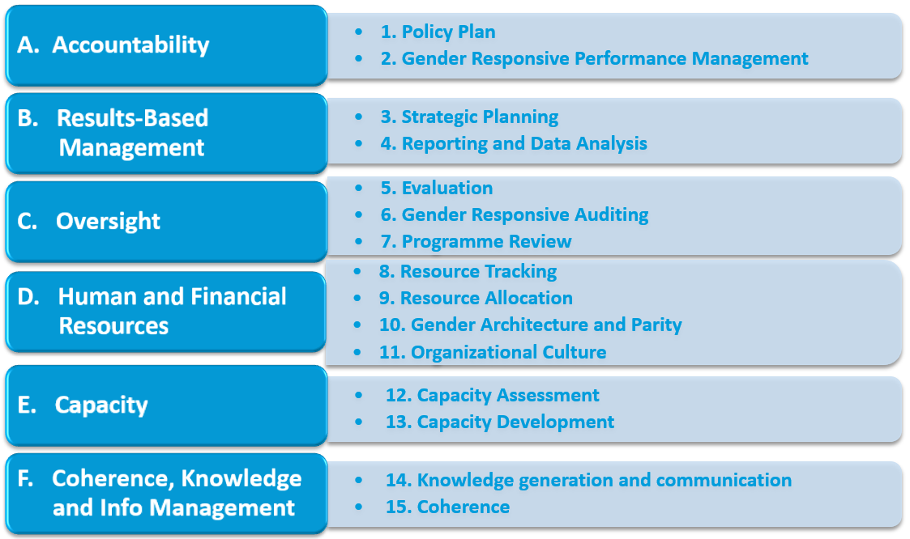
UN-SWAP 1.0 Framework

Slide 4
ITU’s UN-SWAP Progress 2012-17
Notes:
In 2012, 2 out of 15 indicators; 13% compliance
Over 6 year reporting period, increased to 6 out of 15 or

Slide 5
Summary ITU reporting 2017
Progress demonstrated across seven indicators
6 out of 15 (40%) indicators meet or exceed requirements
27 percentage point increase since first 2012 reporting with only 13% compliance
Comparable to other technically-focused entities which average 42% compliance
Lagging behind UN System which averages 65% compliance

Slide 6
Overall Performance on UN-SWAP Indicators
Notes:
Starting from a relatively low level in 2012 (the baseline) the UN system has seen steady progress towards meeting/exceeding UN-SWAP requirements. The UN-SWAP has facilitated significant and sustained improvement in the Organization’s performance with regard to mainstreaming gender equality. The percentage of ratings meeting or exceeding requirements more than doubled from 2012 to 2017, from 31 to 65 per cent. Gains can be attributed to system-wide ownership of the System-wide Action Plan, the leadership of senior management, coordination, networking, capacity development and facilitation by United Nations networks.
Overall, system-wide performance in 2017 remained consistent with that of 2016, with 65 per cent of all ratings falling into the “meets requirements” or “exceeds requirements” category, up 1 percentage point from 2016 that can be attributed to the fact that some indicators are plateauing as low hanging fruits are gone.

Slide 7
Comparative Analysis of Ratings by Year
Percentage of Total Ratings
Notes:
Differentiating the “meets requirements” and “exceeds requirements” categories, however, reveals significant progress. In 2017, 24 per cent of all indicators fell in the “exceeds requirements” category, an increase of 5 percentage points over 2016 and 16 percentage points over 2012.

Slide 8
UN-SWAP 2.0
Leading the way in the UN system - only successful SWAP to date
Phase II – 2018-2022
17 indicators – raising the bar
More challenging to focus on results than solely on agreement of best practices and performance indicators
New indicators on results and leadership and equal representation of women

Slide 9
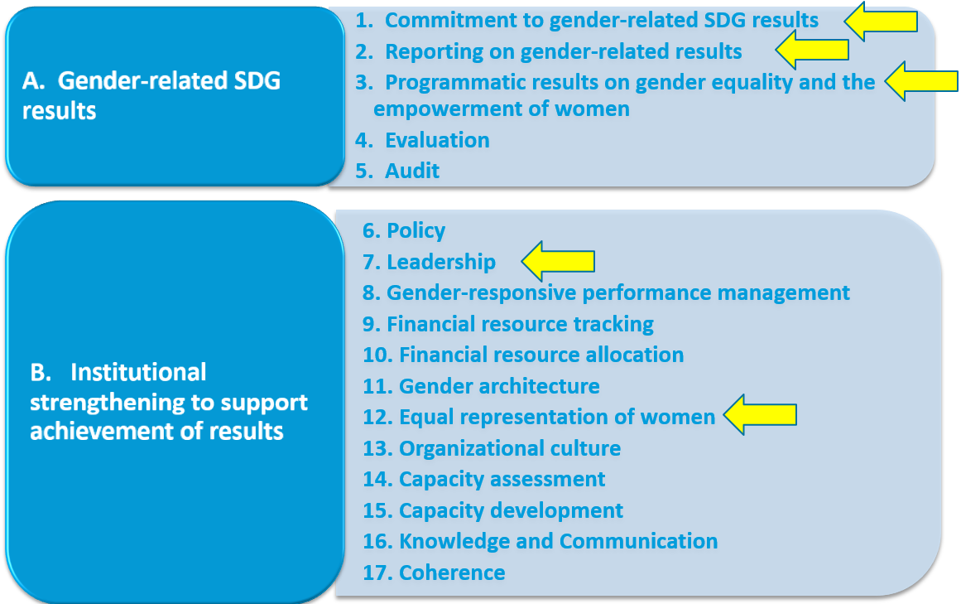
UN-SWAP 2.0 Framework

Slide 10
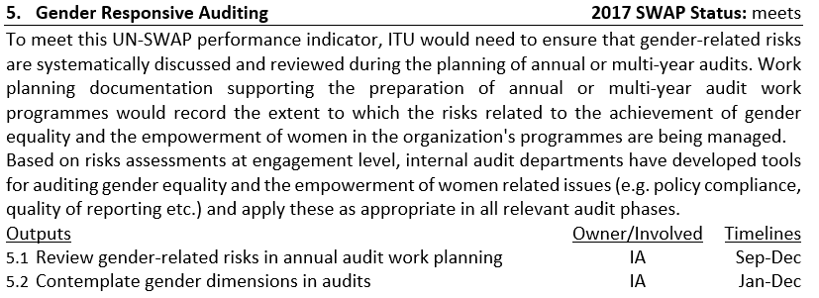
GEM Plan aligned to UN-SWAP 2.0

Slide 11
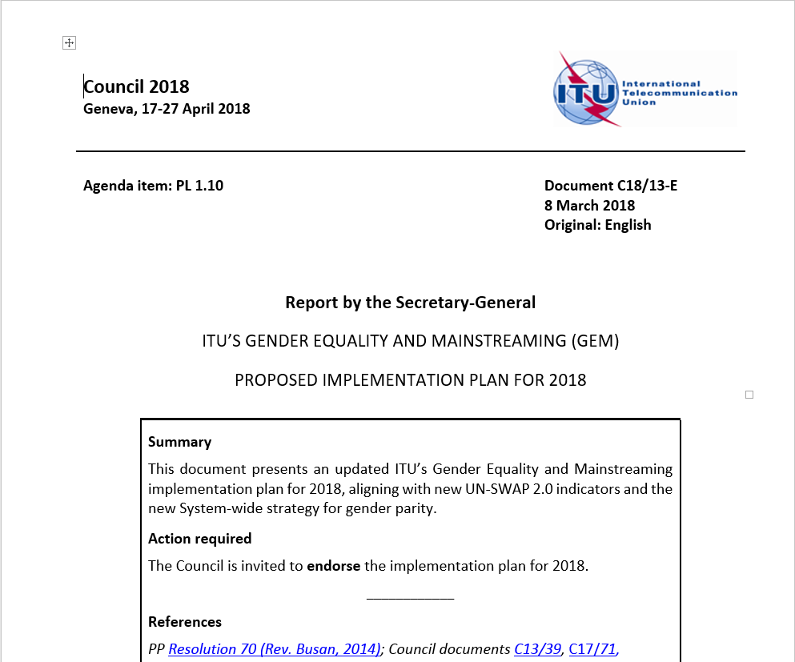
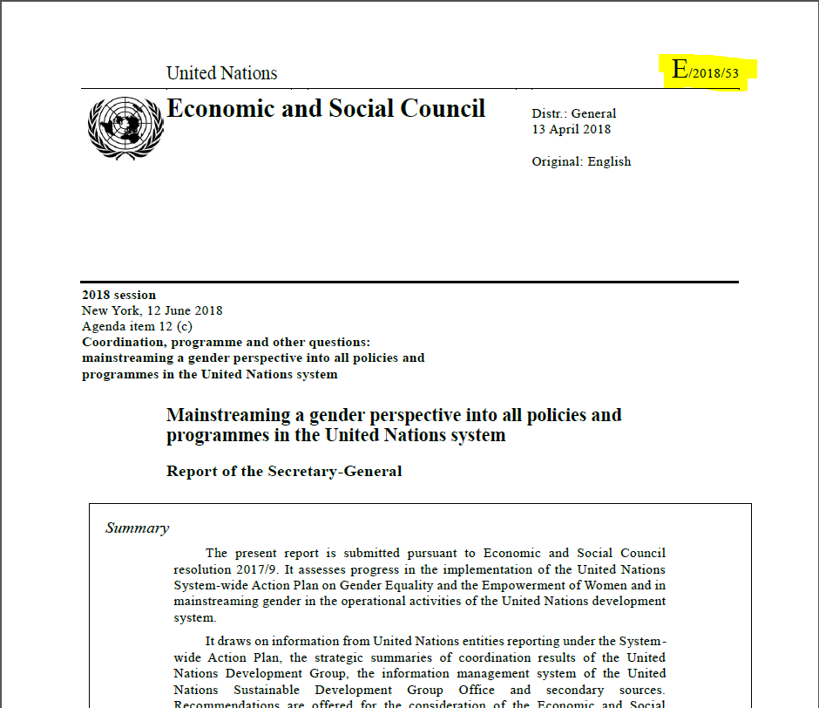
Contact and Resources
Tracy.Tuplin@itu.int
More detail forthcoming for C19
GEM action plan – C18/13
ECOSOC report – E/2018/53
Thank you!

