Slide 1

Draft 2020-2021 Budget
Synthesis and Key Features
Results-Based Budget
SDGs
Document structure
A presentation by:
Alassane Ba, Chief FRMD
June 2019

Slide 2
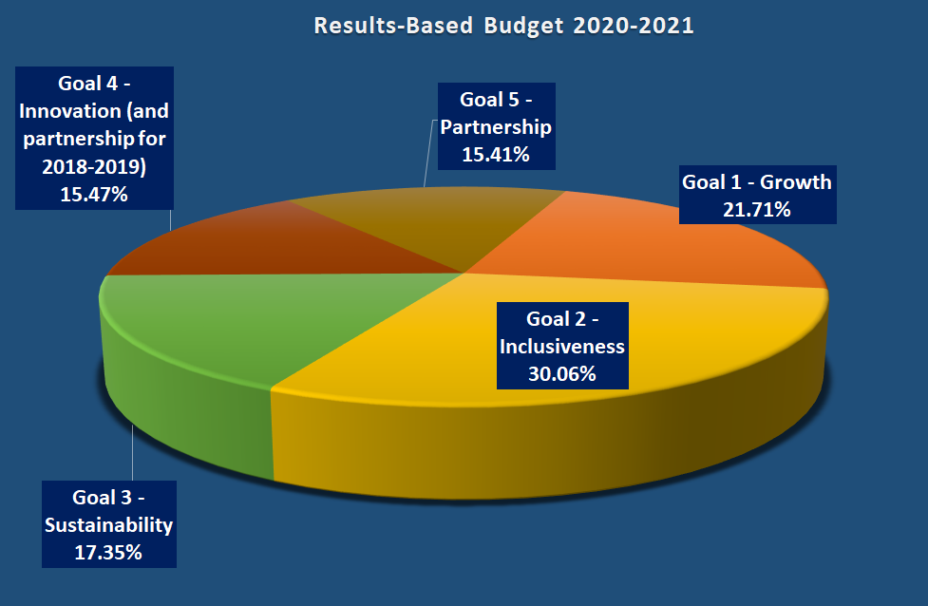
Synthesis and Key Features
Outline of the Results-Based Budget (RBB)
June 2019 – Draft 2020-2021 Budget

Slide 3
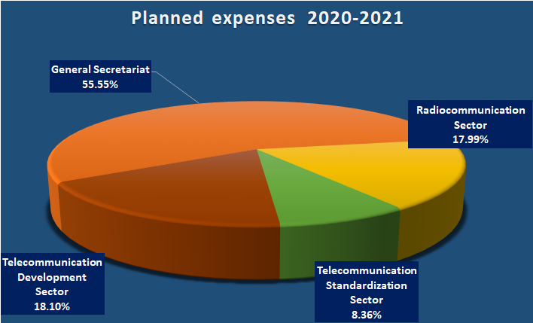
Synthesis and Key Features
Outline of the Financial Budget
June 2019 – Draft 2020-2021 Budget

Slide 4
Synthesis and Key Features
Bases and indicators
Strategic Plan – Resolution 71 (Rev. Dubai, 2018)
Financial Plan – Decision 5 (Rev. Dubai, 2018)
Contributory Unit: CHF 318,000
Exchange rate and conditions of employment as of January 2019
5% Vacancy Rate
CHF 5.4 million provision for possible financial consequences of appeals against ICSC decision on post adjustment
June 2019 – Draft 2020-2021 Budget

Slide 5
Synthesis and Key Features
Comparison with the Financial Plan
June 2019 – Draft 2020-2021 Budget

Slide 6
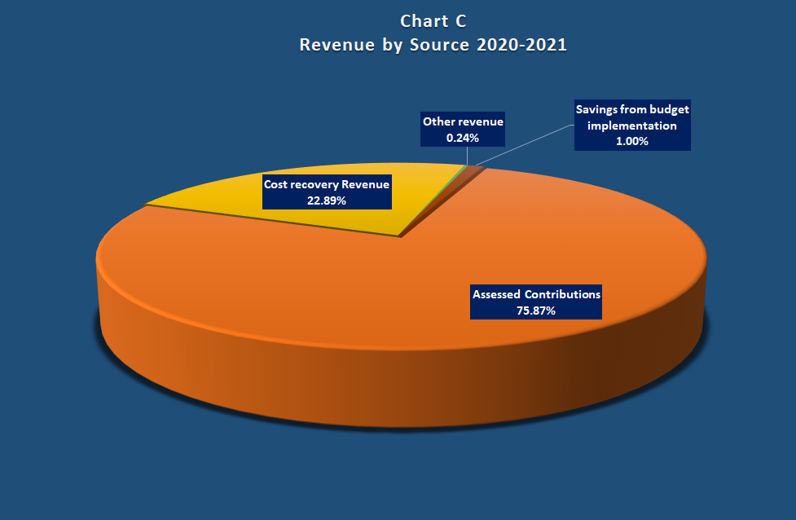
Synthesis and Key Features
The revenue
June 2019 – Draft 2020-2021 Budget

Slide 7
Synthesis and Key Features
The revenue – Assessed contributions
June 2019 – Draft 2020-2021 Budget

Slide 8
Synthesis and Key Features
The revenue – Cost recovery revenue
June 2019 – Draft 2020-2021 Budget

Slide 9
Synthesis and Key Features
ITU Common Expenses
June 2019 – Draft 2020-2021 Budget

Slide 10
Synthesis and Key Features
Fellowships
June 2019 – Draft 2020-2021 Budget

Slide 11
Synthesis and Key Features
Languages
June 2019 – Draft 2020-2021 Budget

Slide 12
Synthesis and Key Features
Budgeted posts
June 2019 – Draft 2020-2021 Budget

Slide 13
Synthesis and Key Features
New posts
June 2019 – Draft 2020-2021 Budget

Slide 14
Results-Based Budget
The cost structure
Planned Expenses
Documentation Costs
Bureau / Department Support Costs
Centralized Administrative Services Costs
Centralised Support Services Costs
Full Costs
June 2019 – Draft 2020-2021 Budget

Slide 15
Results-Based Budget
RBB presentation by Strategic Objectives
June 2019 – Draft 2020-2021 Budget

Slide 16
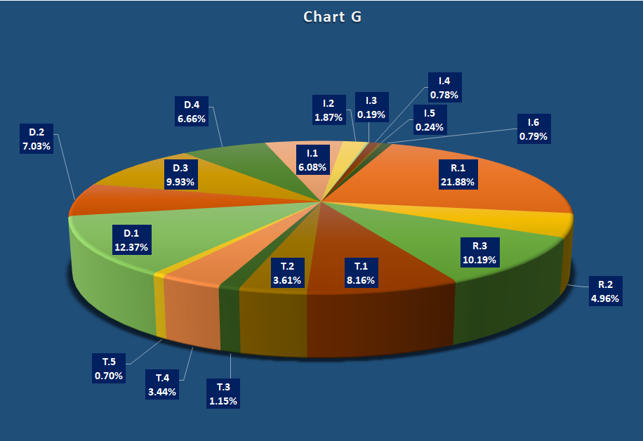
Results-Based Budget
RBB presentation by Strategic Objectives
June 2019 – Draft 2020-2021 Budget

Slide 17
Results-Based Budget
RBB presentation by Goals and Sector
June 2019 – Draft 2020-2021 Budget

Slide 18
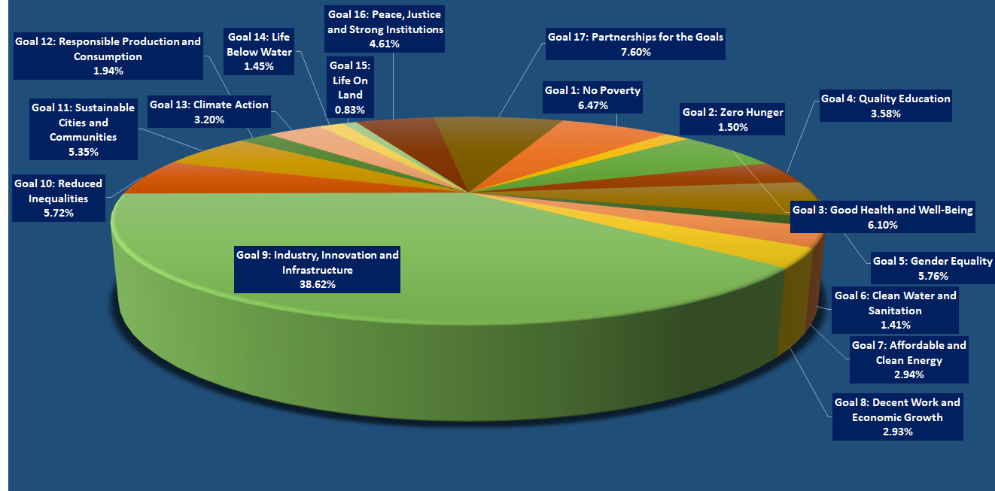
Budget distribution by SDGs
June 2019 – Draft 2020-2021 Budget

Slide 19
Document Structure
The draft budget document comprises 4 parts:
Part 1 provides a synthesis;
Part 2 provides the Results-Based budget at the objective level;
Part 3 provides the consolidated financial budget as well as the draft budget Resolution;
Part 4 provides additional information on documentation, posts, outputs and SDGs.
June 2019 – Draft 2020-2021 Budget

Slide 20
Thank you for your attention
Any questions?
A presentation by:
Alassane Ba, Chief FRMD
June 2019 – Draft 2020-2021 Budget

