Slide 1
Child Online Protection Actions by BDT
Contribution to Council Working Group COP meeting
January 2018
1

Slide 2
Child Online Protection Actions by BDT
Africa region
2

Slide 3
ITU Africa Region
44 Countries : Angola, Benin, Botswana, Burkina Faso, Burundi, Cameroon, Cape Verde, Central African Republic, Chad, Congo, Côte d'Ivoire, Democratic republic of the Congo, Equatorial Guinea, Eritrea, Ethiopia, Gabon, Gambia, Ghana, Guinea, Guinea-Bissau, Kenya, Lesotho, Liberia, Madagascar, Malawi, Mali, Mauritius, Mozambique, Namibia, Niger, Nigeria, Rwanda, Sao Tome and Principe, Senegal, Seychelles, Sierra Leone, South Africa, South Sudan, Swaziland, Tanzania, Togo, Uganda, Zambia, Zimbabwe.
9

Slide 4
COP actions in Africa
A global framework has been elaborated selecting 2 pilots countries in each sub-region;
After signing of the Project Document countries have to fund the project : Capacity building in Project management and a National workshop aiming to the selection of 2 concrete projects to be implemented.
Extension to the other countries is to be conducted progressively.
Missions were organized in Chad, Central Africa Republic, Ivory Coast, Congo, Gabon, Kenya

Slide 5
Country assistance
CENTRAL AFRICA: CHAD and CONGO
CHAD is the pilot country for the whole COP framework implementation.
Congo has already signed the PRODOC and has achieved the national workshop.
Rwanda has already launched the initiative.
Gabon and CAR are considering to sign the PRODOC.
WESTERN AFRICA:COTE D’ IVOIRE and GHANA
Cote d’Ivoire approved to be the pilot Country. A validation workshop for the COP strategy was held in April 2017.
Ghana is considering the PRODOC

Slide 6
Country assistance (cont.)
SOUTHERN AFRICA
A mission was organized and the national workshop was achieved in Swaziland.
South Africa has made progress on its own
Mauritius has launched the initiative.
Inception workshop on the Development of a national strategy/ framework for Malawi held in November, 2017
EASTERN AFRICA
A kick off meeting was organized in Kenya in October 2017and he PRODOC is in the signing process.
After ACOP conference in Kampala , Uganda has already started implementing the initiative.

Slide 7
Follow-up and next steps
The other countries will be consulted in 2018 as appropriate.
Africa Regional Office is expecting all the countries to commit themselves via signed Project Document.
Strategy: to use the Universal Service Fund (USF) to implement activities and submit all the selected projects to the ICTDF Committee for complementary funding.

Slide 8
For more information
afrregion@itu.int
https://www.itu.int/en/ITU-D/Regional-Presence/Africa/

Slide 9
Child Online Protection Actions by BDT
America Region
9

Slide 10
ITU America Region
36 Countries : Argentina, Antigua and Barbuda, Bahamas, Bolivia (Plurinational State of), Brazil, Barbados, Canada, Chile, Costa Rica, Colombia, Cuba, Belize, Dominican Rep., Dominica, Ecuador, El Salvador, Guatemala, Grenada, Haiti, Guyana, Honduras, Jamaica, Mexico, Netherlands Antilles, Peru, Paraguay, Panama, Nicaragua, Saint Lucia, Saint Kitts and Nevis, Suriname, Saint Vincent and the Grenadines, Trinidad and Tobago, United States, Uruguay, and Venezuela.
9

Slide 11
COP Actions in Americas
Awareness parallel session of Child Online Protection to be organized during the event Cybersecurity week named “Cibersecurity from La Plata river”.
A presentation on ITU activities on COP was delivered at the Seminar “Awareness of the dangers and responsible use of the web” organized by ENACOM, Argentina, in Buenos Aires in March 2017
An MoU was signed in October 2017 to cooperate with the Pontifical Scholas Occurrentes (http://web.scholasoccurrentes.org/es/)on child online protection, cyberbullying and use of ICTs by young people and children.
9

Slide 12
For more information
amregion@itu.int
https://www.itu.int/en/ITU-D/Regional-Presence/Americas

Slide 13
Child Online Protection Actions by BDT
Arab region
13

Slide 14
ITU Arab Region
22 Countries : Algeria, Bahrein, Comoros, Djibouti, Egypt, Iraq, Jordan, Kuwait, Lebanon, Libya, Mauritania, Morocco, Oman, Palestine, Qatar, Saudi Arabia, Somalia, Sudan, Syria, Tunisia, United Arab Emirates, Yemen
9

Slide 15
2017 COP actions in Arab region
A national strategy framework for COP has been developed for Sudan;
ARO in collaboration with the Information Technology Institute (ITI) in Egypt organized the Train of Trainers workshop for establishing localized challenge based training curriculum in Cybersecurity for Teens in the Arab region. The objective was to train Arab professionals on the ITI curriculum that is designed based on STEAM inspiring initiative and SAMR methodology to enthuse and engage young students in ICT technology through challenge based activities and cybersecurity skills.
10

Slide 16
Follow-up and next steps
The other countries will be consulted in 2018 on the way forward.
Arab Regional Office will continue to provide technical assistance to selected Arab countries in the development and/or implementation of their respective COP Action plans in 2018.
10

Slide 17
For more information
ITU-RO-ArabStates@itu.int
https://www.itu.int/en/ITU-D/Regional-Presence/ArabStates/

Slide 18
Child Online Protection Actions by BDT
Asia Pacific Region
18

Slide 19
ITU Asia Pacific Region
40 Countries : Afghanistan, Australia, Bangladesh, Brunei Darussalam, Bhutan, Cambodia, China, Cook Islands, Dem. People's Rep. of Korea, East Timor, Fiji, India, Indonesia, Iran (Islamic Republic of), Japan, Kiribati, Korea (Rep. of), Lao P.D.R., Maldives, Malaysia, Marshall Islands, Micronesia, Myanmar, Mongolia, Nauru, Nepal (Republic of), New Zealand, Pakistan, Palau, Papua New Guinea, Philippines, Samoa, Singapore, Solomon Islands, Sri Lanka, Thailand, Tonga, Tuvalu, Vanuatu, Viet Nam
9

Slide 20

ITU-ASEAN MoU
Pursuant to ASEAN-ITU MoU on joint cooperation in ICT Development (2015-2018) signed and endorsed by ASEAN Member States in 2016, one of key cooperation is developing Child Online Protection Regional Framework for ASEAN.
ASEAN ICT MASTERPLAN 2020 (AIM 2020)
Initiative 7.2 Nurture ASEAN Digital Society
Build an ASEAN online community
Action Point | Description | Target / Project
7.2.2 Develop and Foster Cyber Wellness through Guidelines, Education and Outreach Programmes | Provide actionable measures to relevant authorities across ASEAN to develop good online behaviors and etiquette, and to be able to respond to cyber bullying and cases of Internet abuse | Developing a focused model programme targeting education, advocacy, and engagement around cyber wellness, including: Developing guides and promoting awareness on online risks, particularly to vulnerable groups (children, youth, less-abled), and how they should respond Raise awareness and resilience to new threats and risks online (e.g. the rapid spread of mis-informatioin, cyber-vigilantism and over-sharing of personal and corporate information) Developing measures for child online protection, including communication channels to report ‘harmful content’ and online abuse to the relevant AMS authorities, with a focus on safety for children Working with the community to establish online forums and exchange on cyber wellness and Internet abuse, with the goal of bringing together stakeholders’ views Sharing of information and data among countries on trends and challenges in the online space for greater mindshare in formulation of policies and programmes

Slide 21
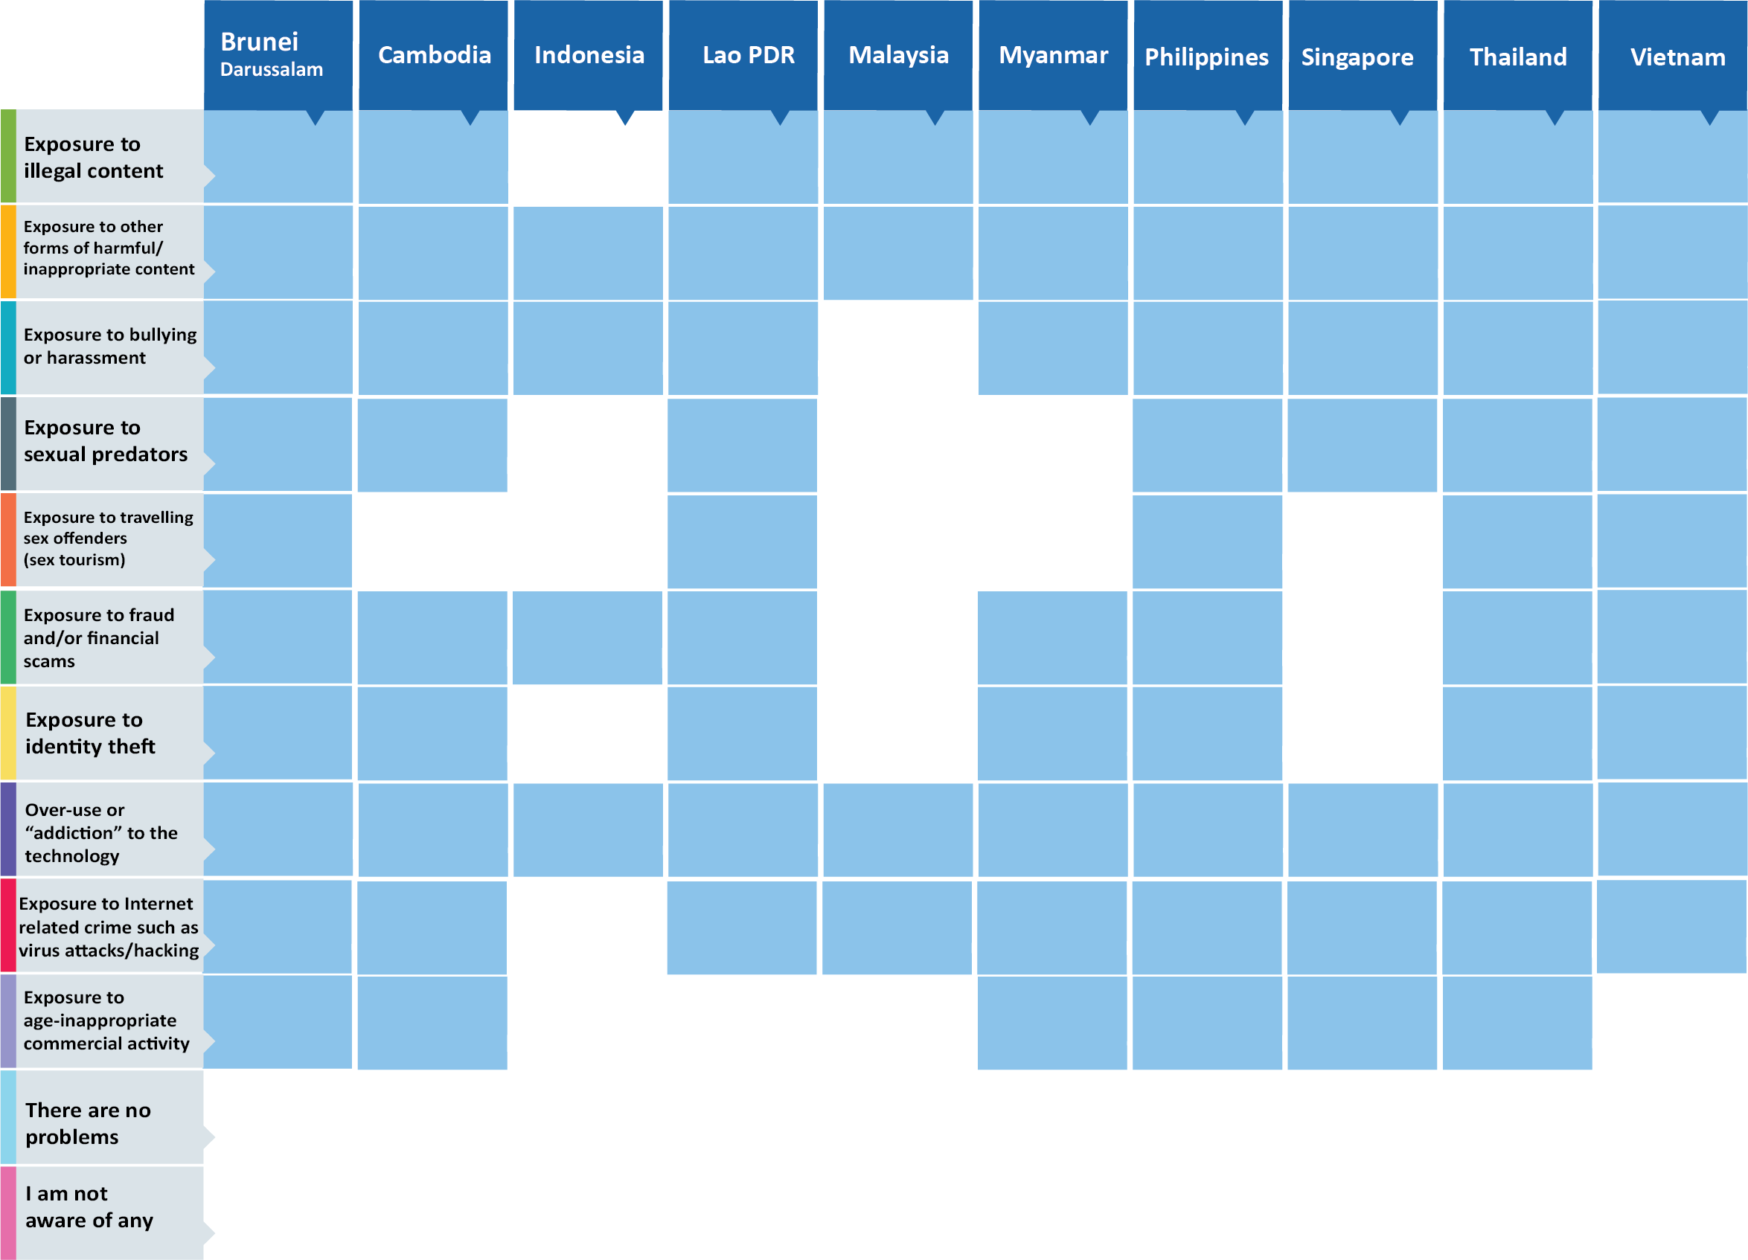
COP Actions in ASEAN
ITU ASEAN Countries Survey
In 2016, ITU conducted country surveys on Child Online Protection among ASEAN Member States.
ITU and ASEAN jointly organized ‘ITU-ASEAN Workshop on Child Online Protection on 13-14 September 2016 in Philippines.
ITU contributed to “National Child Online Protection Summit” in Philippines on 23-24 November 2017.
ITU supported “Seminar on Child Online Protection in ASEAN” organized by MCMC in Malaysia on 5-6 December 2017.

Slide 22

Follow-up and next steps
Pursuant to the outcome of the ASEAN TELMIN 2017, ITU and ASEAN will continue to
Develop and implement ASEAN COP Regional Framework.
Organize a ASEAN-ITU COP Regional Workshop in Thailand in 2018
Assist ASEAN Member States in developing national COP plans
Work in collaboration with partners e.g. UNICEF, Ecpat in implementing action plans for combating Child Online Sexual Abuses

Slide 23
ASEAN Conceptual Regional COP Framework
Facilitate policy and legal framework development and harmonization
  Guidelines, model programmes, etc.
Provide a platform for knowledge sharing, e.g.
  Annual COP forum
  Online forum
Liaise with relevant regional and international stakeholders and partners
  ASEAN Commission on the Promotion and Protection of the Rights of Women and Children (ACWC)
  ASEAN Senior Officials Meeting on Social Welfare and Development (SOMSWD)
  ASEAN Telecommunications and Information Technology Senior Officials Meeting (TELSOM)
  ASEAN Telecommunication Regulators Council (ATRC)
  International community e.g. ITU, APT, UNICEF, UNODC, Interpol/Europol, Ecpat, etc.
Facilitate reporting mechanisms and programme monitoring and evaluation

Slide 24
Conceptual National COP Framework
Define COP landscape
  Understand what the issues/threats are
Develop COP ecosystem
  Understand who are involved and doing what
Review legislative and regulatory frameworks and Action Plans
  Identify loopholes
Develop policies and practical measures
  Identify objectives, indicators and targets
Formulate and implement action plans
  Apply the five-pillar strategy in implementations
Monitor programme implementations
  Regular reviews and meetings among stakeholders
Evaluate the impact
  Conduct surveys to evaluate results and assess the situation

Slide 25
Country assistance
Capacity Building Child Online Protection Workshop Port Vila, Vanuatu – 22-24 Sept 14
  100 participants
  Support from the Prime Minister
  Partners : CTO, Regulator, OGCIO
  Outcome: Guidelines on COP for Vanuatu
COP Guidelines for Brunei : 2014
COP Guidelines for Nepal : 2016-17

Slide 26
For more information
aspregion@itu.int
https://www.itu.int/en/ITU-D/Regional-Presence/asiapacific

Slide 27
Child Online Protection Actions by BDT
CIS Region
27

Slide 28
ITU CIS Region
12 Countries : Armenia, Azerbaijan, Belarus, Georgia, Kazakhstan, Kyrgyzstan, Moldova, Russian Federation, Tajikistan, Turkmenistan, Ukraine, Uzbekistan
9

Slide 29
WTDC-14 Regional Initiative CIS1 - Creating a child online protection center for the CIS region
Objective: To provide ITU Member States in the CIS region with centralized
advisory and technical assistance on various aspects of child online protection.
Results achieved:
Multimedia online training course on safe use of the Internet
Database of technical solutions for child online protection (content filtering) and software (automated system) for choosing optimal technical solution
Automated distribution system of "black" (unsafe) and "white" (safe) lists of Internet resources
ITU Regional Workshop for CIS and Georgia on Complex Aspects of Cybersecurity in Infocommunications (Odessa, Ukraine, 15-17 June 2016)
9

Slide 30

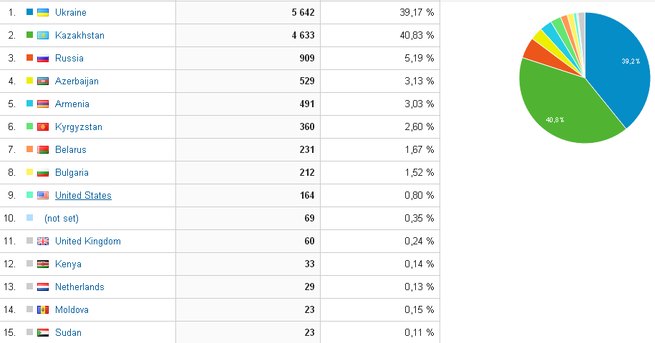
CIS RI1 major outputs – online training course
Multimedia online training course on safe use of the Internet: https://onlinesafety.info/
During first 6 months since launch the course was used by 13,500 unique users from 60 countries
9

Slide 31
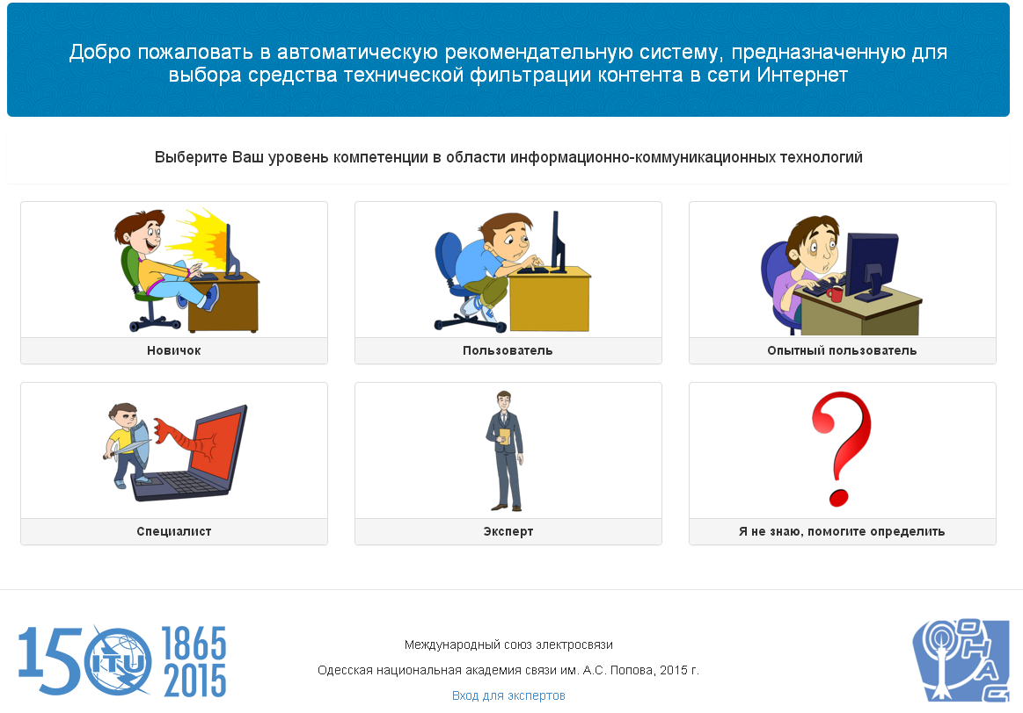
CIS RI1 major outputs – database
Database of technical solutions for child online protection (content filtering) and software (automated system) for choosing optimal technical solution https://contentfiltering.info/
9

Slide 32
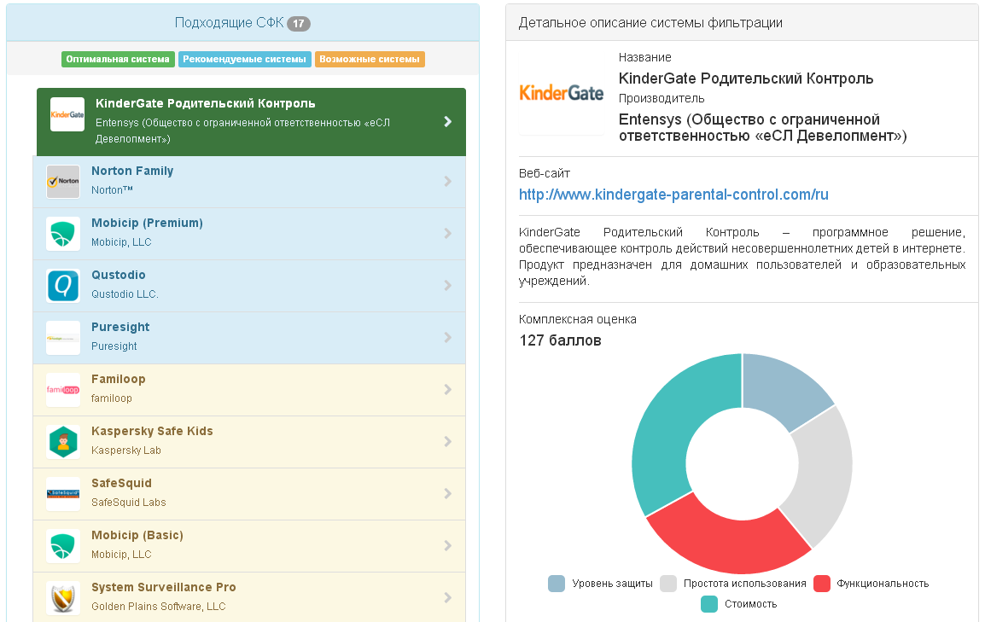
CIS RI1 major outputs – database
9

Slide 33
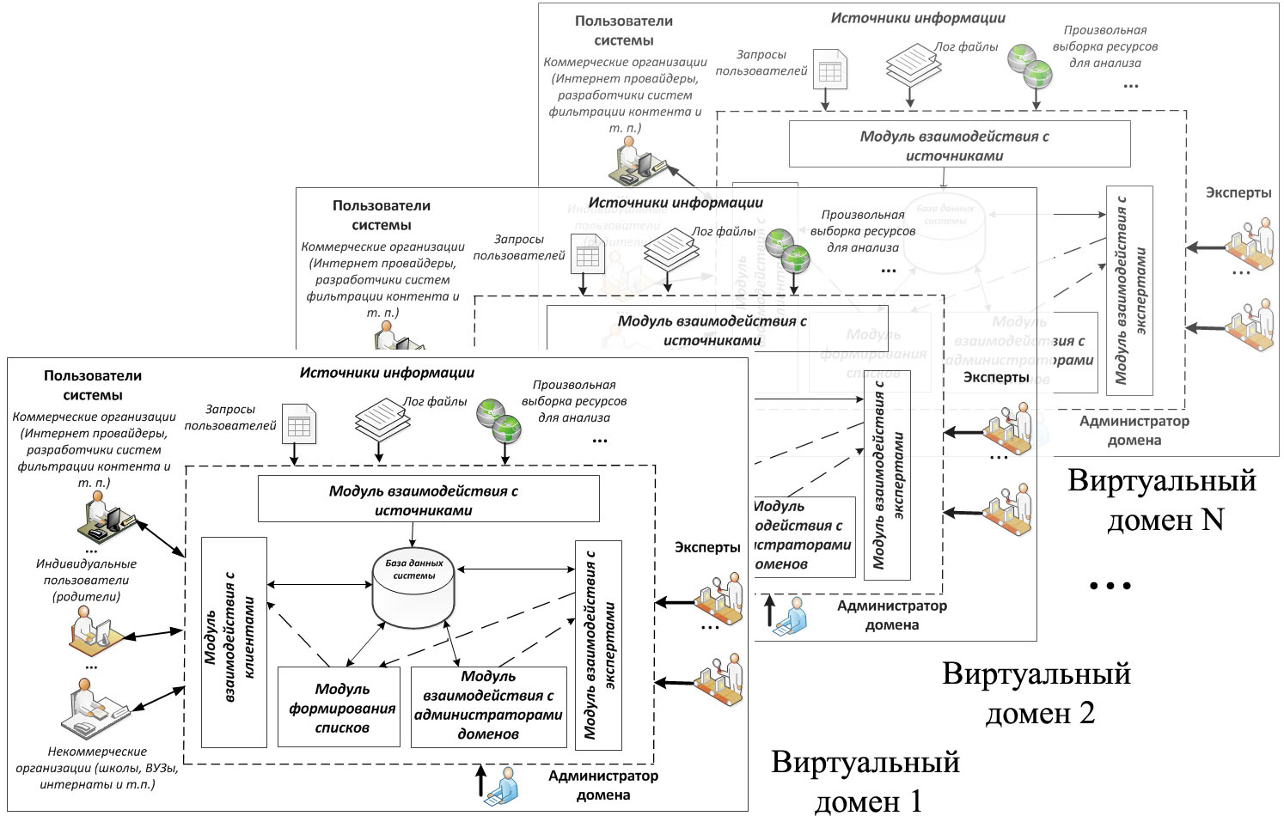
CIS RI1 major outputs – automated system
Automated distribution system of "black" (unsafe) and "white" (safe) lists of Internet resources https://beta.bwld.online/
9

Slide 34
CIS RI1 major outputs – ITU Regional Workshop on Cybersecurity and COP
Venue and date: Odessa, Ukraine, 15-17 June 2016
Participation: 70 delegates from 12 countries
Questions discussed:
Role of international organizations and Governments in the provision of cybersecurity
Policy and regulatory aspects of cybersecurity and COP
Technical tools used
Capacity-building
9

Slide 35
For more information
itumoscow@itu.int​​​​
https://www.itu.int/en/ITU-D/Regional-Presence/CIS/

Slide 36
Child Online Protection Actions by BDT
Europe
36

Slide 37
ITU Europe Region
43 Countries : Albania, Andorra, Austria, Belgium, Bosnia and Herzegovina, Bulgaria, Croatia, Cyprus, Czech Republic, Denmark, Estonia, Finland, France, Germany, Greece, Hungary, Iceland, Ireland, Israel , Italy, Latvia, Liechtenstein, Lithuania, Luxembourg, Malta, The Former Yugoslav Republic of Macedonia, Monaco, Montenegro, Netherlands, Norway, Poland, Portugal, Romania, San Marino, Serbia, Slovak Republic, Slovenia, Spain, Sweden, Switzerland, Turkey, Vatican, United Kingdom
9

Slide 38

ITU Regional Initiative 4 in Europe (EUR-RI4)
Objective: To build trust and confidence in the use of ICTs among children and young people in Europe
Expected Result: Assistance to the countries in need in the following:
Utilizing the existing knowledge on risk and vulnerabilities to which children are exposed in cyberspace and providing best practices
Providing a platform to raise awareness on child online protection (COP) and safety issues
Developing and implementing roadmaps for national or regional COP initiatives.
7

Slide 39
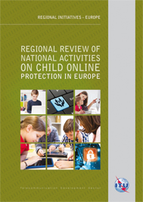
Survey : Review of National Activities April 2017
Launched at the Regional Preparatory Forum, Vilnius, April 2017
18 countries surveyed
Practices collected from 6 countries : Albania, Bosnia & Herzegovina, Romania, Serbia, Slovak Republic, Turkey
39

Slide 40
Areas Covered by the Survey
Perceptions of online child safety issues
Availability of advice or guidance
Availability of awareness raising and related programmes
Legal framework and law enforcement resources
National focal points
Perceptions of the level of co-operation with industry
Perceived assistance needed by each country
10

Slide 41
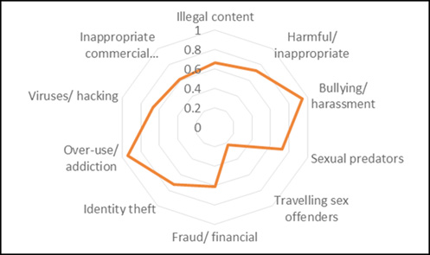
Perceptions of Online Child Safety issues
11

Slide 42
Perceptions of online child safety issues
Concerns by countries
12

Slide 43
Regional Review Conclusions
Every country in the region acknowledge its responsibility to act to ensure that the internet and its associated technologies are safe for children and young people.
Countries increasingly are integrating awareness of online risks into a broader child protection and parenting agenda.
National focal points are a key element in effective online protection. All countries should have a well-resourced national focal point that is connected with regional and international initiatives.
18

Slide 44
Regional Review Conclusions
In many countries, the legislative frameworks are broadly in line with international and regional legal instruments. However, it is extremely important for every country to ensure its legal measures and legislative framework stay in step with technological developments and changes in behaviour.
Advice and guidance on safety online is being provided through several media that target or are used by children. Unified messaging will facilitate and reinforce understanding and reduce potential confusion.
19

Slide 45
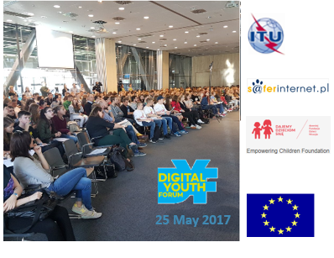


Digital Youth Forum, May 2017
The Digital Youth Forum held in Warsaw, Poland on 25 May 2017
  500+ youth (14–17 years old)
  More than 30 schools connected remotely
  Exposition focusing on digital skills and digital opportunities
Operation Uncool Launched
  200+ respondents to the query supporting open consultation for the purposes of the ITU Council Working Group on Child Online Protection
20

Slide 46
Operation Uncool, May 2017
Launched in 2016 by RErights.org and ITU’s Child Online Protection (COP) initiative
  Rerights.org : Western Sydney University, the Young and Well Cooperative Research Centre Australia, UNICEF’s Voices of Youth and Digitally Connected.
  Invites young people to explore how their rights relate to their use of digital media and technologies like computers, the internet and mobile devices
A consultation inviting young people to share their ideas and experiences.
Two rounds of the consultation effected
Allows the COP Council Working Group Members to consider young people’s opinions and report their concerns to relevant stakeholders so they can reflect young people’s needs in policymaking.
Third round of the consultation is around the topic of digital skills and education.
Survey results will be part of the consultation.
46

Slide 47
Operation Uncool survey results (1)
Technology education
Searching information, using programmes (excel, word) and staying safe online are most common aspects of technology being taught in schools.
Coding, building apps, making videos are aspects that youth would you like to learn at school to be better prepared for the future.
Cyber safety training
Almost all (94%) youth present have received information or training at school on how to be safe online.
School online safety training helps the youth increase their awareness but does not necessarily make them feel safer online.
Many young people interact online to indicate their opinions.
21

Slide 48
Operation Uncool survey results (2)
Online participation
School should focus more on helping the youth to discover/understand the opportunities that new technologies can offer.
There is scope to show/tell the youth more about other people using technology to improve their life or the life of others.
More actions could be proposed to make the youth more confident in their ability to make the most of what technology has to offer
More action could be proposed to make the youth more confident in their ability to use technology to meet their needs now and in the future.
Most young people are in online communities.
Many young people interact online to indicate their opinions.
22

Slide 49
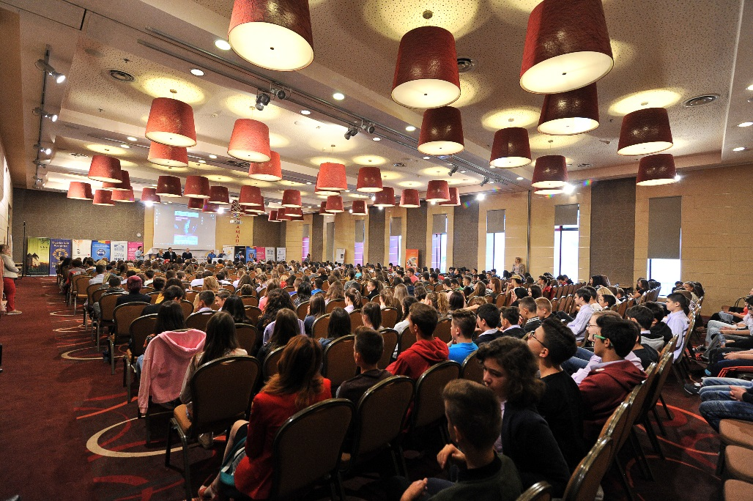
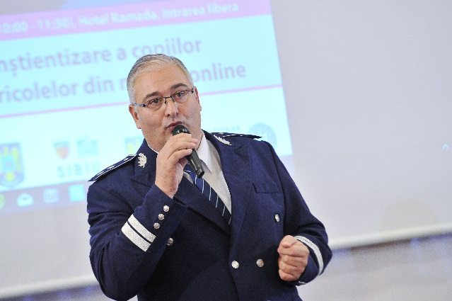

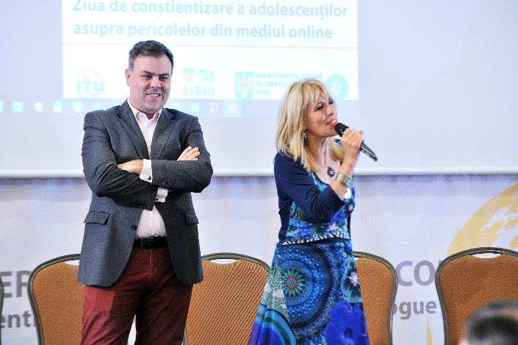
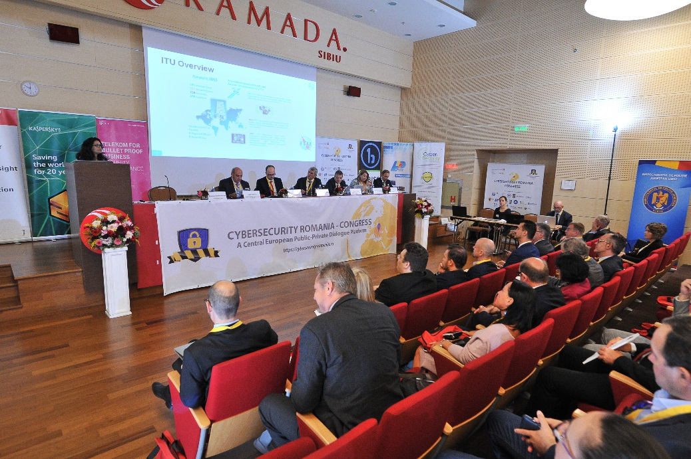
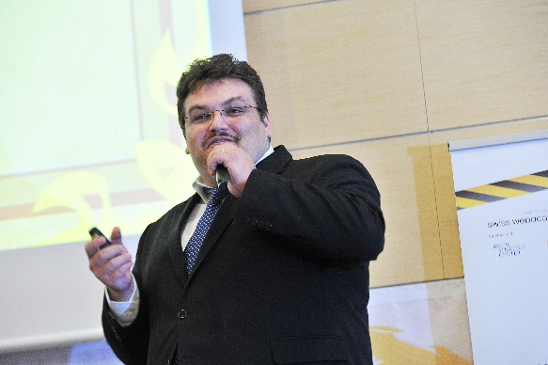
5th Central European Cybersecurity Public-Private Dialogue Platform, September 2017
Awareness day for Children
13 September – Pre Congress
stakeholders on a voluntary basis
400+ CHILDREN ATTENDING
23

Slide 50

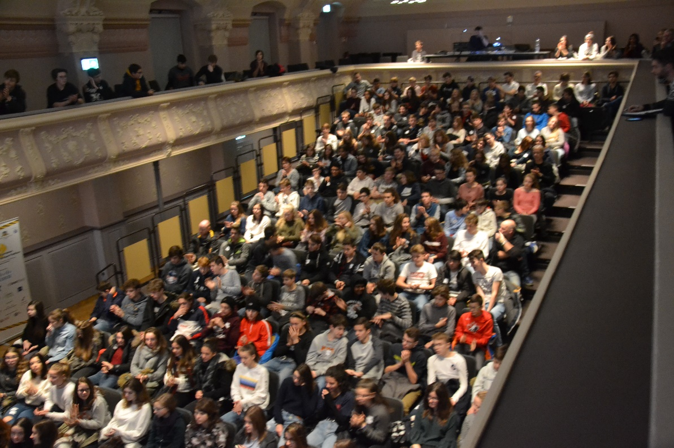
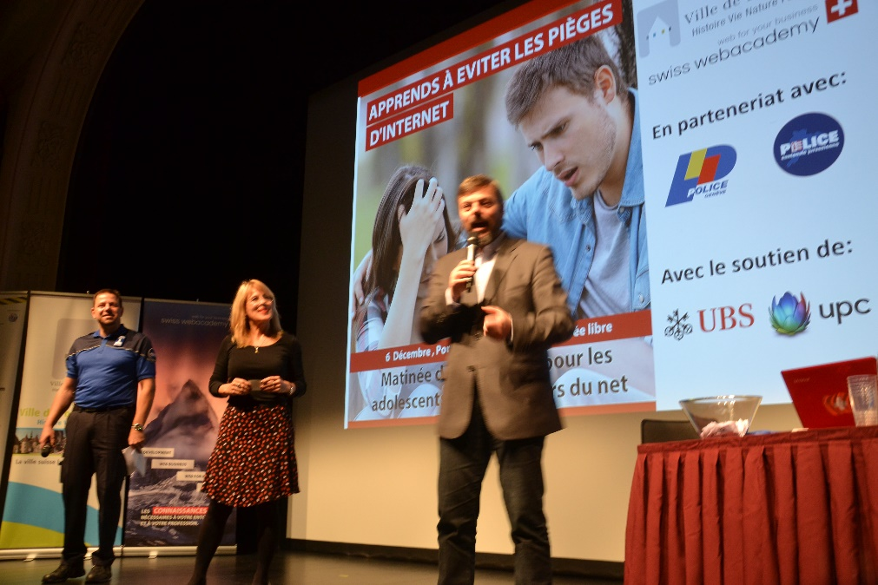
1st Western European Cybersecurity Public-Private Dialogue Platform, December 2017
Held in Porrentruy, Switzerland
100+ Participants
Countries represented :Finland, France, Italy, Romania,
Switzerland, USA
Awareness day for Children
07 November
23

Slide 51
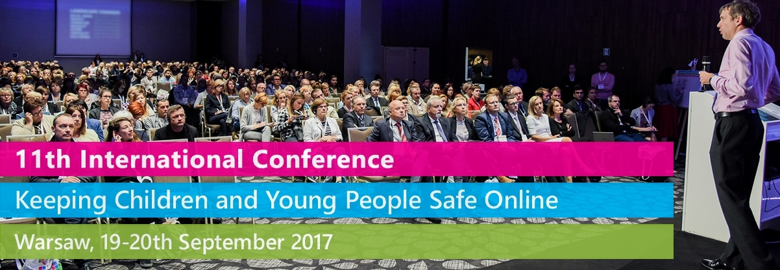
The 11th International Conference "Keeping Children and Young People Safe Online", 19-20 September 2017
Held in Warsaw, Poland
500 Participants
Countries represented : Belgium, Bulgaria, Finland, France, Germany, Greece, Ireland, Lithuania, Luxembourg, the Netherlands, Spain, Switzerland, Turkey, United Kingdom, Ukraine.
Highlights : Fake news, Cyberbullying, Pornography, Privacy issues
Kick off discussions with Klicksafe of Germany and South West Grid for Learning of UK
22

Slide 52
ITU Regional Initiative 4 in Europe
Cycle Starting 2018
EUR 4 - Enhancing trust and confidence in the use of information and communication technologies
Objective: To support the deployment of resilient infrastructure and secure services allowing all citizens, especially children, to use ICTs in their daily lives with
Expected Result: Assistance to the countries in need in the following:
1) Providing regional platforms and tools for building human capacities (awareness and expert training) to enhance trust and confidence in the use of ICTs
2) Sharing country and regional best practices and case studies and conducting surveys on enhancing confidence and trust in the use of ICTs
3) Elaborating or review national cybersecurity strategies
….and more
7

Slide 53
Regional Workshop for Europe and CIS on Cybersecurity and Child Online Protection, April 2018
A.S. Popov Odessa National Academy of Telecommunications Odessa, Ukraine
4-6 April 2018
Role of governments and international organizations
National Cybersecurity Strategies and Roadmaps
Policy aspects, Regulatory framework and Legal measures
Technical tools and procedural aspects
Trends and Emerging Challenges
Capacity Building and Country experiences
Future of cybersecurity and child online protection
23

Slide 54
More 2018 actions planned ..
Digital Youth Forum - May
International Conference "Keeping Children and Young People Safe Online – September
Central European Cybersecurity Public-Private Dialogue Platform - September
Western European Cybersecurity Public-Private Dialogue Platform - December
Child Online Protection and the role of Regulators
Conference co-organized with Klicksafe, Berlin, Germany - Date TBD
Project for Europe Region Countries
How effective are your schools at protecting your children online? How do you know? How do they know ?
In partnership with SWGfL (South West Grid for Learning) and UK Safer Internet Centre
23

Slide 55
Take-aways from European Actions
New technology – new behaviours – new solutions
Internet of things
- connected toys can open access to potential hackers in your home
- tap into personal data in many ways
Hidden influence
Are there stealth tactics hidden in certain digital games to influence behaviour of children ?
AI - As toys reach new levels of sophistication, how concerned should we be about our children playing with artificial buddies that appear to have feelings?
24

Slide 56
Take-aways from European Actions
Stakeholders need to …
Keep abreast of new technology and new techniques used to harm our children
Go through regular awareness /knowledge transfer sessions
Keep close contact / time with our children & their surroundings – know their online lives [regulate internet and smartphone use at home]
React quickly and calmly in suspected cases
Collaborate & Communicate with authorities & stakeholders
And more…
25

Slide 57
For more information
EURregion@itu.int
http://www.itu.int/en/ITU-D/Regional-Presence/Europe

