Slide 1
CWG on Strategic and Financial Plans - Review of the Strategic Targets 2016-2019 CWG-SFP-2/INF-03
Document CWG-SFP-2/INF/3-E 10 August 2017 English only
August 10, 2017

Slide 2
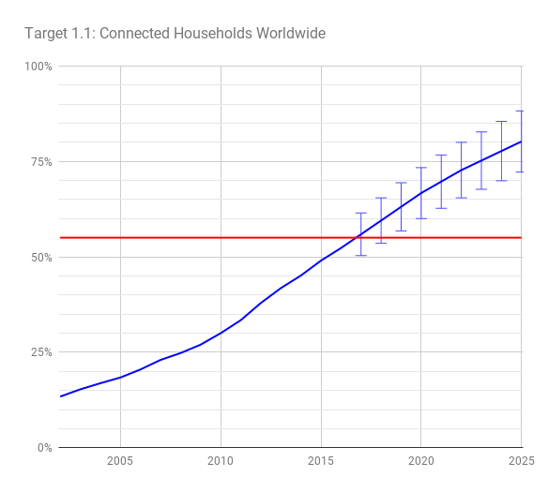
Target 1.1: Connected households worldwide
1.1 Worldwide, 55% of households should have access to the Internet by 2020
Target is expected to be achieved
The worldwide number of households connected to the internet benefits in particular from a strong rise in the number of connected households in developing countries and LDCs (included as separate targets 2.1.A & 2.1.B respectively)
Source: ITU World Telecommunication /ICT Indicators database

Slide 3
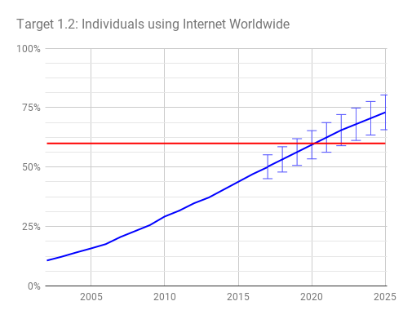
Target 1.2 Individuals using the Internet worldwide
1.2: Worldwide, 60% of individuals should be using the Internet by 2020
Target expected to be achieved
The target may be achieved before 2020, this is in particular due to the strong growth in developing countries and LDC (included as separate targets 2.2.A & 2.2.B respectively).
Relatively slower growth in developed countries suggests that socio-economic factors inhibit further growth
Source: ITU World Telecommunication /ICT Indicators database

Slide 4
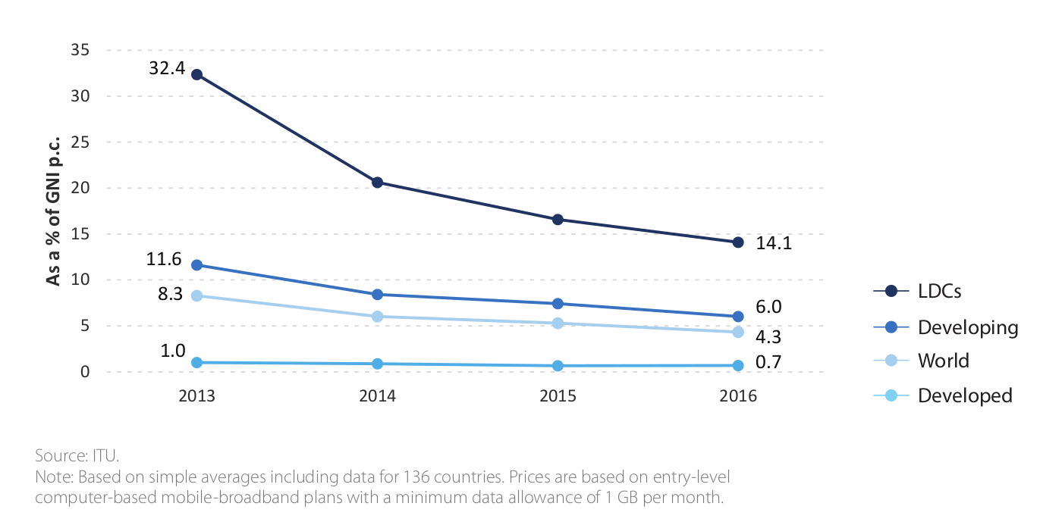
Target 1.3: Affordability
1.3: Worldwide, telecommunication / ICT should be 40% more affordable by 2020
Developed countries trend suggests mobile to be around 32.5% more affordable by 2020
Developing countries trend suggests mobile to be around 33% more affordable by 2020
Costs of internet access are falling, however relatively slow growth in GNI per capita makes this target difficult to achieve
Mobile Broadband Prices as % of GNIpc

Slide 5
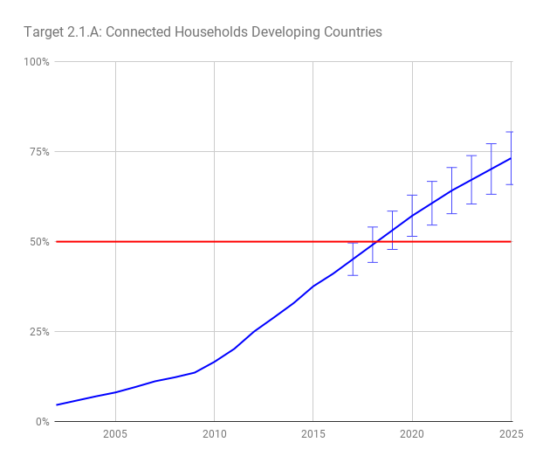
Target 2.1: Connected households: Developing countries / LDCs
2.1.A: In the developing world, 50% of households should have access to the Internet by 2020
Target expected to be achieved
2.1.B: In the least developed countries (LDCs), 15% of households should have access to the Internet by 2020
Target expected to be achieved
LDC adoption is accelerating
Strong growth in all developing countries, the target for developing countries is more ambitious in terms of the aspired growth than the worldwide target and is expected to be achieved a bit later (but still before 2020)
Source: ITU World Telecommunication /ICT Indicators database

Slide 6
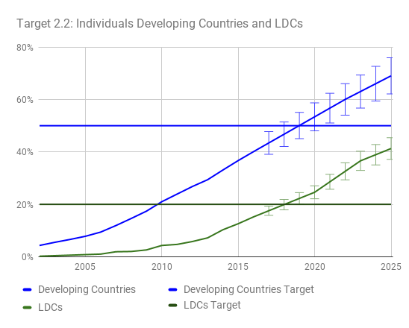
Target 2.2: Individuals using the Internet: Developing countries / LDCs
2.2.A: In the developing world, 50% of individuals should be using the Internet by 2020
Target expected to be achieved
2.2.B: In the least developed countries (LDCs), 20% of individuals should be using the Internet by 2020
Target expected to be achieved
Of the targets focused on connecting individuals, LDCs target looks to be achieved first, followed by the developing countries targets, followed by the worldwide target.

Slide 7
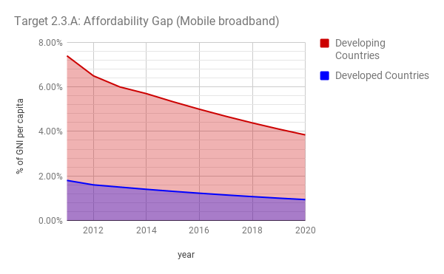
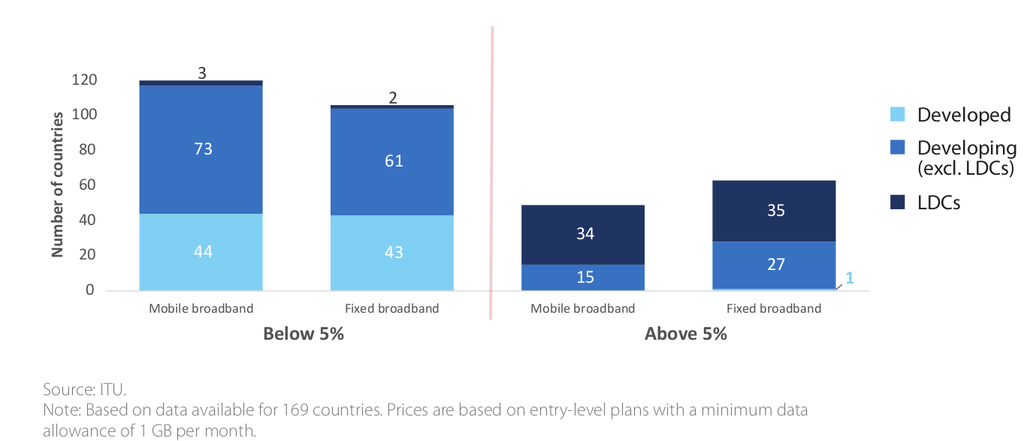
Target 2.3: Affordability gap
2.3.A: The affordability gap between developed and developing countries should be reduced by 40% by 2020
Mobile broadband affordability gap expected reduction around 32.37%
2.3.B: Broadband services should cost no more than 5% of average monthly income in developing countries by 2020
Currently achieved by 120/160 countries or 75% (2016)
The fall in prices in developing countries continues at the pace observed since around 2012, reducing the gap. GNIpc growth was overall limited, therefore having a limited effect on the gap.
Meeting the Target of 5% of GNIpc

Slide 8
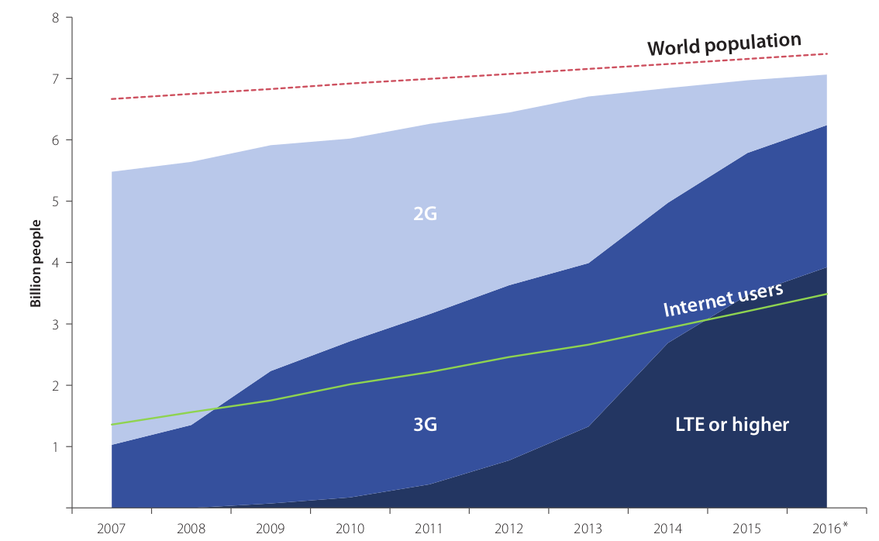
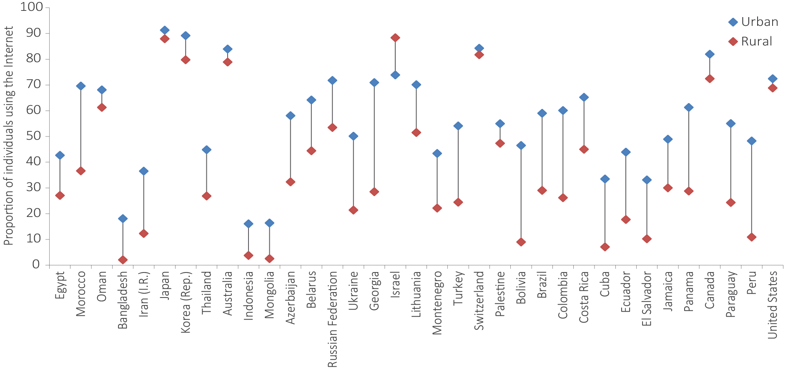
Target 2.4: Broadband Coverage
2.4: Worldwide, 90% of the rural population should be covered by broadband services by 2020
Rural coverage at 67% in 2016
Mobile Coverage of the rural population is higher
2G to LTE upgrade will increase coverage

Slide 9
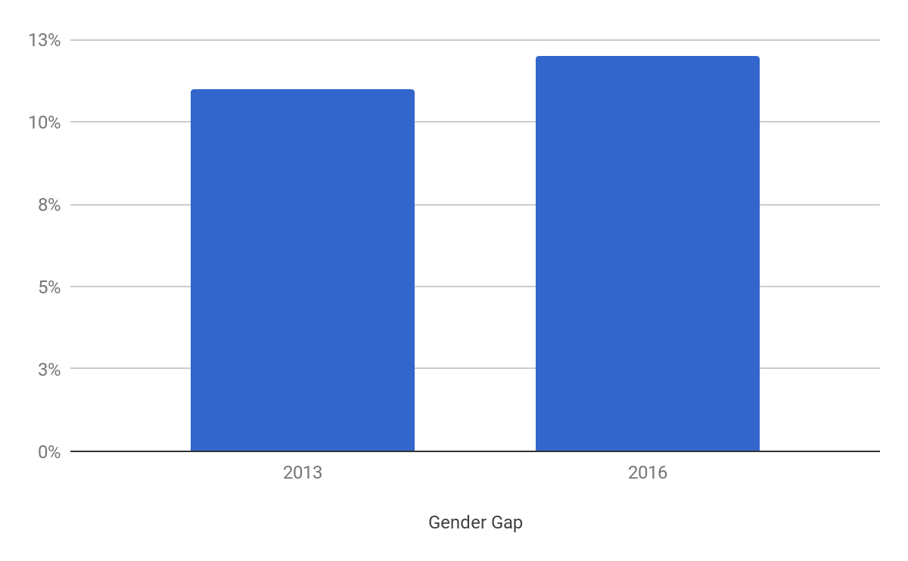
Target 2.5.A: Gender Equality
2.5.A: Gender equality among Internet users should be reached by 2020
Internet usage growing faster among men explained by faster growth in developing countries and particular in LDCs, where the data shows first adopters are likely men
Latest data (2016) show that the divergence is slowing down, i.e. the difference between male and female adoption is still increasing, but at a decelerating pace
2013
2016
Gender gaps by region and classification

Slide 10
Target 2.5.B: Persons with disabilities
Enabling environments ensuring accessible telecommunications/ICTs for persons with disabilities should be established in all countries by 2020
48 out of 64 reporting countries have an accessibility strategy (2016 data), or 75% percent of the reporting countries
Increased from 40 out of 98 reporting countries in 2015 (41% of reporting countries)

Slide 11
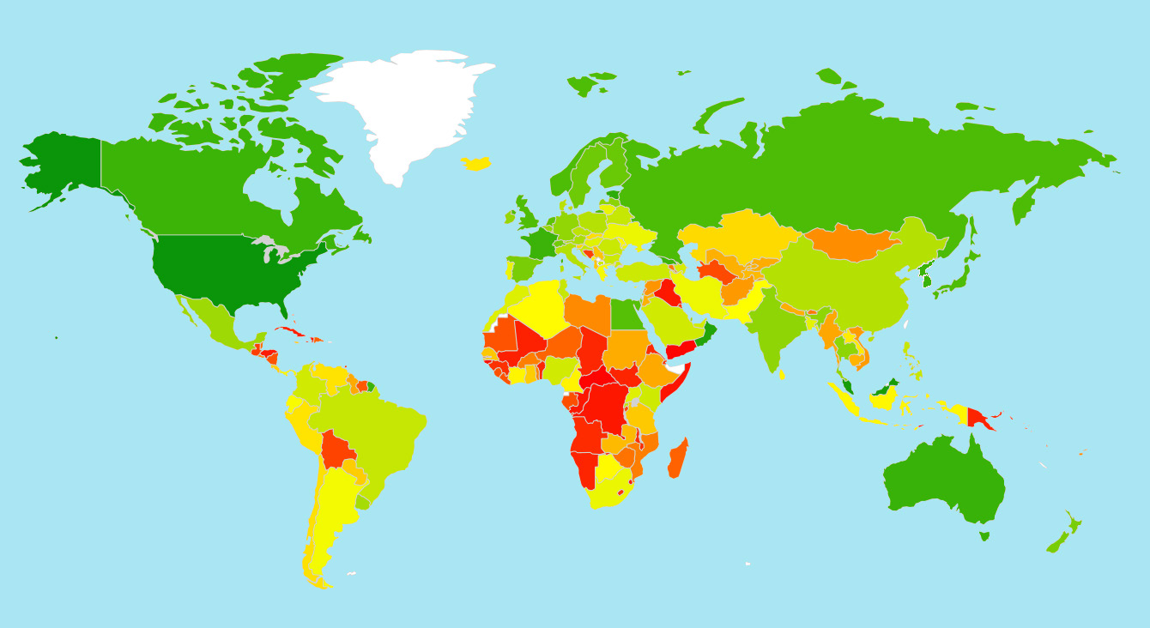
Target 3.1: Cybersecurity readiness
3.1: Cybersecurity readiness should be improved by 40% by 2020
To measure improvement in cybersecurity within the context of the Connect 2020 Agenda, ITU proposes to combine the Global Cybersecurity Index (GCI) results with key indicators of cybersecurity vision and capabilities at the country level: the existence of a national cybersecurity strategy and a national Computer Incident Response Team (CIRT).
By combining the growth in the average GCI scores with the growth in the number of national cybersecurity strategies and national CIRTs, it will be possible to determine if the 40% improvement target in cybersecurity between 2014 and 2020 has been achieved.
GCI heat map 2017
Level of commitment: from Green (highest) to Red (lowest)

Slide 12
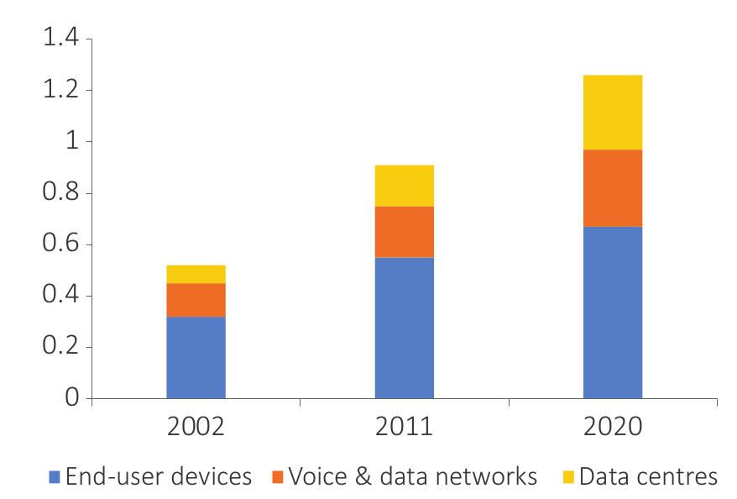
Targets 3.2 & 3.3: E-waste & Greenhouse Gas emissions
3.2: Volume of redundant e-waste to be reduced by 50% by 2020
Data was limited, mostly OECD countries
More data and statistics on e-waste recycling now being collected
Proposal to revise the target to ‘increased recycled e-waste’ to match with available data
Global ICT emissions (gigatonnes of CO2 equivalent – GeSI estimates and projections
3.3: Greenhouse Gas emissions generated by the telecommunication/ICT sector to be decreased per device by 30% by 2020
ITU-T Study Group 5 working on a roadmap for Target 3.3 on GHG emissions reduction
Source: UNCTAD (2015)

Slide 13
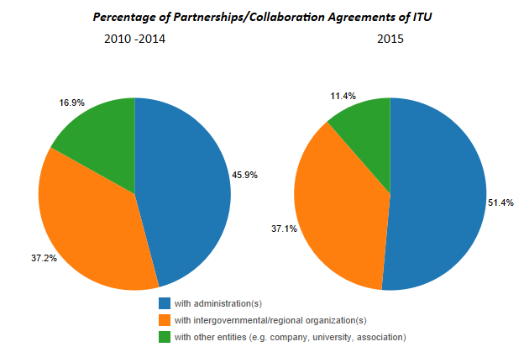
Goal 4: Innovation and Partnership
4.1: Telecommunication/ICT environment conducive to innovation
Related to innovation capacity, possibility to establish proxy indicators that draw on ICT-focused data under wider innovation measurements
In Sub-Saharan Africa, the number of innovation/tech hubs has increased about 15% since 2014 (World Development Report 2016: Digital Dividends)
4.2: Effective partnerships of stakeholders in telecommunication/ICT environment
Data collection could be related with SDG target 17.6.1 (Number of science and/or technology cooperation agreements and programmes between countries, by type of cooperation)
Source: ITU Annual Report 2016

