Slide 1
Revision 1 of Document CWG-SFP-2/6-E 24 August 2017 Original: English
Strategic planning FRAMEWORK
2nd Meeting of the Council Working Group for Strategic and Financial plans for 2020-2023
“Committed to connecting the world”
7 August 2017

Slide 2
Secretariat’s Input to the CWG-SFP
Work plan of the Strategic Planning Working Group (SP-WG)
Situational / strategic analysis
Proposed revised ITU Vision, Mission, Values, Strategic Goals
Process for reviewing the Targets
Strategic Risk management analysis
ITU within the UN System and linkage with the SDGs
Preliminary draft for ITU results framework
Objectives/Outcomes and Outputs
Enablers/support services

Slide 3
Work plan for SP-WG
WORK PLAN OF THE SECRETARIAT’S STRATEGIC PLANNING WORKING GROUP (SP-WG)
PREPARE FOR 2ND CWG-SFP
SUPPORT 2ND CWG-SFP PUBLIC CONSULTATION
PREPARE FOR 3RD CWG-SFP
SUPPORT CWG-SFP CONSULTATION ON THE DRAFT SP
PREPARE FOR 4TH CWG-SFP & COUNCIL 2018
ACTIVITIES
Brainstorming on ITU strategic framework & map with SDGs
Strategic/situational analysis & Internal Strategic Workshops
Report on 1st Public and Staff consultations
Review the Targets
Strategic risks review
Preliminary objectives, outcomes & outputs
Support CWG-SFP to prepare and conduct the 2nd Public Consultation on the proposed ITU Strategic Framework
Continue internal preparations
Report on 2nd Consultation
Present revised Sector & Inter-Sector Obj./ Outcomes & Outputs
WTDC-17 input
Draft the text of SP
Draft strategic situational analysis
Proposal for targets
Draft Rev. Resolutions
Support CWG-SFP to prepare an open consultation on the draft text of the Strategic Plan (including situational analysis)
Present progress and get feedback from the Sector advisory groups
Report on the final public consultation
Inputs from Sector advisory groups
Consolidate and finalize draft texts of the:
Strategic plan
Draft Resolutions
KEY DELIVERABLES
ITU strategic framework (including Vision, Mission, Values, Goals)
Consultation & Staff Survey reports
Docs for 2nd CWG-SFP
CWG-SFP Consultation on the proposed ITU Strategic Framework
Draft text of the SP (including situational analysis)
Draft Revised Resolutions
Docs for 3rd CWG-SFP
CWG-SFP Consultation on the draft ITU Strategic Plan for 2020-2023
Draft Documents submitted to 4th CWG-SFP and the 2018 Session of Council
TIMELINE
11-12 Sep 2017 (2nd CWG-SFP)
End of Jan 2018 (3rd CWG-SFP)
April / Council 2018 (4th CWG-SFP)

Slide 4
Situational / strategic analysis
- Lessons learned (2016-2019 Strategic Plan)
- Strategic / situational analysis (ITU and the environment – SWOT)

Slide 5
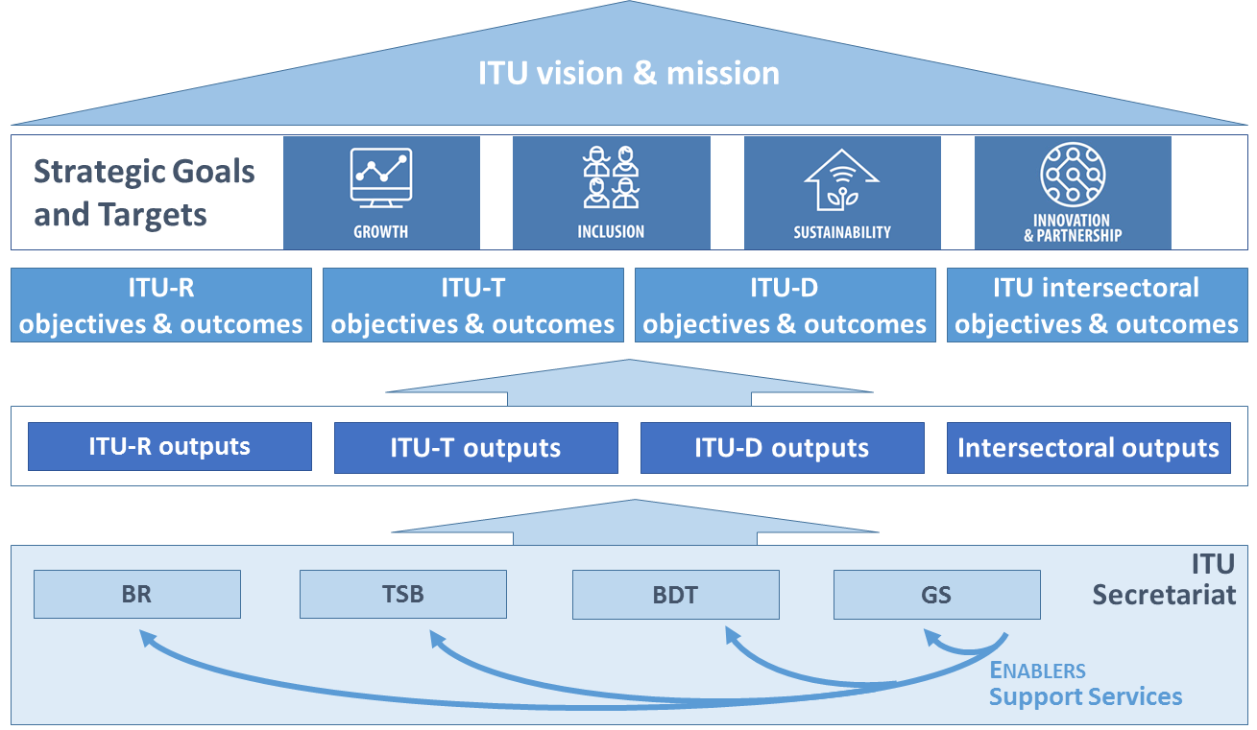
ITU strategic framework for 2016-2019

Slide 6
New concepts introduced in the 2016-2019 Strategic Plan
A strengthened results-based approach
Overall Goals with specific Targets at the level of the Union
Tangible Outcomes and indicators to measure the impact of ITU’s work
General Secretariat enables and supports the work of the Sectors
Enabling/supporting role also measured via indicators
A strengthened concept of “Working as One ITU”
ITU-wide mission, vision, a set of values and a set of organization-wide goals, where all 3 Sectors contribute to with their mandate
Strategic risk management incorporated in the process
Allocation of resources to objectives and goals
Linkage of the resources allocated with the benefits for the membership (outcomes/objectives)

Slide 7
Lessons learned from the 2016-2019 Strategic Plan
ITU-wide set of Goals and Targets
Communicated overall goals of the Union → Connect 2020 Agenda
Monitoring and Reporting
Openness and transparency in publicly reporting progress towards Key Performance Indicators
ITU Annual Progress Report
Reporting format could be reviewed
Indicators: need to review and elaborate more accurate/appropriate indicators
Thorough review of the status of the Connect 2020 Targets will support the development of the new set of targets
Areas for further improvements?

Slide 8
Strategic / situational analysis
Internal factors
External factors
Political
Economic
Social
Technological
Legal
Environmental
Organizational
ITU
Strengths
Weaknesses
Opportunities
Threats
Key Partners

Slide 9
Strengths of the ITU
The UN specialized agency for ICTs with 150 years of history/tradition
Leading role to organize the use of ICT resources globally, through regulations and standards of universal applicability
Unique membership composition – governments, private sector and academia participate in the activities of the organization
Dual role of a normative organization combined with experience in implementing developmental initiatives
Prominent position to foster the enabling role of ICTs to accelerate implementation of the SDGs
A global, neutral, inclusive platform – strong brand with good reputation
Partnerships with key stakeholders and established collaborations
Federal structure – provides more focus on specific fields
Legitimacy and capacity to organize major international conferences and events
Knowledge and skills of ITU membership and staff in technical (e.g. radiocommunications, standardization), policy and regulatory matters, statistics, and development (‘crowdsourcing’ of skills)

Slide 10
Weaknesses of the ITU
Length of the governing bodies decision making process
Federal structure requires coordination and clarification of the roles of each sector to avoid duplication/conflicts
Elements of organizational culture are conservative and risk averse
Difficulty to decide on diversifying sources of income

Slide 11
Opportunities
Creation of new markets and entrance of new key players creates new membership opportunities
Member States from developing world increasingly engage in the multilateral system
Increased relevance of ICT in society, data seen as the new oil
Catalytic impact of ICTs on the implementation of SDGs (impact on medical and social care, education, social identity, etc.)
Digital transformation of the industry and public services
New emerging technologies, systems and players require new harmonized regulations and standards
New environmentally-friendly technologies/markets leading to new opportunities for partnerships
Support from some media and advocacy organizations

Slide 12
Threats
Increasing divisions (e.g. digital, gender, geographical)
Difficulty of the global economy to regain a trajectory of strong, balanced and sustained growth
New digital service providers and increased competition reduce margins, questioning the types of regulations required
Social impact of ICTs (online privacy, consumer protection, security, impact on jobs, growing inequalities, ethics)
The impact on environment of increasing networks, data, devices connected
Pressure from different stakeholders to implement unproven approaches
Duplication of work with other organizations/associations

Slide 13
Key partners
Member States
Sector Members and other industry players
Academia
UN Agencies and other International organizations
Industry associations (including tech SME associations)
NGOs

Slide 14
ITU vision, mission and values

Slide 15
Vision
The better world ITU wants to see
“An information society, empowered by the interconnected world, where telecommunication/information and communication technologies enable and accelerate social, economic and environmentally sustainable growth and development for everyone”
“A world free of hunger and malnutrition where food and agriculture contributes to improving the living standards of all, especially the poorest, in an economically, socially and environmentally sustainable manner”
“The postal sector is seen as an enabler of inclusive development and an essential component of the global economy”
“UNICEF is the driving force that helps build a world where the rights of every child are realized”

Slide 16
Vision – proposal to discuss
“An information society, empowered by the inter connected world, where telecommunication/information and communication technologies enable and accelerate human progress and enable social, economic and environmentally sustainable growth and development for all everyone”
➲ Proposed vision:
A connected world, where telecommunication/information and communication technologies accelerate human progress and enable sustainable development for all

Slide 17
Mission
Mission refers to the main overall purposes of the Union, as per the Basic Instruments of ITU
“To promote, facilitate and foster affordable and universal access to telecommunication/information and communication technology networks, services and applications and their use for social, economic and environmentally sustainable growth and development”
“The promotion of innovation and creativity for the economic, social and cultural development of all countries, through a balanced and effective international intellectual property system”
“As a specialized agency of the United Nations, UNESCO –pursuant to its Constitution – contributes to the building of peace, the eradication of poverty, and sustainable development and intercultural dialogue through education, the sciences, culture, communication and information”
“To stimulate the lasting development of efficient and accessible universal postal services of quality in order to facilitate communication between the inhabitants of the world by … (…)”

Slide 18
Mission – proposal to discuss
“To promote, facilitate and foster universal and affordable and universal access to telecommunication/information and communication technology networks, services and applications and their use for human progress and sustainable development for social, economic and environmentally sustainable growth and development”
➲ Proposed mission:
To promote, facilitate and foster universal and affordable access to telecommunication/information and communication technology networks, services and applications and their use for human progress and sustainable development

Slide 19
Values
ITU’s shared and common beliefs that drive its priorities and guide all decision-making processes
“People-centred, service-oriented and results-based”
“Inclusiveness”
“Universality and neutrality”
“Synergies through Collaboration”
“Innovativeness”
“Efficiency”
“Continuous Improvement”
“Transparency”
“National ownership and capacity”
“Accountability for results and transparency”
“Partnerships and coordination”
“Excellence”
“Service orientation” “Working as one” “Accountability for results”
“Environmental, social and governance responsibility”
“Accountability” “Integrity”
“Transparency” “Mutual respect”
“Professionalism” “Results orientation”

Slide 20
Values – proposal
➲ Proposed values statement:
The Union recognizes that achieving its mission requires that it builds and maintains trust among its Members and inspires the confidence of the public at-large. This applies to both what the Union does and how it is done.
The Union is committed to continuously building and safeguarding that trust by ensuring that its actions, as an enabler of human progress:
Promote innovation and inclusiveness
Enable collaboration and harmonization
Strive for transparency, openness, neutrality and impartiality
Be accountable for achieving results with integrity.
The Union expects all of its staff to faithfully adhere to the Standards of Conduct for the International Civil Service and the ITU Code of Ethics. ITU also expects that any partner will uphold the highest standards of ethical behavior.

Slide 21
Strategic Goals – proposal for modifications
Growth: Enable and foster access to and increased use of digital services building digital economy and society
- (2016) Enable and foster access to and increased use of telecommunication/ICT
Inclusiveness: Bridge the gaps for an inclusive digital society and provide broadband access ‘leaving no one behind’
- (2016) Bridge the digital divide and provide broadband for all
Sustainability: Manage emerging risks and challenges resulting from the increased use of telecommunication/ICT
- (2016) Manage challenges resulting from telecommunication/ICT development
Innovation: Enable the digital transformation of society and economy by facilitating innovation in telecommunication/ICT
- (2016) Lead, improve and adapt to the changing telecommunication/ICT environment
Partnership: Strengthen cooperation among Member States, private sector, especially SMEs, academia, intergovernmental organizations and all other stakeholders, in the role of telecommunication/ICT towards the implementation of the SDGs
- (2016) Lead, improve and adapt to the changing telecommunication/ICT environment

Slide 22
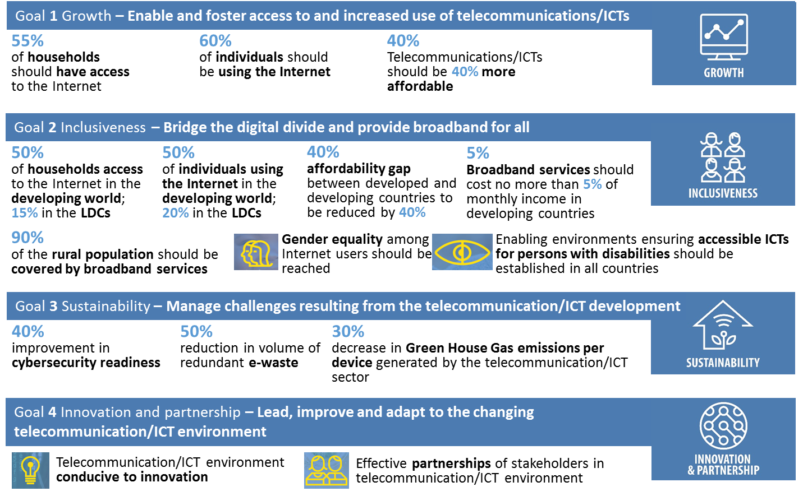
Strategic Targets – being reviewed
➲
➲
➲
➲
➲
➲ ICT-related SDG Targets:
4.4: Proportion of youth/adults with ICT skills, by type of skills
5.b: Proportion of individuals who own a mobile telephone, by sex
9.c: Percentage of the population covered by a mobile network, broken down by technology
17.6: Fixed Internet broadband subscriptions, broken down by speed
17.8: Proportion of individuals using the Internet
→ INCLUSIVENESS
→ INCLUSIVENESS
→ INCLUSIVENESS
→ GROWTH
→ GROWTH

Slide 23
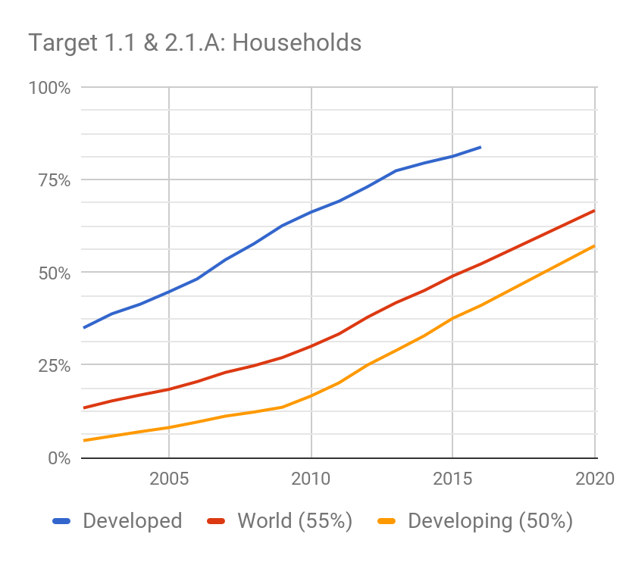
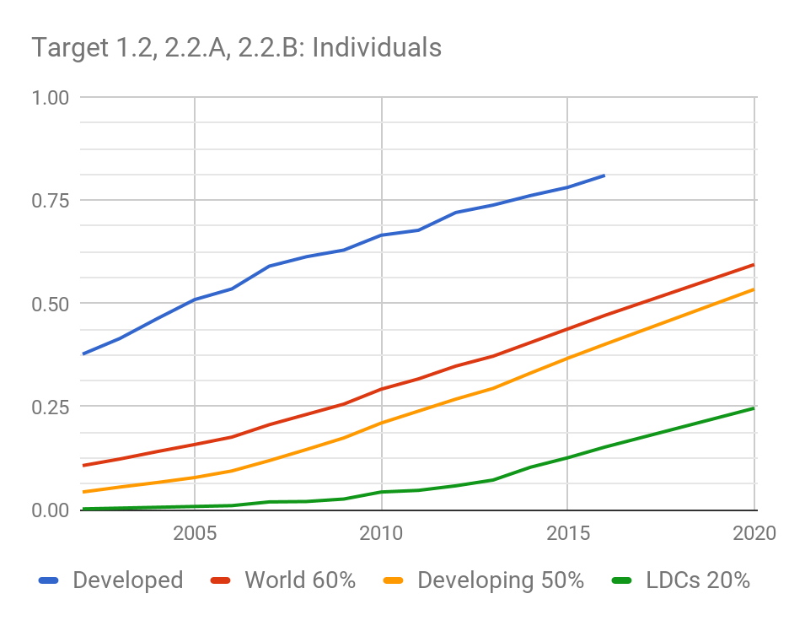
Goal 1
1.1: Worldwide, 55% of households connected
Expected to be achieved
PROPOSAL: by 2023: 65% / by 2025: 70%
1.2: Worldwide, 60% of individuals should be using the Internet by 2020 → SDG 17.8.1
Expected to be achieved
PROPOSAL: by 2023: 65% / by 2025: 70%
1.3: Worldwide, ICT should be 40% more affordable by 2020
Developed countries expected: -32.5%
Developing countries expected: -33.0%
PROPOSAL: by 2023: 25% more affordable / by 2025: 30% more affordable compared to 2016
New 1.4 PROPOSAL: by 2023/2025, all countries should adopt a digital agenda/strategy
New 1.5 PROPOSAL: x% percent of SMEs selling online
New 1.6 → SDGs 17.6.2 (Fixed broadband, by speed)
PROPOSAL: Increase by x% the fixed broadband subscriptions
PROPOSAL: x% of countries to have 50% of the fixed broadband subscriptions more than 10 Mbit
New 1.7 → SDG 16.10.2 (Public access to information)
PROPOSAL: x% of population interacting with government services online
* Source: ITU data (World Telecommunication/ICT Indicators Database)

Slide 24
Goal 2
2.1.A: Developing, 50% of households connected
Expected to be achieved
PROPOSAL: by 2023: 55% / by 2025: 60%
2.1.B: In the least developed countries (LDCs), 15% of households
Expected to be achieved
PROPOSAL: by 2023: 25% / by 2025: 30%
2.2.A: Developing world, 50% of individuals using the Internet by 2020
Expected to be achieved
PROPOSAL by 2023: 55% / by 2025: 60%
2.2.B: LDCs, 20% of individuals should be using the Internet by 2020
Expected to be achieved
PROPOSAL by 2023: 30% / by 2025: 35%
New → SDG 8.10.2: Proportion of adults with an account at a bank or other financial institution or with a mobile-money-service provider
PROPOSAL: by 2023/2025: x% of population to use e-banking/mobile banking
2.3.A: The affordability gap between developed and developing countries should be reduced by 40% by 2020
PROPOSAL: by 2025, reduced by another 30%
2.3.B: Broadband services should cost no more than 5% of average monthly income in developing countries by 2020
Achieved in 120 countries
PROPOSAL: by 2023 <3% or by 2025 <2.5% of GNIpc
2.4: Worldwide, 90% of the rural population should be covered by broadband services by 2020 → SDG 9.c.1 Proportion of population covered by a mobile network, by technology
Rural coverage at 67% in 2016
PROPOSAL: total population coverage by 2023 – 95% / by 2025 – 98%
2.5.A: Achieving gender equality among internet users by 2020
Gender gap overall slightly growing (albeit at slowing rate)
PROPOSAL:
Gender equality among ICT users
Gender equality on mobile phone ownership (SDG 5.b.1: Proportion of individuals who own a mobile telephone, by sex)
2.5.B: Strategy for accessibility (48/64 countries, 2016 data)
PROPOSAL: Keep target for all countries
New 2.5.C → SDG 4.4.1 (Youth/adults ICT skills, by skill)
PROPOSAL: Improve proportion with ICT skills (distinction by developed/developing countries)

Slide 25
Goal 3 (Sustainability), 4 (Innovation) & 5 (Partnership)
3.1: Cybersecurity readiness should be improved by 40% by 2020
PROPOSAL: Improve cybersecurity preparedness of countries (with key capabilities: presence of strategy, national computer incident/emergency response teams and legislation)
3.2: Volume of redundant e-waste to be reduced by 50% by 2020
PROPOSAL:
Increase the global e-waste recycling rate to x%
Increase the number of countries with an e-waste legislation to x
3.3: GHG emissions decreased per device by 30% by 2020
OPTIONS:
Link with Paris Agreement / ICT sector to proportionally contribute to Intended Nationally Determined Contributions (INDCs)
Telecommunication/ICT infrastructure to use ‘cleaner’ energy
New 3.4 → SDG 11.B.2: Number of countries with national and local disaster risk reduction strategies
PROPOSAL:
Increased number of countries that have a National Emergency Telecommunication Plan
Increased number of countries that have multi-hazard early warning systems (Sendai Framework indicator G1)
Increased number of countries that have implemented CAP
4.1: ICT environment conducive to innovation
OPTIONS:
All countries to have a policy/strategy for innovation with focus on tech SMEs
All countries to promote innovation hubs
New 4.2 → SDG 9.B.1: Proportion of medium and high-tech industry value added in total value added
PROPOSAL: x% of jobs in the ICT sector (male / female)
New 5.1: (Effective partnerships of stakeholders in ICT environment) → SDG 17.6.1 on number of science and/or technology cooperation agreements)
PROPOSAL: Increased ICT-related funding/development programmes

Slide 26
Strategic Risks

Slide 27
Overview of Strategic Risks
Risk 1
Diminishing relevance and ability to demonstrate clear added value
Risk 4
Concerns regarding trust and confidence
Risk 5
Inadequate internal structures, tools, methodology and processes
Risk 2
Spreading too thin
Risk 6
Inadequacy of funding (Insufficient funding support)
Risk 3
Failure to respond quickly to emerging needs and innovate

Slide 28
Strategic Risk 1
Risk
Diminishing relevance and ability to demonstrate clear added value
Risk of duplication of efforts and inconsistencies inside the organization that affects our ability to demonstrate added value
Risk of conflicting efforts, inconsistencies and competition with other relevant organizations and bodies that leads to misperception of ITU’s mandate, mission and role
Mitigation Strategy
- Risk avoidance: by clear mandates of each structure and role in the Union
- Risk limitation: improve the cooperation framework
- Risk avoidance: identify and concentrate on areas with clear added value
- Risk transfer: by establishing long term partnerships
- Risk limitation: by an appropriate and consistent communication strategy (internal and external)

Slide 29
Strategic Risk 2
Risk
Spreading too thin
Risk of mission dilution and losing sight of the organization core mandate
Mitigation Strategy
- Risk avoidance: by focusing and building on the strengths of the Union
- Risk limitation: by ensuring consistency of ITU activities / working outside of silos

Slide 30
Strategic Risk 3
Risk
Failure to respond quickly to emerging needs and innovate
Risk of unresponsiveness, leading to disengagement of membership and other stakeholders
Risk of being left behind
Mitigation Strategy
- Risk avoidance: plan for the future while being agile, responsive and innovative
- Risk limitation: define, promote and implement a fit-for-purpose organizational culture
- Risk transfer: proactively engage stakeholders

Slide 31
Strategic Risk 4
Risk
Concerns regarding trust and confidence
Risk of rising concerns related to trust by membership and stakeholders
Risk of rising concerns on confidence within membership
Mitigation Strategy
- Risk avoidance: adopt and implement common values – all actions guided by the adopted values
- Risk limitation: engage with membership and other stakeholders, improve communication, commit to the values, promote ownership of strategic initiatives

Slide 32
Strategic Risk 5
Risk
Inadequate internal structures, tools, methodology and processes
Risk of structures, methods and tools becoming inadequate, failing to be effective
Mitigation Strategy
- Risk limitation: Optimize internal structures, improve tools, methodologies and processes
- Risk transfer: Initiate processes for quality certification
- Risk limitation: Improve internal and external communication

Slide 33
Strategic Risk 6
Risk
Inadequacy of funding (Insufficient funding support)
Risk of reduced financial contributions
Mitigation Strategy
- Risk limitation: focus on new markets and players
- Risk limitation: ensure effective financial planning
- Risk limitation: membership engagement strategies
- Risk transfer: increase relevance of ITU activities

Slide 34
Linkage with the SDGs
- Examples from other Agencies
- Proposed approach for ITU

Slide 35
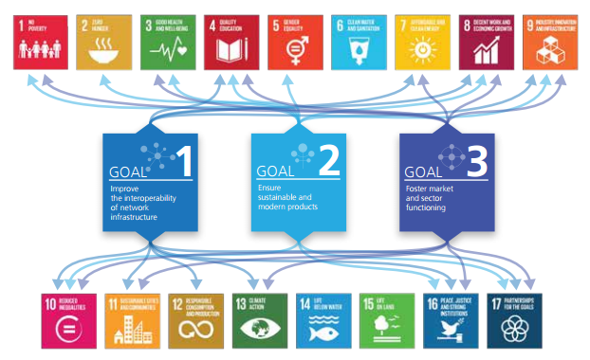
Example from UPU

Slide 36
Example of WIPO
Focus on SDG 9 (Innovation)
“The period of the new MTSP will see the first implementation of the United Nations Sustainable Development Goals (SDGs) and 2030 Agenda for Sustainable Development. The MTSP will be executed with a view to ensuring an effective contribution by the Organization, within its mandate, to the implementation of the SDGs, with special attention to innovation in SDG 9”
WIPO strategies
“Support for the implementation of the SDGs and 2030 Agenda for Sustainable Development within the mandate of the Organization and, in particular, in relation to innovation in SDG 9”
“The Organization seeks to play a supportive and engaged role in the implementation of the SDGs”

Slide 37
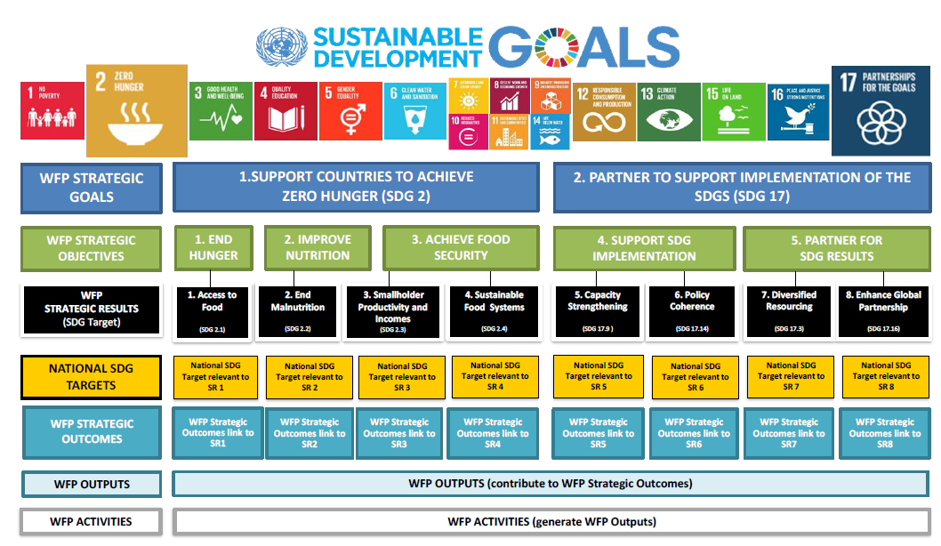
Example from WFP

Slide 38
Proposed approach: SDG mapping
Mapping ITU key activities & outputs to SDGs Size of the SDGs is relative to the number of key activities/outputs

Slide 39
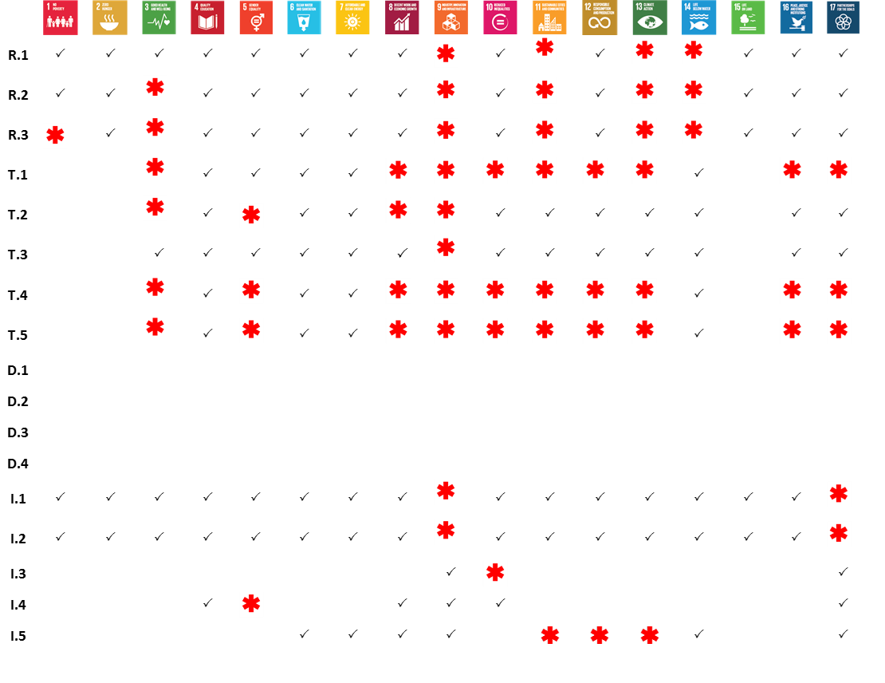
Linkage with SDGs: Mapping at the level of the Objectives
Mapping of ITU objectives to SDGs
A ‘primary’ or ‘secondary’ link is generated for the objectives that contribute to the achievement of the SDG
Primary ( ← ) if this SDG is a focus area for ITU
Secondary (✓) if the work of ITU has an enabling role (as per current input)
Current preliminary/inputs available at SDG Mapping Tool:
https://www.itu.int/net4/CRM/SDG/#/home/objectives

Slide 40
Proposed approach: SDG mapping
* Figure to be updated upon the completion of the mapping exercise
Smart
cities
Key focus
ITU’s role:
Contribute to Key Focus areas of SDGs
Promote enabling role of ICTs across sectors for all SDGs (through diverse partnerships)
Promote technological trends for the SDG implementation
Track progress and evaluate ICT-driven SDGs
Empowering women through ICTs
Higher education in ICTs
Universal & affordable access for all
Enhanced use of ICTs for global partnership

Slide 41
ITU results framework
- Sector & Inter-sectoral Objectives, Outcomes and Outputs
- Enablers

Slide 42
R.1 (Spectrum regulations)
Objective | Outcomes | Outputs
R.1 Meet, in a rational, equitable, efficient, economical and timely way, the ITU membership's requirements for radio-frequency spectrum and satellite-orbit resources, while avoiding harmful interference | R.1-1: Increased number of countries having satellite networks and earth stations recorded in the Master International Frequency Register (MIFR) R.1-2: Increased number of countries having terrestrial frequency assignments recorded in the MIFR R.1-3: Increased percentage of assignments recorded in the MIFR with a favourable finding R.1-4: Increased percentage of countries which have completed the transition to digital terrestrial television broadcasting R.1-5: Increased percentage of spectrum assigned to satellite networks which is free from harmful interference R.1-6: Increased percentage of assignments to terrestrial services recorded in the MIFR which are free from harmful interference | – Final acts of world radiocommunication conferences, updated Radio Regulations – Final acts of regional radiocommunication conferences, regional agreements – Rules of Procedure and other decisions of the Radio Regulations Board (RRB) – Publication of space notices and other related activities – Publication of terrestrial notices and other related activities

Slide 43
R.2 (Radiocommunication standards)
Objective | Outcomes | Outputs
R.2 Provide for worldwide connectivity and interoperability, improved performance, quality, affordability and timeliness of service and overall system economy in radiocommunications, including through the development of international standards | R.2-1: Increased mobile-broadband access, including in frequency bands identified for international mobile telecommunications (IMT) R.2-2: Reduced mobile-broadband price basket, as a percentage of gross national income (GNI) per capita R.2-3: Increased number of fixed links and increased amount of traffic handled by the fixed service (Tbit/s) R.2-4: Increased number of households with digital terrestrial television reception R.2-5: Increased number of transponders (equivalent 36 MHz) on communication satellites in operation and corresponding capacity (Tbit/s); Number of VSAT terminals; Number of households with satellite television reception R.2-6: Increased number of devices with radionavigation-satellite reception R.2-7: Increased number of satellites having Earth exploration payloads in operation, corresponding quantity and resolution of transmitted images and data volume downloaded (Tbytes) | – Decisions of the Radiocommunication Assembly, ITU-R resolutions – ITU-R recommendations, reports (including the CPM report) and handbooks – Advice from the Radiocommunication Advisory Group

Slide 44
R.3 (Disseminate information)
Objective | Outcomes | Outputs
R.3 Foster the acquisition and sharing of knowledge and know-how on radiocommunications | R.3-1: Increased knowledge and know-how on the Radio Regulations, Rules of Procedure, regional agreements, recommendations and best practices on spectrum use R.3-2: Increased participation in ITU-R activities (including through remote participation), in particular by developing countries | – ITU-R publications – Assistance to members, in particular developing countries and LDCs – Liaison/support to development activities – Seminars, workshops and other events

Slide 45
T.1 (Development of standards)
Objective | Outcomes | Outputs
T.1 Develop non-discriminatory international standards (ITU-T recommendations), in a timely manner, and foster interoperability and improved performance of equipment, networks, services and applications | T.1-1: Increased utilization of ITU-T recommendations T.1-2: Improved conformance to ITU-T recommendations T.1-3: Enhanced standards in new technologies and services | – Resolutions, recommendations and opinions of the World Telecommunication Standardization Assembly (WTSA) – WTSA regional consultation sessions – Advice and decisions of the Telecommunication Standardization Advisory Group (TSAG) – ITU-T recommendations and related results of ITU-T study groups – ITU-T general assistance and cooperation – Conformity database – Interoperability test centres and events – Development of test suites

Slide 46
T.2 (Bridging the standards gap)
Objective | Outcomes | Outputs
T.2 Promote the active participation of the membership, in particular developing countries, in the definition and adoption of non-discriminatory international standards (ITU-T recommendations) with a view to bridging the standardization gap | T.2-1: Increased participation in the ITU-T standardization process, including attendance of meetings, submission of contributions, taking leadership positions and hosting of meetings/workshops, especially from developing countries T.2-2: Increase of the ITU-T membership, including Sector Members, Associates and Academia | – Bridging the standardization gap (e.g. remote participation, fellowships, establishment of regional study groups) – Workshops and seminars, including offline and online training activities, complementing the capacity-building work on bridging the standardization gap undertaken in ITU-D – Outreach and promotion

Slide 47
T.3 (Telecommunication resources)
Objective | Outcomes | Outputs
T.3 Ensure effective allocation and management of international telecommunication numbering, naming, addressing and identification resources in accordance with ITU-T recommendations and procedures | T.3-1: Timely and accurate allocation of international telecommunication numbering, naming, addressing and identification resources, as specified in the relevant recommendations | – Relevant TSB databases – Allocation and management of international telecommunication numbering, naming, addressing and identification resources in accordance with ITU-T recommendations and procedures

Slide 48
T.4 (Knowledge sharing)
Objective | Outcomes | Outputs
T.4 Foster the acquisition and sharing of knowledge and know-how on the standardization activities of ITU-T | T.4-1: Increased knowledge on ITU-T standards and on best practices in their implementation of ITU-T standards T.4-2: Increased participation in ITU-T's standardization activities and increased awareness of the relevance of ITU-T standards T.4-3: Increased Sector visibility | – ITU-T publications – Database publications – Outreach and promotion – ITU Operational Bulletin

Slide 49
T.5 (Cooperation with standardization bodies)
Objective | Outcomes | Outputs
T.5 Extend and facilitate cooperation with international, regional and national standardization bodies | T.5-1: Increased communications with other standards organizations T.5-2: Decreased number of conflicting standards T.5-3: Increased number of memoranda of understanding/collaboration agreements with other organizations T.5-4: Increased number of ITU-T A.4, A.5 and A.6 qualified organizations T.5-5: Increased number of workshops/events organized jointly with other organizations | – Memoranda of understanding (MoUs) and collaboration agreements – ITU-T A.4/A.5/A.6 qualifications – Jointly organized workshops/events

Slide 50
D.1 (Coordination)
Objective | Outcomes | Outputs
D.1 Coordination: Foster international cooperation and agreement on telecommunication/ICT development issues | D.1-1: Enhanced review and increased level of agreement on the draft ITU-D contribution to the draft ITU strategic plan, the World Telecommunication Development Conference (WTDC) Declaration, and the WTDC Action Plan D.1-2: Assessment of the implementation of the Action Plan and of the WSIS Plan of Action D.1-3: Enhanced knowledge-sharing, dialogue and partnership among Member States, Sector Members, Associates, Academia and other stakeholders on telecommunication/ICT issues. | D.1-1 World Telecommunication Development Conference (WTDC) and WTDC Final Report D.1-2 Regional Preparatory Meetings (RPMs) and Final Reports of the RPMs D.1-3 Telecommunication Development Advisory Group (TDAG) and reports of the TDAG for the BDT Director and for WTDC D.1-4 Study Groups and guidelines, recommendations and reports of Study Groups D.1-5 Platforms for regional coordination, including Regional Development Forums (RDFs) [New] D.1-6: Partnership platforms, products and services

Slide 51
D.2 (Modern and secure telecommunication/ICT Infrastructure)
Objective | Outcomes | Outputs
D.2 Modern and secure telecommunication/ICT Infrastructure: Foster the development of infrastructure and services, including building confidence and security in the use of telecommunications/ICTs | D.2-1: Enhanced capacity of ITU Membership to make available resilient telecommunication/ICT infrastructure and services, including broadband and broadcasting, bridging the digital standardization gap, conformance and interoperability and spectrum management D.2-2: Enhanced capacity of ITU Membership to effectively respond to cyber threats and develop national cybersecurity strategies and capabilities, including capacity building D.2-3: Strengthened capacity of Member States to use telecommunication/ICT for disaster risk reduction and emergency telecommunications | D.2-1 Products and services on telecommunication/ICT infrastructure and services, including broadband and broadcasting, bridging the digital standardization gap, conformance and interoperability and spectrum management D.2-2 Products and services on building confidence and security in the use of telecommunications/ICTs D.2-3 Products and services on disaster risk reduction and emergency telecommunications

Slide 52
D.3 (Enabling environment)
Objective | Outcomes | Outputs
D.3 Enabling Environment: Foster an enabling policy and regulatory environment conducive to sustainable telecommunication/ICT development | D.3-1: Strengthened capacity of Member States to develop enabling policy, legal and regulatory frameworks conducive to development of telecommunications/ICTs. D.3-2: Strengthened capacity of Member States to produce high-quality, internationally comparable ICT statistics based on agreed standards and methodologies. D.3-3: Improved human and institutional capacity of ITU Membership to tap into the full potential of telecommunications/ICTs. D.3-4: Strengthened capacity of ITU Membership to integrate telecommunications/ICT innovation in national development agendas. | D.3-1 Products and services on telecommunications/ICT policy and regulation D.3-2 Products and services on telecommunications/ICT statistics D.3-3 Products and services on human and institutional capacity building D.3-4 Products and services on telecommunications/ICT innovation

Slide 53
D.4 (Inclusive digital society)
Objective | Outcomes | Outputs
D.4 Inclusive Digital Society: Foster the development and use of telecommunications/ICTs and applications to empower people and societies for socio-economic development and environmental protection | D-4-1: Improved access to and use of telecommunication/ICT in Least Developed Countries (LDCs), small island developing states (SIDS) and landlocked developing countries (LLDCs) and countries with economies in transition. D.4-2: Improved capacity of ITU Membership to leverage ICT applications, including mobile, in high-priority areas (e.g. health, agriculture, commerce, governance, education, finance). D.4-3: Strengthened capacity of ITU Membership to develop strategies, policies and practices for digital inclusion, especially people with specific needs. D.4-4: Enhanced capacity of ITU Membership to develop ICT strategies and solutions on climate-change adaptation and mitigation. | D.4-1 Products and services on concentrated assistance to LDCs, SIDS and LLDCs and countries with economies in transition D.4-2 Products and services on ICT applications D.4-3 Products and services on digital inclusion of people with specific needs D.4-4 Products and services on ICT climate-change adaptation and mitigation

Slide 54
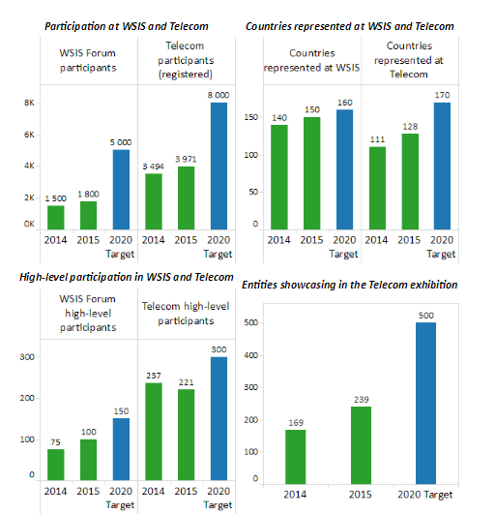
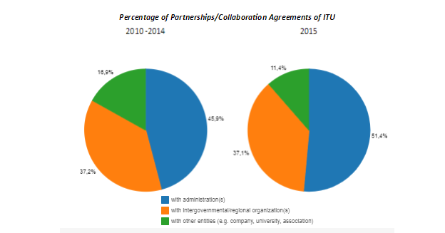
Inter-sectoral Objectives (new I.1)
I.1 (2016-2019) Enhance international dialogue among stakeholders
I.2. (2016-2019) Enhance partnerships and cooperation within the telecommunication/ICT environment
➲ Proposal for review:
New I.1: Foster closer collaboration among all stakeholders in the ICT ecosystem for the fulfilment of the SDGs

Slide 55
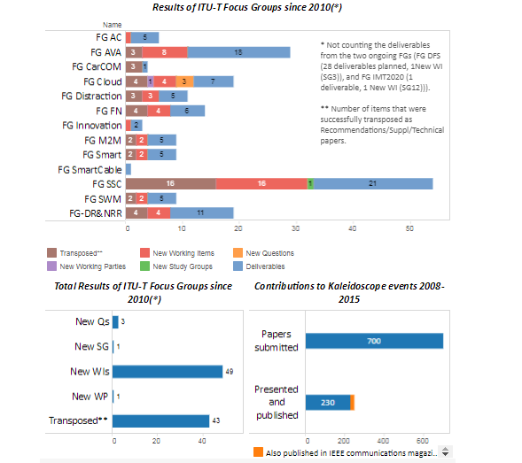
Inter-sectoral Objectives (new I.2)
I.3 (2016-2019) Enhance identification and analysis of emerging trends in the telecommunication/ICT environment
➲ Proposal for review:
New I.2: Enhance and promote emerging ICT trends for the acceleration of the implementation of the SDGs

Slide 56
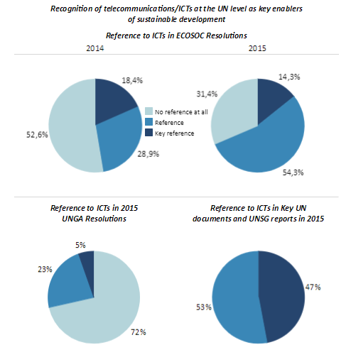
Inter-sectoral Objectives
I.4 (2016-2019) Enhance/promote recognition of (importance of) telecommunications/ICTs as a key enabler of social, economic and environmentally sustainable development
➲ Proposal for review:
Incorporated in the proposed New I.1 & I.2

Slide 57
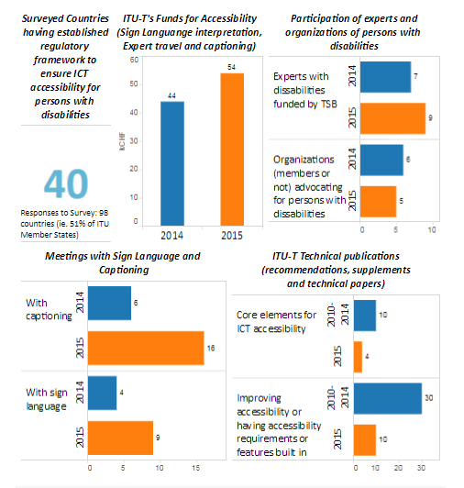
Inter-sectoral Objectives (new I.3)
Enhance access to telecommunications/ICTs for persons with disabilities and specific needs
➲ Proposal for revision:
New I.3: Enhance ICT accessibility for persons with disabilities

Slide 58
Inter-sectoral Objectives (new I.4 and I.5)
Topics proposed:
Inter-sectoral objective regarding gender equality and women empowerment through ICTs
Inter-sectoral Objective on Environmental Sustainability / ICTs and Climate Change
➲ Proposal for review:
New I.4: ‘Enhance the use of ICTs for gender equality and empowerment of women ’ (working proposal)
New I.5: ‘Reduce environmental footprint of the telecommunication/ICT sector’ (working proposal)

Slide 59
Inter-sectoral Objectives proposal
2016-2019
I.1: Enhance international dialogue among stakeholders
I.2: Enhance partnerships and cooperation within the telecommunication/ICT environment
I.3: Enhance identification and analysis of emerging trends in the telecommunication/ICT environment
I.4: Enhance/promote recognition of (the importance of) the telecommunication/ICTs as a key enabler of social, economic and environmentally sustainable development.
I.5: Enhance access to telecommunications/ICTs for persons with disabilities and specific needs
2020-2023
I.1: Foster closer collaboration among all stakeholders in the ICT ecosystem for the fulfilment of the SDGs
I.2: Enhance and promote emerging ICT trends for the acceleration of the implementation of the SDGs
I.3: Enhance ICT accessibility for persons with disabilities
I.4: ‘Enhance the use of ICTs for gender equality and empowerment of women ’ (working proposal)
I.5: ‘Reduce environmental footprint of the telecommunication/ICT sector’ (working proposal)

Slide 60
I.1 (Collaboration)
Objective | Outcomes | Outputs
I.1 Foster closer collaboration among all stakeholders in the ICT ecosystem for the fulfilment of the SDGs | I.1-1: Increased collaboration among relevant stakeholders I.1-2: Increased synergies from partnerships I.1-3: Increased multilateral and intergovernmental recognition of telecommunications/ICTs as a cross-cutting enabler for the Agenda 2030 and the SDGs all three pillars of sustainable development (economic growth, social inclusion and environmental balance), as defined in the outcome document of the United Nations Rio+20 Sustainable Development Conference, and in support of the United Nations mission of peace, security and human rights I.1-4: Enhanced support to tech SMEs developing and delivering ICT products and services | I.1-1 Intersectoral world conferences, forums, events and platforms for high-level debate (such as WCIT, WTPF, WSIS, ITU TELECOM) I.1-2 Knowledge-sharing, networking and partnerships I.1-3 Memoranda of understanding (MoUs) I.1-4 Reports and other inputs to UN inter-agency, multilateral and intergovernmental processes I.1-5 Establishment of support services for tech SMEs in ITU activities and events
Existing (in 2016-2019 SP)
Modified
New

Slide 61
I.2 (Emerging ICT trends)
Objective | Outcomes | Outputs
I.2 Enhance and promote emerging ICT trends for the acceleration of the implementation of the SDGs | I.2-1: Timely identification and analysis of emerging trends in telecommunications/ICTs providing knowledge and expertise to accelerate the implementation of the SDGs and establishment of new areas of activities related to them | I.2-1 Intersectoral initiatives and reports on emerging telecommunication/ICT trends and other similar initiatives (including ITU News)
Existing (in 2016-2019 SP)
Modified
New

Slide 62
I.3 (ICT accessibility)
Objective | Outcomes | Outputs
I.3 Enhance ICT accessibility for persons with disabilities and specific needs | I.3-1 Increased availability and compliance of telecommunication/ICT equipment, services and applications with universal design principles I.3-2 Increased engagement of organizations of persons with disabilities and specific needs in the work of the Union I.3-3 Increased awareness, including multilateral and intergovernmental recognition, of the need to enhance access to telecommunications/ICTs for persons with disabilities and specific needs | I.3-1 Reports, guidelines, standards and checklists relating to accessibility of telecommunications/ICTs I.3-2 Mobilization of resources and technical expertise, for example, through promoting greater participation in international and regional meetings by persons with disabilities and specific needs I.5-3 Further development and implementation of the ITU Accessibility Policy and related plans I.3-3 Advocacy, both at UN level and at regional and national levels
Existing (in 2016-2019 SP)
Modified
New

Slide 63
I.4 (Gender equality)
Objective | Outcomes | Outputs
I.4 ‘Enhance the use of ICTs for gender equality and empowerment of women (working title) | I.4-1 Enhanced access to and use of ICTs to promote the empowerment of women I.4-2 Enhanced participation of women at all level of decision making in the work of the Union and the ICT sector I. 4-3 Increased engagement with other UN organizations and stakeholders involved in using ICTs to promote the empowerment of women | I.4-1 Toolkits, assessment tools and guidelines for policy development and skills development and other practices for implementation I.4-2 Networks, collaboration, initiatives and partnerships I.4-3 Advocacy, both at UN level and at regional and national levels
Existing (in 2016-2019 SP)
Modified
New

Slide 64
I.5 (Environmental sustainability)
Objective | Outcomes | Outputs
(working title) I.5 ‘Reduce environmental footprint of the telecommunication/ICT sector’ | (working proposals) I.5-1 Increasing number of recycled e-waste I.5-2 Reduce energy consumption (alternatively) I.5-2 Improved efficiency of environmental policies and standards I.5-3 Improved Key Performance Indicators on Smart Sustainable Cities | (working proposals) I.5-1 Safety and environmental performance of ICT equipment and facilities (e-waste management) I.5-2 Energy efficiency policies and standards I.5-3 Global platform for Smart Sustainable Cities
Existing (in 2016-2019 SP)
Modified
New

Slide 65
Objectives of the Sectors vs. the work of the Bureaux
A suggestion was discussed at the CWG-SFP meeting to differentiate the Objectives of the Sector from the Objectives (Enablers) of the Bureaux
➲ Related proposal:
Use the concept of ‘Enablers’ for the Bureaux as well, similarly to how it was used in the General Secretariat in the 2016-2019 SP

Slide 66
Enablers

Slide 67
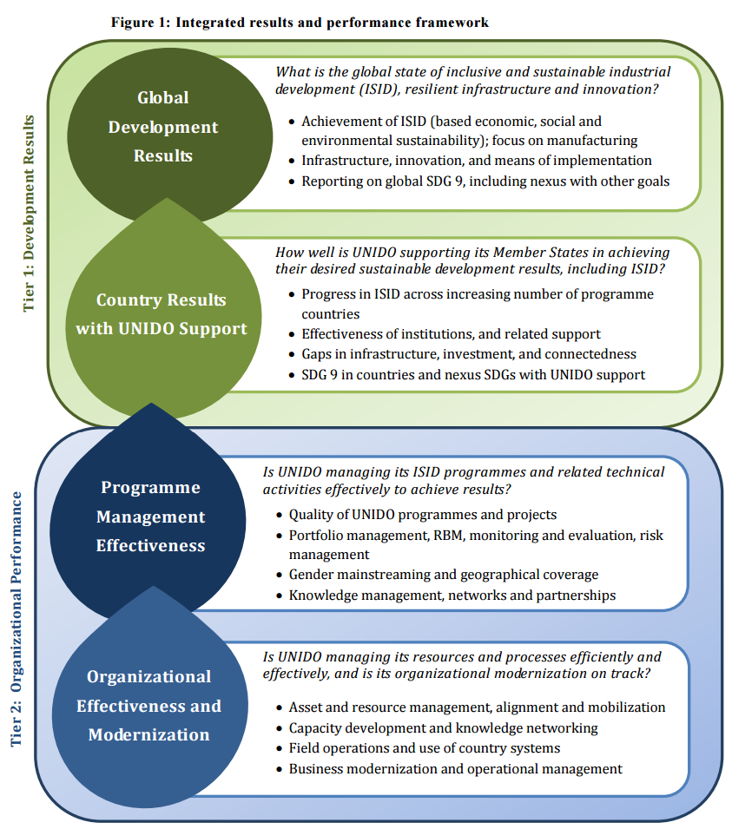
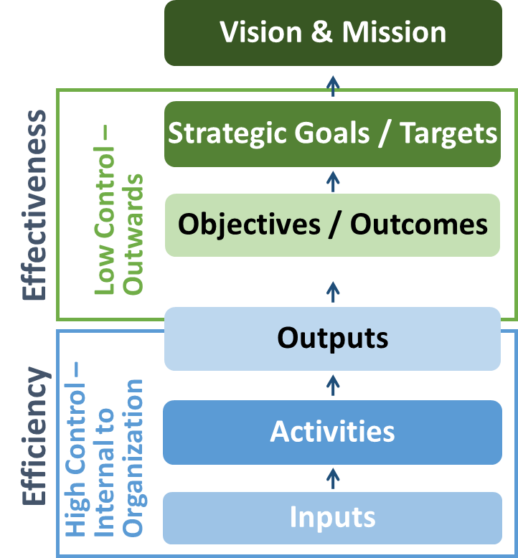
Example: work of the Secretariat vs. work of the Union in the SDG framework
The UNIDO approach (comparing to the ITU strategic framework)
ITU Sectors
ITU secretariat / Bureaux

Slide 68
Enablers – the role of the GS and the Bureaux
ITU vision & mission
Strategic Goals
and Targets
ITU-R objectives & outcomes
ITU-T
objectives & outcomes
ITU-D
objectives & outcomes
ITU intersectoral
objectives & outcomes
ITU-R outputs
ITU-T outputs
ITU-D outputs
Intersectoral outputs
ENABLERS
Support Services
ITU
Secretariat
BR
TSB
BDT
GS
Enablers are provided also by the Bureaux, not only by the GS
The work (and objectives) of the Bureaux will be described similarly to how the GS would describe how the Enablers contribute to the overarching Objectives and Goals

