Slide 1
Broadband Wireless Access (BWA) and Satellite Services:
“The Future of C Band in Asia Pacific”
1st Nov 2013 - Nadi Fiji

Slide 2
Overview of Presentation
Introductions
Role of satellite services
The 3.5 GHz frequency band and the ITU
What way forward for mobile services?
How should Pacific Islands respond ?

Slide 3
Our Mission
The Asia Pacific representative for the satellite TV, cable TV, broadcaster, broadband and wireless video sectors
130 members in 17 Asian markets:
    Pay-TV content providers
    Cable, satellite, broadband and mobile platforms
    Satellite system operators
    Equipment & technology suppliers
    Industry research
Working with government and industry to enhance market growth

Slide 4
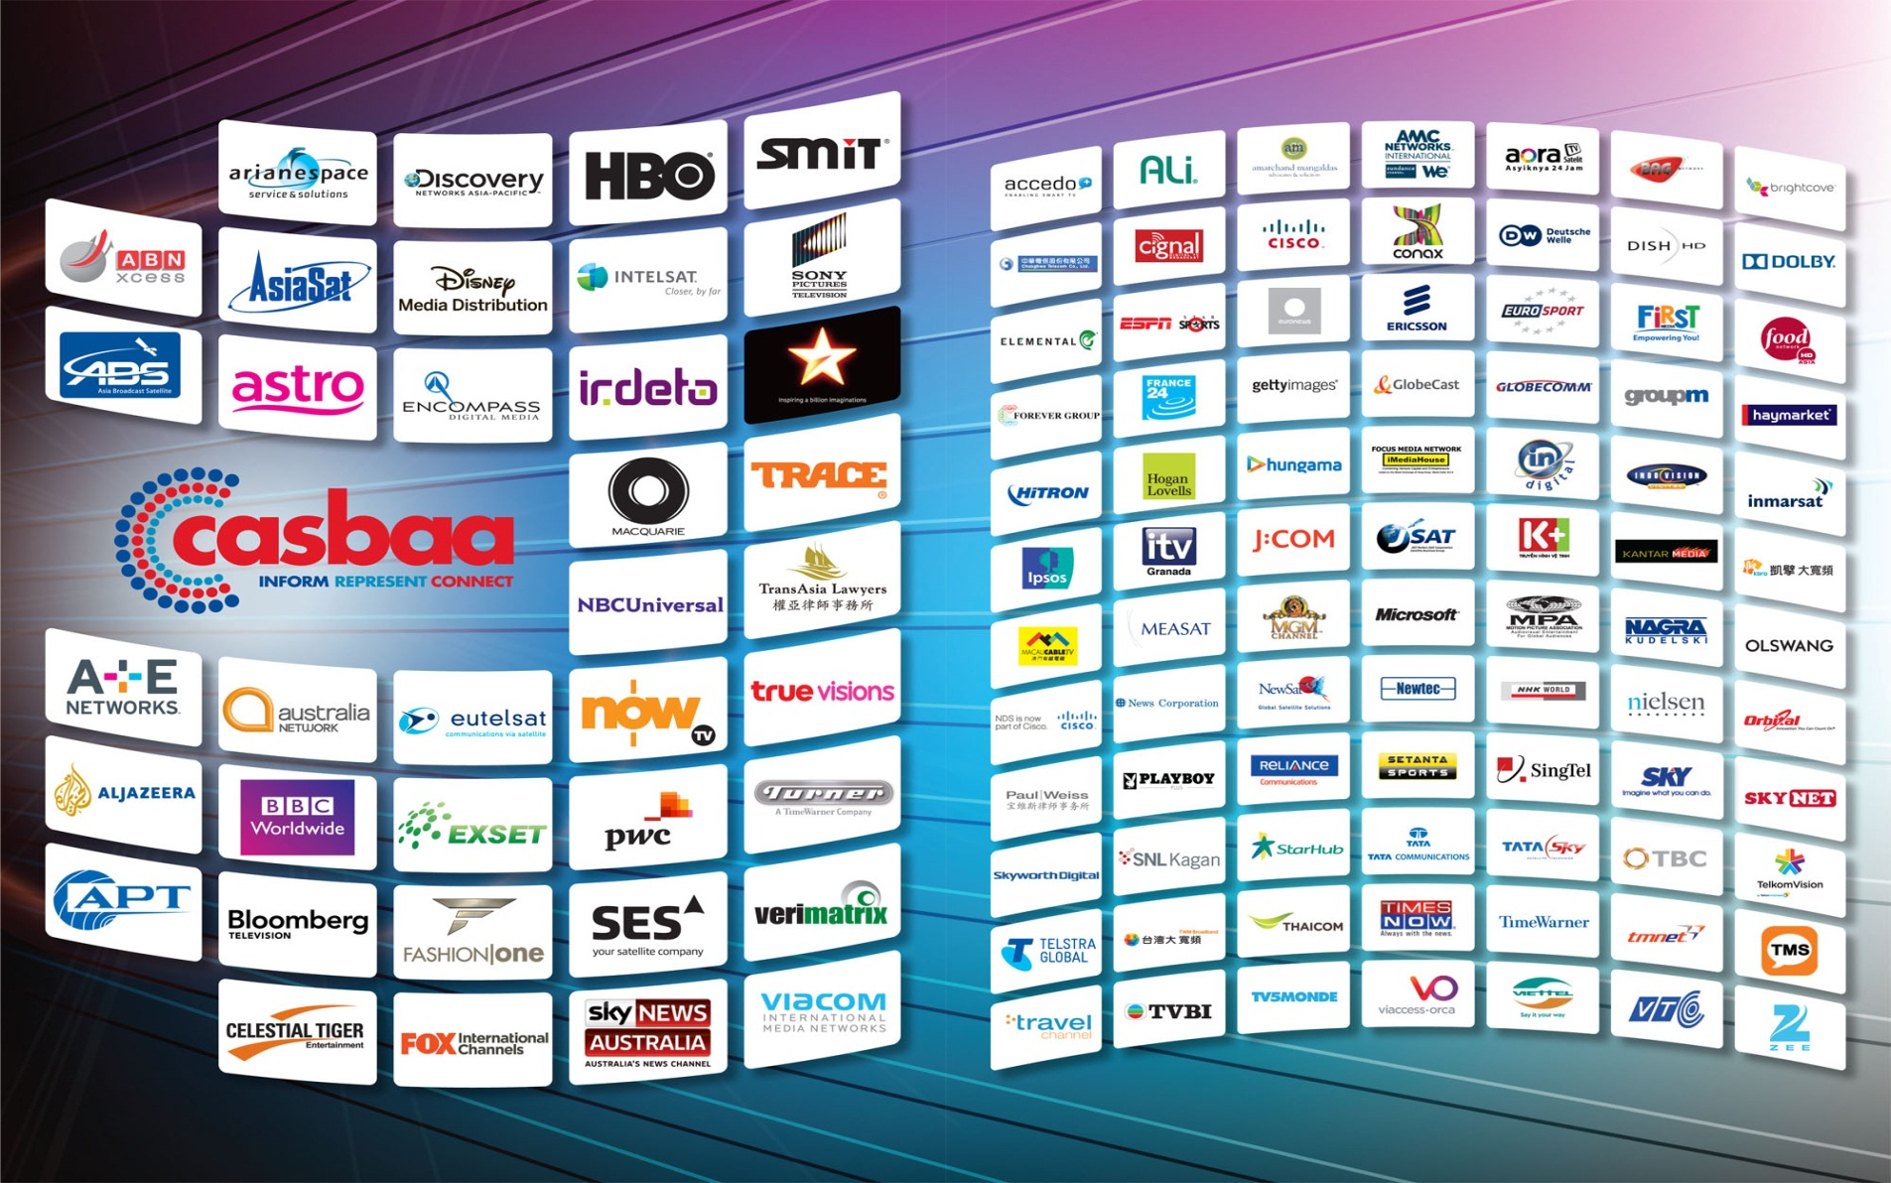
Member Companies

Slide 5
Overview of Presentation
Introductions
Role of satellite services
The 3.5 GHz frequency band and the ITU
What way forward for mobile services?
How should Pacific islands respond ?

Slide 6
C-Band (4 / 6 GHz) is heavily used by the satellite industry for critical links
C-Band frequency band – uses 6 GHz (5.725 - 6.725 GHz) for transmissions to the satellite (uplink) and 4 GHz (3.4 – 4.2 GHz) for transmission from the satellite to the receiving dish (downlink)
Most suitable frequency band for satellite communications for critical services
This is especially the case in regions with heavy rainfall rates such South Asia, where other satellite service frequency bands are susceptible to interruption during heavy rain fall
Today, over 160 geostationary satellites provide more than 3000 transponders utilizing C-band frequencies for the provisions of telecommunications and broadcasting services
5

Slide 7
Fixed Satellite Services (FSS) C-Band is used to support B2B applications that require high availability
FSS C-Band Applications
Providing GSM Backhaul services from remote locations
Corporate VSAT networks e.g. Petrol Stations; Corporate Offices; Banks/ATMs; Supermarkets; Manufacturing Industries; and, Cinemas
Providing connectivity solutions to remote communities
Connecting University campuses to allow access to lectures / classes
Distribution of TV content across the country and region
Provision of services for security authorities
National development projects e.g. remote connectivity; Broadband; and, Tele-medicine / Tele-education
Disaster and Emergency Network Restoration services

Slide 8
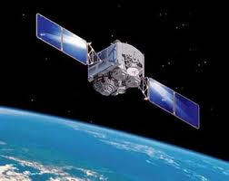
C Band Satellite use in the Pacific
International connectivity
Telecommunications services
trunking (Voice, Internet, data, SMS)
Video content access for national broadcasters and distribution (Direct to home, TVRO)
Emergency communications and Disaster Recovery

Slide 9


C Band Satellite use in the Pacific
domestic connectivity
Links remote islands to main island
when distances exceeds 150 - 200 Kms
Extend mobile coverage in remote locations
C Band Vsat allow shared bandwidth bringing costs down and efficiency
Emergency communications and
Disaster Recovery

Slide 10
C Band Satellite use in the Pacific
New long term trends requiring C Band
Satellite redundancy for submarine cable :
when a new submarine cable links a country for its international communications it generates an average
20 % per annum Satellite capacity growth rate for rural broadband communications (2010-2013)
Many Pacific Islands countries see C band as the only way to develop National and international braodband connectivity.

Slide 11
Overview of Presentation
Introductions
Role of satellite services
The 3.5 GHz frequency band and the ITU
What way forward for mobile services?
How should Pacific Islands respond ?

Slide 12
Key Issue: Spectrum Scarcity
At WRC-07 terrestrial interests sought global allocations for terrestrial IMT applications in the FSS C-band used by satellite operators
WRC-07 did not adopt global allocations but adopted opt-in IMT footnotes in the band 3.4 – 3.6 GHz (called 3.5 GHz band)
Using these footnotes some countries are deploying BWA in the 3.5 GHz band
These applications include:
BWA – e.g. WiMAX (mobile)
FWA – e.g. WiMAX (fixed)
IMT – e.g. LTE

Slide 13
BWA Interference into C-band FSS
Regulatory Issues
Present Situation
At WRC-07 10 countries in ITU Region 3 (Asia), 81 countries in ITU Region 1 (Europe and Africa) and 14 countries in ITU Region 2 (Americas) signed the IMT opt-in footnotes in the band 3.4-3.6 GHz.
In Region3, the 10 countries (communities) are Bangladesh, China, India, Iran, Japan, Korea, New Zealand, Pakistan, Singapore and French Overseas Communities in Region 3.
5

Slide 14
BWA Interference into C-band FSS
Regulatory Issues
Present Situation
BWA/FWA and IMT applications (e.g. WiMAX and LTE) are being deployed in the 3.4 – 3.6 GHz band under the opt-in IMT footnote allocation. These applications are presently the main cause of interference into C-band FSS applications.
ITU studies have shown that terrestrial and satellite applications using the same frequency (and even using adjacent frequencies) in the same geographic area are not compatible if ubiquitous terminals are used by both the terrestrial and satellite applications.

Slide 15
New Regulatory Threat
WRC-15 agenda item 1.1
Terrestrial operators will be back at WRC-15 for more spectrum under agenda item 1.1 which reads:
  “1.1 to consider additional spectrum allocations to the mobile service on a primary basis and identification of additional frequency bands for International Mobile Telecommunications (IMT) and related regulatory provisions, to facilitate the development of terrestrial mobile broadband applications.”

Slide 16
WRC-15 agenda item 1.1
Background
The WiMAX standards are sponsored by the IEEE and are continually being upgraded.
The 3rd Generation Partnership Project (3GPP) has been developing a competing mobile standard called LTE (long-term evolution) and has approved TD-LTE for the bands 3400 – 3600 MHz (band 42) and the band 3600 – 3800 MHz (band 43).
As far as interference into FSS is concerned, land point-to-area transmit/receive applications (even when the two-way terminals are stationary as is the case with FWA) cause interference equivalent to applications in the mobile service.
Under WRC-15 agenda item 1.1 terrestrial interest will seek more spectrum in the FSS C-band for mobile terrestrial applications including such applications as WiMAX and LTE.
Notes:
However, Resolution 957 (WRC-12) was developed to study the possibility of reviewing the definitions of the fixed service, fixed station, mobile station, and the impact of these modifications on the existing services and regulatory procedures (coordination, notification, recording) of the Radio Regulations.
The BR will report the results of these studies under Agenda Item 9.1 of WRC-15

Slide 17
The issue is a real one in the Pacific. . .
Fiji experienced major disruption of live Soccer world Cup for all Fijian viewers;
OPT New Caledonia got Wimax point to point links heavily affected by VSAT C Band illegal transmission from a cruise ship in Noumea harbour
Other experiences in Tonga at early stage or trial of wimax as a last mile option

Slide 18
And in many other countries. . .
When sharing was tried during Bolivia’s TV reception of live World Cup games the signal was suddenly interrupted knocking the World Cup off the air. This could potentially become a regular occurrence;
In response, The Inter-American Telecommunications Commission (CITEL) has proposed with support from six countries (Brazil, Chile, Guatemala, Uruguay, Argentina and Colombia) that the 3600-4200 MHz band be removed from the list of candidate bands for IMT;
Operating experience in Indonesia, Bangladesh, Pakistan and Malaysia have confirmed this interference;
During WiMAX testing in Hong Kong, television signals feeding millions of households throughout Asia were inadvertently knocked off the air!

Slide 19
Sharing between BWA (including WiMAX) and Satellite services is difficult because of three key reasons
Power level
Point to
multipoint
services
Mobile, fixed or
nomadic users
At the earth station input the WiMAX signal is approximately 10,000 times higher power (+40 dB ) than satellite signal
  Satellite downlink signals are very low power since satellites are located 36,000 km above the earth
  WiMAX signals travel only 10’s of miles and are very high powered
High powered WiMAX signals obliterates the satellite signal
Current Terrestrial Microwave services are point-to-point using highly directive antennas
BWA and FWA deployment in 3.5 GHz band is point-to-multi point with the consumer receive/transmit terminals located anywhere within an area
Traditional point-to-point terrestrial links allow for coordination with FSS applications
BWA and FWA applications can be mobile, fixed or nomadic
Since the consumer terminal can be located anywhere within the service area sharing is impossible
Characteristics of WiMAX services makes sharing virtually impossible
Even the WiMAX Forum recognizes that sharing with FSS in 3.5 GHz band is not possible
Notes:
Make into 3 slides

Slide 20
Satellite receive antennas face three different types of interference
WiMax carrier
Impact of WiMAX on Satellite Reception
Satellite carrier
In-band Interference
WiMAX operating at 3.4 – 3.6 GHz extended C-band OBLITERATES satellite receive signals operating in the same band
Separation distances of between 30 and 300 km required*
Out-of-band Emissions
WiMAX use of one part of the 3.4 – 3.6 GHz band CREATES INTERFERENCE in non-overlapping parts of 3.4 – 4.2 GHz band through out-of-band emissions,
Requires use of expensive antenna filters
Separation distances between 2 and 60km required*
LNB Saturation
WiMAX signals in 3.4 – 3.6 GHz saturate Low Noise Amplifiers on satellite receivers causing non-linear operation BLOCKING signals in the entire 3.4 – 4.2 GHz C-band,
Separation distance between 1.5 and 70km required*
FSS receive filter
3.4
3.6
3.8
4.0
4.2
GHz
FSS receive filter
3.4
3.6
3.8
4.0
4.2
GHz
FSS receive filter
* Dependent on study
3.4
3.6
3.8
4.0
4.2
GHz
Notes:
Teh / Devin to update tables

Slide 21
Universal Recognition of the impossibility of sharing the 3.5 GHz band
The Asia-Pacific Broadcasting Union (“ABU”) has warned that “… if [WiMAX is] implemented in the same frequency bands as the satellite downlinks, it may make satellite operation in the entire C band impracticable. These bands are by far the most important frequency bands for satellite communication in Asia.”
  The Report ITU-R M.2109 concluded that sharing between fixed-satellite service and IMT in the bands of 3400-4200 MHz and 4500-4800 MHz requires unrealistic separation distances of tens of kilometers.
European Conference of Postal & Telecommunications Administration (CEPT) Report on Spectrum Sharing showed that the maximum distances required for BWA central stations are between 270 km and 320 km (referred as “mitigation distances”). Even with coordination it is clear that the necessary separation distances are at least tens of kilometres and may be hundreds of kilometres. The feasibility of the use of mitigation techniques by BWA systems to reduce the separation distances has not been demonstrated.

Slide 22
Even the WiMax Forum has determined sharing of C-Band FSS and WiMax is not practical
  “Earth stations sites may be required to……. use shielding enclosures (walls or pits)”*
  “For the cases where earth station deployment in this band is widespread and terminals are generally not registered with the administration concerned (e.g. for VSAT applications, TV cable-head end terminals etc.), coordination on a site-by-site basis is not feasible and co-frequency operation may be difficult without geographical separations between the services”*
  “Whilst this can be overcome by the remedial actions of fitting filters on the earth station, this would not be practical where thousands or millions of such terminals are already operating. Even where filtering is generally applied, adjacent band operation may be restricted due to the roll-off characteristics of the filter used”*
  *Extracted from WiMAX Forum Sharing Study

Slide 23
Overview of Presentation
Introductions
Role of satellite services
The 3.5 GHz frequency band and the ITU
What way forward for mobile services?
How should Pacific Islands respond ?

Slide 24
Potential Political & Consumer Backlash
BWA (including WiMAX and LTE) operating in C-band spectrum will cause interference into C-band FSS in the case where satellite earth stations are ubiquitously deployed
This means:
  Disruption of critical telecommunication services including:
    GSM backhaul
    Corporate Networks
    Government Networks: Distance Learning, Telemedicine, etc.
  Blocking of TV Transmissions for millions of viewers

Slide 25
Potential Political & Consumer Backlash
  Way forward – Alternative Frequencies for WiMAX
The WiMAX standard is specified up to 66 GHz. There is no uniform global licensed spectrum for WiMAX. Presently the most popular frequencies are 2.3 GHz, 2.5 GHz and 3.5 GHz. However, several manufacturers are now manufacturing WiMAX equipment for a range of frequencies including frequencies in the 700, 800 MHz, 1.4, 1.8, 2.3-2.7, 3.3-3.8, and 4.9-6.425 GHz bands.

Slide 26
Overview of Presentation
Introductions
Role of satellite services
The 3.5 GHz frequency band and the ITU
What way forward for mobile services?
How should Pacific Islands respond ?

Slide 27
How Should the Pacific Islands Respond?
Pacific Islands are in heavy rainfall rates which cause outages for satellite services using the Ku- and Ka-bands
CASBAA is of the opinion that it is in the interest of the Pacific Islands to protect interference-free operation for FSS C-band applications by not licensing BWA applications in the 3.5 GHz band
If Pacific Islands regulators are considering licensing BWA (including WiMAX and LTE) it should consider alternative frequencies as given in the previous slide.

Slide 28
CASBAA asks for your support over the coming years in developing a coordinated response with all partners (Pacific Islands telecommunications Association – Global VSAT Forum …)
Thank you

