Slide 1
TUVALU TELECOM
FUTURE OF C BAND ON ASIA PACIFIC REGION
Tanoa International
Nadi, Fiji
1st November 2013

Slide 2
Content
1. Coutry Profiles
Geographic Location
Demograhy
2. Network Core Services
3. C Band Relation to Tuvalu

Slide 3
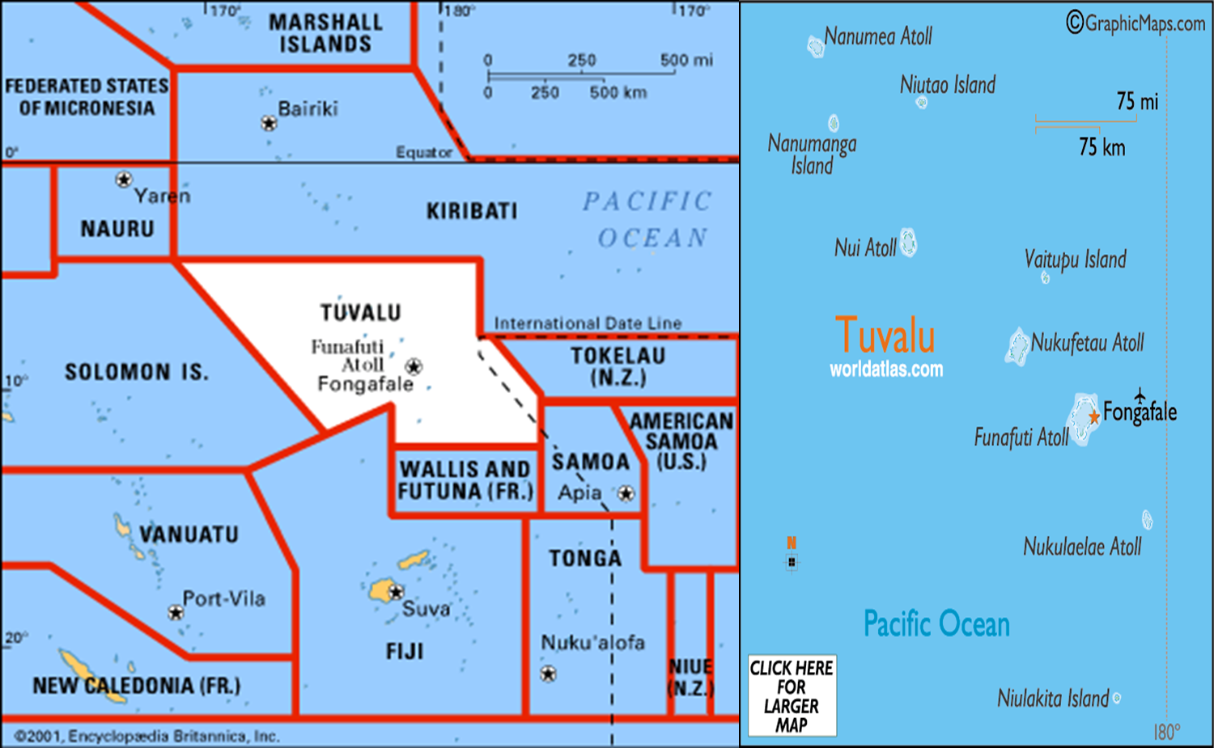
Geographic Location

Slide 4
Demography
Population : 9,561
GDP /capita: USD$1,800
Inflation rate: 4.8%
Industries: fishing, tourism, copra
Export: fish, copra

Slide 5
Network Core Services
Satellite services (9 sites C Band)
Fixed Services
PSTN
GSM fixed
Internet (VDSL2 &ADSL2+)
TV (SKY PACIFIC)
FM Radio
Mobile Services
GSM
Internet (Wifi)

Slide 6
C BAND in Relation to Tuvalu
Network
Linking
International
Inter islands
Backhauling
GSM from each islands
Lastly is the Life line
Social and economic
Disaster

Slide 7
Vinaka !!!

