Slide 1

ITU FORUM : C-Band Matters
1 November 2013, Nadi, Fiji
C-BAND
WRC 15: A Regulatory Priority for the Pacific Islands
Panny Yokope
Engineering and Resource Planning, NICTA, PNG

Slide 2
PROGRESS WITH IMT STUDIES -
ITU Joint Task Group 4-5-6-7
  4 Sharing study scenarios under consideration
    GSMA, Japan, UK, USA
    Outcomes will be 4 different estimates of “exclusion zone” sizes required for satisfactory sharing of terrestrial IMT and satellite services
    Each estimate will address short term and long term availability criteria
    We have examined examples of 20 km and 150 km
Notes:
2

Slide 3
THE PACIFIC ISLANDS – Scenario
The value of C-Band
Critical dependency on C-Band for communications for economic existence and social quality of life
Disaster mitigation and relief
Submarine cable – where available – only serves a single landing point. There are many islands
C-Band provides a complementary backbone role for future mobile (eg. 4G in Kiribati)
Ku and Ka band are heavily affected by rain fade
Wrong decisions at WRC 2015 would be crippling

Slide 4
There are four broad categories of applications relying on C-band:
APPLICATIONS ON C-BAND
two-way large dishes (e.g. trunk telephony) – licensed
two-way Very Small Aperture Terminals (VSATs) (e.g. Banking
terminals and ATM networks) – licensed
receive only commercial applications (e.g. cable head ends) –
registered
receive only consumer applications (e.g. DTH satellite TV
broadcasting) – unlicensed terminals, such as SKY Pacific
which broadcasts in C-Band to Pacific Islands

Slide 5
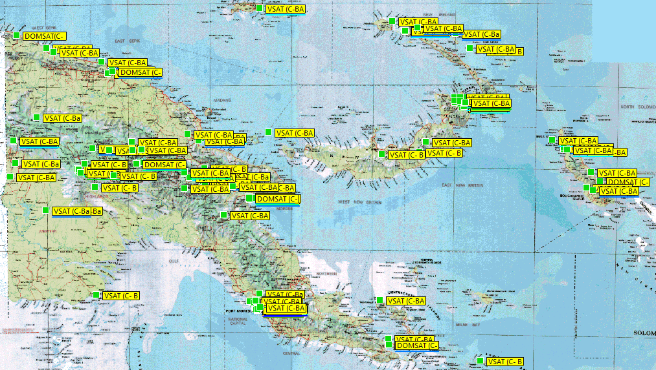
PNG : Nationwide C-Band Sites
-source NICTA

Slide 6
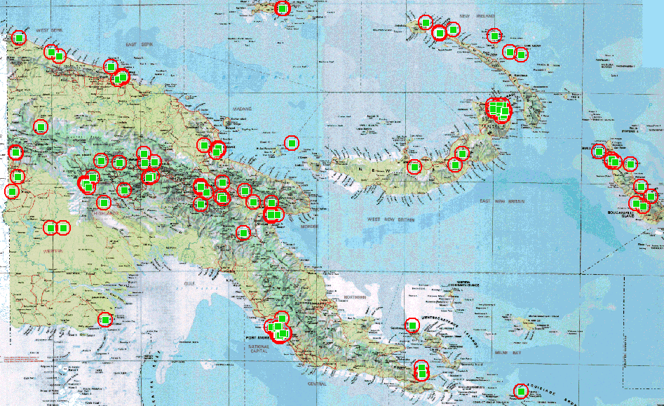
PNG : NATIONWIDE LAYOUT - 20km Protection Zone
-source NICTA

Slide 7
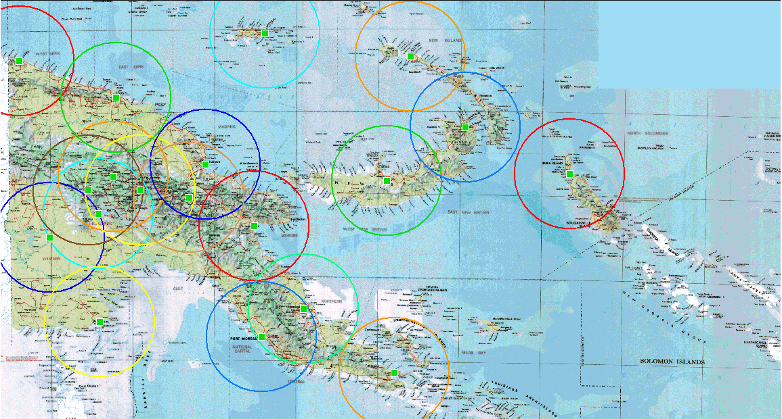
PNG : Major Centres -150km Protection Zone
-source NICTA

Slide 8
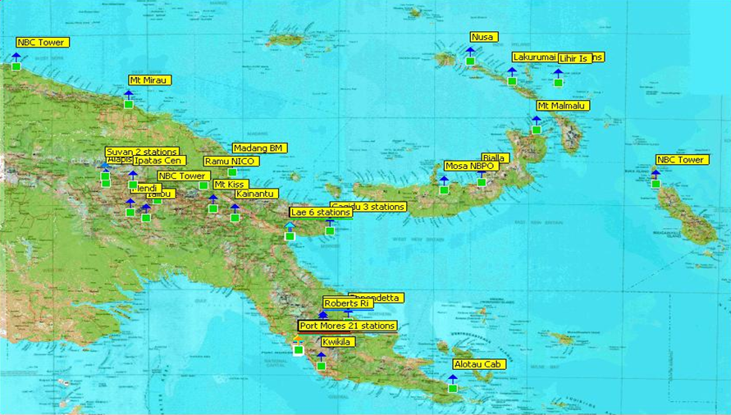
PNG Registered TVRO stations
-source NICTA

Slide 9
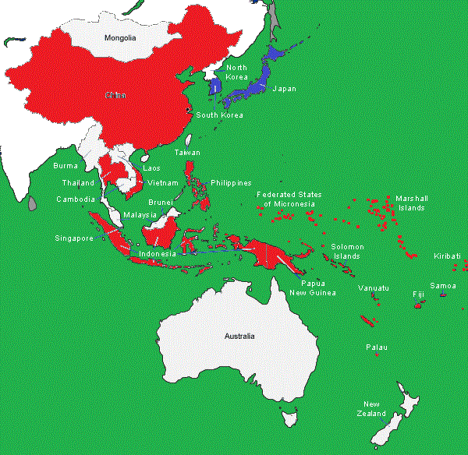
ASIA – PACIFIC COUNTRIES- Dependency on C-Band
Countries and their dependency on C-Band Satellite.
Dependent on C-Band
Not Dependent on C-Band
Uncoloured is not defined yet

Slide 10

THE PACIFIC ISLANDS – A Regulatory Strategy
Identify and catalogue C-Band usage
Determine critical needs for C-Band
Identify Regional Champion(s) eg. PNG + 1
Influence Regional WRC preparations
Link in with Global WRC-15 activity

Slide 11
STRATEGIC MILESTONES
ITU JTG 4-5-6-7 : responsible for sharing studies and CPM text
- 2 more meetings up to July 2014 (Mar 14, Jul 14)
APT APG : responsible for regional inputs to CPM and WRC 15
- 3 more meetings before WRC 15 (APG3 =Jul 14, APG4, APG5)
ITU CPM-2 : March 2015
ITU WRC 15 : November 2015
PI’s should consider contributions – ITU JTG & APG3

Slide 12
CONCLUSION
Regulators have concerns for their clients
Co-ordinated regional collective action is efficient
Experiences of WRC 2007 will be valuable at WRC 2015
A Regional regulatory priority is recommended
PI’s have an opportunity to influence through contributions to appropriate meetings

Slide 13
THANK YOU..

