Slide 1

C Band issues for WRC-15:
2nd Round?
Joaquin RESTREPO
Head, OPS Division
ITU, Radiocommunication Bureau
Forum: Future of C Band in Asia-Pacific
ITU Regional Radiocommunication Seminar for
Asia-Pacific (RRS-13-Asia-Pacific)
Nadi, Fiji, 1st November 2013

Slide 2
SPECTRUM ALLOCATIONS
All Spectrum Bands are already allocated (Innal: RR, IFT; nal.: NAFT)
Effective Assignments, and intensive exploitation of frequencies below 4 GHz (Administrations)
Attending the needs for more Spectrum from some services, is only possible by modifying the current allocation of other ones
A “refarming” is necessary: where to migrate an incumbent service to let the room to a new comer?
How to avoid a “domino” effect?

Slide 3
SPECTRUM ALLOCATIONS
Responding to growing Capacity Demand (Mbps) can be improved by:
  New technologies: better spectrum efficiency (Mbps/MHz); e.g. TDT
  Increasing Radio Stations (lower coverage (traffic)/Station); e.g. Femtocells
  Allocating more Spectrum
Prevent Domino’s Effect:
Compare and prioritize growing demands (and social impact)
Foster network updating (spectrum efficiency)

Slide 4
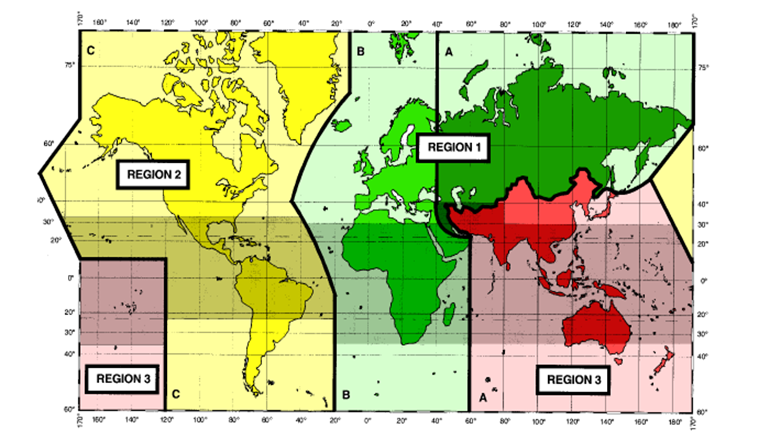
IMT in Americas (As in RR)

Slide 5
C Band
As in Satellite Sector
Dowlink:
Standard C Band: 3.700 to 4200 MHz
Extended C Band: 3400 to 3700
Uplink:
Standard C Band: 5.900 to 6.400 MHz
Extended C Band: 6.400 to 6.700 MHz

Slide 6
IMT during WRC-12
IMT Services (Mobile Broadband): identification
98
Band (MHz) | Radio Rules Footnotes
450-470 | 5.286AA
698-960 | 5.313A, 5.317A
1 710-2 025 | 5.384A, 5.388
2 110-2 200 | 5.388
2 300-2 400 | 5.384A
2 500-2 690 | 5.384A
3 400-3 600 | 5.430A, 5.432A, 5.432B, 5.433A

Slide 7
C Band on WRCs
WRC-07 Decision: No Change
WRC-15 Agenda Items
1.1 to consider additional spectrum allocations to the mobile service on a primary basis and identification of additional frequency bands for International Mobile Telecommunications (IMT) and related regulatory provisions, to facilitate the development of terrestrial mobile broadband applications, in accordance with Resolution 233 (WRC-12)
o) Report ITU-R M.2109, on sharing studies between IMT-Advanced systems and geostationary-satellite networks in the fixed-satellite service in the 3.400-4.200 and 4 500-4 800 MHz frequency bands;

Slide 8
C Band in Region 3 (As in RR)

Slide 9
Forum C Band on Asia Pacific

Slide 10


www.itu.int
Thank you…
Notes:
Thank you.

