Slide 1

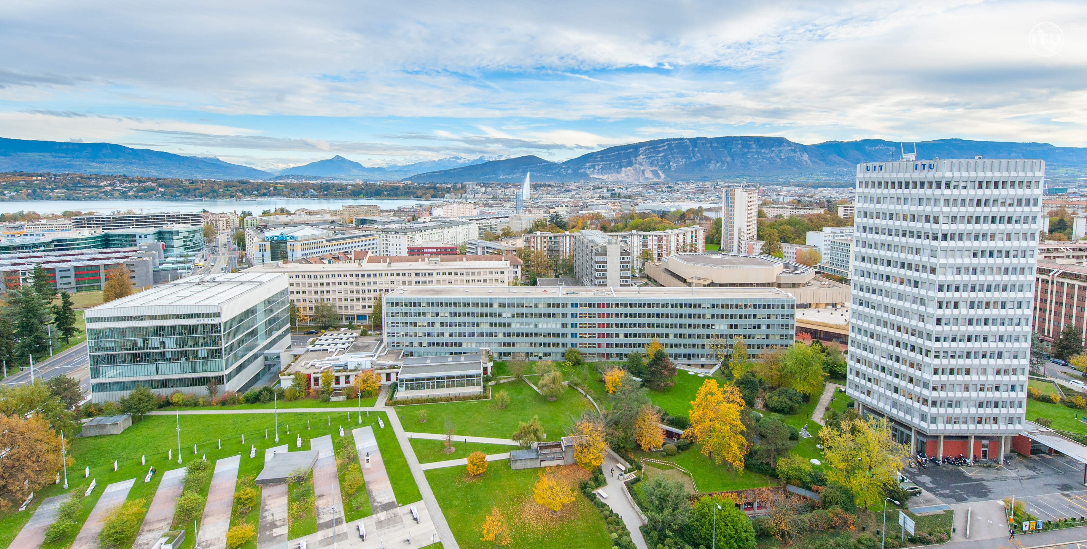
Practical information for ITU-R physical meetings with remote participation

Slide 2
Introduction
Rationale
For physical meetings with remote participation, the meeting room set-up, in particular the integration of the microphone systems of the room with Zoom platform, and their usage, needs to be clarified to the participants.
Background information
Each room in ITU and CICG has been assigned with a dedicated Zoom license. For a particular meeting, the Chair / Moderator, the participants (being in Geneva or remote) and the meeting room use the same Zoom link (assignment done by IT) to connect to a session.

Slide 3

Before travelling
Information for in-person participants
They must bring their own PC and ensure that Zoom is installed and functional.
They must bring their own wired headsets with an integrated microphone and external noise suppression. The use of wireless headsets is strongly discouraged.

Slide 4

Requests for the floor
Raising hands:
Despite the fact that participants present in the room may raise their hand physically, it is important to align the order of the requests for the floor for both, participants physically present and those participating remotely.
To simplify, everyone has to be connected to Zoom and raises the hand only via the platform (in order to be visible to all participants). In addition, this approach would allow the use of rooms not equipped with integrated audio system.
If a hand is raised by a physically present participant, the participant could be invited to use the Zoom hand-raise option to request the floor.

Slide 5

ITU rooms with integrated audio system
The following ITU rooms have integrated audio system with Zoom:
Room Popov
Rooms C, C1, C2
Room A
Room T103
Rooms E, G1, G2, G3
Rooms H, H1, H2
Rooms K, K1, K2
Rooms L, L1, L2

Slide 6







Rooms with an integrated audio system
Listening and speaking:
All large rooms have microphones and integrated audio system.
The Chair / Moderator / Counsellor needs to test the audio system at the beginning of the meeting.
Participants can choose to listen via:
(1) their laptop connected to the Zoom platform, using their own headsets; or
(2) using the room audio.
Participants can choose to speak via:
(1) their laptop microphone via the Zoom platform; or
(2) use the room microphones. In this case, their laptop shall be muted.
However, the meeting may decide not to use the room microphones and use only the audio connection via the laptop (Zoom). In this case, everybody is only connected via Zoom like in a fully virtual meeting.
Participants must wait to be recognized to unmute themselves and speak. At the conclusion of their intervention, participants are invited to mute their microphone.

Slide 7

Rooms without integrated audio system
Listening and speaking:
Not all small rooms have microphones and integrated audio system.
Participants can only listen via their laptop connected to the Zoom platform, using their own headsets.
Participants can only speak via their laptop microphones via the Zoom platform, using their own headsets with an integrated microphone and external noise suppression.
Participants must wait to be recognized to unmute themselves and speak. At the conclusion of their intervention, participants are invited to mute their microphone to avoid any echoes and delays.
If no one is connected remotely to the session, the meeting may decide not to connect via Zoom. If at some point during the session a participant connects remotely, the moderator will immediately inform participants present in the room and everyone should connect via Zoom to continue the meeting.

Slide 8





Presenting and displaying documents
Presenting:
The Chair / Moderator / Counsellor should use Zoom to display the documents (same procedure as in fully virtual meetings).
In a room, the main screen will be independently connected to Zoom to display the session.
In large rooms, participants can see the content of the document displayed either:
(1) on the room screens; or
(2) on their own laptop using Zoom.

Slide 9

Use of Zoom chat function
Zoom chat function:
If a participant experiences any difficulties, he/she is encouraged to send a private message to either the technical moderator or, if that fails, then to the public chat.
The moderator’s role is to facilitate the technical aspects of the meeting. They may respond to questions about whether the audio is being heard, whether access has been granted, or other technical aspects of the meeting.
Generally, messages sent to the public chat are not considered to be official input to the meeting.
Even if participants might use the public chat function as a means of indicating their support for a point under discussion without taking the floor to do so, it is strongly recommended that they do take the floor and make their intervention verbally. In this way, it will be clear for all the attendees and simplify the task of the Chair / Moderator.

Slide 10



Room reservation
Regarding the room reservation, some special arrangements need to be considered.
Before the meeting:
In preparation for each of the meetings, the Counsellor requests the reservation / allocation of sufficient rooms. These rooms will be prepared by the IT.
All sessions will be displayed on the ITU screens, on the ITU website and in the Restricted Virtual Events portal.
During the meeting – new sessions requested:
Please request such slots at least 1 period in advance so that ISD can prepare the Zoom link and send a moderator to start the session (ex.: for a slot at 1300 hours CET, request to be submitted by 1030 hours CET).
If requested for the next day, please do so immediately after the closure of the meeting day (e.g., 1700 hours CET), in any case before 1730 hours CET.
Please advise if you think you will exceptionally have requests outside of the working hours indicated above, e.g., in case the sessions cannot be programmed / updated the following morning at 0830 hours CET.

Slide 11
Room reservation
REQUESTS FROM Participants | Who to send requests to | Working hours for processing of such requests
Participants may request new slots / rooms | room.management@itu.int and office V.247 (like before) Please specify: Session title Display (Y/N) Date, Start-End times Number of physical participants | Weekdays 0830-1230 - 1330-1730

Slide 12
Email to registered participants
There will be a common text in the email-message to all registered participants (to be sent by ITU-Registrations some days prior to the meeting).
Upcoming ITU-R event
Remote and Physical Participation Information
Dear Registered Participants,
This message is intended to provide you with advance information on how to participate in the following ITU-R event:
Title of the ITU-R Event
Date
Working hours
Registered participants may join the sessions of this event in person and/or connect remotely, regardless of the option they selected during the on-line registration process.

Slide 13
Email to registered participants (cont’d)
Remote Participation
Download/update the remote participation platform to be used for the event: Zoom.
Go to the ITU Restricted Virtual Events Portal.
Log in with your ITU user account credentials.
Remote participation is granted to registered participants only (when required, registration requests must also be approved by the corresponding focal point). Make sure to use the same ITU user account credentials to register and to connect remotely.
If you plan on requesting the floor or to present a document, connect early to your session to test your audio and microphone configuration. Access to the remote connections are available 30 minutes prior to the start of the session. The use of a wired high-quality headset with an integrated microphone is highly recommended. The use of wireless headsets is discouraged.
Should you experience any difficulties to join the session remotely, click here for troubleshooting and further assistance.
Physical Participation
Participants must bring their own laptop and ensure that Zoom is installed and functional. You may connect to the Zoom platform from within the conference room. For anyone choosing to connect to the platform from within the conference room, the use of a wired high-quality headset with an integrated microphone and external noise suppression is highly recommended. The use of wireless headsets is strongly discouraged.

Slide 14


Good practices during the meeting
The access to each meeting is via the “Restricted Virtual Event” ITU website (same procedure as for the e-meetings).
The platform to be used is “Zoom”. Participants present in Geneva are strongly encouraged to also connect to the Zoom platform (using a wired headset with an integrated microphone).
The commonly use of the Zoom platform would also allow any participant to share the screen. If there is such intention, please inform the Counsellor or the in-room present IT support in advance.
For “raising hands” of participants present in Geneva, it is strongly recommended to use the feature in Zoom. Only this ensures a proper consideration in the “order of the raised hands”. Nevertheless, if a hand is raised manually, we will try to ensure proper consideration and that participant could be reminded to use the hand-raise option in Zoom.
All users in the room need to turn down the volume of their PC speakers completely and only increase their headset volumes to the minimum level. This will avoid echoes (audio feedback) that may result in delays and interruptions during the meeting.

Slide 15




Good practices during the meeting (cont’d)
For speaking, participants can choose Zoom or the integrated room microphones. When using the integrated room microphones, the laptop shall be muted.
When making an intervention, please speak slowly and clearly. It would be appreciated if participants would adhere to making shorter interventions and clearly indicating that they have concluded their remarks.
To ensure fair and equitable participation in the meeting, the Chair / Moderator may choose to recognize a participant who is making their first intervention on a subject prior to one who has spoken before, even if they appear later in the queue.
If the meeting is behind schedule, the Chair / Moderator may establish a limit on the time and number of interventions made by each participant. The meeting would appreciate all participants making as short and as few interventions as possible in order to allow full participation of participants within the time established for the meeting.*
Every effort is being made to facilitate the smooth flow of the meeting. Thank you in advance for your assistance and consideration in this regard.
* According to provision GR 108 of the General Rules for Conferences, Assemblies and Meetings of the Union.

Slide 16

Thank you!
https://www.itu.int/en/ITU-R/Pages/default.aspx
brsgd@itu.int

