Slide 1
Panel Session 3
WRC-15 Agenda item
1.1
Cindy Cook

Slide 2
Agenda Item 1.1
to consider additional spectrum allocations to the mobile service on a primary basis and identification of additional frequency bands for International Mobile Telecommunications (IMT) and related regulatory provisions, to facilitate the development of terrestrial mobile broadband applications, in accordance with Resolution 233 (WRC-12)

Slide 3
AI 1.1 - Methods
The following draft methods may be applied to potential candidate frequency bands:
Method A – No change, which may be accompanied by reasons.
Method B – Make an allocation to the MS on a primary basis (either by a new allocation or the upgrade of an existing secondary allocation) with a view to facilitate the development of terrestrial mobile broadband applications.
  Method B-Table of Allocations (ToA) - Make an allocation to the MS on a primary basis in the Table of Frequency Allocations.
  Method B-Footnote (FN) - Make an allocation to the MS on a primary basis in a footnote.
Method C - To identify the frequency band for IMT either in a new or existing footnote. This Method can be applied individually if there is already a primary mobile allocation or in conjunction with Method B.

Slide 4
AI 1.1 – Methods cont’d
Methods – continued
In addition, any condition of use specific to a frequency band by the MS or IMT systems will be described under the specific frequency band under Methods B and/or C.
Other considerations - Current status of the frequency band: There is an allocation on a primary basis for the MS for a frequency band in a Region and it is identified for IMT in certain countries in that Region. Those countries which may wish to add their names to that footnote can submit proposals to WRC-15 taking into account Resolution 26 (Rev.WRC-07) in accordance with Resolution 233 (WRC-12). If agreed within a Region, countries or the regional group could submit a proposal to WRC-15 to modify an existing footnote reflecting the identified frequency bands for IMT in that region.

Slide 5
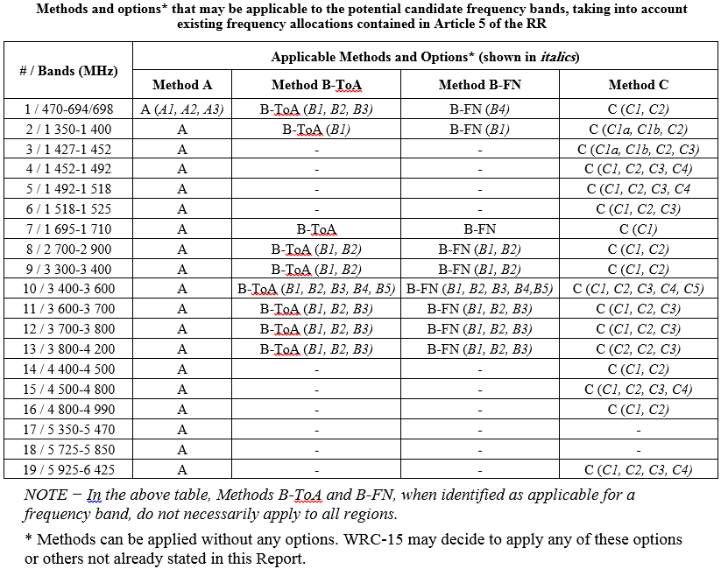
AI 1.1– Candidate bands, methods, options
Information from the CPM Report to WRC-15

Slide 6






Agenda item 1.1 – Regional Positions
Frequency Band | APT | ASMG | ATU | CEPT | CITEL | RCC
1 - 470-694/698 MHz | A | A | A | A |  | A
2 – 1 350-1 400 MHz | A | A | C | A |  | A

Slide 7
Agenda item 1.1 – Regional Positions
Frequency Band | APT | ASMG | ATU | CEPT | CITEL | RCC
3 – 1 427-1 452 MHz | C | A | C | C | C | A
4 – 1 452-1 492 MHz |  | C | C | C | C | A
5 – 1 492-1 518 MHz | C | C | C | C | C | A
6 – 1 518-1 525 MHz | A | A |  | A |  | A

Slide 8
Agenda item 1.1 – Regional Positions
Frequency Band | APT | ASMG | ATU | CEPT | CITEL | RCC
7 – 1 695-1 710 MHz | A | A | A | A |  | A
8 – 2 700-2 900 MHz | A | A |  |  | A | A
9 – 3 300-3 400 MHz |  | A |  | A |  | A

Slide 9
Agenda item 1.1 – Regional Positions
Frequency Band | APT | ASMG | ATU | CEPT | CITEL | RCC
10 – 3 400-3 600 MHz | A | B&C |  | B&C | B&C | A
11 – 3 600-3 700 MHz | A | A | A | B&C | A | A
12 – 3 700-3 800 MHz | A | A | A | B&C | A | A
13 – 3 800-4 200 MHz | A | A | A | A | A | A

Slide 10
Agenda item 1.1 – Regional Positions
Frequency Band | APT | ASMG | ATU | CEPT | CITEL | RCC
14 – 4 400-4 500 MHz |  | A | A | A |  | C
15 – 4 500-4 800 MHz | A | A | A | A | A | A
16 – 4 800-4 990 MHz |  | A |  | A |  | C

Slide 11
Agenda item 1.1 – Regional Positions
Frequency Band | APT | ASMG | ATU | CEPT | CITEL | RCC
17 – 5 350-5 470 MHz | A | A | A | A | A | A
18 – 5 725-5 850 MHz | A | A | A | A |  | A
19 – 5 925-6 425 MHz | A | A | A | A | A | C

